Slide 1
8.1 Types of Chemical Bonds
Notes:
1

Slide 2
Bonding Basics
Atoms will position themselves so that the system will achieve the lowest possible energy.
The distance where this energy is minimal is the bond length (distance between 2 nuclei, usually in nm or pm).
The energy required to break a bond is called the bond energy (usually in kJ/mol).
The shorter the bond length (the stronger the attraction and the higher the bond energy.)
Notes:
2

Slide 3
The bond length is the distance at which the system has minimal energy

Slide 4
Practice
Rank in order of increasing bond energy:
H—F , H—Br, H—Cl

Slide 5
Answer
With increase in atomic size from F to Br bond length increases
As the bond length increases the bond energy decreases
In order of increasing bond energies.
H—Br H—Cl H—F

Slide 6
Ionic Bonds
An attraction between anions and cations
Electrons are completely transferred.
A bond between a metal and a nonmetal.
Stronger than covalent bonds.
Commonly called metallic salts.

Slide 7
Ions Formation
Metal atoms tend to lose all valence electrons to form cations. Cations are smaller than parent atom
Nonmetal atoms tend to gain enough electrons to fill the outer s and p subshells. Anions are larger than parent atom
Ionic Radius: ( see fig. 8.8 pg. 364)
Isoelectric ions- ions containing the same number of electrons…the size decreases as the nuclear charge increases.

Slide 8
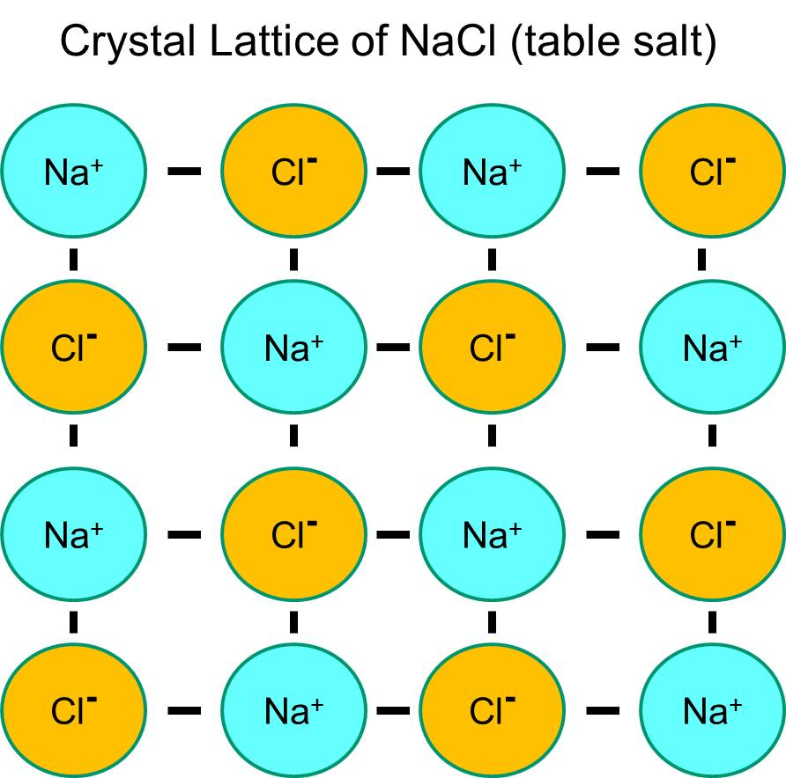
Properties of Ionic compounds
High MP & BP
Hard, not easily crushed
Conduct electricity when melted or dissolved because ions are freed up to move.
The ions are in a very strong CRYSTAL LATTICE pattern.

Slide 9
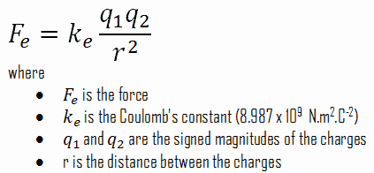
Coulomb’s law can be used to calculate the energy of an interaction between a pair of ions. It can be used for both attractive and repulsive forces.

Slide 10
Summary of Coulomb’s Law
The strength of an ionic bond can be determined by 2 factors:
The charge of the ions, the higher the numerical charge value the stronger the attraction.
The distance of the ions, the closer they are the stronger the bond.
Notes:
10

Slide 11
Covalent Bonds
This type of bonding most occurs between a nonmetal and a nonmetal, or between metalloids and nonmetals.
Lower MP & BP
Tend to be volatile gases or liquids
Softer substances and crush easily
Poor conductors of electricity

Slide 12
Just in case you forgot ….
Electronegativity is the attraction an atom has for a shared pair of electrons.
Electronegativity increases across a row and up a column

Slide 13
Ionization Energy
The energy needed to remove one or more electrons from a neutral atom to form a positively charged ion.
By definition, the first ionization energy of an element is the energy needed to remove the outermost, or highest energy, electron from a neutral atom in the gas phase.

Slide 14
Covalent Bonding
When two atoms have a small difference in their tendencies to lose or gain electrons, we observe electron sharing and covalent bonding.
Differences in electronegativity can be used to determine if the electrons are shared equally or unequally.
Often, instead of using a single line to indicate the covalent bond, an arrow is used with the head pointing toward the atom with the greater attraction for the electrons.
H F
Notes:
14

Slide 15
Types of Covalent Bonds

Slide 16
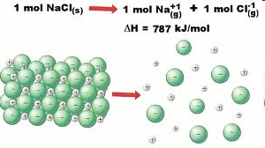
Lattice Energy
The energy required to break an ionic bond into its gaseous foundational elements:

Slide 17
Lattice energy increases as:
Ionic size decreases
Ionic charge increases
As the size of lattice energy increases, it becomes difficult for ions to get separated from the ionic lattice which gives more stability to the ionic solid.
Therefore, ionic solids do not convert into gaseous state (sublime) at room temperature and they melt at high temperatures

Slide 18
8.8 Covalent Bond Energies and Chemical Reactions
Breaking bonds requires energy, and the process is endothermic.
Based on the type of atoms involved in the bond, we can use existing tables to look up the energy required to break the bond.
The values will be in kJ/mol

Slide 19
(Bond Orders)

Slide 20
Relationships:
Atomic radius will influence bond length, larger atoms will have longer bond lengths.
Bond length and bond energy are inverse, as the bond length increases the bond energy decreases.
As the number of shared pairs of electrons increases, bond length shortens and bond energy increases.

Slide 21
Calculating Δ H from bond energies
ΔH = -
Energy required to break the bonds
Energy released when bond form

Slide 22
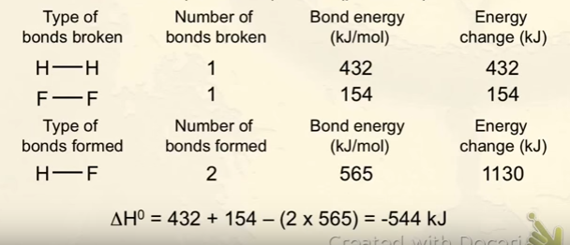
Solution

Slide 23
8.10 Lewis Structures
Lewis Dot Diagrams represent the number of valence electrons present in an atom.
Lewis structures are often used to indicate the bonds in a covalent molecule.
Lines are used to represent bonds
1 line = single bond,
2 lines = double bond
3 lines = triple bond
2 dots represent lone pairs of electrons
Notes:
23

Slide 24
Drawing Lewis Structures
1. Count the total number of valence electrons in the molecule. If you divide this by 2, it will give you the # of bonds needed to draw the structure.
2. Create a “skeleton” structure by connecting surrounding atoms to the central atom. The central atom is the one that there is one of or the least electronegative (generally the first element in the formula is the central).
3. Place electrons between the central atom and surrounding atoms so that it has an octet. (remember hydrogen only needs 2).
Complete octets on the outside atoms.
5. If you run out of electrons to complete the octets of the surrounding atoms, then you must move electrons from the central atom to the outside and create double or triple bonds between the central atom and a surrounding atom.
Notes:
24

Slide 25
Practice
Draw a Lewis Structure for:
A water molecule:
Ammonia:
Carbon dioxide:
Methane:
Ethane:
Ammonium ion:

Slide 26
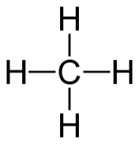
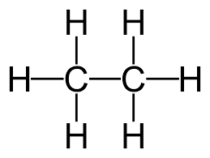
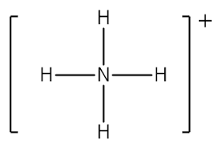
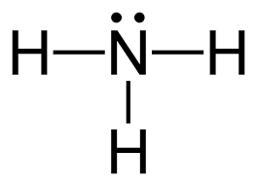
Answer to practice

Slide 28
8.11 EXCEPTIONS TO THE OCTET RULE

Slide 29
Hydrogen
Only two electrons are required for H to obtain a noble gas configuration like He
No double bonds on hydrogen
Never put lone pairs on H in a lewis structure.

Slide 30
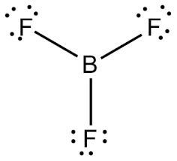
Electron Deficient
Means the central atom has less than 8 electrons
The second row elements B and Be often have fewer than 8 electrons around them in compounds and as a result are highly reactive
Boron is satisfied with 6 electrons
Berillium is fine with 4 electrons
Boron Trifluoride BF₃

Slide 31
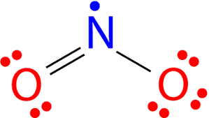
Odd-Electron Molecules
Molecules with odd numbers of electrons will result in a Lewis structure with one unpaired electron.
Nitrogen is a period 2 element and can be satisfied with less than an octet.
Nitrogen dioxide ………. 17 valence electrons

Slide 32
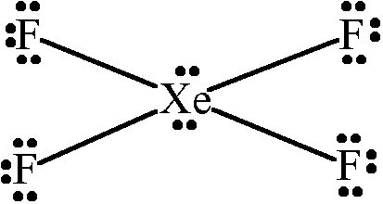
Expanded Octet
Means that the central atom is sharing more than 8 electrons.
Third Row and heavier elements can exceed the octet rule by using their empty valence d orbitals.
To make a Lewis dot for this type of molecule, satisfy the octet rule and then any extra electrons should be placed on the atoms that have available d-orbitals
Xenon tetrafluoride
XeF₄

Slide 33
Resonance
Resonance refers to when more than one
valid Lewis structure can exist for a molecule. The actual structure lies somewhere in between the two as an average.

Slide 34
The formal charge of an atom in a molecule is the hypothetical charge the atom would have if we could redistribute the electrons in the bonds evenly between the atoms ignoring electronegativity.
You can use formal charges to identify the most reasonable Lewis structure for a given molecule

Slide 35
Easy way to calculate formal charge
Formal charge = FC
Valence electrons = VE
Bonded pairs = sticks
Nonbonded electrons= dots
FC = VE – (# of STICKS) - (# of DOTS)

Slide 36
Guidelines for determining best structure
A molecular structure in which all formal charges are zero.
The structure with the smallest nonzero formal charges.
Lewis structures are preferable when adjacent formal charges are zero or of the opposite sign.
When we must choose among several Lewis structures with similar distributions of formal charges, the structure with the negative formal charges on the more electronegative atoms is preferable.

Slide 37
Nitrous oxide, N₂O, commonly known as laughing gas, is used as an anesthetic in minor surgeries, such as the routine extraction of wisdom teeth. Which is the likely structure for nitrous oxide?

Slide 38
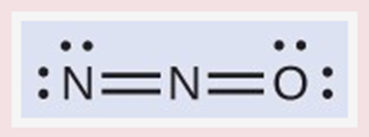
Answer

Slide 39
Electron Configuration
It is a shorthand description of how electrons are arranged around the nucleus of an atom.
Electron configurations are important because they help us predict chemical behavior. We can predict whether two elements will react or not, and if they react, we can also predict what kind of reaction we are likely to have, as well as how strong the reaction will be.

Slide 40
The Aufbau Principle:
When building up the electron configuration of an atom, electrons are placed in orbitals, subshells, and shells in order of increasing energy
Pauli Exclusion Principle:
No atomic orbital can contain more than two electrons and they must be opposite spin!
Hund’s Rule:
When an electron is added to a subshell, it will always occupy an empty orbital if one is available. They will only pair up if an empty orbital is not available.

Slide 41
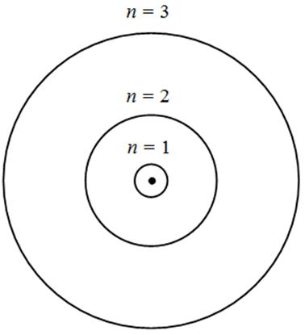
Bohr Model
n = principle energy level
PEL
Each PEL can have sublevels that hold electrons in orbitals
S _
P _ _ _
D _ _ _ _ _
F _ _ _ _ _ _ _

Slide 42
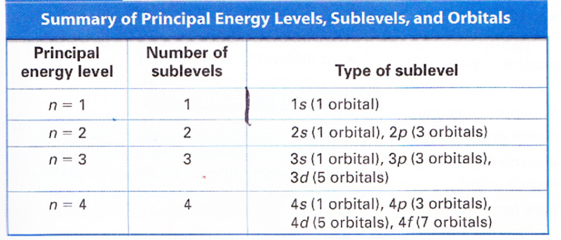
Square this number to find the total number of orbitals

Slide 43
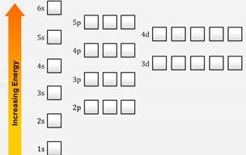
Aufbau Energy Levels

Slide 44
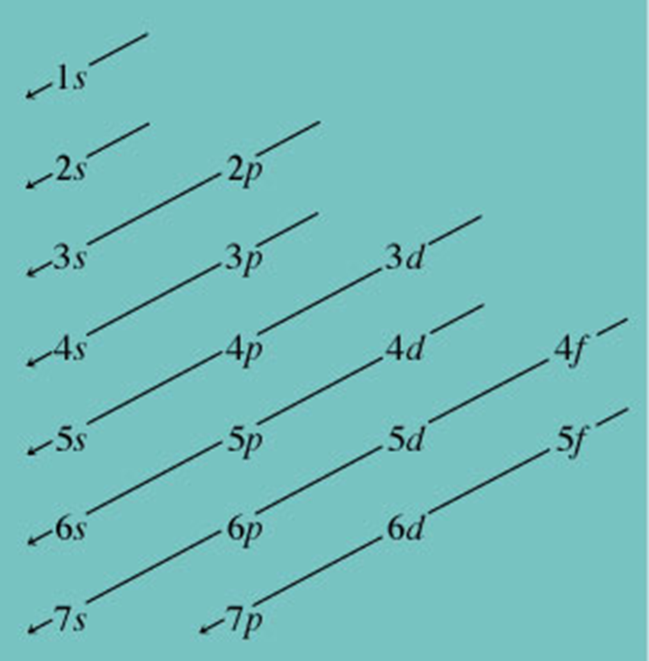
Orbital Box Diagram
It describes the subshell filling order, or the order can be determined by using the periodic table

Slide 45
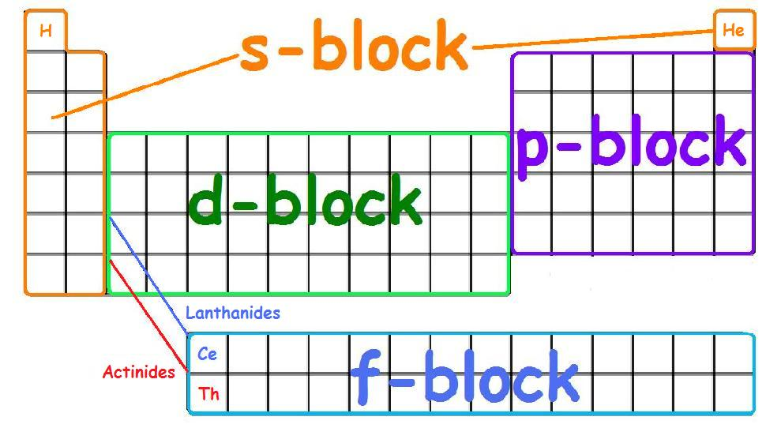

Slide 49
Molecular
Shape

Slide 50
Regents Chemistry Taught Molecular Geometry
The molecule’s structural name is always based on the number of the atoms in the molecule.
Basically, you pretend that the lone pairs of electrons are not there, and then you name the molecule by only considering the arrangement of the atoms.
It was a simpler way of naming the structures.
2 atoms | Linear
3 atoms | Bent and Angular
4 atoms | Trigonal planar
5 atoms | Tetrahedral

Slide 51
VSEPR (Electron Pair Arrangement)
Valence shell electron pair repulsion theory gives us another way to predict the SHAPE of a covalently bonded molecule.(nonmetals)
The basic idea is that valence electron pairs around a central atom (BOTH bonded and unbonded pairs) are arranged around the central atom in a way that minimizes the repulsions of the like charges.

Slide 52
Steps to determining the VSEPR Shape
1.) Write the Lewis electron-dot formula
2.) Determine the number of “things” surrounding the central atom…
* Double and triple bonds count as only one
* Lone electron pairs also count as one
3.) Determine the electron pair arrangement that maximizes the distance between all of the things (put the electron pairs as far apart as possible)
4.) Place the surrounding atoms on the bonds
5.) Name it!

Slide 53
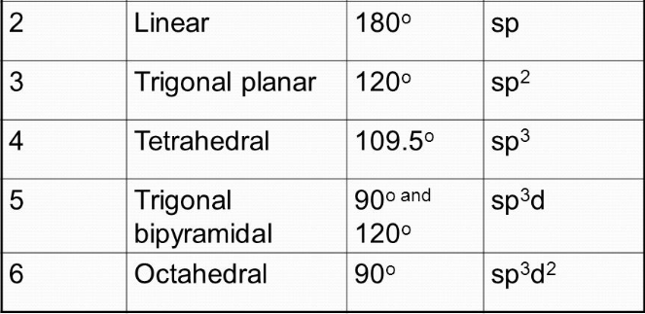
MUST MEMORIZE !
# of Electron Pairs | Shape | Bond Angle | Hybridization

Slide 54
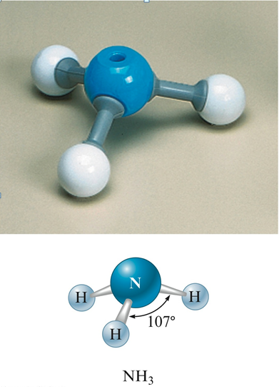
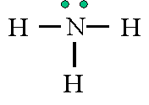
VSEPR theory names this a trigonal pyramidal
Molecular Geometry calls it a Trigonal Planar.

Slide 55
Molecular Polarity

Slide 56
8.3 Polarity
Molecular dipoles occur due to the unequal sharing of electrons between atoms in a molecule. Those atoms that are more electronegative pull the bonded electrons closer to themselves.
Even though the total charge on a molecule is zero, the positive and negative charges are not completely symmetrical in most molecules.
These molecules are said to be polar because they possess a permanent dipole.
Notes:
56

Slide 57
Nonpolar Molecule
Nonpolar
When atoms bond together to form molecules, they share or give electrons.
If the electrons are shared equally by the atoms, then there is no resulting charge and the molecule is nonpolar.

Slide 58
Dipoles & Polarity
Dipoles maybe symbolized by either Greek letter delta (lowercase), δ , or arrows crossed at the positive end, or both.
Notes:
58

Slide 59
Polar or Nonpolar
A polar molecule is one in which one side, or end, of the molecule has a slight positive charge and the other side, or end, has a slight negative charge. This will occur whenever the molecule is not completely symmetric.
A nonpolar molecule is one which is completely symmetric and there is an equal distribution of charge
Symmetry has two components
the geometric arrangement of the outer atoms
whether or not they are all the same type of atom

Slide 60
Determing Molecular Polarity
Draw the Lewis structure
If there is no lone pair on the central and all of the surrounding atoms are the same then the molecule will be nonpolar.
If there is a lone pair on the central atom it will be polar even if all the other atoms are the same.
If there are lone pairs around the central and nonsymmetrical distribution of the surrounding atoms the molecule is polar.

Slide 62
Hybridization of Atomic Orbitals

Slide 63
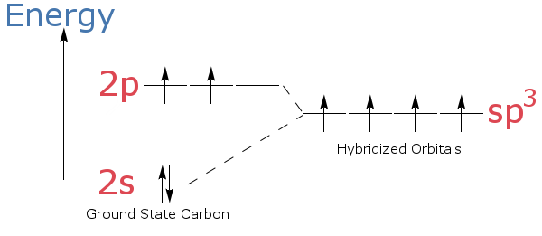
HYBRIDIZATION OF CARBON
Carbon has 4 valence electrons
Hybridizing (combining orbitals) allows carbon to now have 4 equal energy bonding sites.
This makes it more stable.

Slide 64
Hybridization of Orbitals
Mixing of atomic orbitals to make a new type of orbital called a hybrid molecular orbital.
The number of hybrid orbitals formed is the same as the number of atomic orbitals that were mixed.
The type of hybrid orbital formed depends on the types of atomic orbitals mixed.
Hybridized orbitals are lower in energy compared to nonhybridized orbitals.

Slide 65
Quick and Easy Method for determining Hybrid Orbitals
Count up the number of “things” surrounding a central atom.
Number of THINGS | Hybridization | VSEPR Shape
4 | 4…….sp3 | Tetrahedral
3 | 3…….sp2 | Trigonal planar
2 | 2…….sp | Linear

Slide 66
Sigma & Pi Bonds
Sigma bonds – basically all single bonds in a molecule
Pi bonds – one of the electron pairs in a multiple bond is a sigma bond, the rest are pi bonds.
Notes:
66

Slide 67
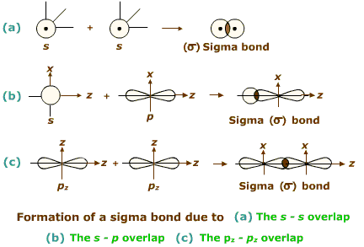
Formation of a sigma bond

Slide 68
Formation of a pi bond

