Slide 1
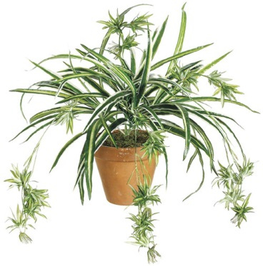
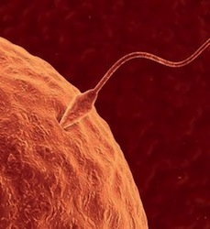
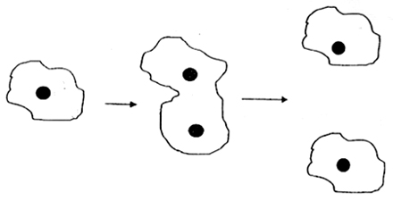
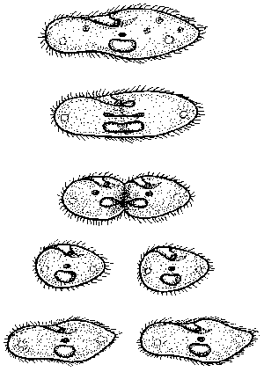
TYPES OF REPRODUCTION - Reproduction is the production of _____________ and is necessary for the continuation of a _____________
TWO TYPES OF REPRODUCTION
clone ameb
Paramecium
reproducing
asexually
offspring
species
ASEXUAL | SEXUAL
All the ________ (“recipes”) come from a ________ parent | The offspring receives ______ its genes from the mother in the ______ and half from the father in the ________
Offspring are genetically ____________ to the one parent. They are _________ | Offspring ____________ but are _____ identical to either of the ______ parents
Asexual reproduction uses a process called ___________ | Sexual reproduction uses ____________ to make eggs & sperm, then ___________ to grow and develop
genes
half
single
egg
sperm
resemble
identical
not
clones
two
mitosis
meiosis
mitosis

Slide 2
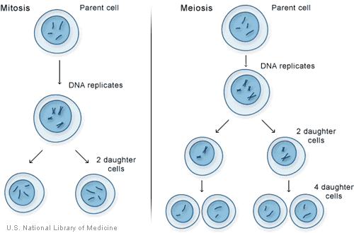
2 TYPES OF CELL DIVISION
MITOSIS MEIOSIS
Mitosis is used to make ________ cells Meiosis is used to make sperm & _____
like ______ and muscle. Mitosis is also
used to repair damaged ___________
and for _____________ reproduction.
In a human cell, Pr Parent cell is
there are ____ in _________
chromosomes. or testes
After mitosis, there Meiosis gives
are ___ daughter ____ daughter
cells that are cells that have
________ of the 23 (or ______)
parent cell. Each b the number of
has ____ chromosomes sperm & eggs chromosomes
body
eggs
skin
tissue
asexual
46
ovaries
2
4
clones
half
46

Slide 3
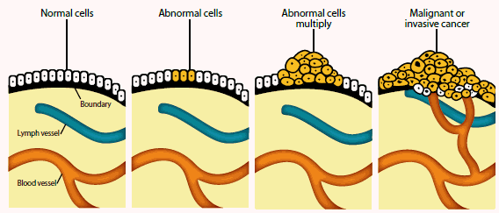
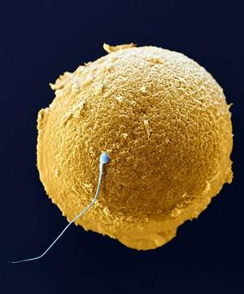
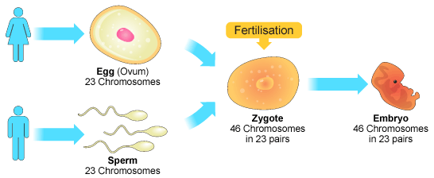
CANCER is uncontrolled ____________ of abnormal cells. Cancer cells do not perform
their usual _____________ and they multiply _____________.
FERTILIZATION - During fertilization the eggs & sperm (___________) fuse together and become _____ new cell (a ____________).
GAMETES
The cells of the
embryo multiply by ___________
mitosis
functions
rapidly
gametes
one
zygote
mitosis

Slide 4
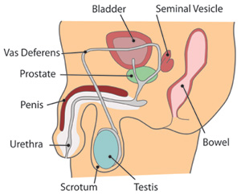
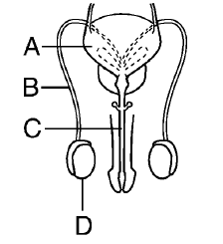
MALE REPRODUCTIVE SYSTEM
The male reproductive system produces ____________ (sperm) and makes possible the delivery of gametes for ______________ fertilization (inside the body of the female).
____________
_____________
_____________
________________
The testes are where ________ are
produced by _____________ and the male hormone _________________
is produced. Testosterone helps the sperm to ___________ and brings about
adult sex characteristics such as facial ________ and a ________ voice.
gametes
internal
bladder
vas deferens
urethra
testes
sperm
meiosis
testosterone
mature
hair
deep

Slide 5
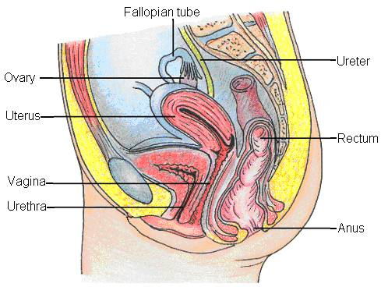
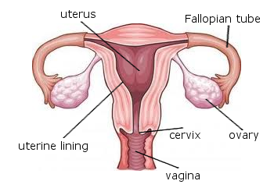
FEMALE REPRODUCTIVE SYSTEM
The female reproductive system produces ____________ (eggs) in the ovaries, allows for internal _________________ (inside the body of the female), and supports the
development of the baby in the _____________.
1. The ovaries produce _______ by meiosis
2. The ovaries also produce the female hormones ______________ and _______________. These hormones help the eggs to ___________ and the ___________ to develop.
Estrogen and progesterone cause adult sex characteristics such the menstrual
cycle and breast _________________.
3. Sperm are deposited in the ___________, swim through the cervix and uterus, then
______________ the egg in the fallopian tube. The embryo develops internally
inside the _______ of the female.
gametes
fertilization
uterus
eggs
estrogen
progesterone
mature
embryo
development
vagina
fertilize
body

Slide 6
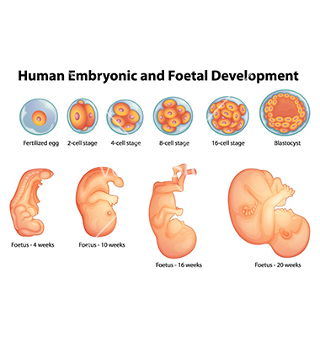
EMBRYONIC DEVELOPMENT – The fertilized egg, or zygote, divides by
___________ into a multicellular baby
1ST MITOSIS
ZYGOTE
During development, cells and tissues start to
become ______________ from each other,
a process called _____________________.
Different genes ____________ on in different
cells causing specialized cell types such as
skin, ________, and muscle. Specialized organs
develop such as ________ and the __________.
By 3 weeks old, the embryo’s heart is __________and the brain & spinal cord are forming.
By 9 weeks old, _____ the body systems are forming and the baby will be developing
either ovaries or ___________.
mitosis
different
differentiation
switch
bone
eyes
brain
beating
all
testes

Slide 7
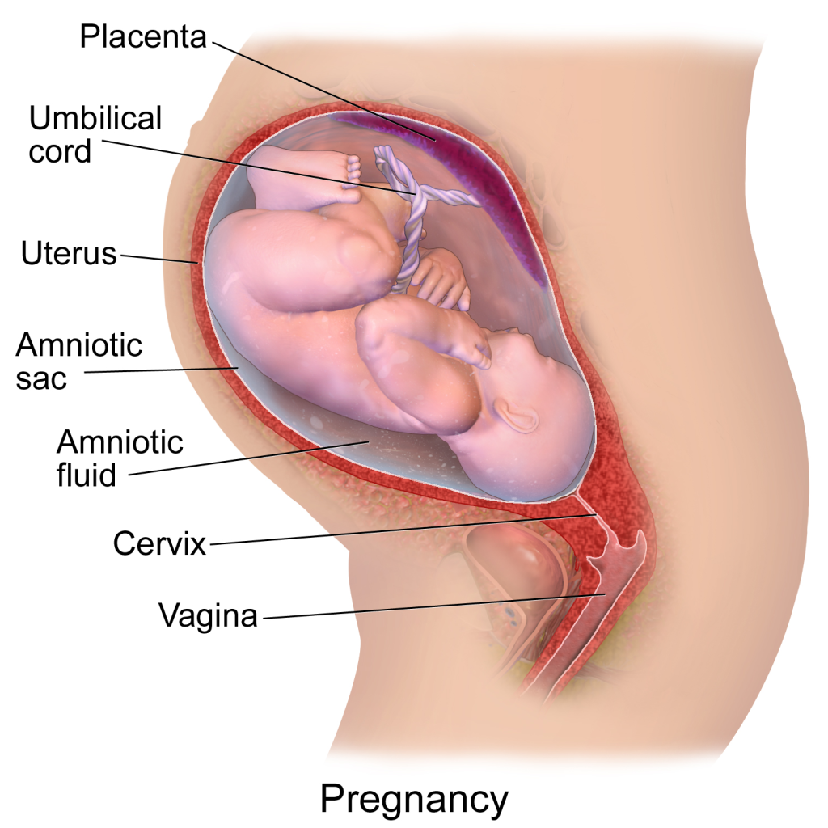
PREGNANCY
The baby develops _________________ in the mother’s ____________ (womb)
PLACENTA – Thickened area of tissue
allowing for _____________ of
nutrients, O₂, CO₂, and __________
between the mom and the baby
UMBILICAL CORD – Attaches the baby
to the ____________ and contains
the baby’s ________ vessels
AMNIOTIC FLUID - ____________ the baby
internally
uterus
exchange
wastes
placenta
blood
cushions

Slide 8
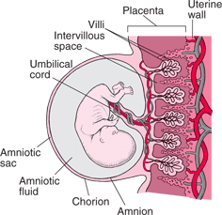
PLACENTA FUNCTION - The placenta is a thickened tissue area with the
________ blood vessels on one side and the ________ blood vessels on the other side.
** Mom’s and baby’s blood _________ mix**
Nutrients and O₂ __________ from the
mother’s blood across the placenta
into the baby’s ________. Likewise,
CO₂ and wastes diffuse from the
________ blood into the mother’s.
Antibodies also diffuse across the
____________ to protect the baby during development and ________ birth
BABY’S BLOOD MOM’S BLOOD
VESSELS VESSELS
baby’s
mom’s
never
diffuse
blood
baby’s
placenta
after

Slide 9
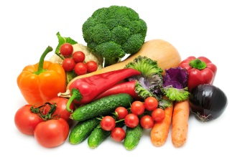
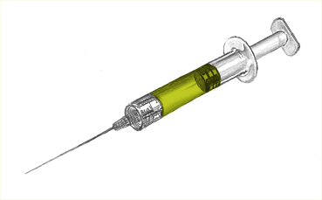
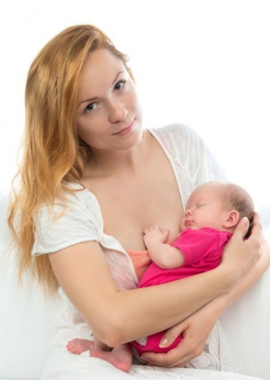
PREGNANCY CHOICES
The embryo may encounter _________ from the mother’s choices & environment:
1. DIET & NUTRITION – If the mother has an _______________ diet, the baby
may not get all the nutrients it needs. A healthy diet
can _____________ a baby’s development
2. ALCOHOL, DRUGS, & TOBACCO – These toxins will __________ across the placenta and enter the baby’s bloodstream. The baby’s tiny
body can be _______ heavily impacted than the mom’s body
3. INFECTIONS – Some infections can pass from the ___________ to the baby
such as HIV, chicken pox, and __________ (German measles)
NEWBORN NUTRITION
When born, the baby receives nutrition from the mother’s _______ produced in the __________ cells in breast tissue. Mother’s milk also contains ______________ and white blood cells to help the newborn fight off disease.
risks
inadequate
improve
diffuse
more
mother
rubella
milk
mammary
antibodies

