Slide 1
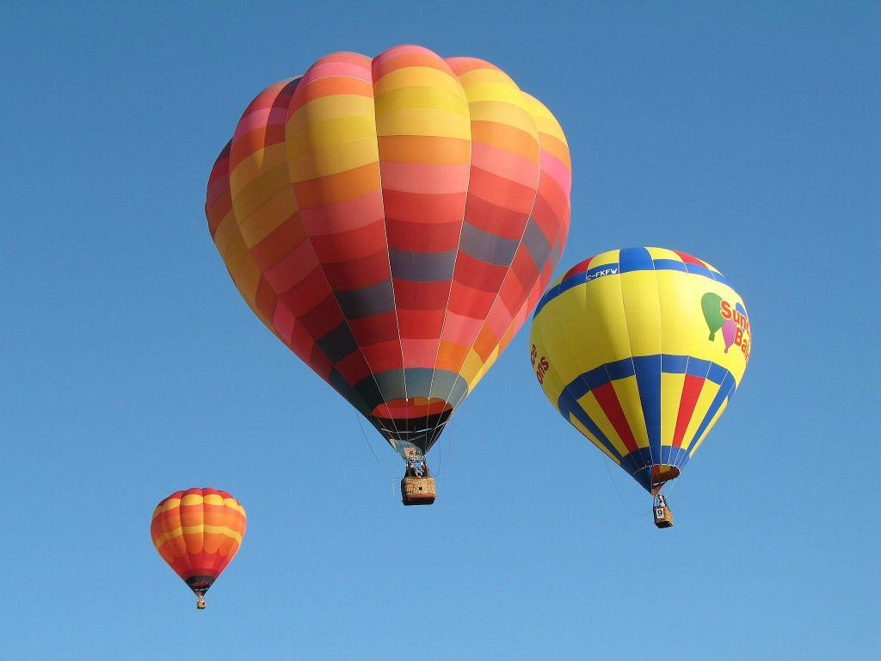
Gases

Slide 2
The Nature of Gases
No definite shape or volume
Expand to fill their containers (they spread out to occupy the greatest amount of space)
They occupy more space than solids or liquids.
Compressible-can be made more compact by applying pressure.
When their particles collide with the walls of their container, they exert a measurable pressure.

Slide 3
Measuring Pressure
The first device for measuring atmospheric
pressure was developed by Evangelista Torricelli
during the 17th century.
The device was called a “barometer”
Baro = weight
Meter = measure

Slide 4
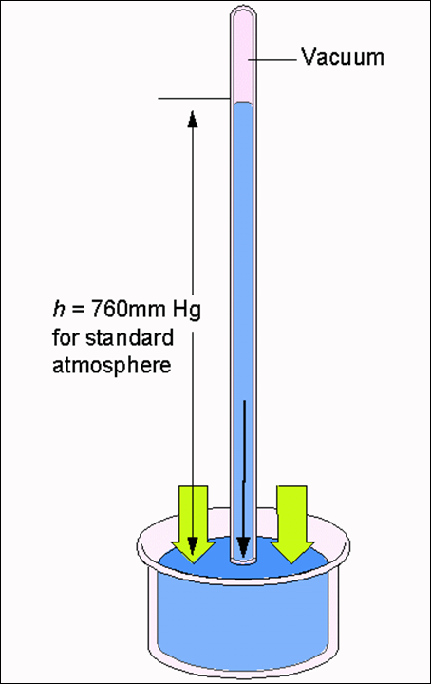
An Early Barometer
The normal pressure due to the atmosphere at sea level can support a column of mercury that is 760 mm high.

Slide 5
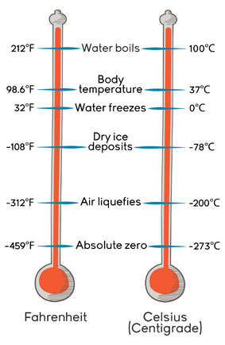
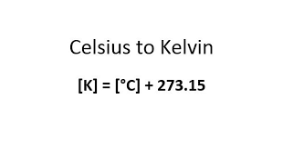
Kelvin Scale
All gas calculations are done using the Kelvin scale for temperature

Slide 6
Standard Temperature and Pressure “STP”
Either of these:
273 Kelvin (273.15 K)
0 °C
And any one of these:
1 atm
101.3 kPa
760 mm Hg
760 torr

Slide 7
Postulates of the Kinetic Molecular Theory (KMT)
Gas particles are in continuous, random, and rapid motion.
Gas particles collide with each other and the walls of their container. Therefore, during collisions, no energy is lost, ( They are elastic collisions.)
Gas particles do not attract one another, and each one moves independently.
The volume of the particles themselves is so small, that they are treated as occupying zero space themselves compared to the volume of the container.
The KE of the gas is directly proportional to the Kelvin temperature.

Slide 8
The KMT theory describes how an ideal gas behaves. In reality, most gases …
Gas molecules do have a measurable volume
Gas molecules can have some slight intermolecular forces.
REAL GASES BEHAVE MOST LIKE AN IDEAL GAS AT HIGH TEMPERATURES, LOW PRESSURES AND SMALLER QUANTITIES OF MOLECULES.

Slide 9
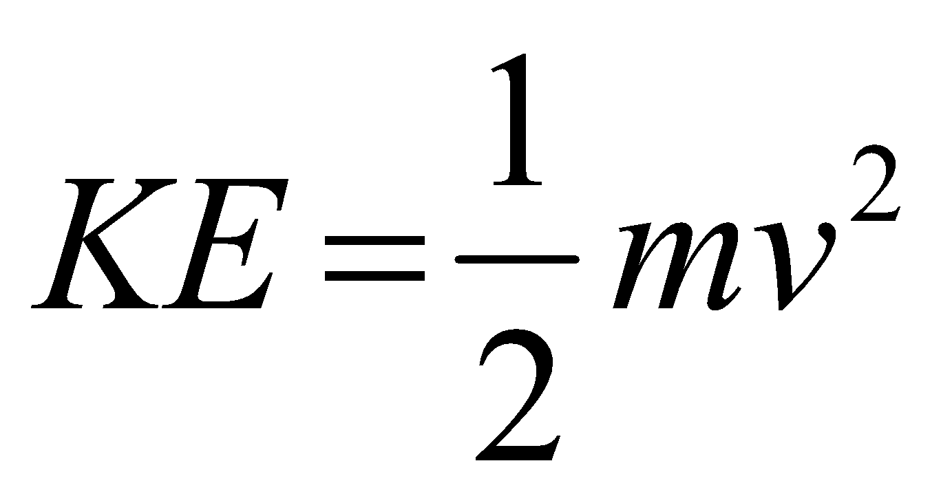
Kinetic Energy of Gas Particles
At the same conditions of temperature, all gases have the same average kinetic energy.
m = mass
v = velocity
∴ At the same temperature, small molecules move FASTER than large molecules

Slide 10
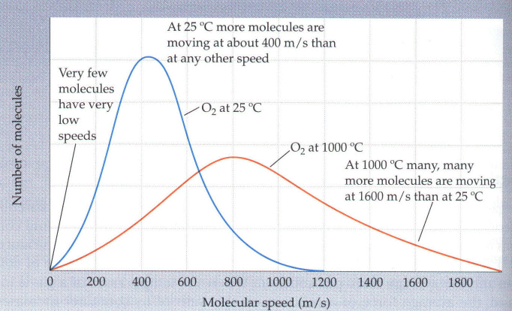
Speed of Gases compared to temperature

Slide 11
Explanation of Diagram
At any given temp, gas molecules have both high and low speeds.
As temp increases, the distribution of speeds is found to be across a wider range
As the temp increases, a greater number of particles are traveling faster.

Slide 12
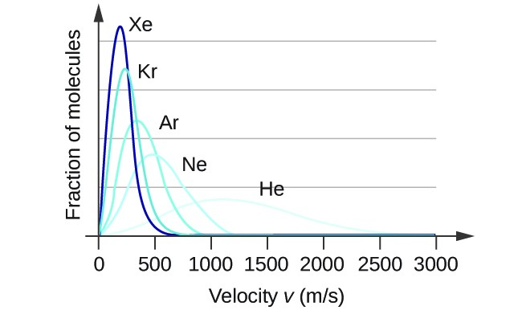
Speed of gases compared to molecule size
Heavier molecules have lower speeds!

Slide 13
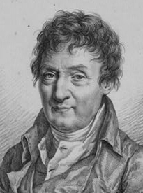
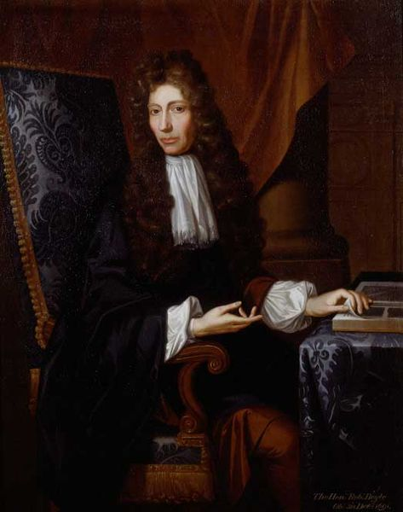
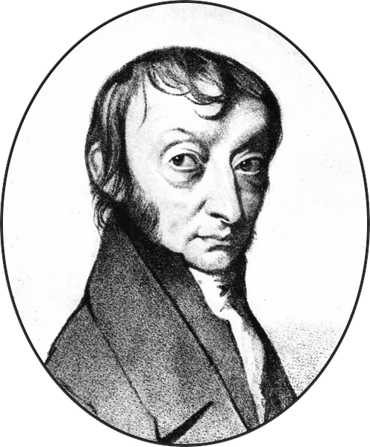
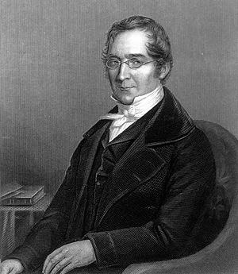
Gas Laws
Jacques Charles
Robert Boyle
Amadeo Avogadro
Joseph Louis Gay-Lussac

Slide 14
Factors that Effect a GAS
The quantity of a gas n, in moles
The temperature of a gas T, in Kelvin
The pressure of a gas, P, atm or torr
4. The volume of a gas, V, L or ml

Slide 15
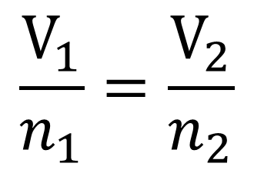
Avogadro’s Law
Equal volumes of gas at the same temp and pressure, have the same number of particles.
22.4 L of ANY GAS at STP has 6.02 x 10²³ particles.

Slide 16
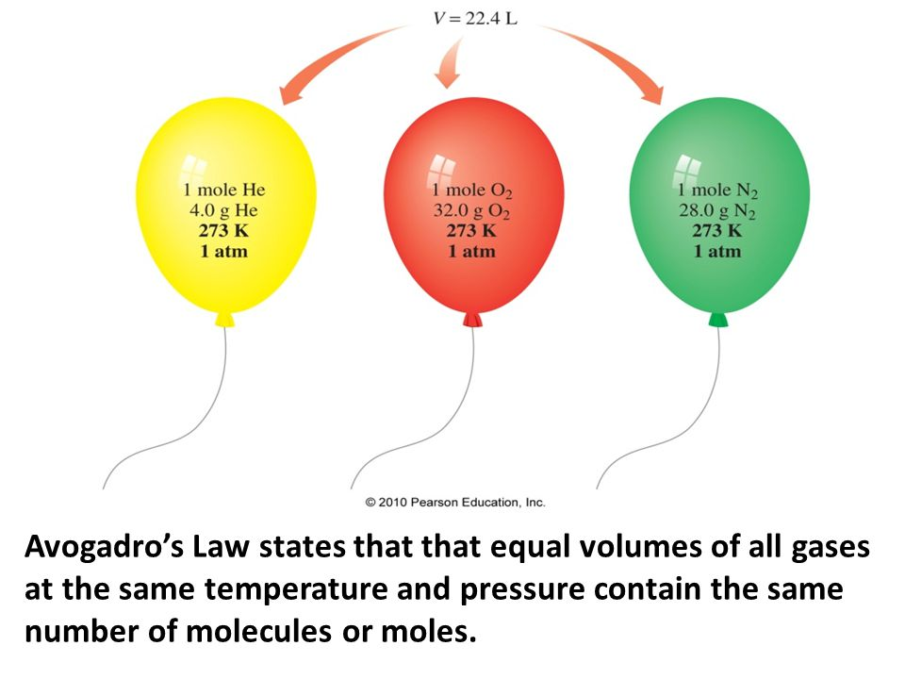

Slide 17
Avogadro’s Example
A flexible container of Oxygen(O₂) has a volume of 10.0 ml at STP.
Find the # moles and molecules in the container
.010 liter × 1 mol = 4.464 x 10⁻⁴ moles
22.4 L
4.464 x 10⁻⁴ mol x 6.02 x 10²³ = 2.687 x 10 ²⁰
1 mol molecules

Slide 18
Boyle’s Law
Pressure is inversely related to volume (temperature is constant)

Slide 19
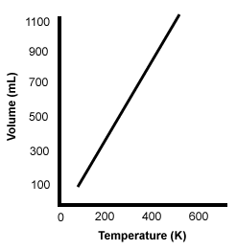
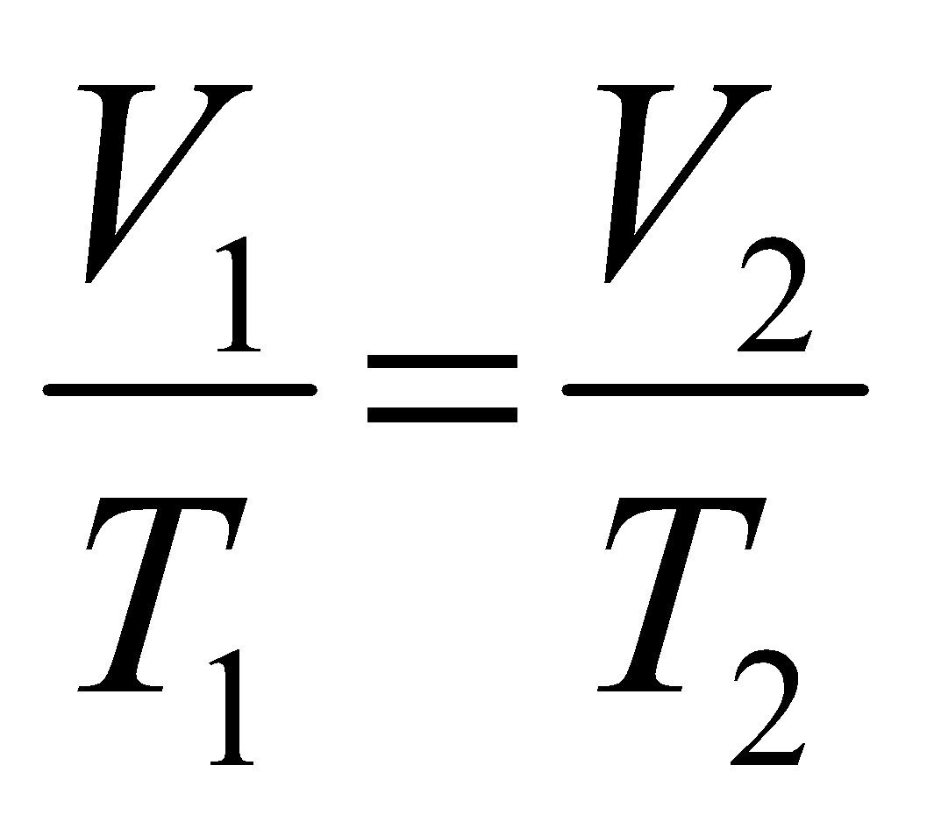
Charles’s Law
The volume of a gas is directly proportional
to temperature (P = constant)
Temperature MUST be in KELVINS!

Slide 20
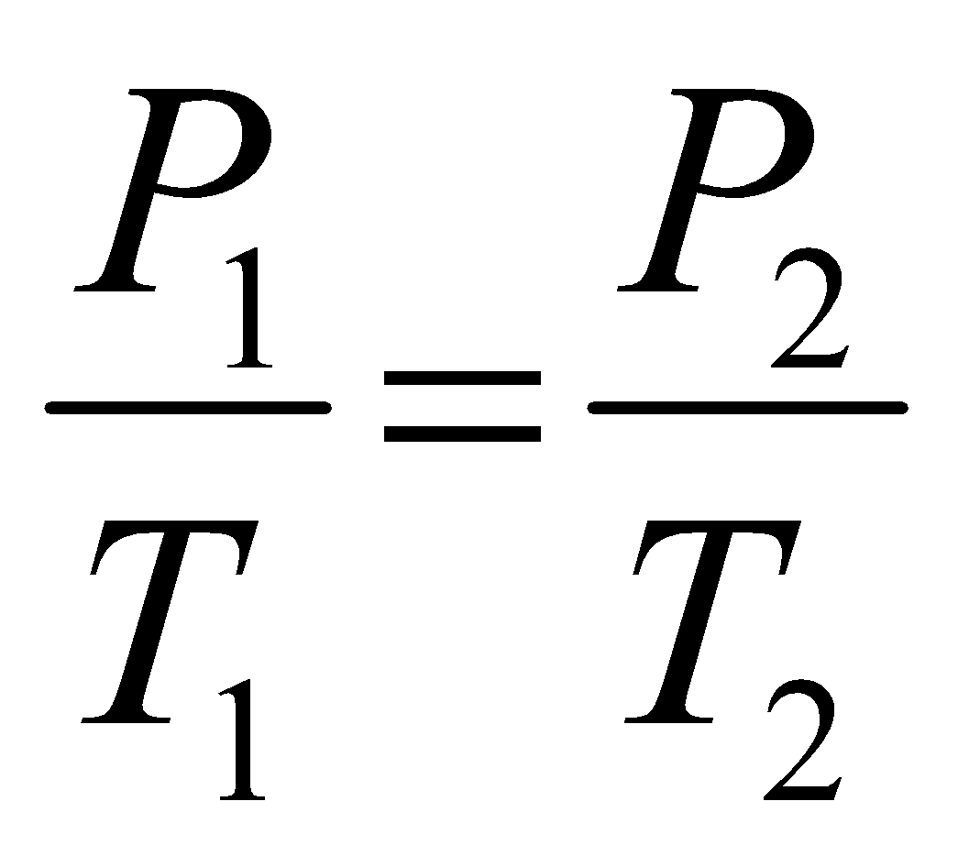
Gay Lussac’s Law
The pressure and temperature of a gas are directly related (volume is constant)
TEMPERATURE MUST BE IN KELVIN !!!!!

Slide 21
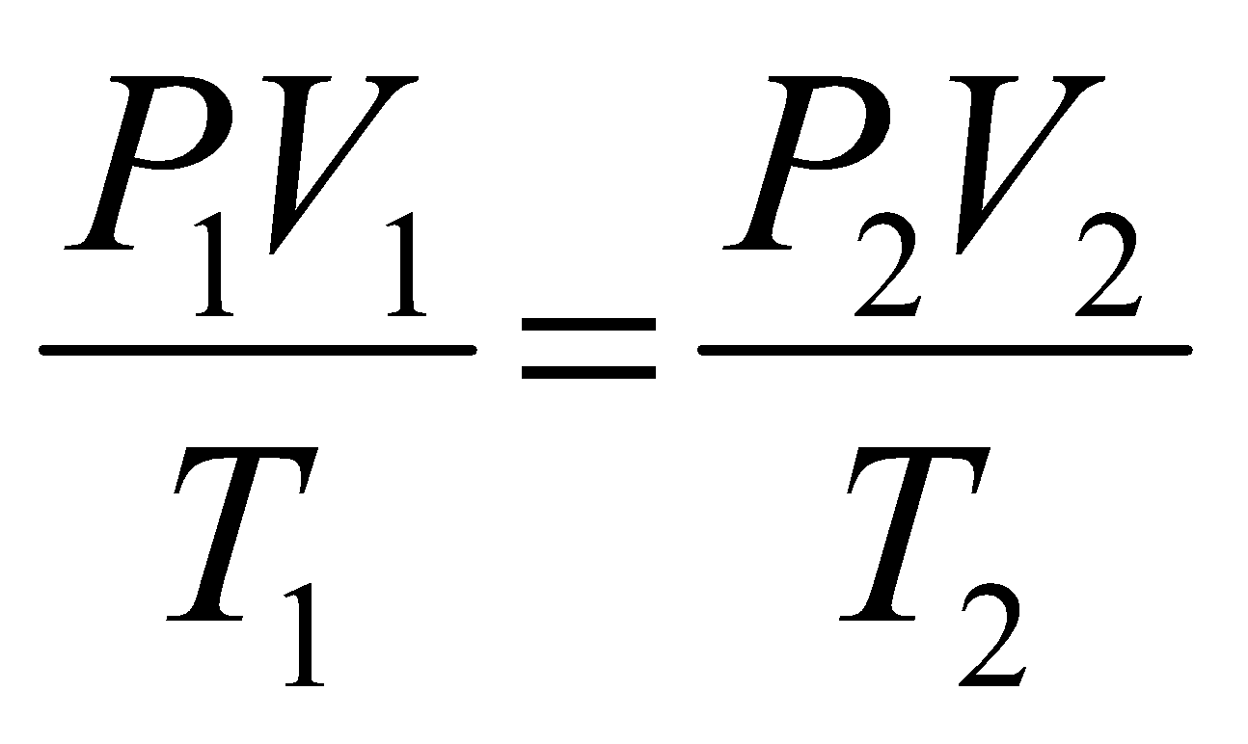
The COMBINED GAS LAW : the relationship between pressure, volume and temperature of a fixed amount of gas.
n₁
n₂
Pressure needs to be in same units on both sides
Temperature must be in Kelvin.
n= number of moles of gas

Slide 22
WHAT IS AN IDEAL GAS ?
. An ideal gas is defined as one in which there are no intermolecular forces between the atoms or molecules.
The energy is in the form of kinetic energy and any energy is results in a change in temperature.
The ideal gas law works extremely well at high temperature and low pressure.

Slide 23
Ideal Gas Law
PV = nRT
P = pressure in atm
V = volume in liters
n = moles
R = proportionality constant
T = temperature in Kelvin

Slide 26
Gas Stoichiometry #1
If reactants and products are at the same conditions of temperature and pressure, then mole ratios of gases are also volume ratios.
3 H₂(g) + N₂(g) → 2NH₃(g)
3 moles H₂ + 1 mole N₂ → 2 moles NH₃
3 liters H₂ + 1 liter N₂ → 2 liters NH₃

Slide 27
Gas Stoichiometry #2
How many liters of ammonia can be produced when 12 liters of hydrogen react with an excess of nitrogen?
3 H₂(g) + N₂(g) → 2NH₃(g)
12 L H₂
2
L NH₃
= L NH₃
8.0
3
L H₂

Slide 28
Gas Stoichiometry #3
How many liters of oxygen gas, at STP, can be collected from the complete decomposition of 50.0 grams of potassium chlorate?
2 KClO₃(s) → 2 KCl(s) + 3 O₂(g)
50.0 g KClO₃
1 mol KClO₃
3 mol O₂
22.4 L O₂
122.55 g KClO₃
2 mol KClO₃
1 mol O₂
= 13.7 L O₂

