Slide 1
The Environmental Protection Agency
EPA

Slide 2
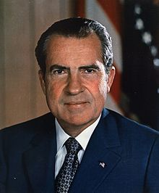
The EPA
Founded in 1970 by Nixon
Federal Government Agency
NOT a cabinet department

Slide 3
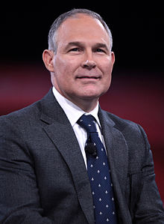
The EPA
Current Administrator – Scott Pruitt
Headquarters – Washington D.C.
Annual Budget - $8,139,887,000 (2016)
15,376 Full Time Employees

Slide 4
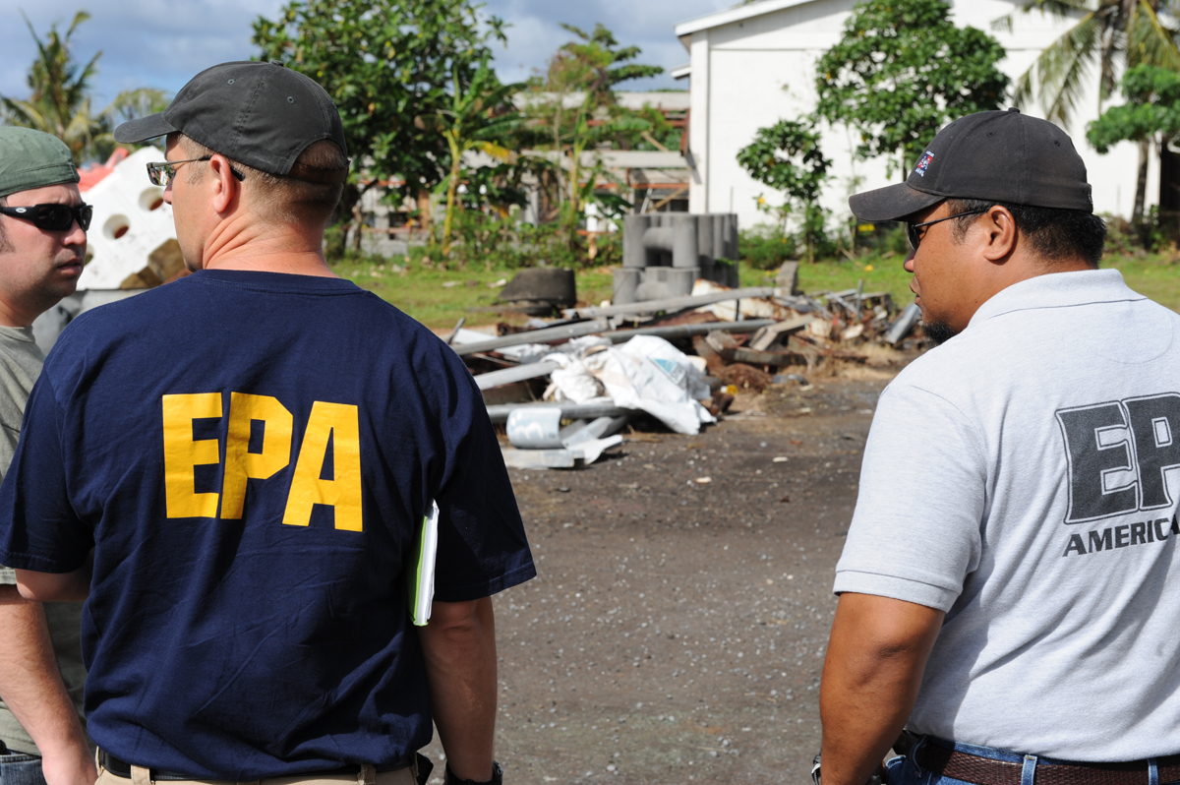
“The mission of EPA is to protect human health and the environment.”

Slide 5
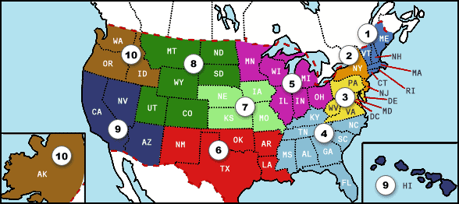
New York – Region 2

Slide 6
Contact Information
Washington D.C. HQ: (202) 564 – 4700
Region 2: (877) 251-4575
Buffalo Office: Western New York Public Information Office U.S. Environmental Protection Agency 186 Exchange Street Buffalo, New York 14204
716-551-4410 – Mike Basile

Slide 7
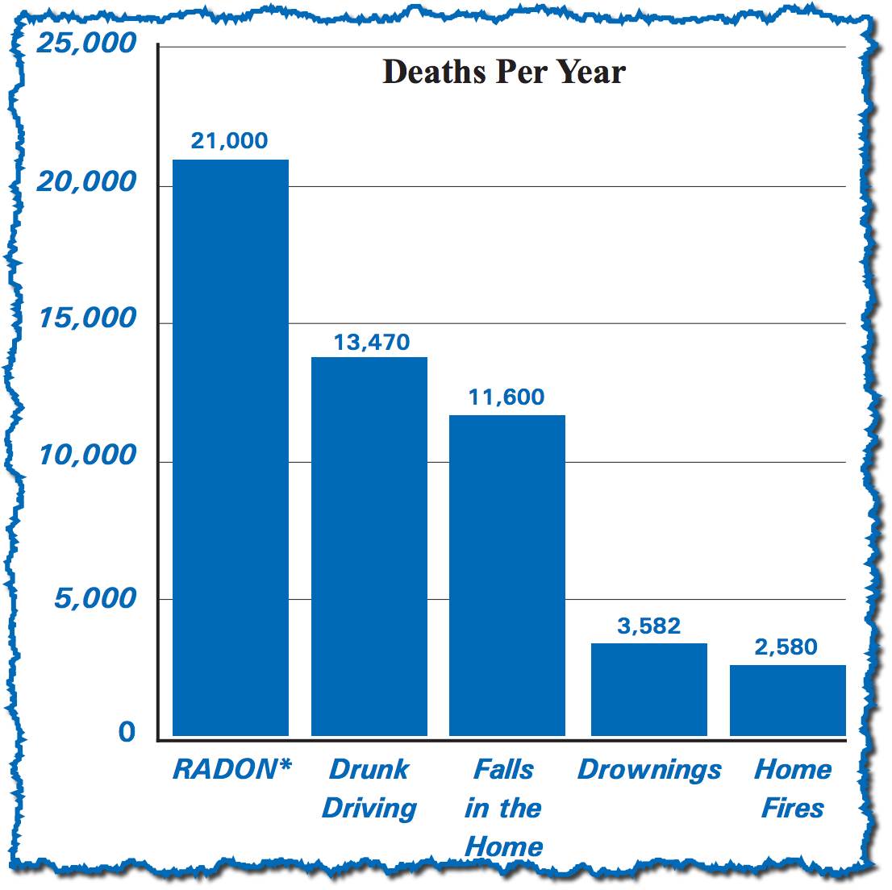
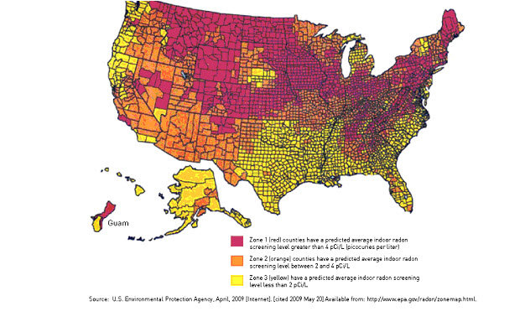
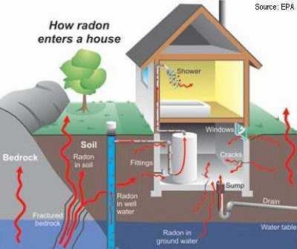
Radon Risks and Removal

Slide 8
References
www.epa.gov
http://www.pstkc.com/inspection-services/
http://gerardhomeinspection.com/home-inspection-services/radon-testing-in-greater-cincinnati/

