Slide 1
Chapter 12 Chemical Kinetics
Notes:
1

Slide 2
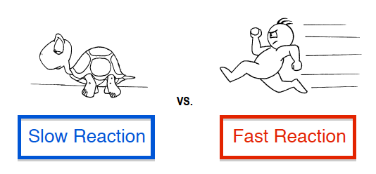
Chemical Kinetics
Studies the rate(Speed) at which a chemical process occurs.
Speed of a reaction is measured by the change in concentration over time
Notes:
2

Slide 3
Reaction rate is the change in concentration of a reactant or product per unit time.
There are two ways of measuring rate:
(1)Decrease of the reactant concentration over time
(2)Increase of the product concentration over time
.

Slide 4
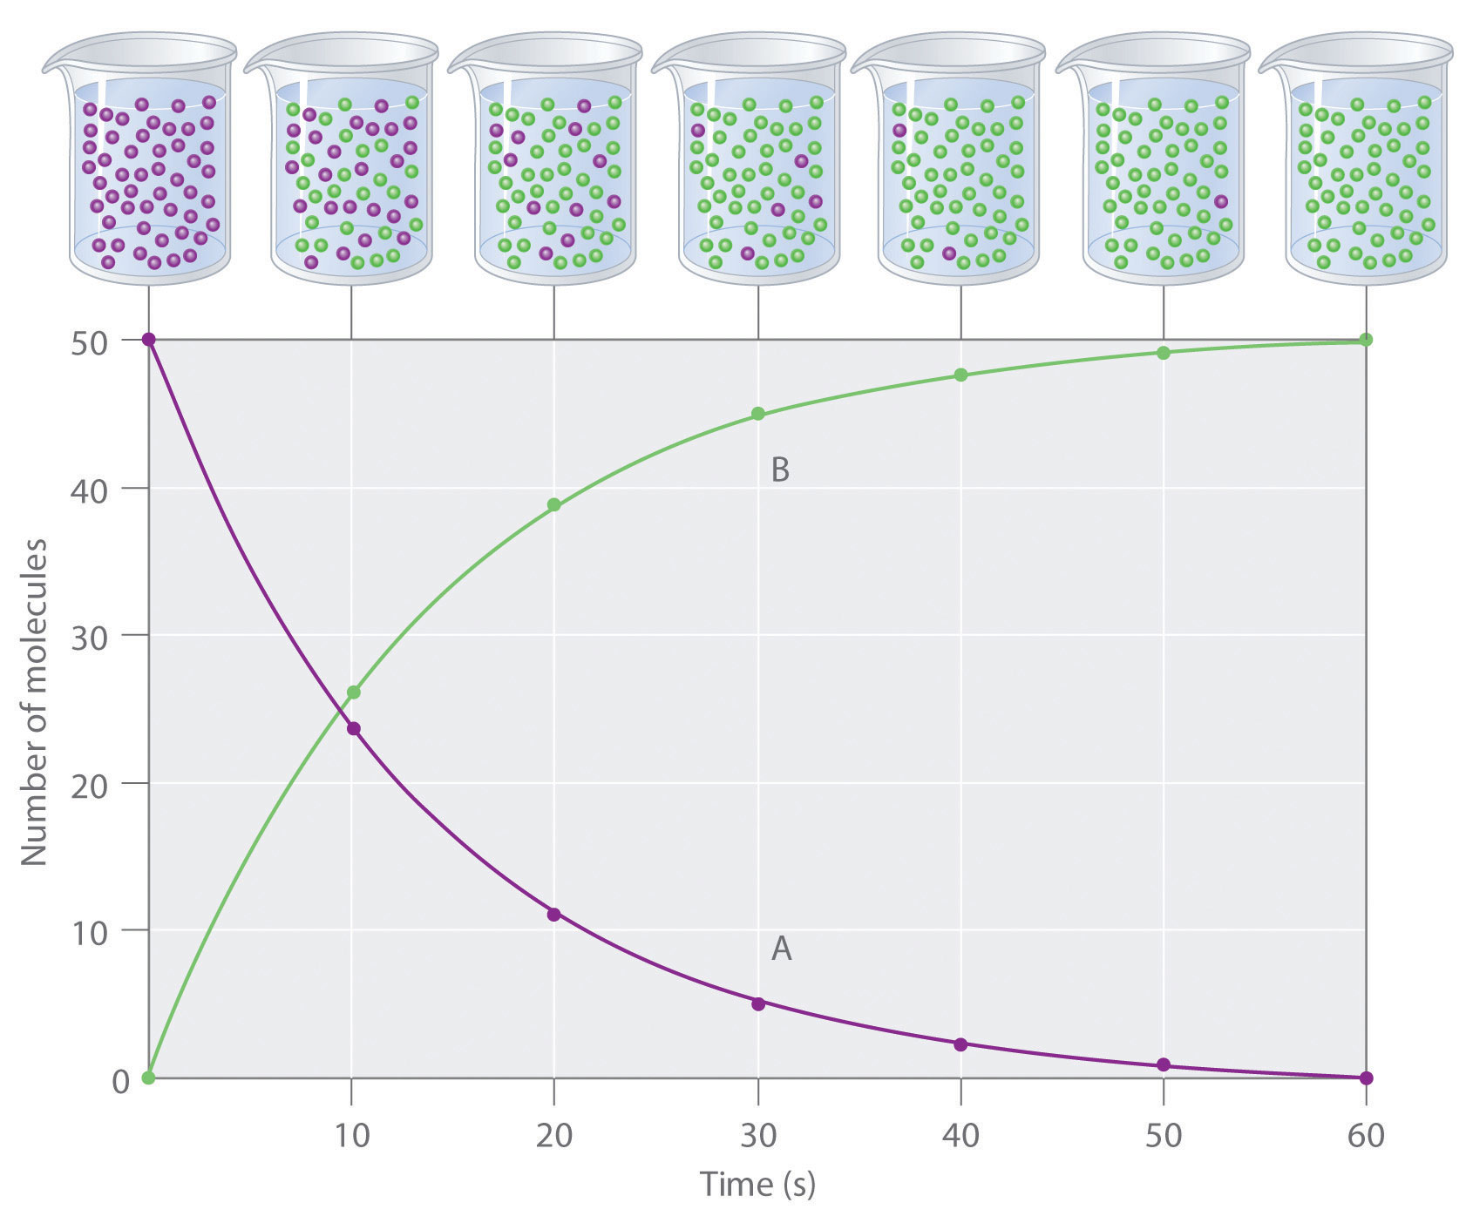

Slide 5
Factors That Affect Reaction Rates
Concentration of Reactants
As the concentration of reactants increases, so does the likelihood that reactant molecules will collide.
Temperature
At higher temperatures, reactant molecules have more kinetic energy, move faster, and collide more often and with greater energy.
Catalysts
Increases the rate by lowering the activation energy
Surface area
Increases the opportunity for collisions between reactants
Pressure of gaseous reactants or Products.
Increased number of collisions
Notes:
5

Slide 7
12.1 Reaction Rates
Most Common Units… Rate = M/s
(Remember…Molarity (M) = moles/Liter)
Average reaction rate is the change in the concentration of a reactant or a product over time (M/s).
A B
Δ[A]
Δ[A] = change in concentration of A over time period Δt
rate = -
Δt
Δ[B]
Δ[B] = change in concentration of B over time period Δt
rate =
Δt
Because [A] decreases with time, Δ[A] is negative.

Slide 8
Reaction Rates and Stoichiometry
C₄H₉Cl(aq) + H₂O(l) C₄H₉OH(aq) + HCl(aq)
In this reaction, the ratio of C₄H₉Cl to C₄H₉OH is 1:1
Thus, the rate of disappearance of C₄H₉Cl is the same as the rate of appearance of C₄H₉OH
Rate =
-Δ[C₄H₉Cl]
Δt
Δ[C₄H₉OH]
Δt
=
Notes:
8

Slide 9
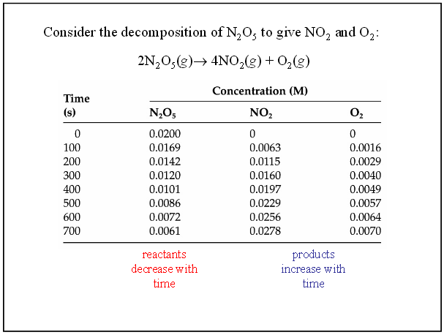
Reaction Rates and Stoichiometry
What if the ratio is not 1:1?
Notes:
9

Slide 10
Practice Questions using data:
a.) Calculate the average rate of decomposition of N₂O_{5(g)} between
0 and 100 s. Use this rate to calculate the average rate of production of O_{2(g)} over the same time period.
b.) What would the average rate of production of NO_{2(g)} be?

Slide 11
AVERAGE Reaction Rates Practice Worksheet
C₄H₉Cl(aq) + H₂O(l) → C₄H₉OH(aq) + HCl(aq)
The average reaction rate over each interval is the change in concentration divided by the change in time.
Rate =
-Δ[C₄H₉Cl]
Δt

Slide 12
THE RATE LAW: uses INITIAL RATES DATA
Time is not involved in these calculations.
Each reaction has its own equation
that gives its rate based on initial reactant concentrations.
It can give the speed of the rx at a given moment in time.

Slide 13
Calculating The Initial Rate Law
The rate law expresses the mathematical relationship between rate of a reaction and concentrations of the reactants. The products and time play no role in the calculations!!!
aA + bB products
Rate = k [A] ^{x} [B] ^{y}
Rate = Molarity /sec
k= rate constant (varies with each reaction, temperature dependent)
[A] [B] = Concentrations of reactants in M (moles/liter)
x and y = Values for the reaction order.
They tell us how important each of the reactants is in regard to speed.The higher the number the more value it has to overall speed.
x does not equal a and y does not equal b

Slide 14
Initial Rate Data Practice Problem
aA + bB products
Trial | [A] M/S | [B] M/S | Rate M/S
1 | 0.100 | .100 | 2.00 x10-3
2 | 0.200 | .100 | 4.00 x 10 -3
3 | 0.200 | .200 | 16.00 x 10 -3

Slide 15
Determining Rate Order

Slide 16
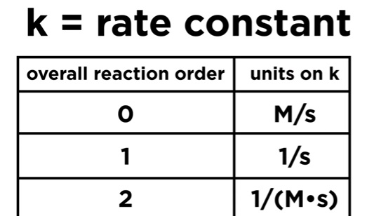
Proper Units for the Rate Constant
The larger the k value, the faster the reaction proceeds
3 | 1/(M²●s)

Slide 17
Concentration and Rate Homework
Compare Experiments 1 and 2: when [NH₄⁺] doubles, the initial rate doubles.
Notes:
17

Slide 18
Concentration and Rate
Homework
Likewise, compare Experiments 5 and 6: when [NO₂⁻] doubles, the initial rate doubles.
Notes:
18

Slide 19
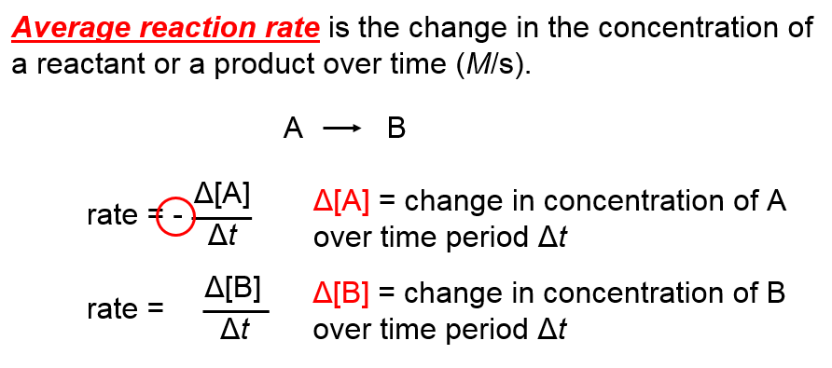
THE STORY SO FAR: First came…
Average (Initial) reaction rate limitations:
They only accurately give the rate at the moment that the reactants are mixed and the reaction begins.

Slide 20
Second was:Rate Law Expressions
Each reaction has its own equation
that gives its rate based on initial reactant concentrations.
It can give the speed of the rx at a given moment in time.

Slide 21
NOW! Integrated Rate Laws
They can be used to:
Determine the amount of reactant or product present after a period of time
To estimate the time required for a reaction to proceed to a certain extent.
To determine half-life, the length of time a radioactive material must be stored for its radioactivity to decay to a safe level

Slide 22
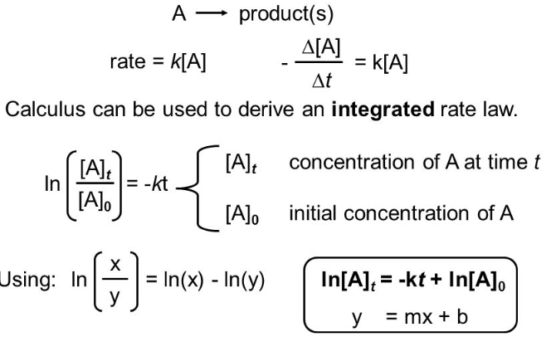
Where do the integrated expressions come from?
They have been derived through setting the AVERAGE REACTION RATE FORMULA equal to the RATE ORDER EXPRESSION
You do not need to learn the derivation process!

Slide 23
Zero Order Integrated Rate Law
The rate of change is independent of the concentration of the reactant.
[A]_{t} = - kt + [A]₀
Y = mx + b
This means that we can graph the concentration as a function of time and it should create a straight line that will give a slope and then you can find the value of -k

Slide 24
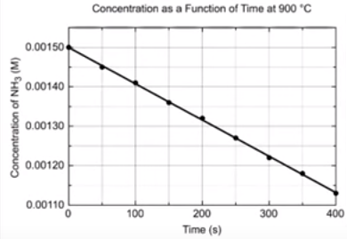
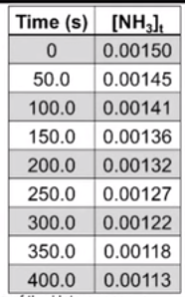
Zero Order Integration
2NH_{3(g)} N_{2(g)} + 3 H₂ _{(g)} [A]_{t} = - kt + [A]₀

Slide 25
First Order Integrated Rate Law
The rate is proportional to the concentration of a single reactant raised to the first power
ln[A]_{t} = -kt + ln [A]₀
Y = mx + b
If a reaction is first-order, a plot of ln[A]_{t} vs t
will give a straight line with a slope of -k.

Slide 26
First-Order Integration
When lnN₂O₅ is plotted as a function of time, a straight line results.
The reaction is first-order, a plot of ln [A]_{t} vs. t will yield a straight line with a slope of -k.
Notes:
26

Slide 27
Second Order Integrated Rate Law
The rate is proportional to either the concentration of a single reactant raised to the second power or two reactants each raised to the first power.
also in the form
y = mx + b
Notes:
27

Slide 28
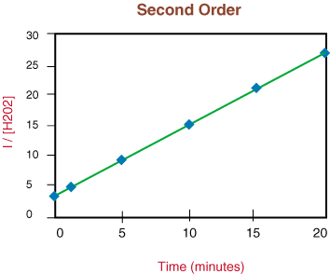
Second-Order Integration
So if a reaction is second-order in A, a plot of
vs. t will yield a straight line with a slope of k.
Notes:
28

Slide 29
How are these equations helpful?
You now have a technique for determining the order of a reaction by observing graphs created from experimental data of concentration vs time.
If a simple graph of concentration vs time is a straight line then you know that it is a zero order reaction.
If the natural log of concentration vs time is a straight line then you know that it is a first order reaction.
If the reciprocal concentration vs time is a straight line then you know that it is a second order.

Slide 30
The conclusion:
In all cases, once you get a straight line fit , you can then get the rate constant from calculating the slope of the line.
Slope (m) = ΔY
ΔX

Slide 31
Summary of Integrated Graphs

Slide 32
Determining rxn order
The decomposition of NO₂ at 300°C is described by the equation
2NO₂ (g)
2NO (g) + O₂ (g)
and yields these data:
Time (s) | [NO₂], M
0.0 | 0.01000
50.0 | 0.00787
100.0 | 0.00649
200.0 | 0.00481
300.0 | 0.00380
ln [NO]₂ | 1/ [NO₂]
Notes:
32

Slide 33
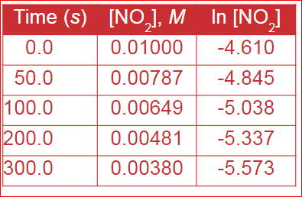
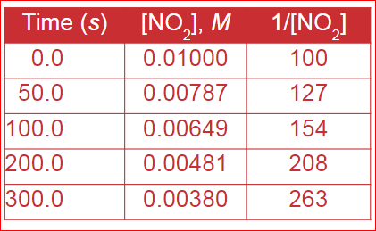
Calculaitons:

Slide 34
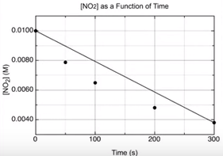
[NO₂] vs Time
The plot is not a straight line, so the process is not zero-order.

Slide 35
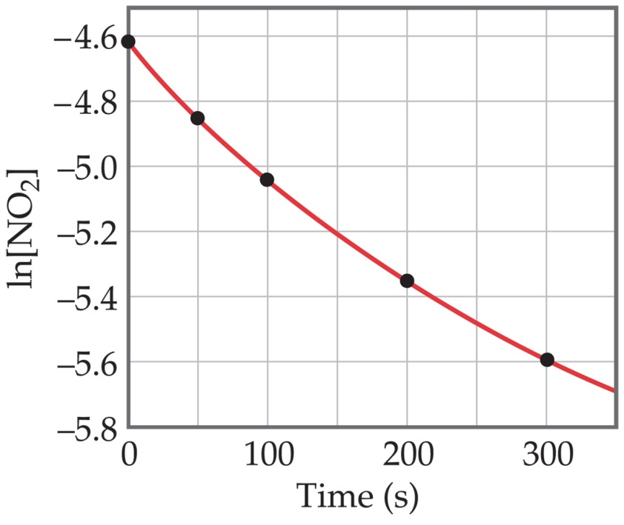
Determining rxn order
Graphing ln [NO₂] vs. t yields:
The plot is not a straight line, so the process is not first-order in [A].
Time (s) | [NO₂], M | ln [NO₂]
0.0 | 0.01000 | -4.610
50.0 | 0.00787 | -4.845
100.0 | 0.00649 | -5.038
200.0 | 0.00481 | -5.337
300.0 | 0.00380 | -5.573
Does not fit:
Notes:
35

Slide 36
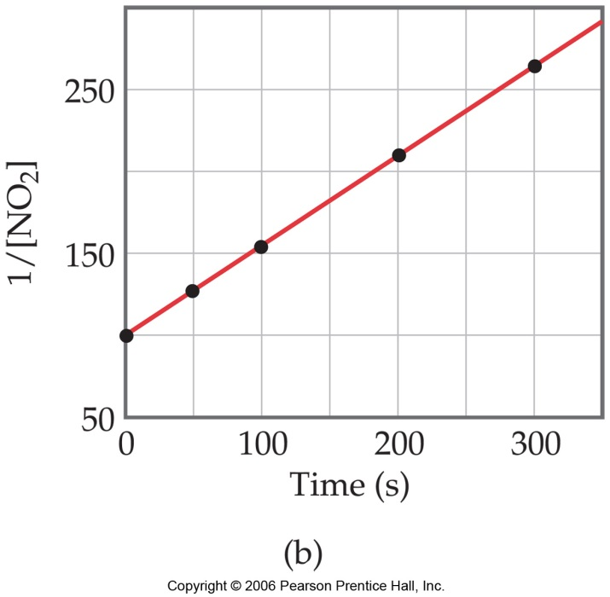
Second-Order Processes
A graph of 1/[NO₂] vs. t gives this plot.
Time (s) | [NO₂], M | 1/[NO₂]
0.0 | 0.01000 | 100
50.0 | 0.00787 | 127
100.0 | 0.00649 | 154
200.0 | 0.00481 | 208
300.0 | 0.00380 | 263
This is a straight line. Therefore, the process is second-order in [NO₂].
Notes:
36

Slide 37
Calculation of k
Constant
Slope (m) = ΔY
ΔX
150 - 100
100-0
K = .5 1/M●s

Slide 38
Half-Life
Half-life is defined as the time required for one-half of a reactant to react or the rate of decay of a radioactive substance.
A radioactive substances are simply unstable isotopes, meaning that they have an imbalance of neutrons and protons.
After a while, the extra energy will be released from the unstable atom. After enough energy is released, the atom returns to a stable state and is no longer radioactive. All radioactive materials eventually decay, just not at the same rate.
Notes:
38

Slide 39
Determining a Half Life
To determine a half life, t_{½}, the time required for the initial concentration of a reactant to be reduced to one-half its initial value, we need to know:
The order of the reaction or be able to calculate it.
The rate constant, k, for the reaction
In some cases, we need to know the initial concentration, [A_{o}]
Substitute this information into the equation for the half life of a reaction with this order and solve for t_{½}.

Slide 40
Half-Life
For a first-order reaction half-life is constant
Most Radioactive decay processes are 1st order.
ln[A]_{t} - ln[A]_{o}= ⁻kt
If asked,How many minutes will it take…
Use this equation
To find half-life, use this equation
Notes:
40

Slide 41
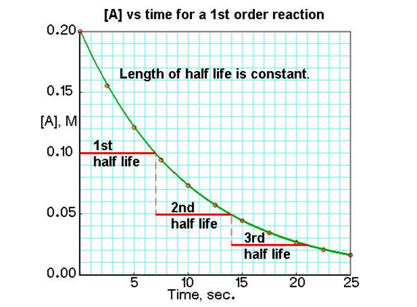
1st Order reactions Half-life is constant

Slide 42
Finding the Overall Rate Law
Utilizing Reaction Mechanisms

Slide 43
Reaction Mechanisms
Not all reactions occur in one step, actually most do not!
A reaction mechanism is the step by step sequence of 2 or more simple reactions that combine to form the overall reaction.
A reaction mechanism describes in detail exactly what takes place at each stage of an overall chemical reaction.
Notes:
43

Slide 44
Reaction Mechanism Terms
Complex reaction- overall reaction
Elementary steps- series of simpler reactions
that combine to form the complex reaction.
Intermediate-a substance produced in one elementary step and consumed in another.
Catalyst-increases the rate but not consumed by the reaction.It remains unchanged.

Slide 45
Multistep Mechanisms
In a multistep process, one of the steps will be slower than all others.
The slowest step is called the rate-determining step.It will be the one used to find the rate law for the overall reaction.
The overall reaction cannot occur faster than this slowest, rate-determining step
Notes:
45

Slide 46
Hypothetical Reactions #1
P + Q B (SLOW)
2) B + Q 2R (FAST)
What is the overall rate law for this reaction?
What is the complex equation for this reaction?
Notes:
46

Slide 47
Hypothetical Reactions # 2
P + Q B (SLOW)
2) B + Q P + 2R(FAST)
What is the overall rate law for this reaction?
What is the complex equation for this reaction?

Slide 48
Practice
2NO N₂O₂ (slow)
N₂O₂ + H₂ N₂O + H₂O (fast)
N₂O + H₂ H₂O +N₂(fast)
a.)Which is the rate determining step?
b.)Does this reaction have a catalyst?
c.)What is the complex equation for this reaction?
d.) What is the rate law?

Slide 49
Answers to practice problem
A.) Step one is the rate determining step
B.) No catalyst
C.) 2NO + 2H₂ N₂ + 2H₂O
D.) rate = k [NO]²

Slide 50
Please Remember!!!!
YOU CAN ONLY USE THE COEFFICIENT METHOD TO DETERMINE THE RATE LAW OF ELEMENTARY STEPS.
YOU CANNOT USE THE COEFFICIENTS FROM THE COMPLEX EQUATION AND DO THE SAME THING.

