Slide 1
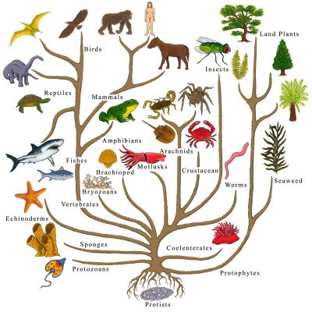
THE BASIC IDEA OF EVOLUTION
According to this idea, Earth’s
__________ day species _________
developed from earlier
distinctly _____________
species.
Life on Earth is thought to
have begun as simple,
_________ - celled organisms.
About a __________ years ago,
increasingly ___________
multi-cellular organisms began
to evolve.
_________
The great ___________ of
organisms is the result of billions
of ________ of evolution, filling _________________
available niches with life forms.
present
PRESENT
different
single
billion
complex
PAST
diversity
years
Common Ancestor

Slide 2
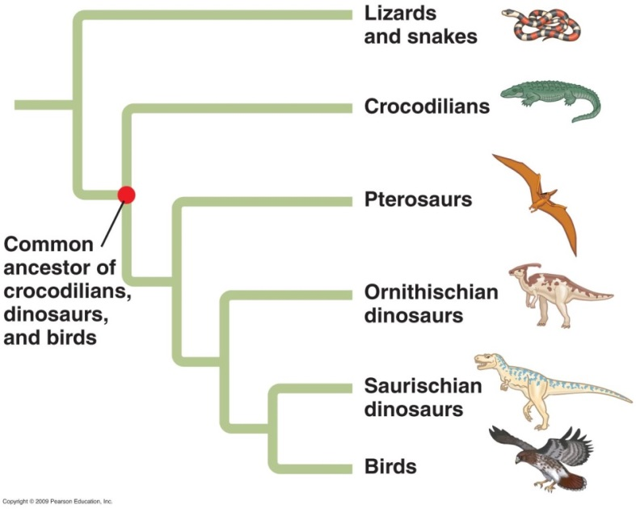
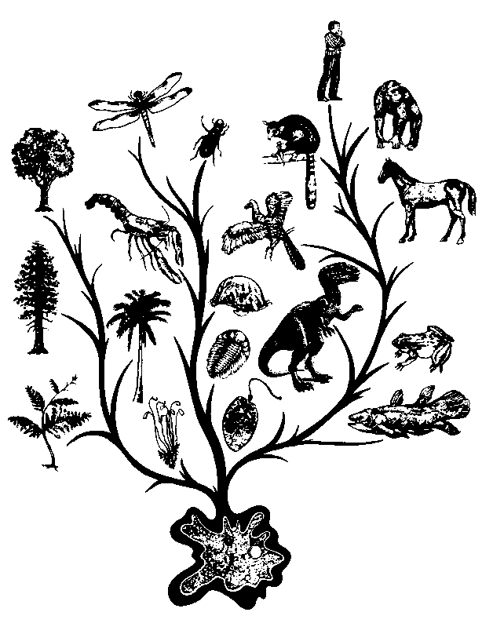
not
Evolution does ______ necessitate
long-term progress in some set
____________. Evolutionary changes
appear to be like the growth of a ______.
Some branches ___________
from the beginning with little or no
change, many ______ out (go extinct),
and others give rise to more ___________
organisms.
_________________
___________
___
_______________________
_____________________
direction
bush
survive
die
complex
alive today
extinct
common ancestor of
ferns & palm trees
common ancestor of all

Slide 3
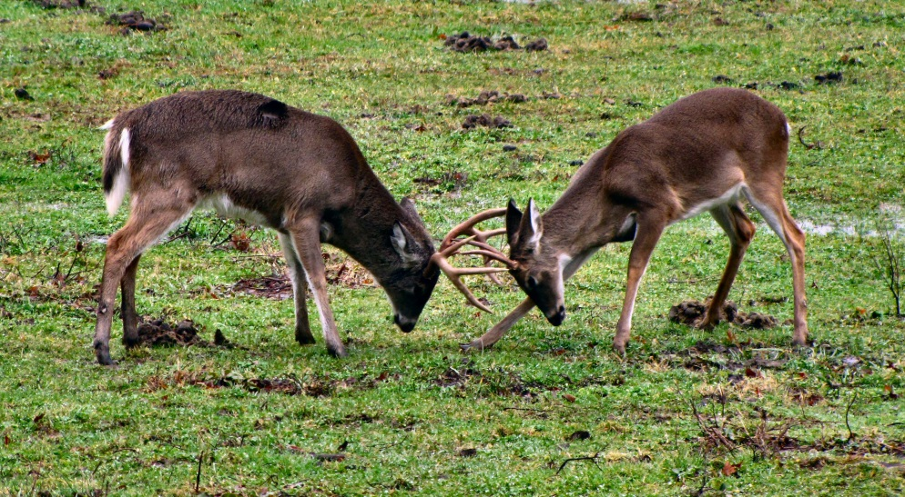
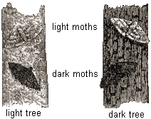
NATURAL SELECTION – Charles __________ started the theory of
“Natural Selection” (i.e. nature selects who will survive and who will ______. This theory is commonly called “Survival of the ______________.”
Too ________ organisms are born and they must compete for ___________ (limited) resources
There are variations ( ______________ ) among
the organisms in their structures and
_______________. Those organisms
with adaptations (______________ structures
and behaviors) will get the resources and
____________.
Peppered moths
Darwin
die
Fittest
many
finite
differences
behaviors
helpful
survive

Slide 4
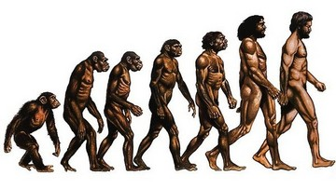
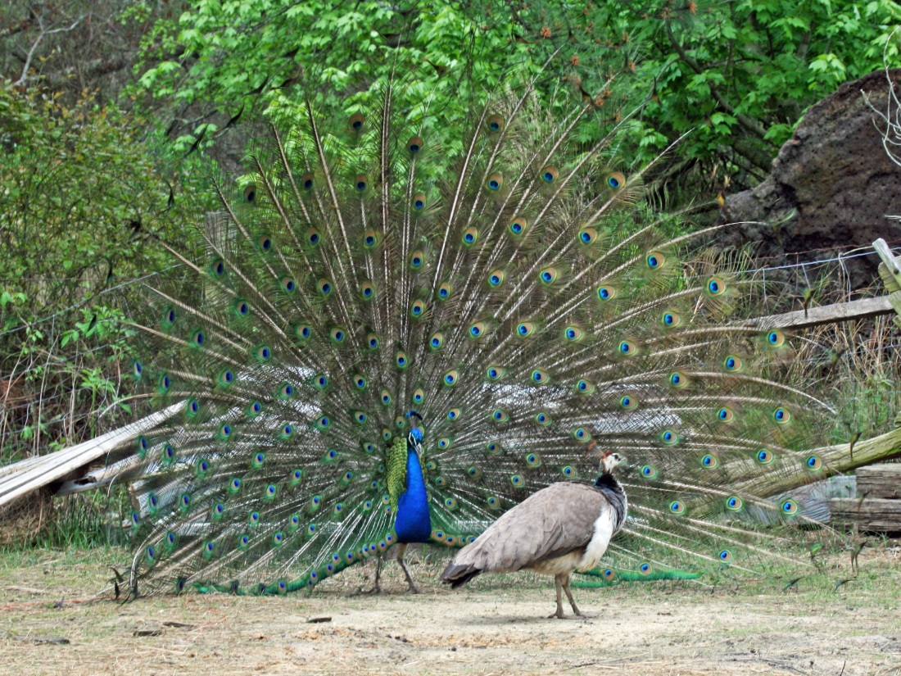
pass
3. The organisms who survive will ________ their traits on to their offspring. Over time, the proportion of individuals with advantageous characteristics will _____________.
4. Small differences between parents and offspring
can __________________ in successive
generations so the descendants become
very ________________ from their ancestors.
Behaviors have evolved through
natural selection to ensure
reproductive ________________.
increase
accumulate
different
success

Slide 5
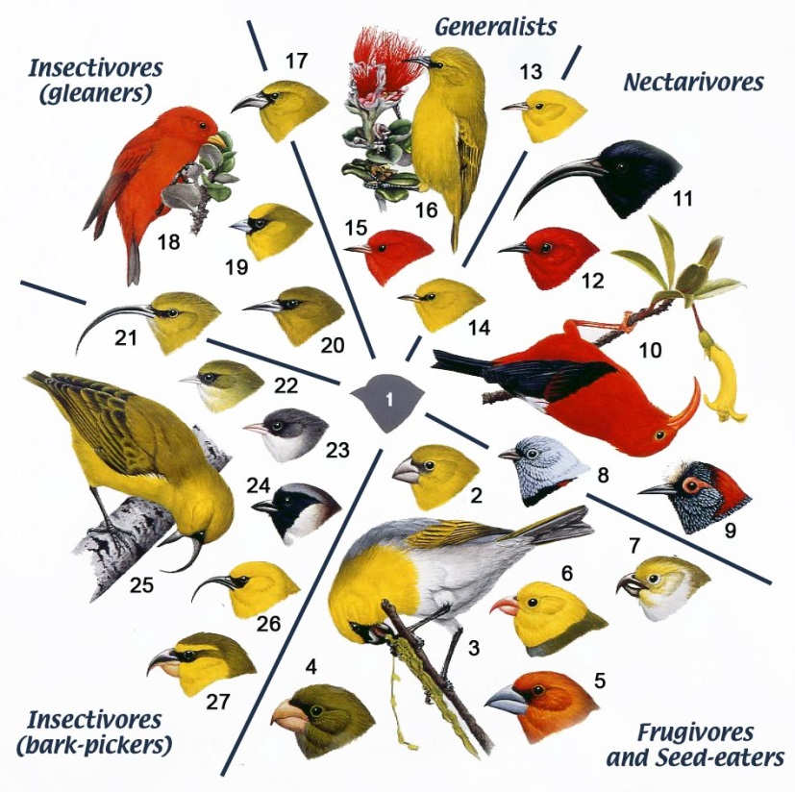
SOURCES OF VARIATION
Variation within a ___________ increases the
likelihood that at least some of the members
will ___________ under ___________
environmental conditions.
The 2 sources of variation according to evolution are:
(1) ____________ – The ___________ of a gene
in a reproductive cell
(2) ___________________ of genes. The mixing
of genes from 2 parents during _________
reproduction providing ____ combinations
Species evolve over time due to the selection by the __________________ of those better
able to survive and leave _______________.
species
survive
changing
MUTATION
changing
RECOMBINATION
sexual
new
environment
offspring

Slide 6
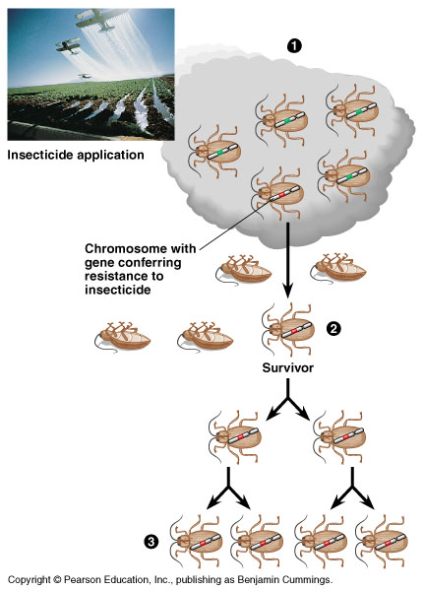
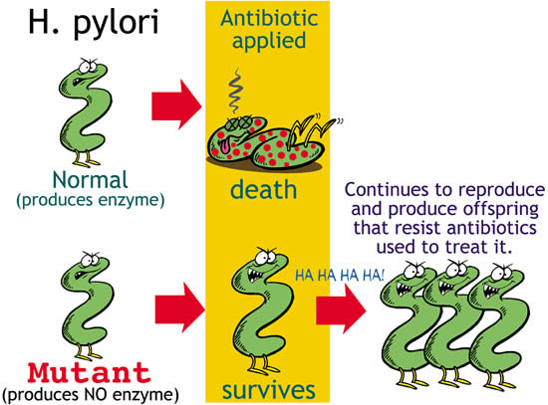
selects
“Selection Agent” – Any environmental factor that ___________ organisms for death.
(1)_________________ (2) _____________________
The bacteria that are resistant to
the ________________ live and
Susceptible insects ______ (they are pass this ________ on to their
selected against). Resistant ones _____. offspring.
PESTICIDES
ANTIBIOTICS
antibiotic
die
trait
live

Slide 7
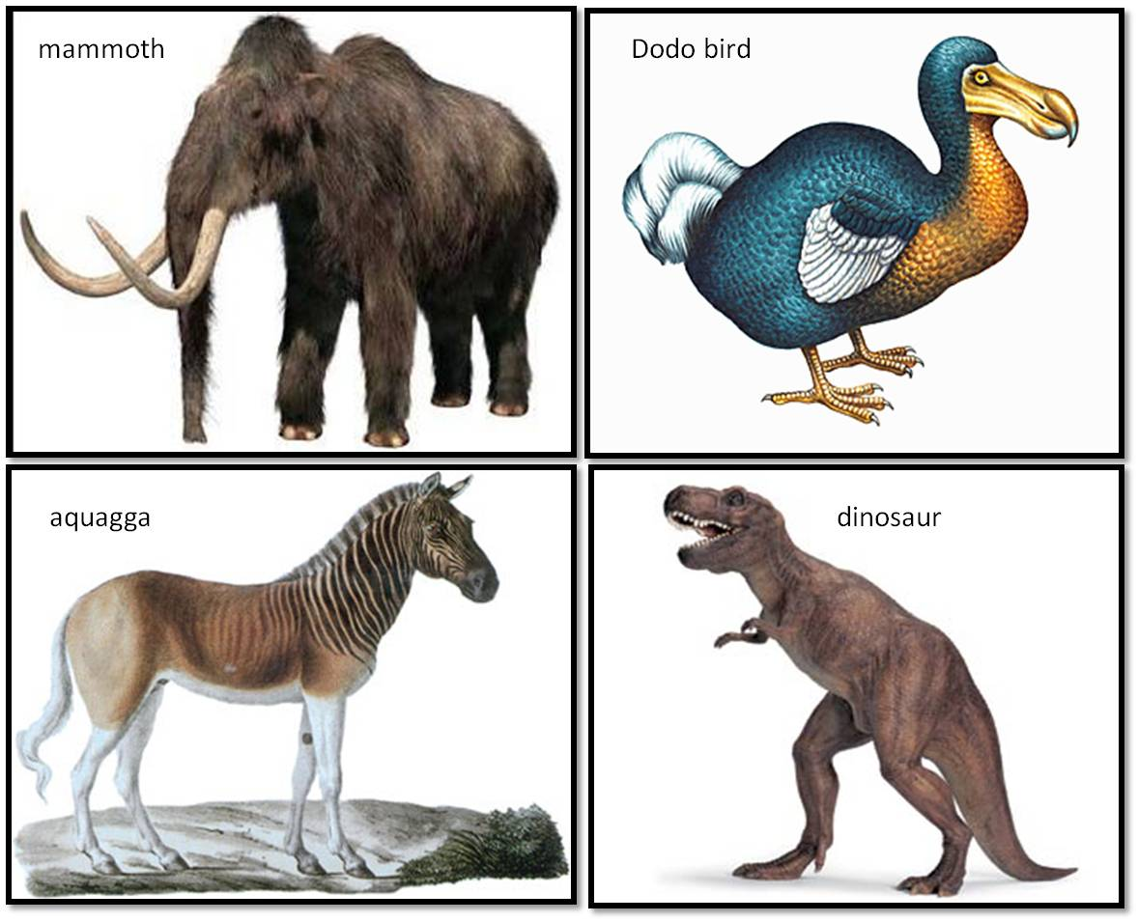
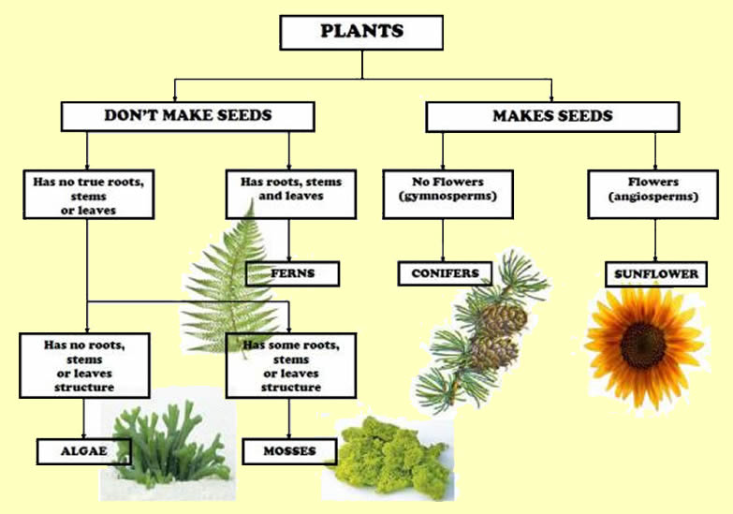
EXTINCTION
Extinction of a ___________ occurs
when the environment ____________
and the adaptive characteristics of
a species are _________________ to
allow its survival. Extinction of
species is ____________; most of
the species that have lived on Earth
____ longer exist.
CLASSIFICATION
Organisms are classified into _________
and subgroups based on structural
similarities and proposed ________________ relationships
species
changes
insufficient
common
no
groups
evolutionary

Slide 8
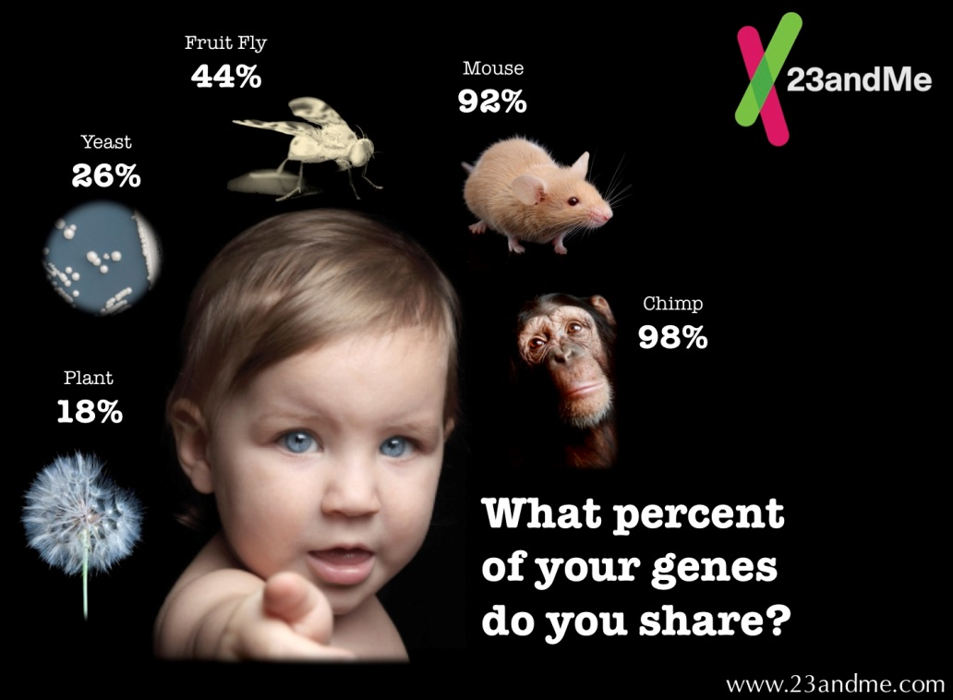
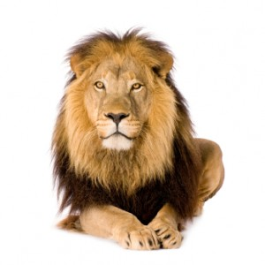
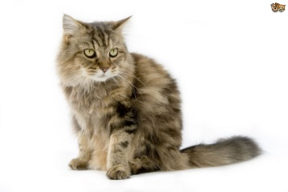
compared
DNA sequences can also be ___________
to classify organisms into groups. The
more ____________ the DNA, the more
_____________ related.
Because DNA codes for structural
_________ like hair, classification
systems based on structure and DNA
tend to ___________.
SPECIES is the most fundamental ______
of classification. For two organisms
to be the _______ species, they must
be able to mate and have offspring
that can mate again.
similar
closely
traits
match
Kingdom | Animal | Animal
Phylum | Chordate | Chordate
Class | Mammal | Mammal
Order | Carnivore | Carnivore
Family | Felidae | Felidae
Genus | Felis | Felis
Species | __________ | ___________
unit
same
domesticus
leo

Slide 9
DICHOTOMOUS KEY – This is a classification key used to __________ unknown
organisms. At each step, the traits of the organism fall into 1 of ___ steps. Each choice then leads to the next step until the identity is ______________.
A B C
IDENTIFY THE INSECTS:
A = ________________
B = ________________
C = ________________
identify
2
revealed
Beetles
Flies
Dragonflies

