Slide 1
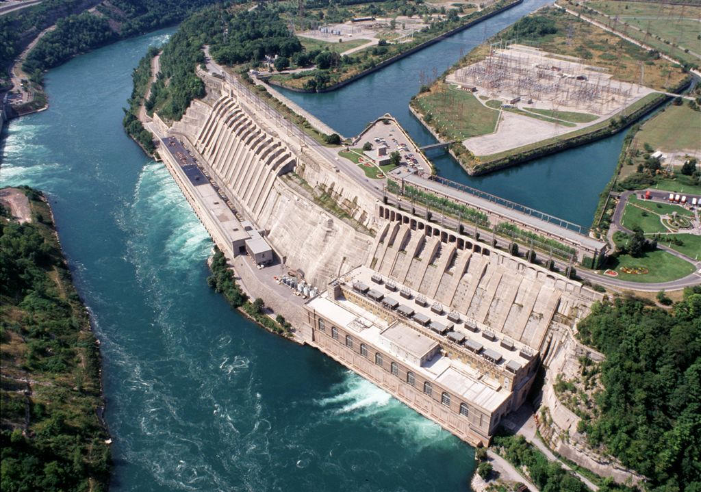
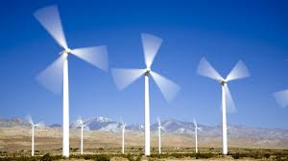
Indirect Solar Energy
Hydropower, Wind power, and Biomass

Slide 2
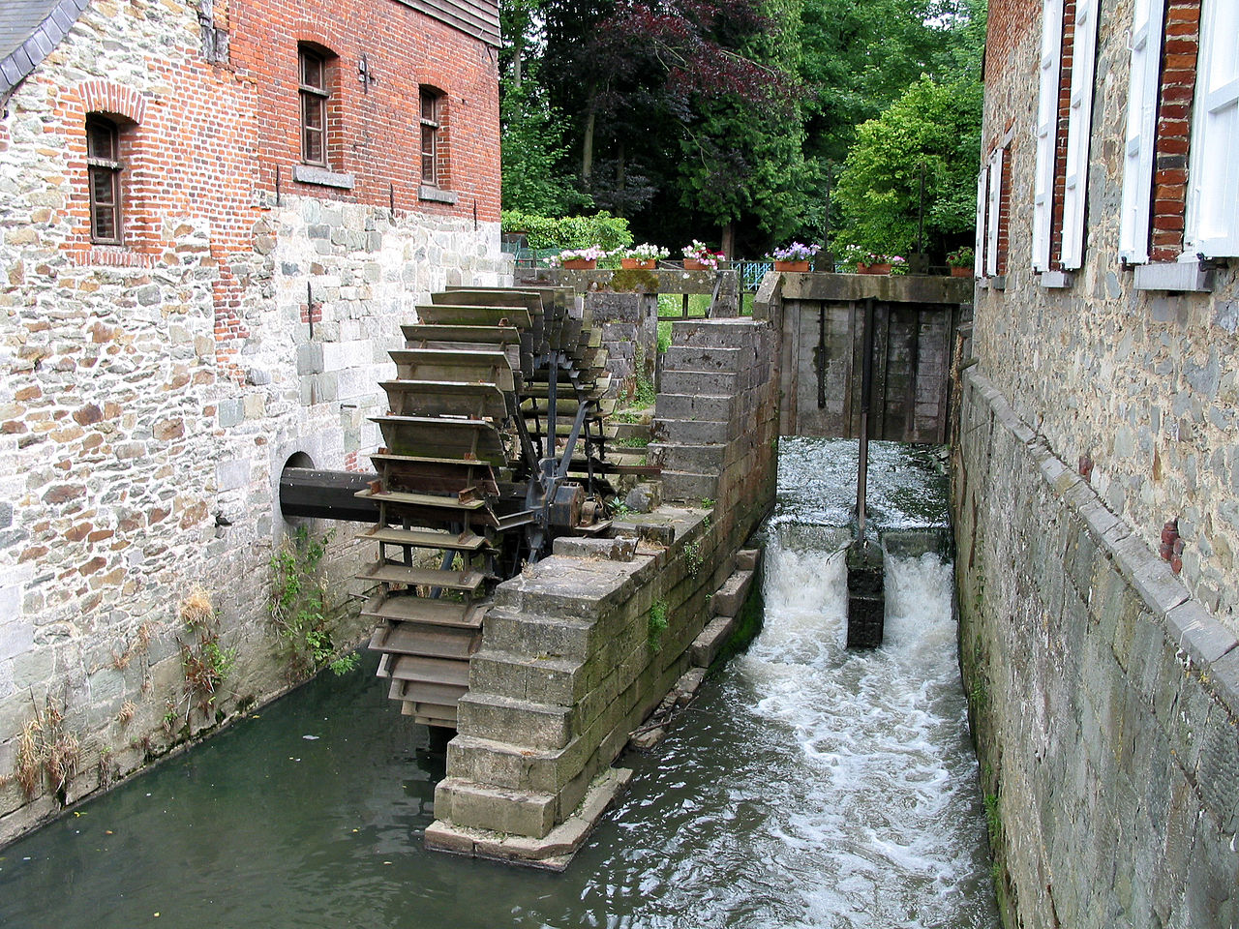
Hydropower
Used throughout history – watermills
Amount of power generated proportional to height of the water (head), and the volume of the flow
https://www.youtube.com/watch?v=rnPEtwQtmGQ

Slide 3
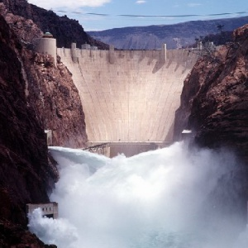
Hydropower Statistics
About 6.7% of the electrical power in U.S.
About 50% of renewable energy in U.S.
17-24% of the electrical power in the world
China, Brazil, Canada, U.S., Russia
Only 20% of U.S. potential used

Slide 4
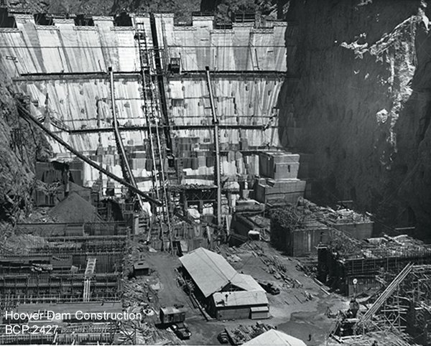
Pros of Hydropower
Renewable – water is not destroyed by process
Nonpolluting
Domestic
Infrastructure exists (PWA – New Deal 1933)

Slide 5
Cons of Hydropower
Environmental impacts both upstream and downstream
Cold water rivers become warm water reservoirs
Decrease biodiversity
Intermittent periods of floods and droughts downstream
Flooding upstream – farmland, sacred land, rural populations

Slide 6
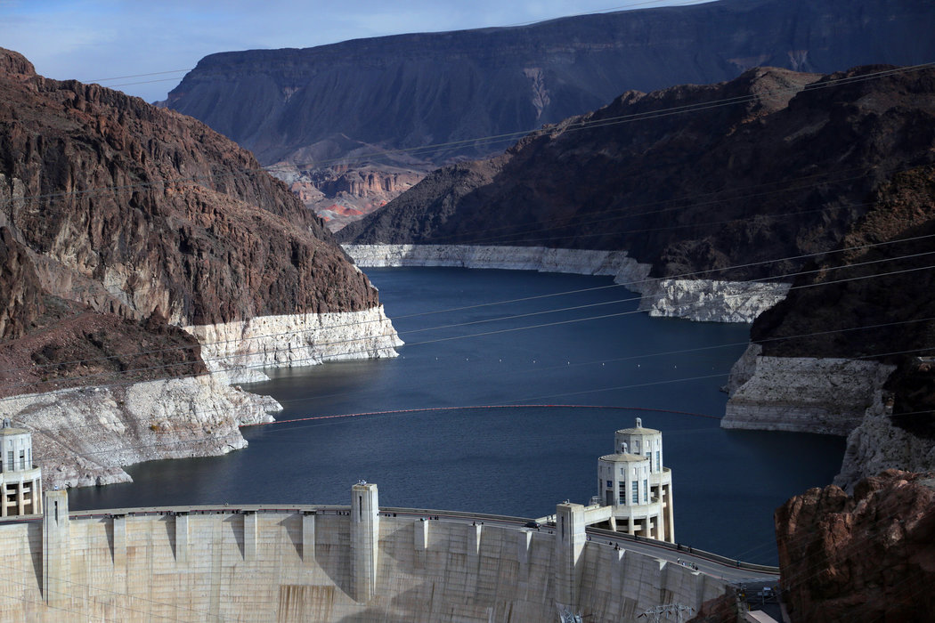
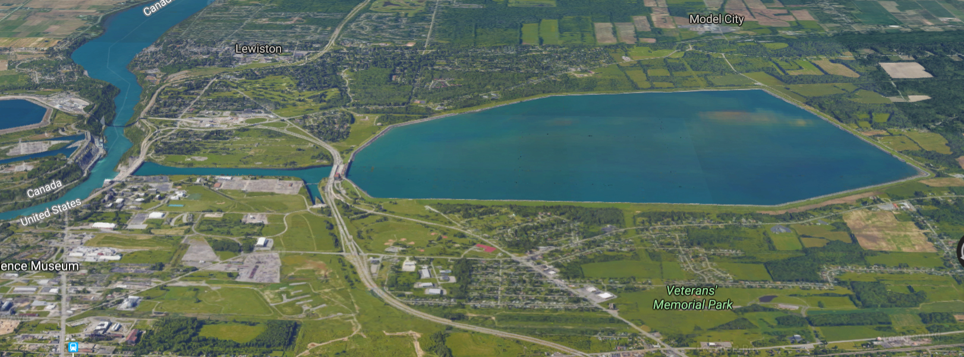

Slide 7
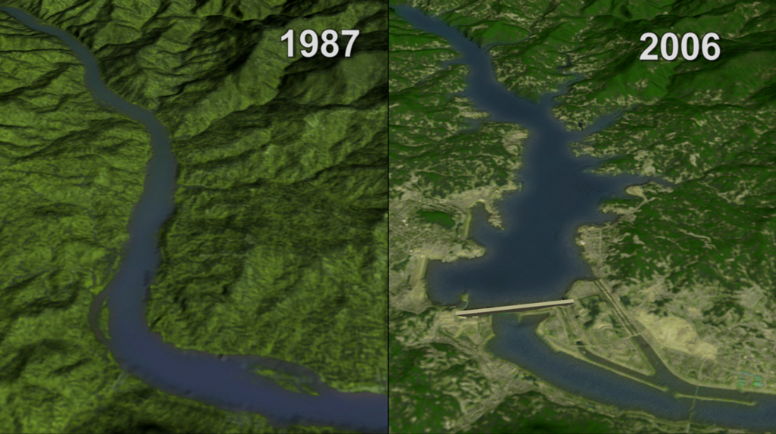

Slide 8
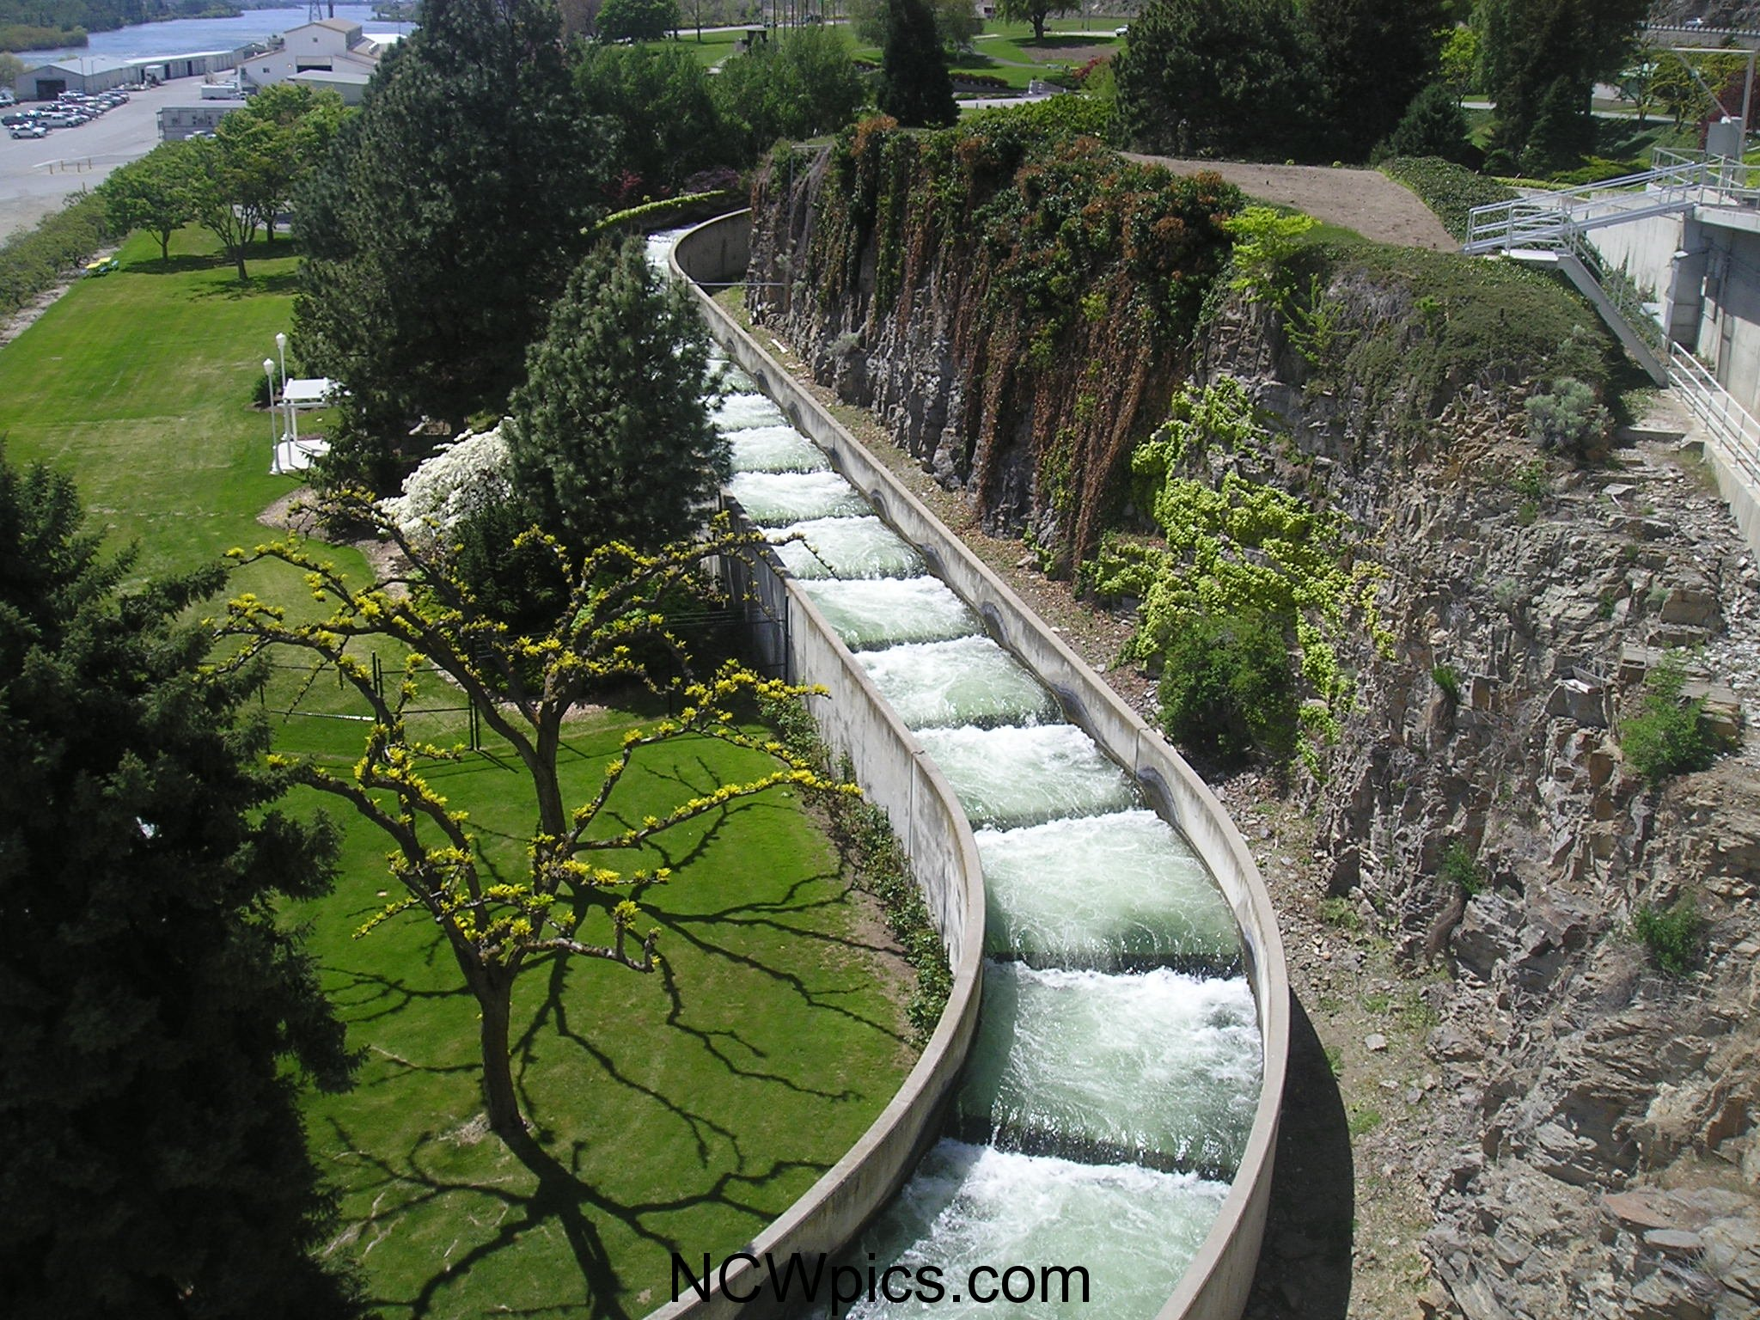
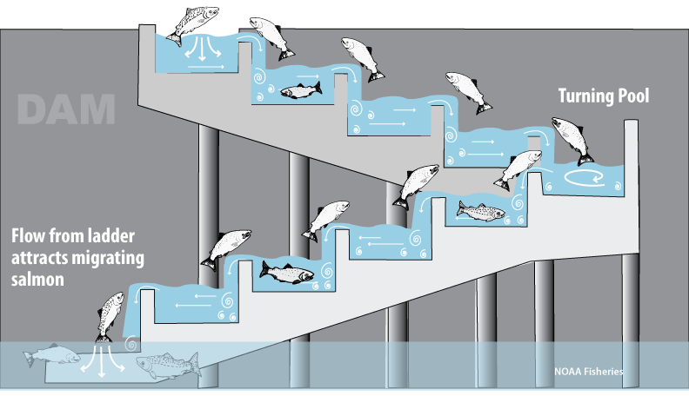
https://www.youtube.com/watch?v=l9qA8c-E_oA

Slide 9
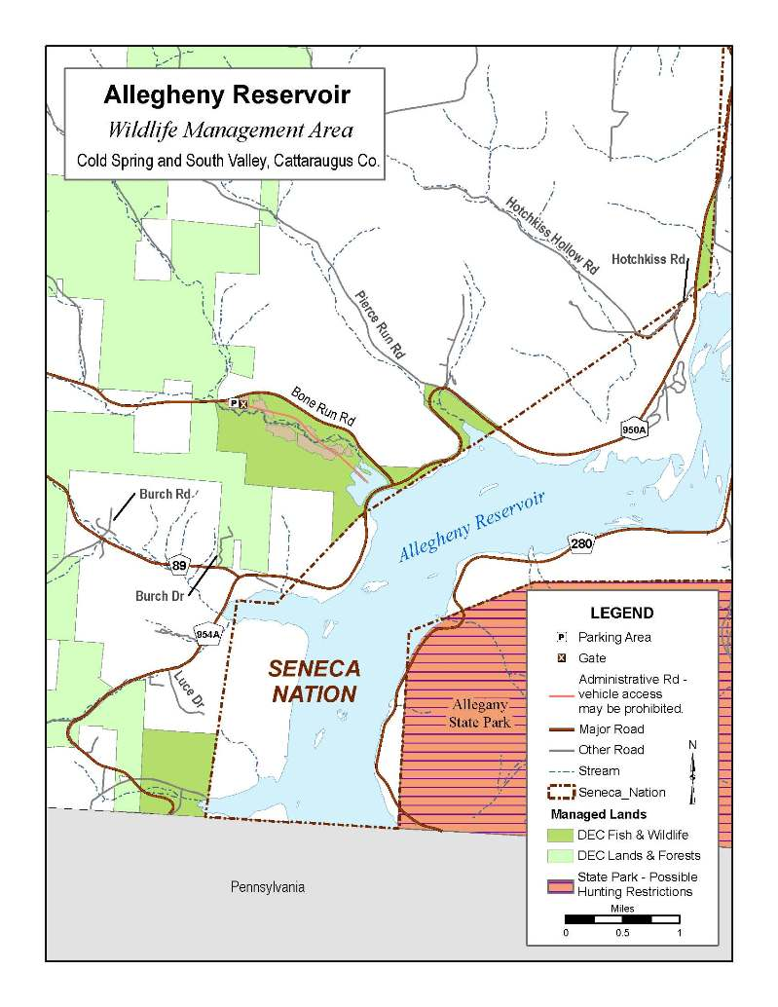
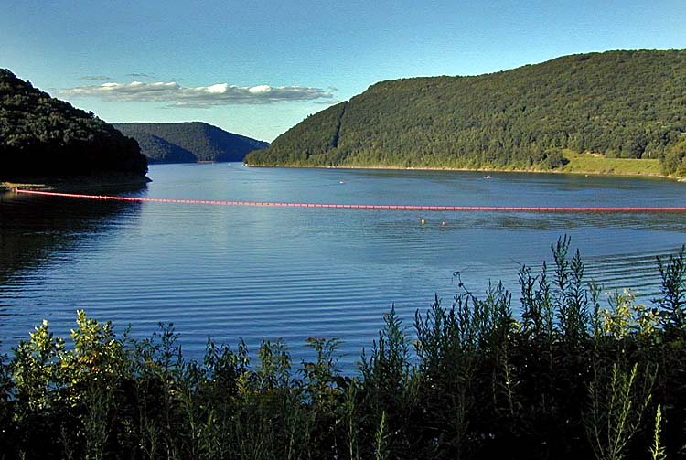
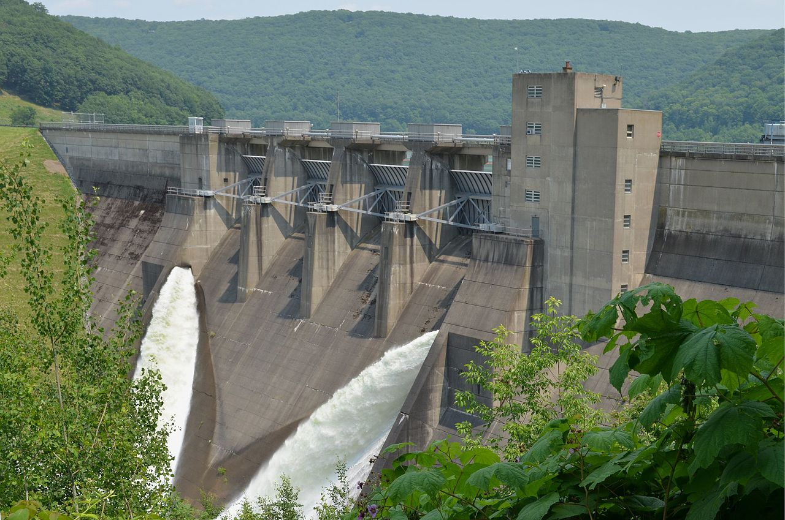

Slide 10
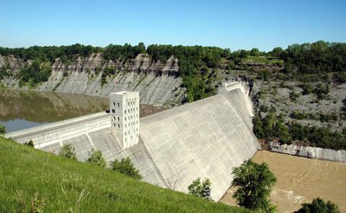

Slide 11
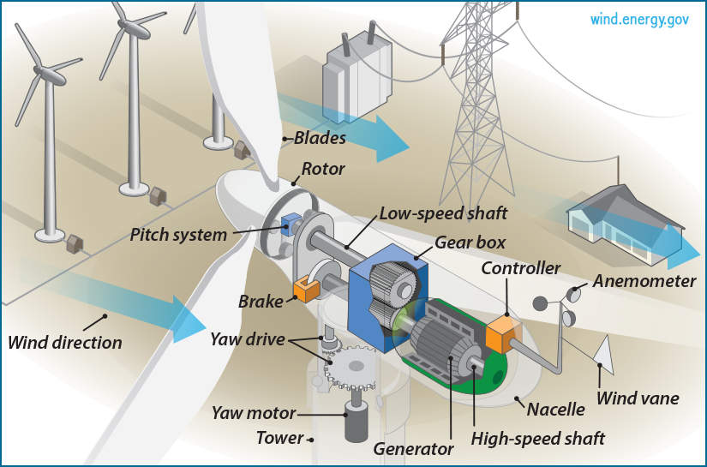
Wind POwer
https://energy.gov/eere/wind/animation-how-wind-turbine-works

Slide 12
Wind Power Stats
40 U.S. states have utility based wind power
~50,000 utility wind turbines in U.S.
Generating 74,000mW of energy
Power about 20 million houses
128 million investment in last decade (88,000 jobs)

Slide 13
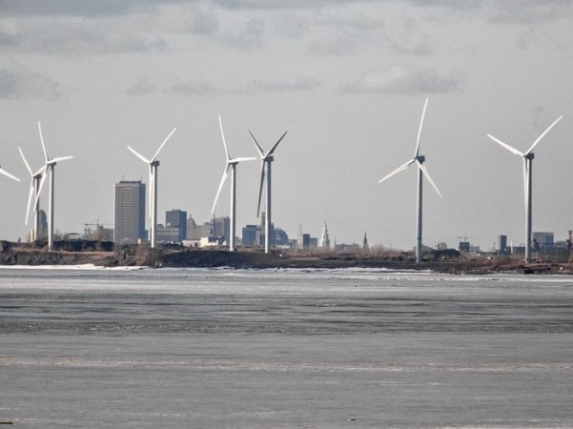
Pros of Wind Power
Clean
Renewable
Landowner income
Scalable
Domestic

Slide 14
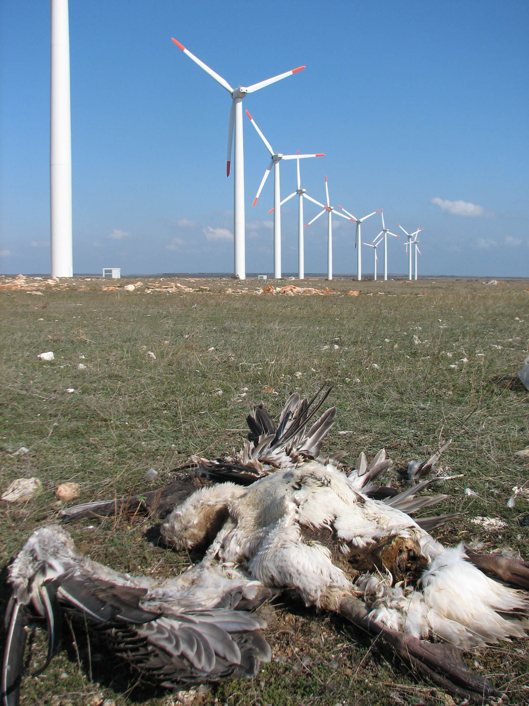
Cons of Wind Power
Backup/storage needs to be provided
Ugly and Loud
Bird hazard

Slide 15
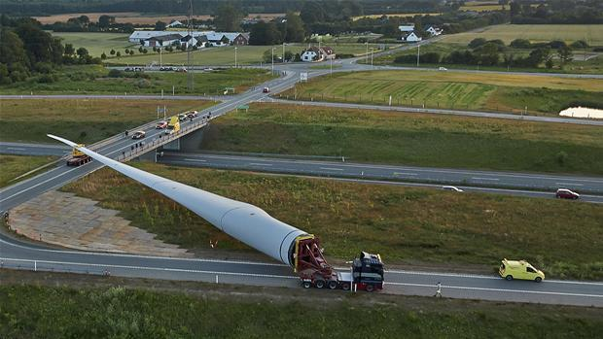

Slide 16
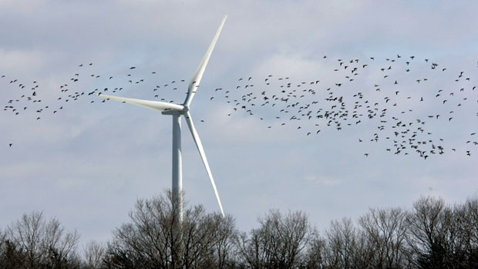

Slide 17
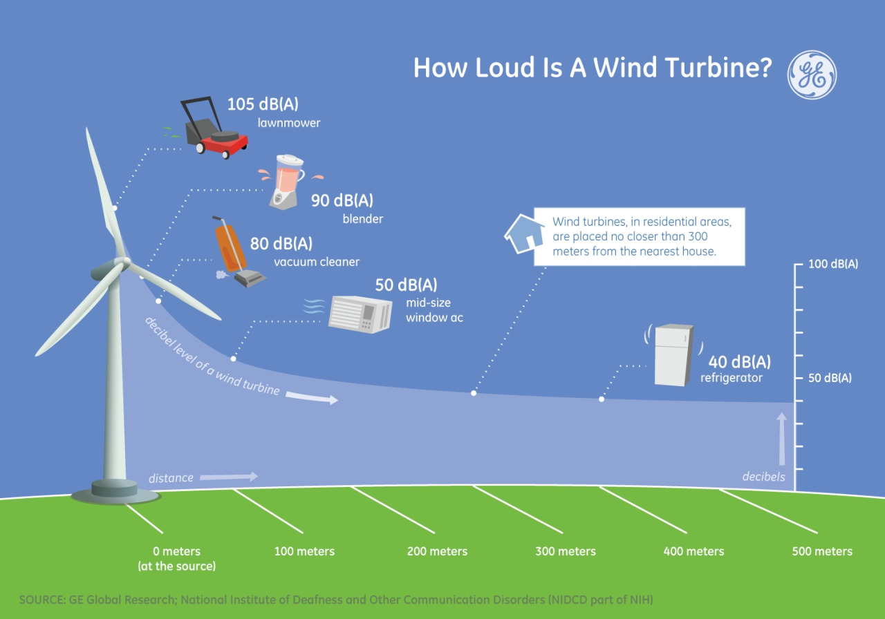

Slide 18
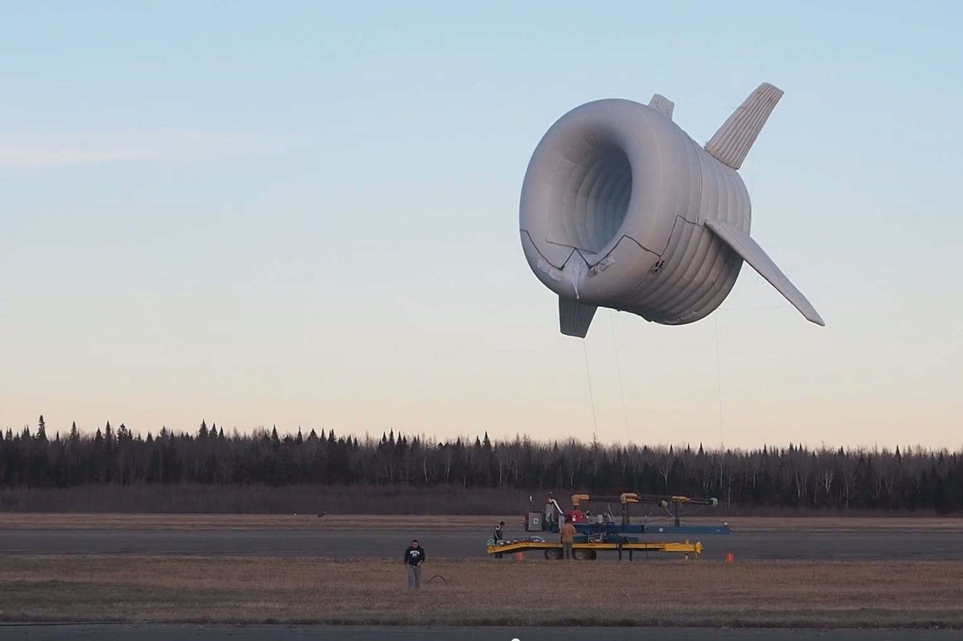
The Bat
https://www.youtube.com/watch?v=kldA4nWANA8

Slide 19
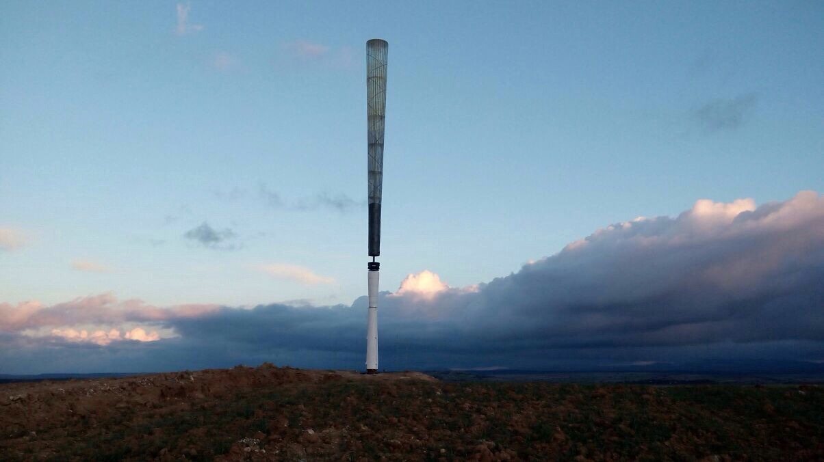
Vortex
https://www.youtube.com/watch?v=dUu91zsVZ0o

