Slide 1
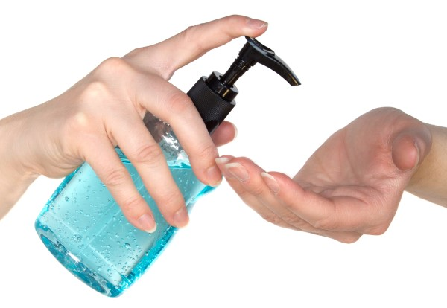
SCIENTIFIC METHOD
The scientific method is an ___________________ way to solve _______________.
5 STEPS OF THE SCIENTIFIC METHOD:
(1) Observe a _______________ / ask a ________________
Ex. Will __________________ stop people from
getting sick?
(2) State a _______________ (An “educated guess”)
Ex. If hand sanitizer is applied ____ times a day,
then people will get ______ colds each year.
HELPFUL HINT! A good idea is to state a hypothesis as an “ _____ / _______ “ statement. Remember
a hypothesis is a _____________ (not a question) and needs to be _________________.
organized
problems
problem
question
hand sanitizer
hypothesis
3
less
If
Then
statement
measurable

Slide 2
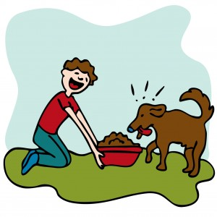
PRACTICE HYPOTHESIS WRITING
A. If you practice writing good hypotheses, then your final exam grade will ______________.
If plants receive 12 hours of light a day, then they will grow ______________.
(HINT: Stay away from the word “better” and use measurable data)
If bacteria are exposed to UV light for 5 days, then ________________________________________.
D. READ THE PASSAGE AND GENERATE A HYPOTHESIS
Pete is wondering if high protein dog food might impact the thickness
of his dog’s fur. He buys several varieties of dog food, each with a
different protein content to feed to his dog.
STATE YOUR HYPOTHESIS: ________________________________________________________
_______________________________________________________________________
increase
taller
100% of the bacteria will die
If the dog is fed high protein dog food,
then his fur will grow thicker

Slide 3
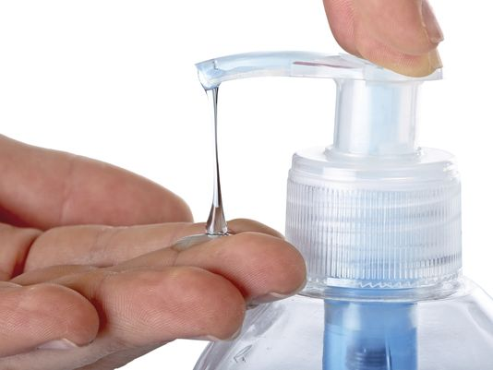
experiment
(3) Run an ________________
A good experiment has only one independent _______________ (factor that varies) and all other
factors are held ______________ (kept the same).
INDEPENDENT VARIABLE – The factor that “____” am testing and
varies between the groups
Ex. _____________________
DEPENDENT VARIABLE – The ________ being collected. Data are the
numbers you _______________ and collect.
Ex. _____________________________
CONSTANTS – Factors that are kept the _________ in both groups. These are factors that could also ________________ the outcome of the experiment.
Ex. ________________ _________________
variable
constant
I
hand sanitizer
data
measure
number of colds per year
same
impact
nutrition
amount of sleep

Slide 4
EXPERIMENTAL DESIGN
EXPERIMENTAL
CONTROL
_____________________ (TEST) GROUP | _______________ GROUP
Gets the Independent Variable ________________ CONSTANTS _______________________ _______________________ ________________________ | Gets ____ variable (or a ______________ *) CONSTANTS ______________________ ______________________ ______________________ *Placebo - A pill or ______________ that looks like the variable but does not contain the medicine.
hand sanitizer
no
placebo
1000 people
1000 people
healthy food
healthy food
8 hours of sleep
8 hours of sleep
lotion
THOUGHT QUESTION - Why does a good experiment have only 1 independent variable? ANSWER - If there is a
difference in the _______________ between the groups, it ________ be due to the variable since all other
treatments were the same.
results
must

Slide 5
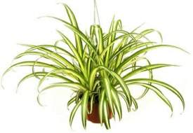
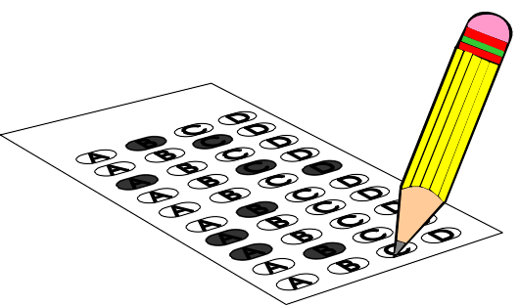
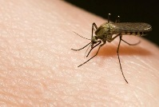
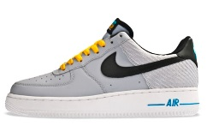
VARIABLES PRACTICE
DIRECTIONS: Identify the Independent Variable (“I” change) and the Dependent Variable (Data collected) in each of
the following hypotheses:
HYPOTHESIS |  | INDEPENDENT VARIABLE | DEPENDENT VARIABLE
If spider plants are grown at a temperature of 80ºF then their roots will grow longer
If students study with music then their test scores will increase
If sunflowers receive 12 hours of sunlight per day then they will grow taller
If hikers use mosquito repellant then they won’t get as many mosquito bites
If athletes wear Nike brand sneakers then they will be able to jump higher
temperature
root length
music
test scores
hours of sunlight
height
mosquito
repellant
# of bites
brand of sneaker
jump height

Slide 6
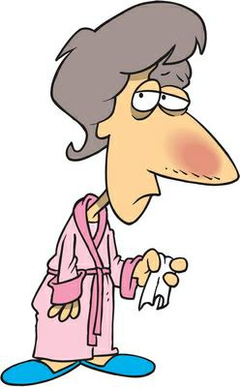
data
(4) Collect __________ and analyze it
Ex. After 1 year, the people who used hand sanitizer had an average of ____ cold per year,
while the people who did not use hand sanitizer had an average of ____ colds per year.
(5) Draw a _____________________
Did the results show the hypothesis to be true or ___________ ?
Our conclusion: _______________________________
REVIEW – The 5 Steps of the Scientific Method
1. Observe a _____________ / Ask a Question 4. Collect _______ & analyze it
2. State a ___________________ 5. Draw a ________________
3. Run an ___________________
1
3
conclusion
false
hypothesis is true
problem
data
hypothesis
conclusion
experiment

Slide 7
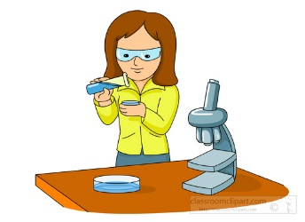
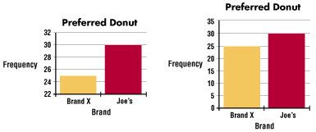
6 QUALITIES OF A VALID EXPERIMENT
1. A large ______________________. This increases the reliability or ________________ of an experiment
Ex. Poll on how many U.S. citizens think high school should start at 10:00 AM
2. ______________ the experiment again & again to see if you get the __________ results
3. Data must be complete and not _________________
sample size
validity
Repeat
same
misleading

Slide 8
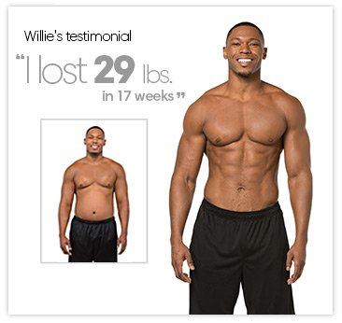
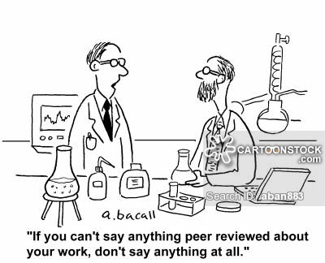
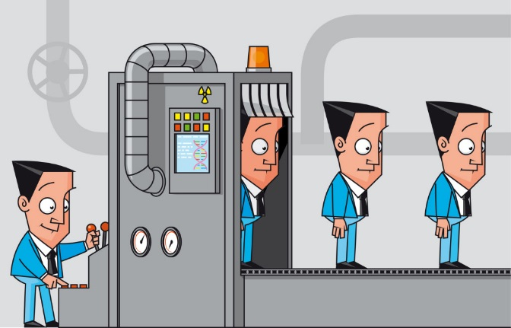
data
opinion
4. Base conclusions on the _________ and not personal ________________.
5. Use _______ review to analyze your experiment
and to evaluate your ________________________.
6. The results of the study should be made ______________ and be _________________ to similar studies
peer
conclusion
public
compared

Slide 9
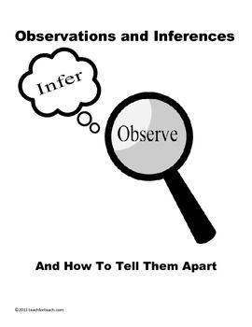
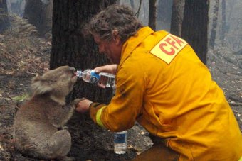
OBSERVATION and INFERENCE
OBSERVATION INFERENCE
Information you can take A __________________ based
in with your _____ senses upon an observation
PRACTICE
Make 2 observations about this picture
________________________ ________________________
Make 2 inferences about this picture
________________________ _________________________

Slide 10
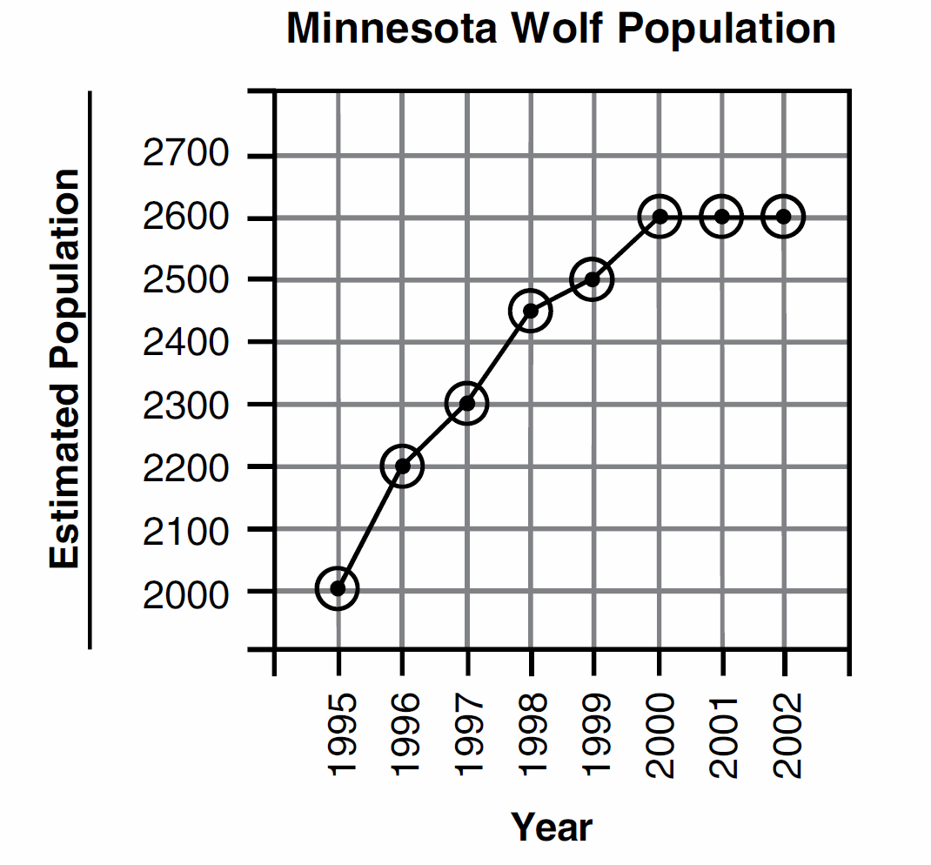
GRAPHING
Why do biologists use graphs? 1. Graphs are an easy way to _______________ and _____________ data
2. Graphs are useful for making ____________________ and conclusions
KEY FEATURES OF GRAPHS:
1. A ____________ tells the reader what you are graphing
2. Put proper ____________ (names)
and ________ (numbers) on each axis
3. Use equal __________________ ex. 0 2 4 6 ___ 10
ex. 0 .25 _____ .75 1.0 1.25 1.50 ____ 2.0
4. Use most of the __________ on the graph paper
5. Put the _________________ variable on the X axis and the Dependent variable on the ____ axis
6. When possible, start with a “ ___” at the corner of the X and Y axis
7. Graph in _____________ so you can erase and change your labels and data points
organize
display
inferences
title
labels
units
increments
8
.50
1.75
space
independent
Y
0
pencil

Slide 11
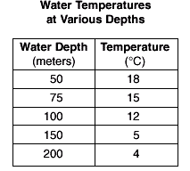
PRACTICE GRAPH!
Make a line graph of the data
Analysis:
What is the relationship between
Water Depth and Temperature?
______________________________
______________________________

