Slide 1
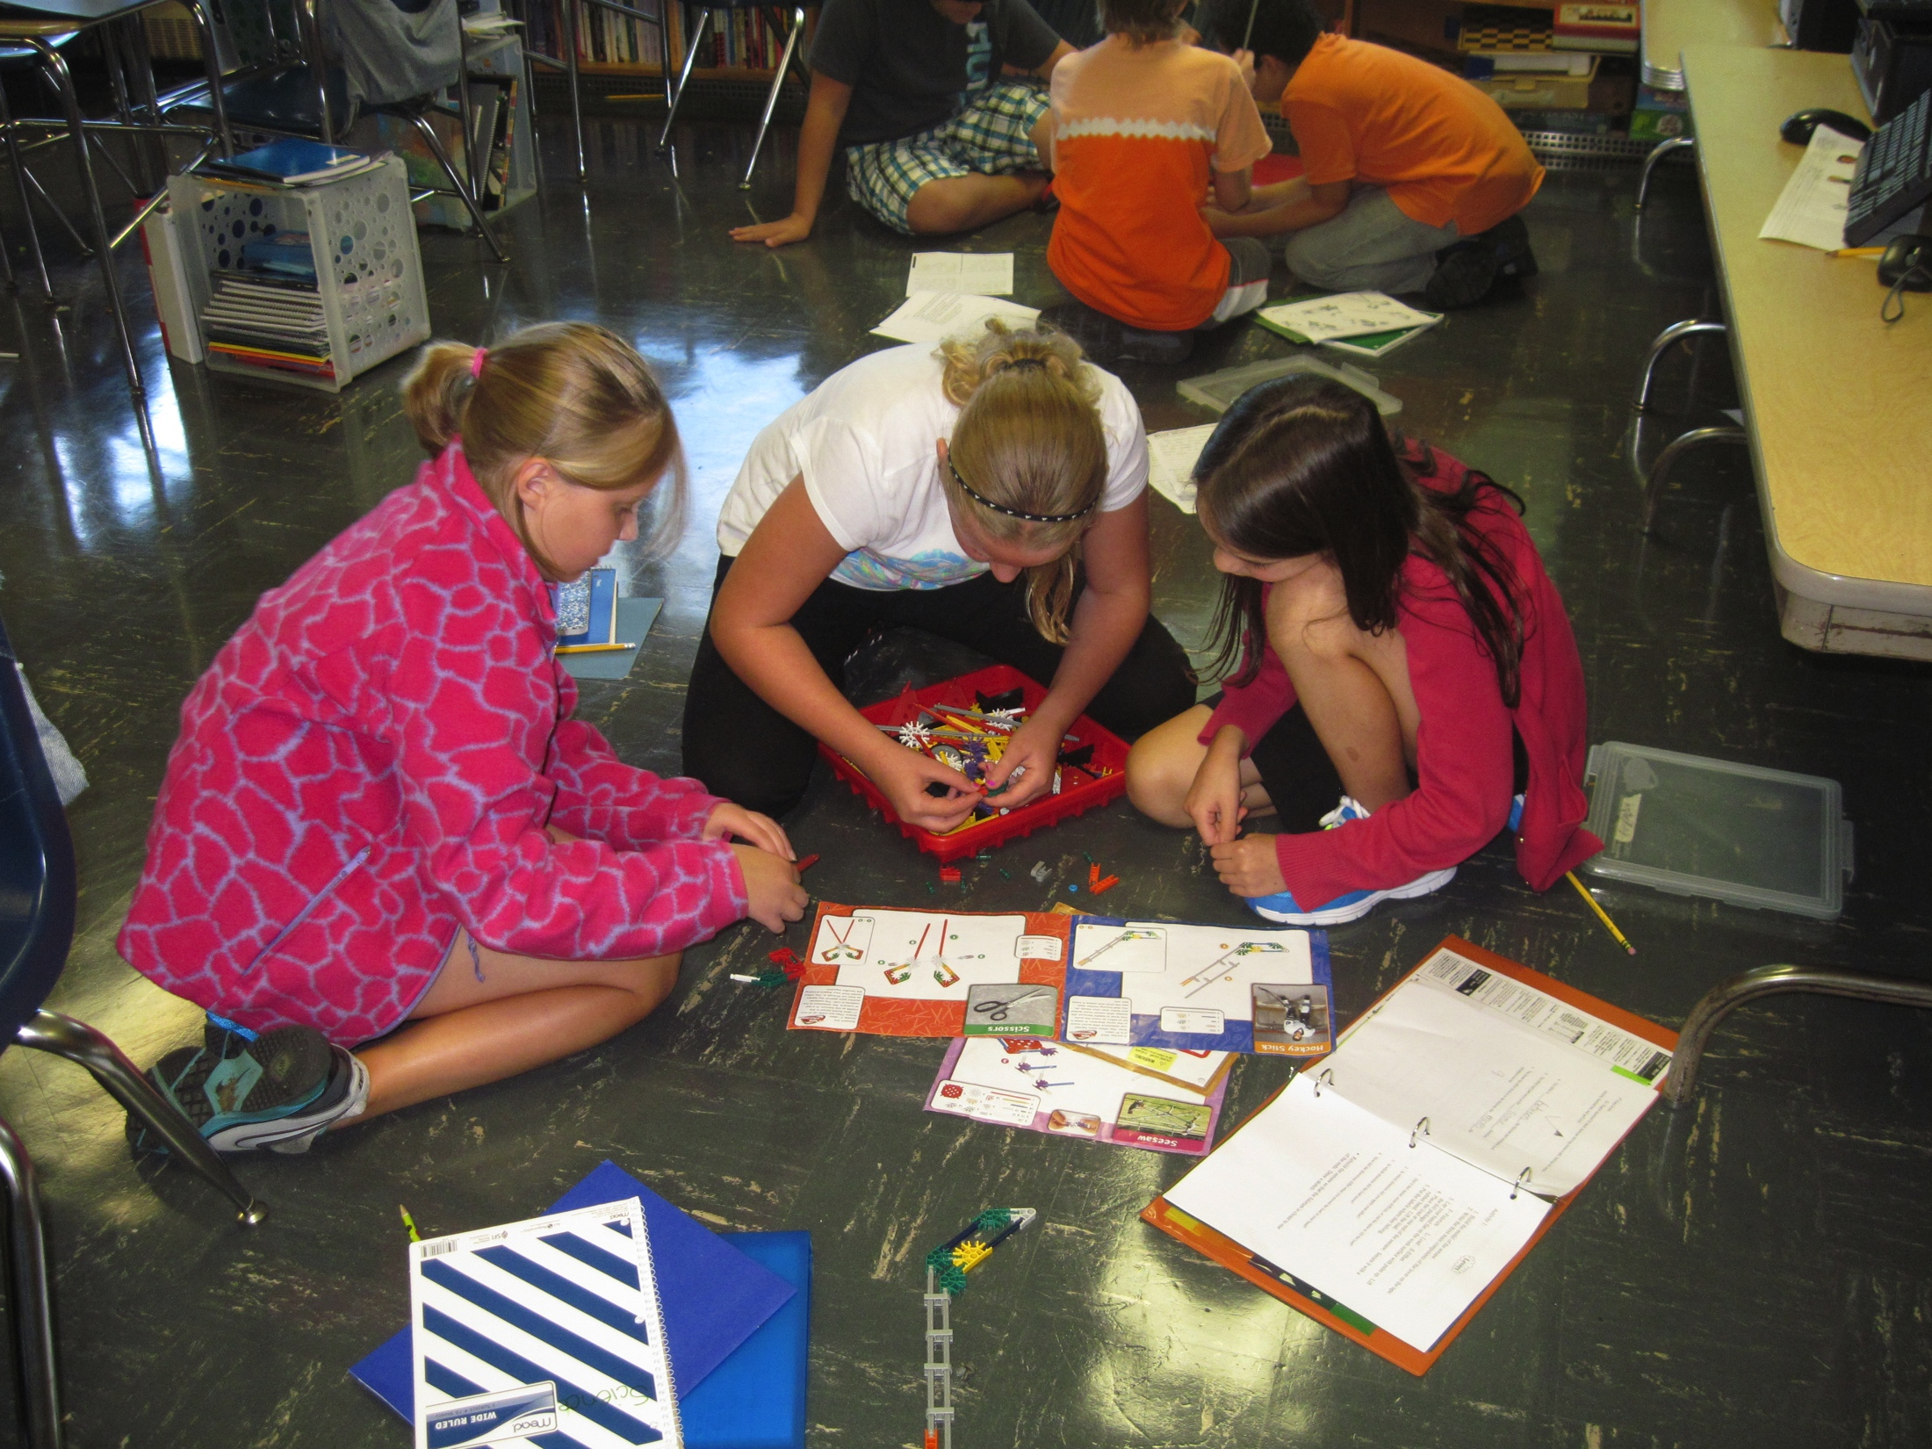
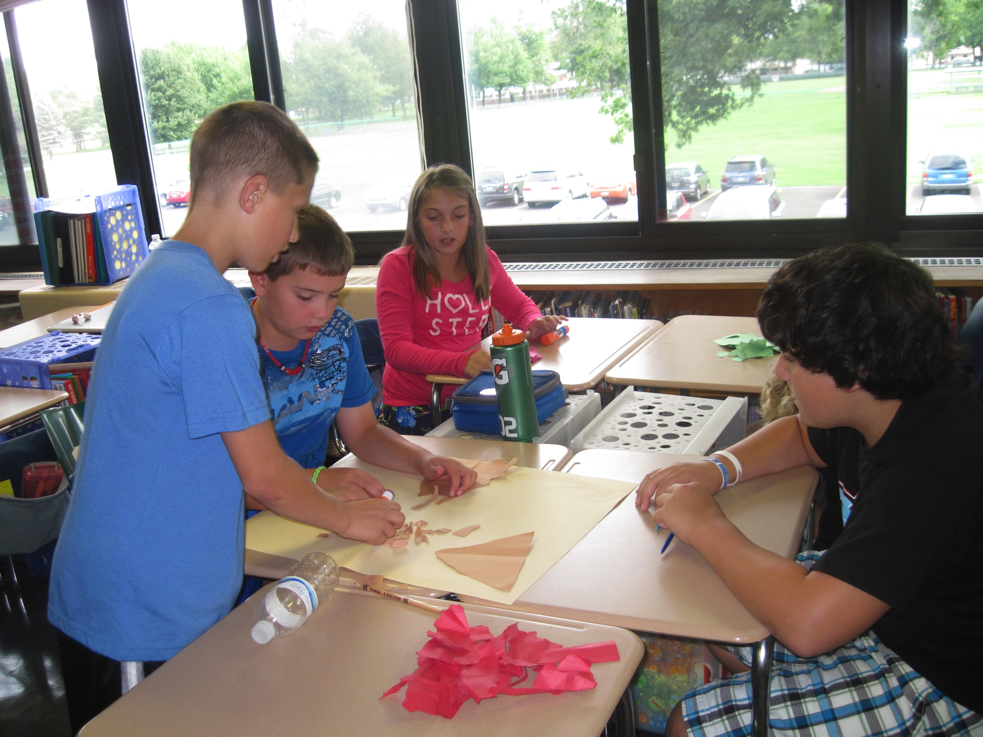
The Major Progress Program
Informational Meeting

Slide 2
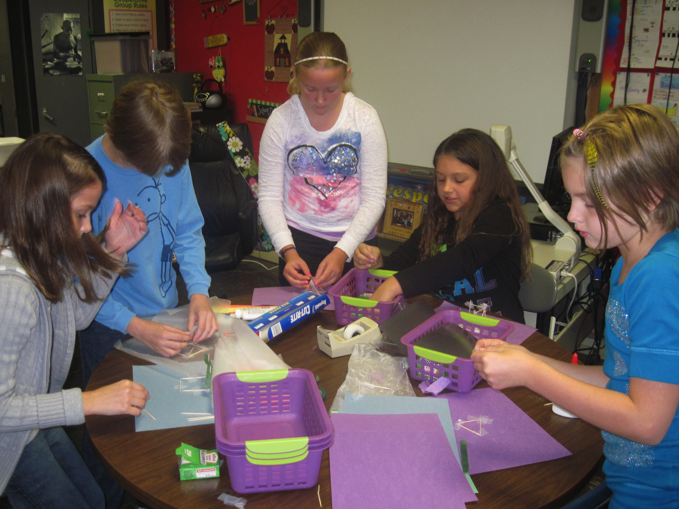
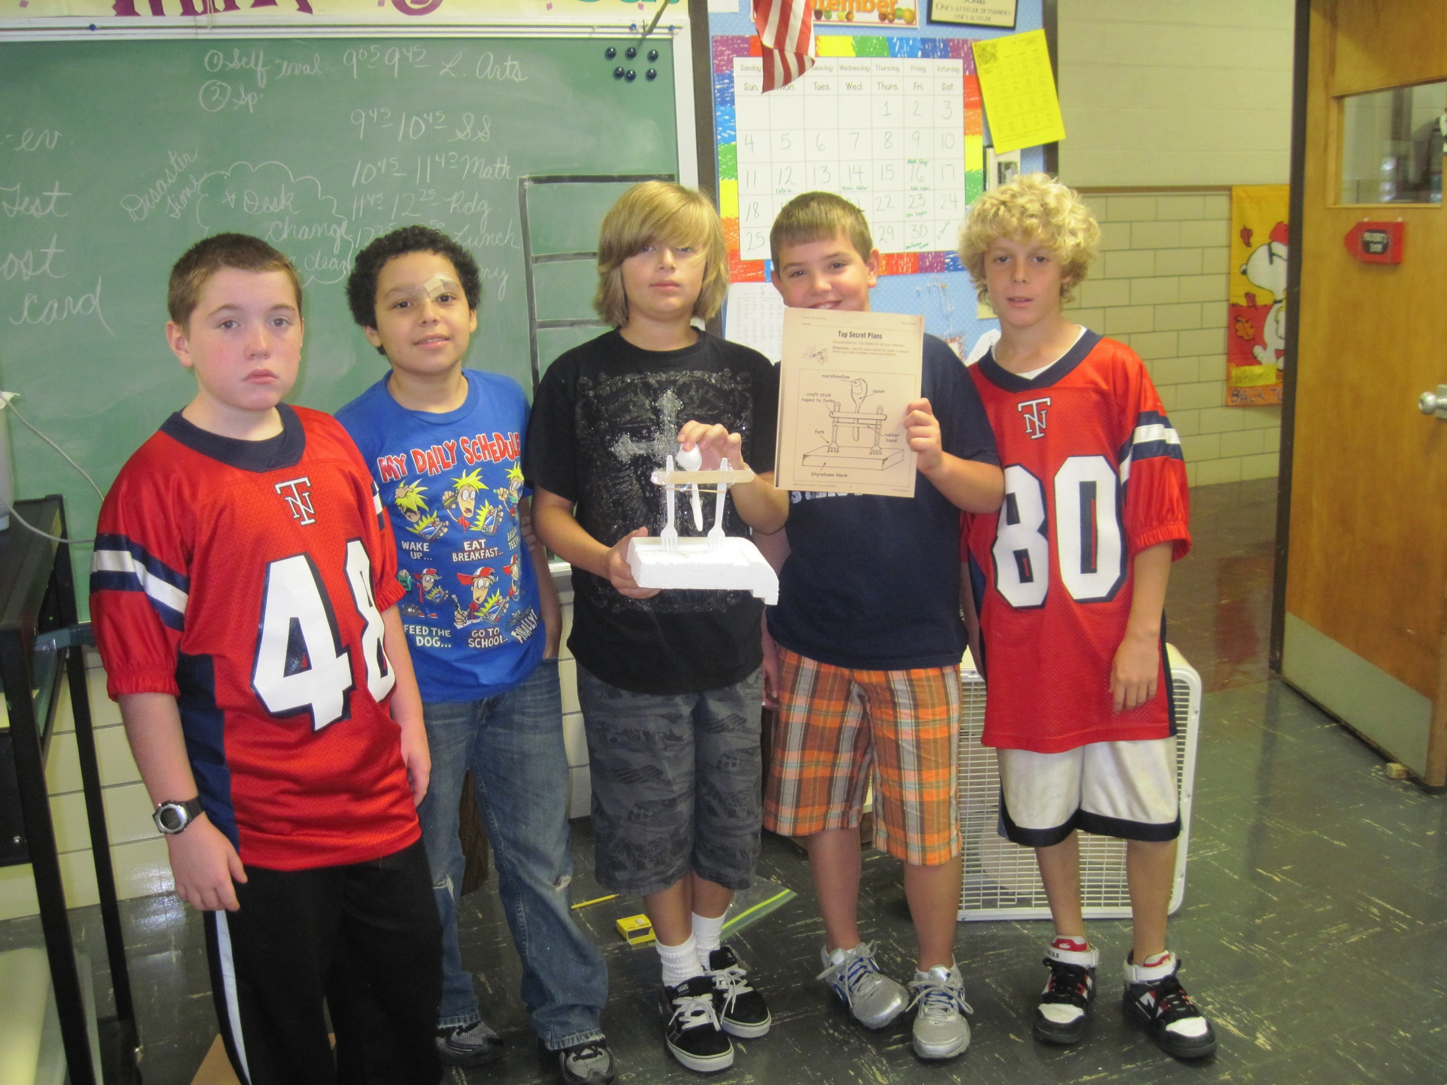
What is it?
A multi-age classroom of fifth and sixth graders
Average class size of 25 students
One classroom teacher
Two year program
Students who are considered to be:
High achievers
Highly motivated
Independent workers

Slide 3
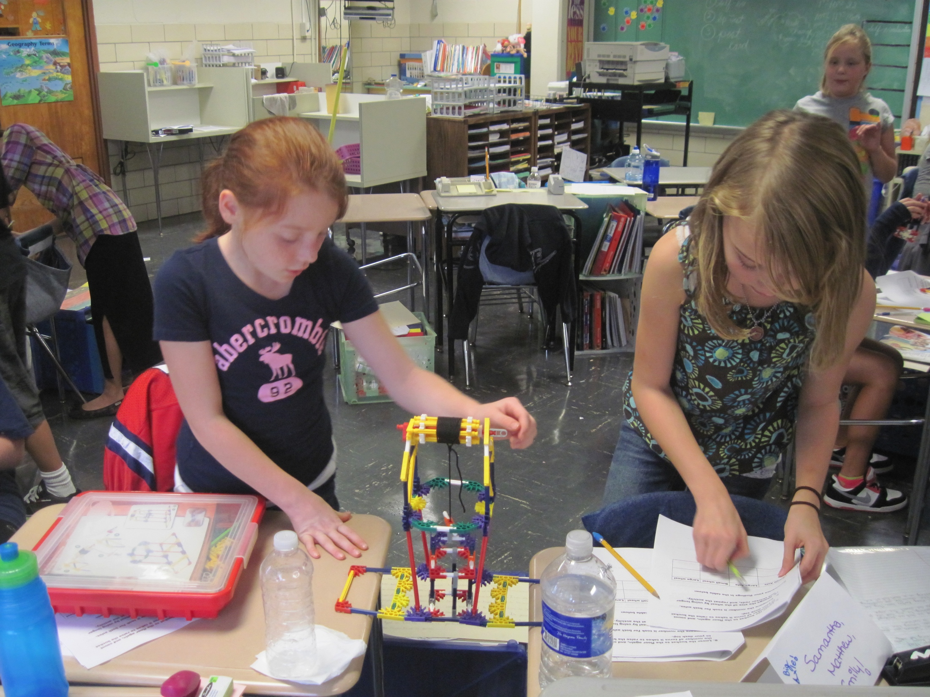
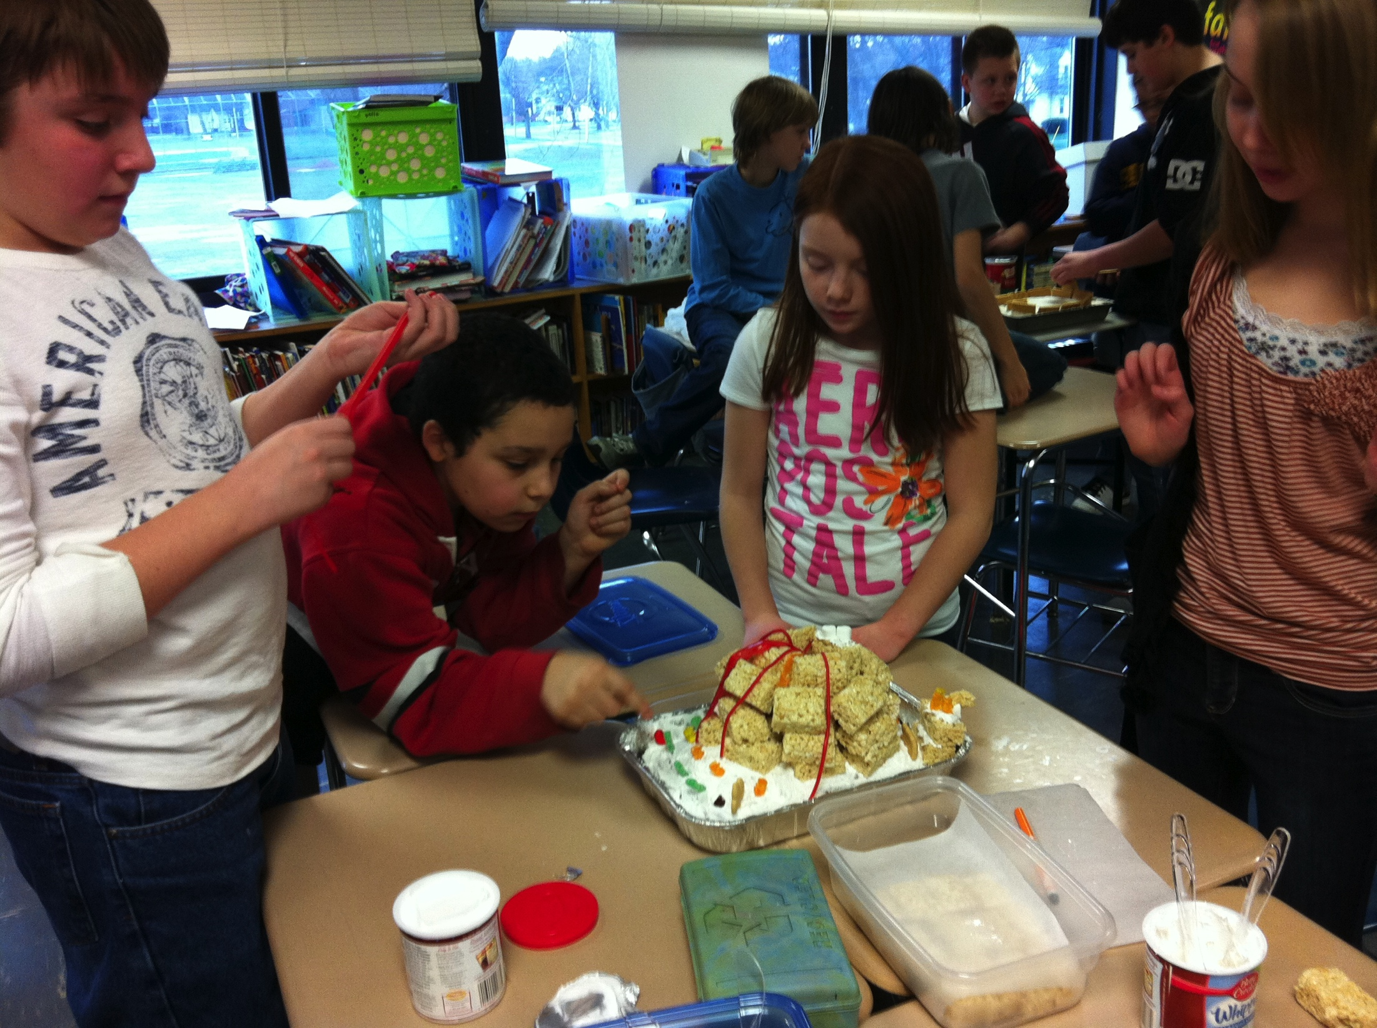
How was my child selected?
State test scores
Learning and Motivation Inventory
Effort grades

Slide 4
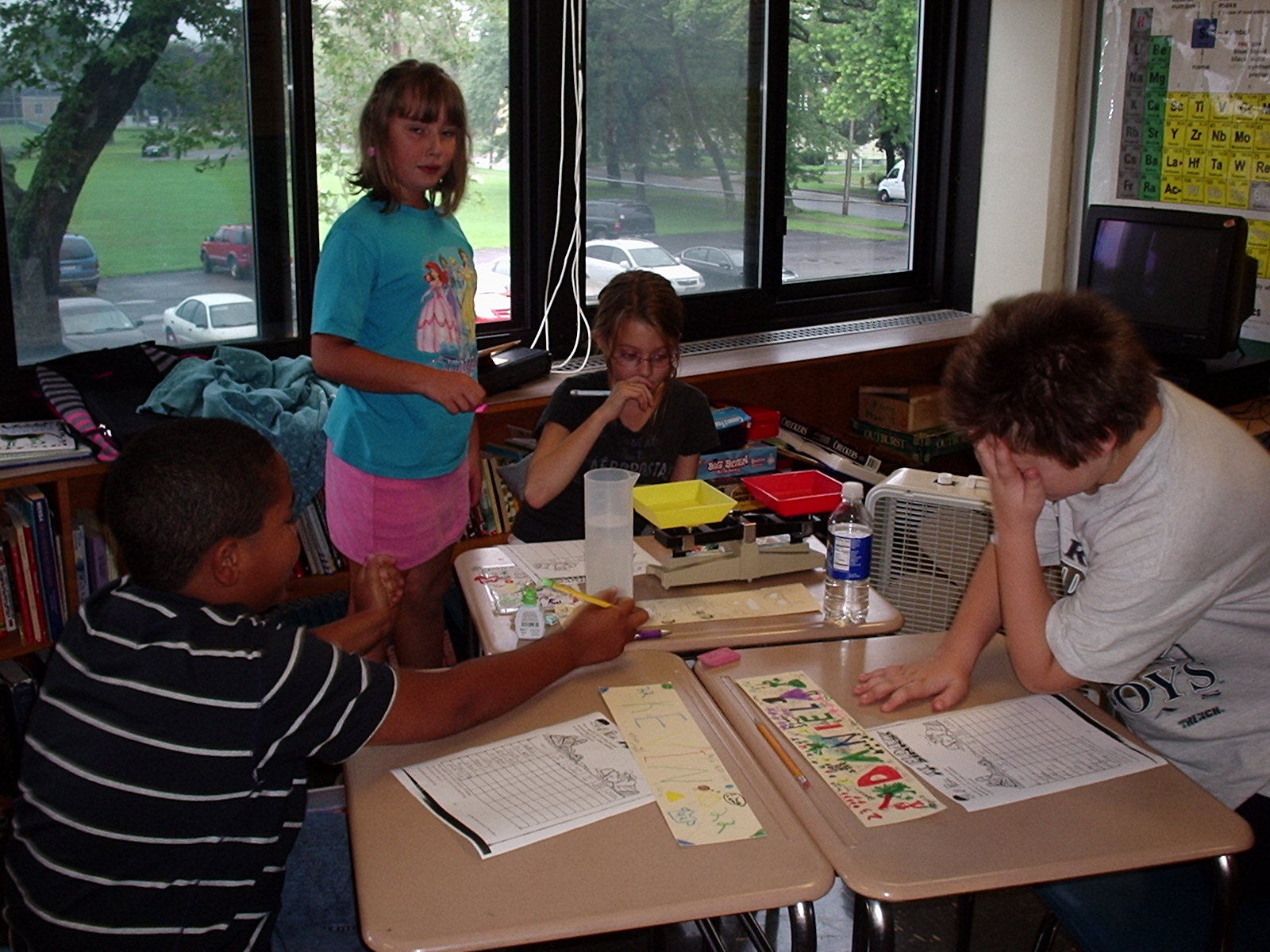
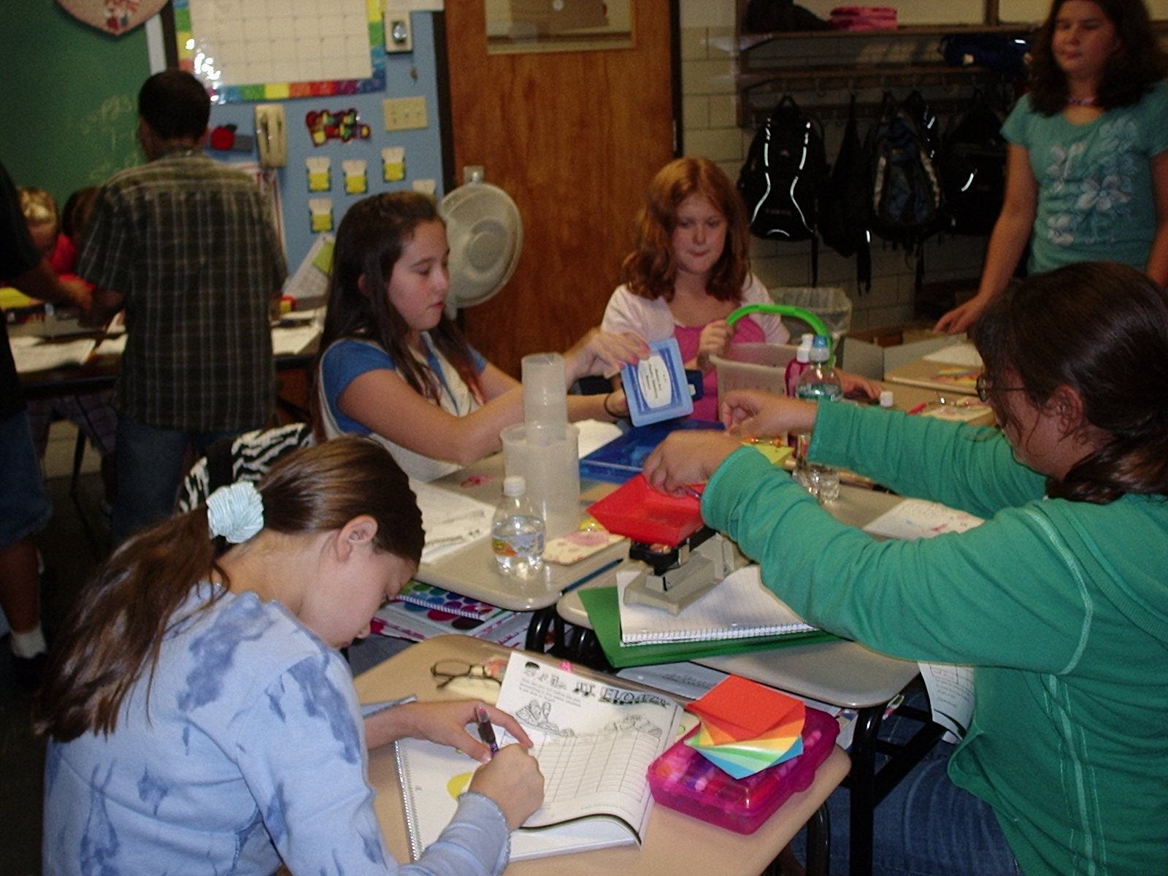
Why Consider Homogeneous Grouping?
In a typical classroom:
Rigid scope a sequence
Range of abilities
Most able will likely learn the least
Rigorous test preparation

Slide 5
What Can Happen to High Achievers in a Typical Classroom?
Jessie James Syndrome
When we steal time from kids
These students tend to get extra work, peer tutor, or sit there
Can work below potential
Can allow peer acceptance to overshadow achievement
Tend to resist challenges after receiving high praise with little or no effort
Can start to believe that easy means smart
May eventually have a difficult time rising to a challenge
Ceiling effect

Slide 6
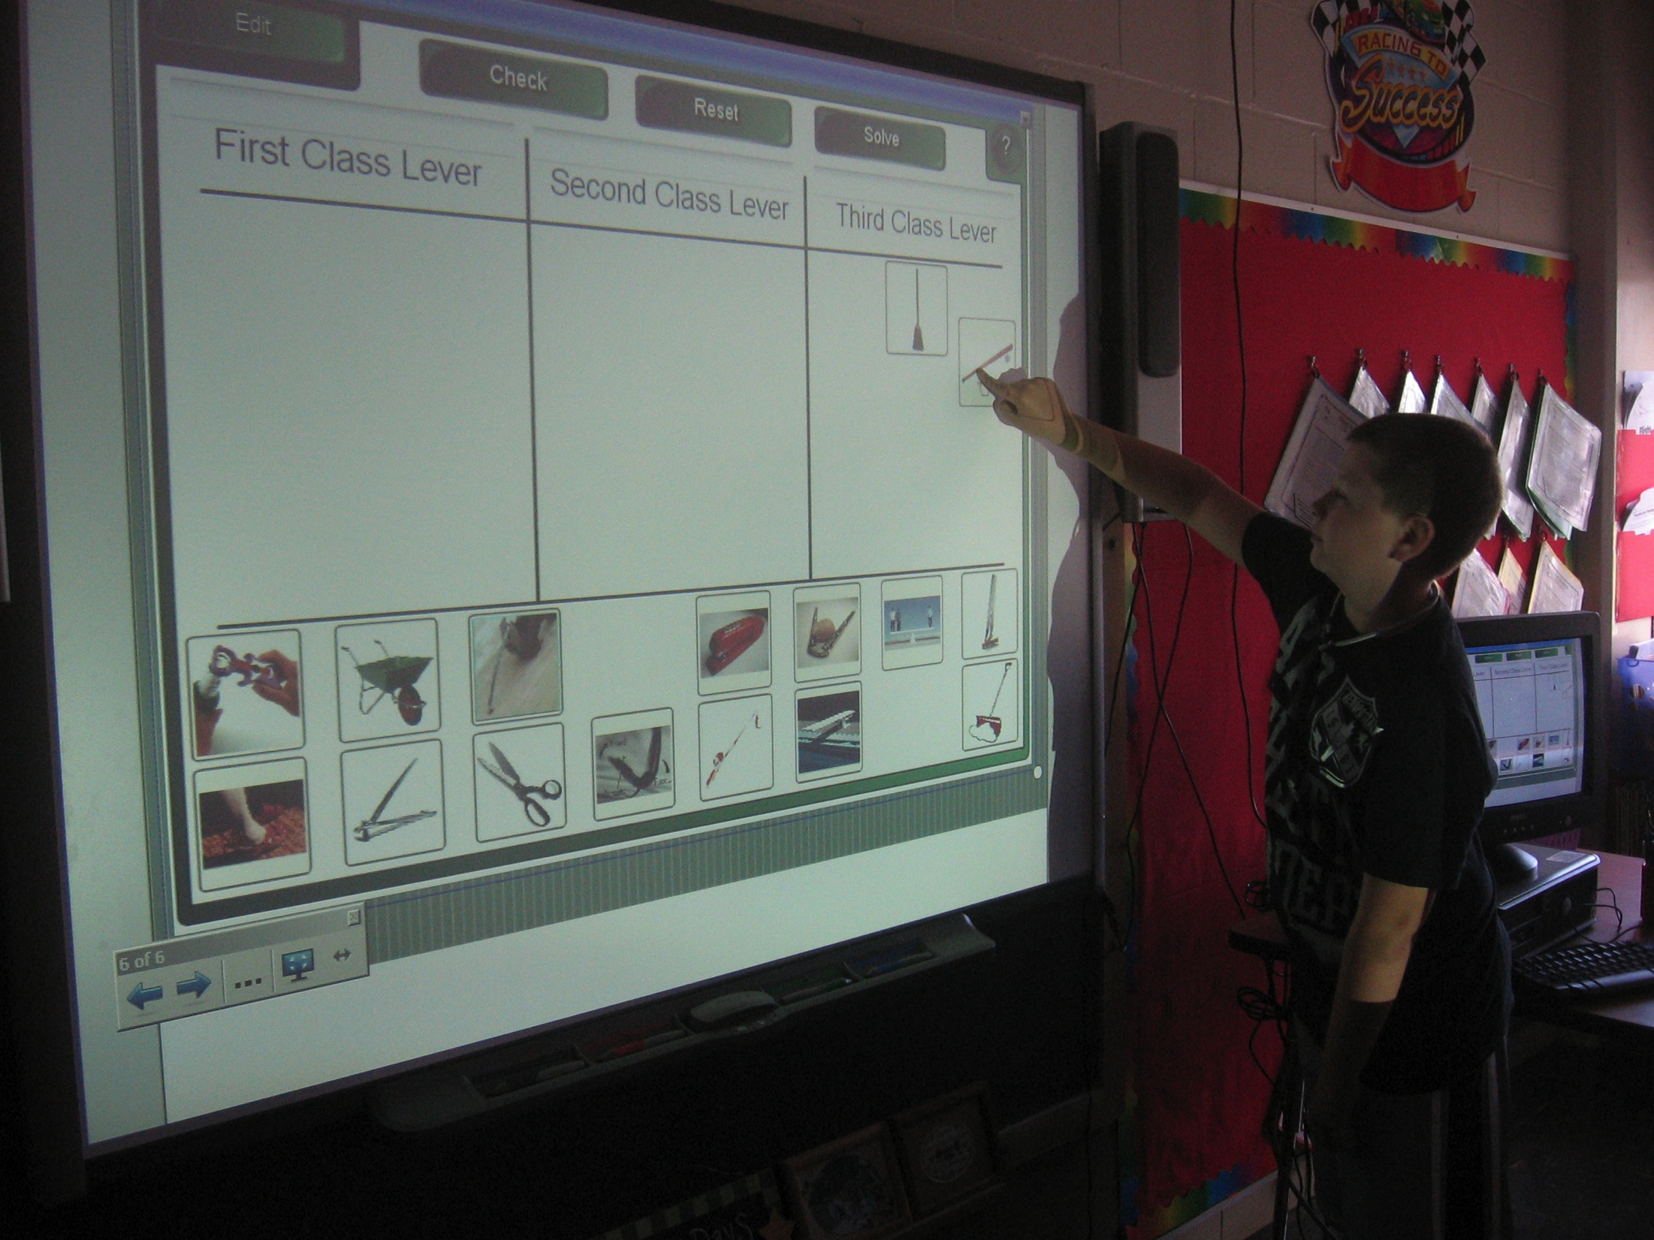
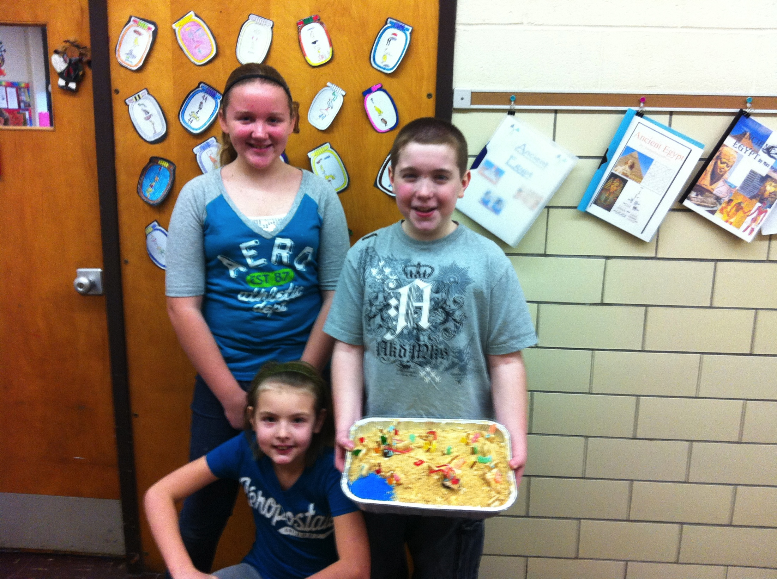
According to Dr. Sylvia Rimm:
“The surest path to high self-esteem is to be successful at something you perceived would be difficult. Each time we steal our students’ struggle by insisting they do work that is too easy for them, we steal their opportunity to have an esteem building experience. Unless kids are consistently engaged in challenging work, they will lose the motivation to work hard.”

Slide 7
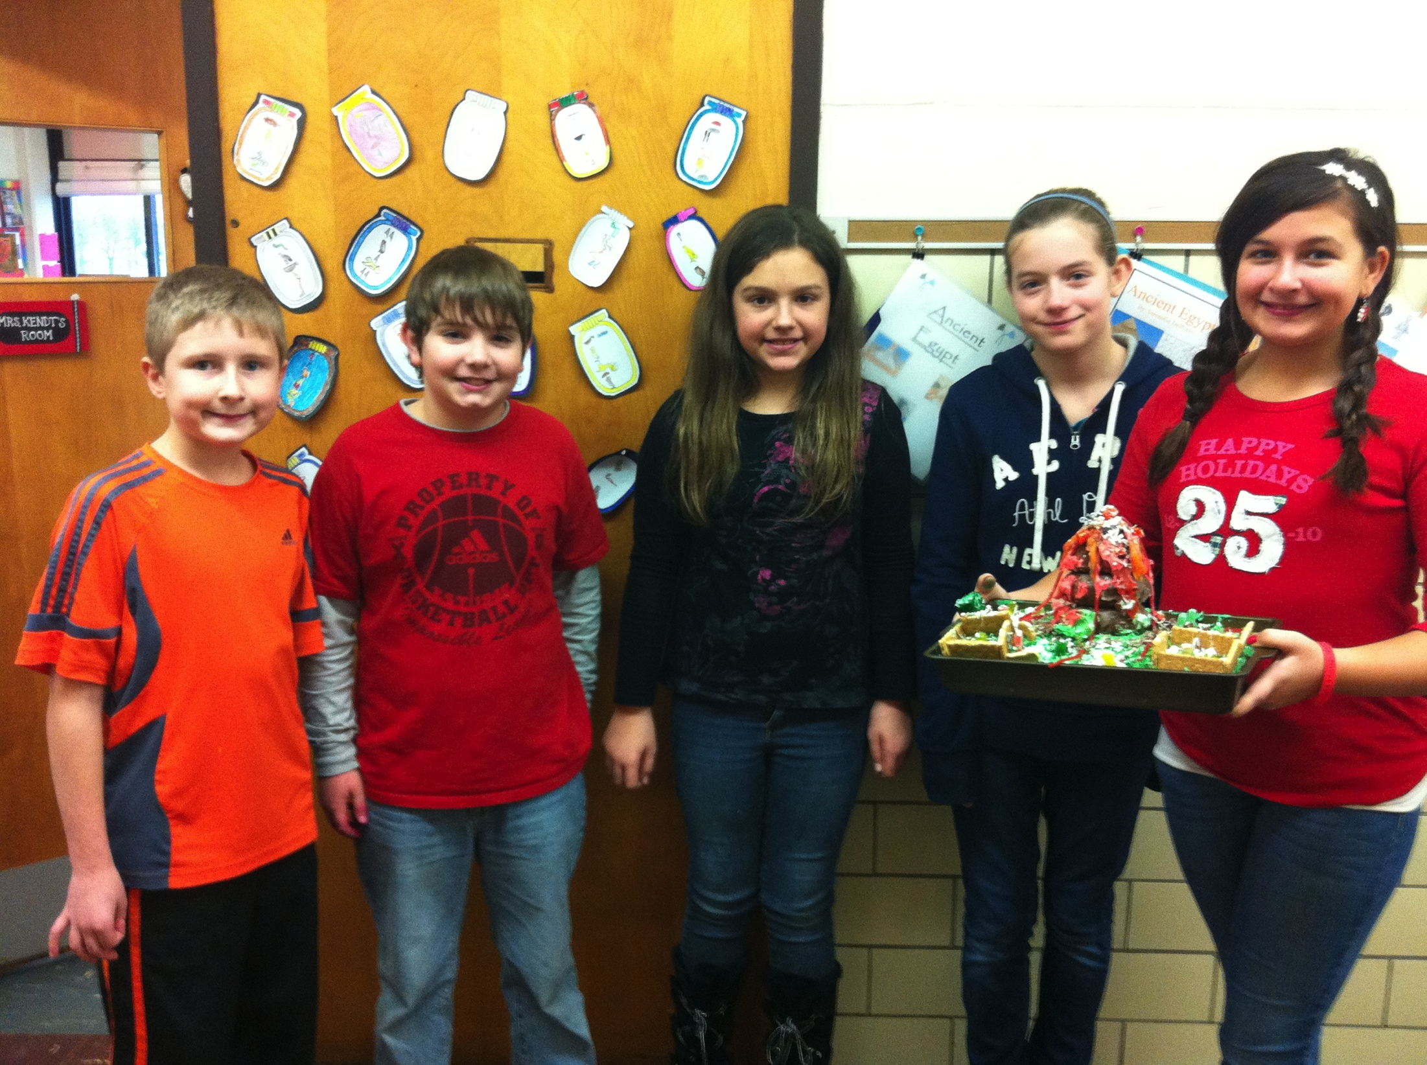
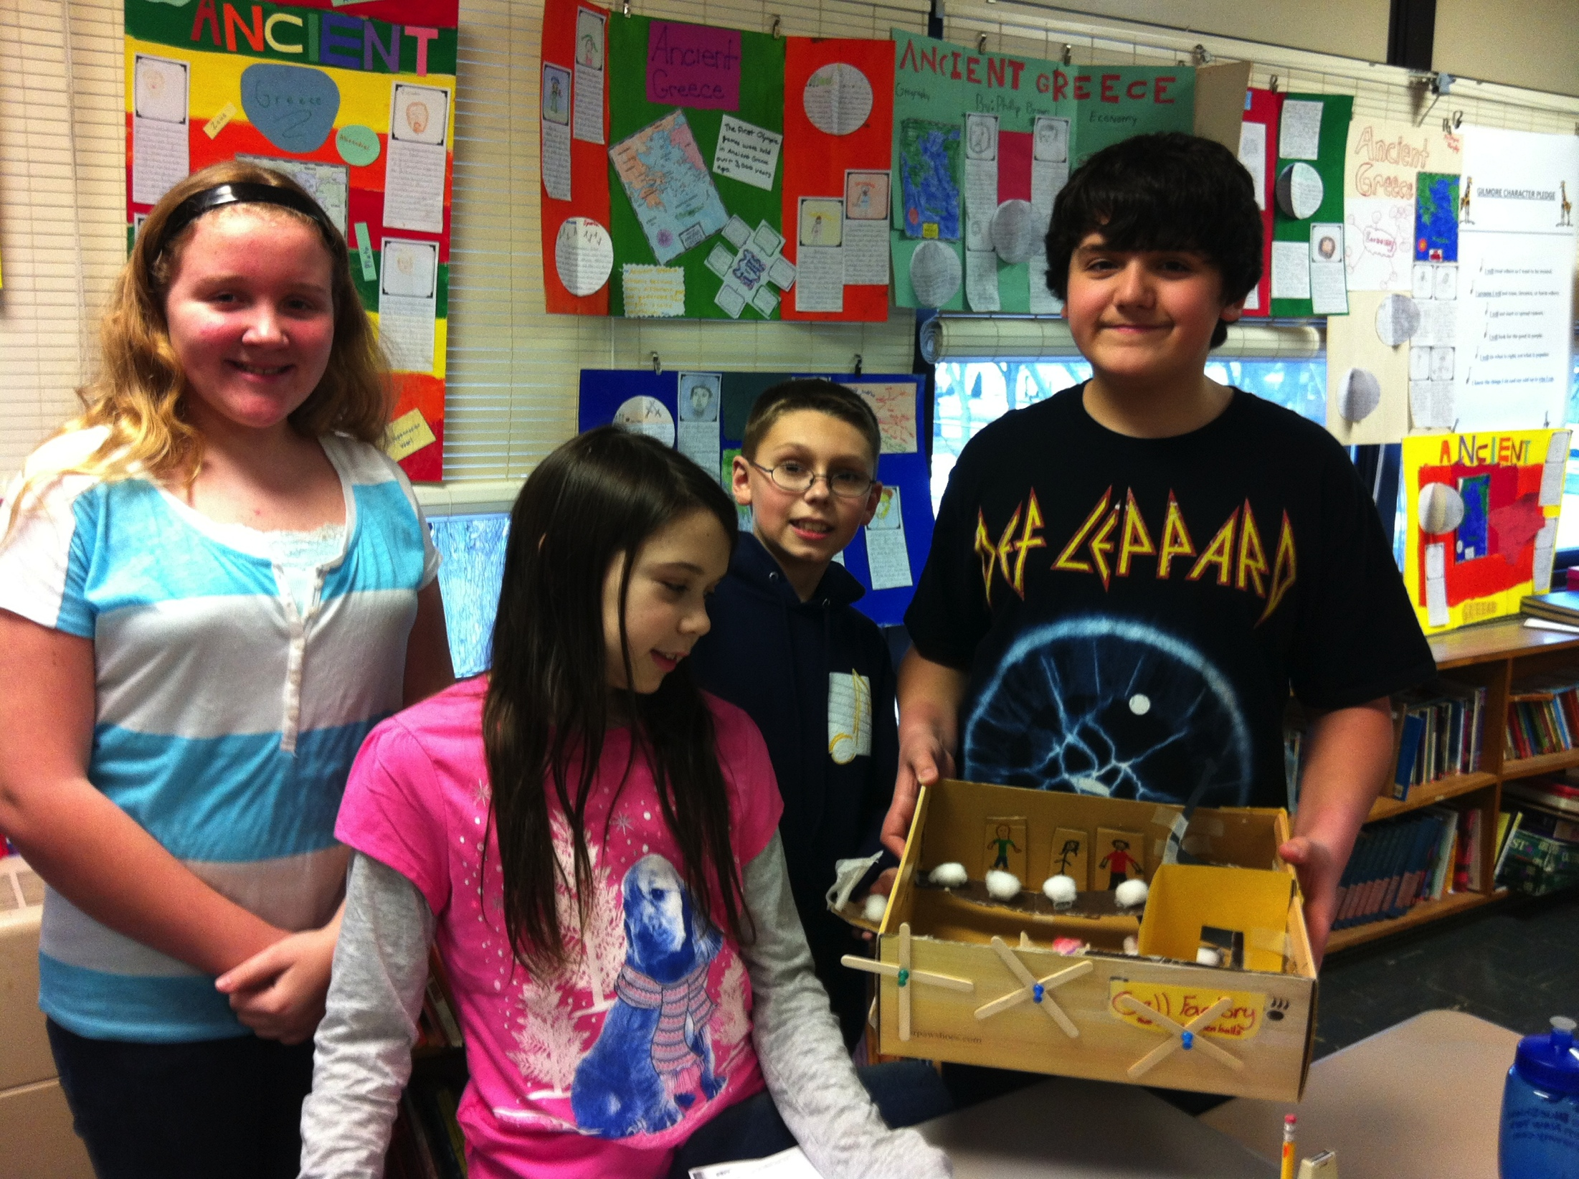
Based on Philosophy
Pros | Cons
Can be challenging and enriching | Can be considered exclusionary
Like a pre-AP class | Can be an adjustment
Stronger friendships can be formed | Can miss old school and friends

Slide 8
Based on the Research:
High achievers can be more appropriately challenged.
Students can receive more enrichment instruction.
Kulik & Kulik claim that high achievers grouped homogeneously gain more than their heterogeneous peers.
Stronger friendships are reported due to common interests.

Slide 9
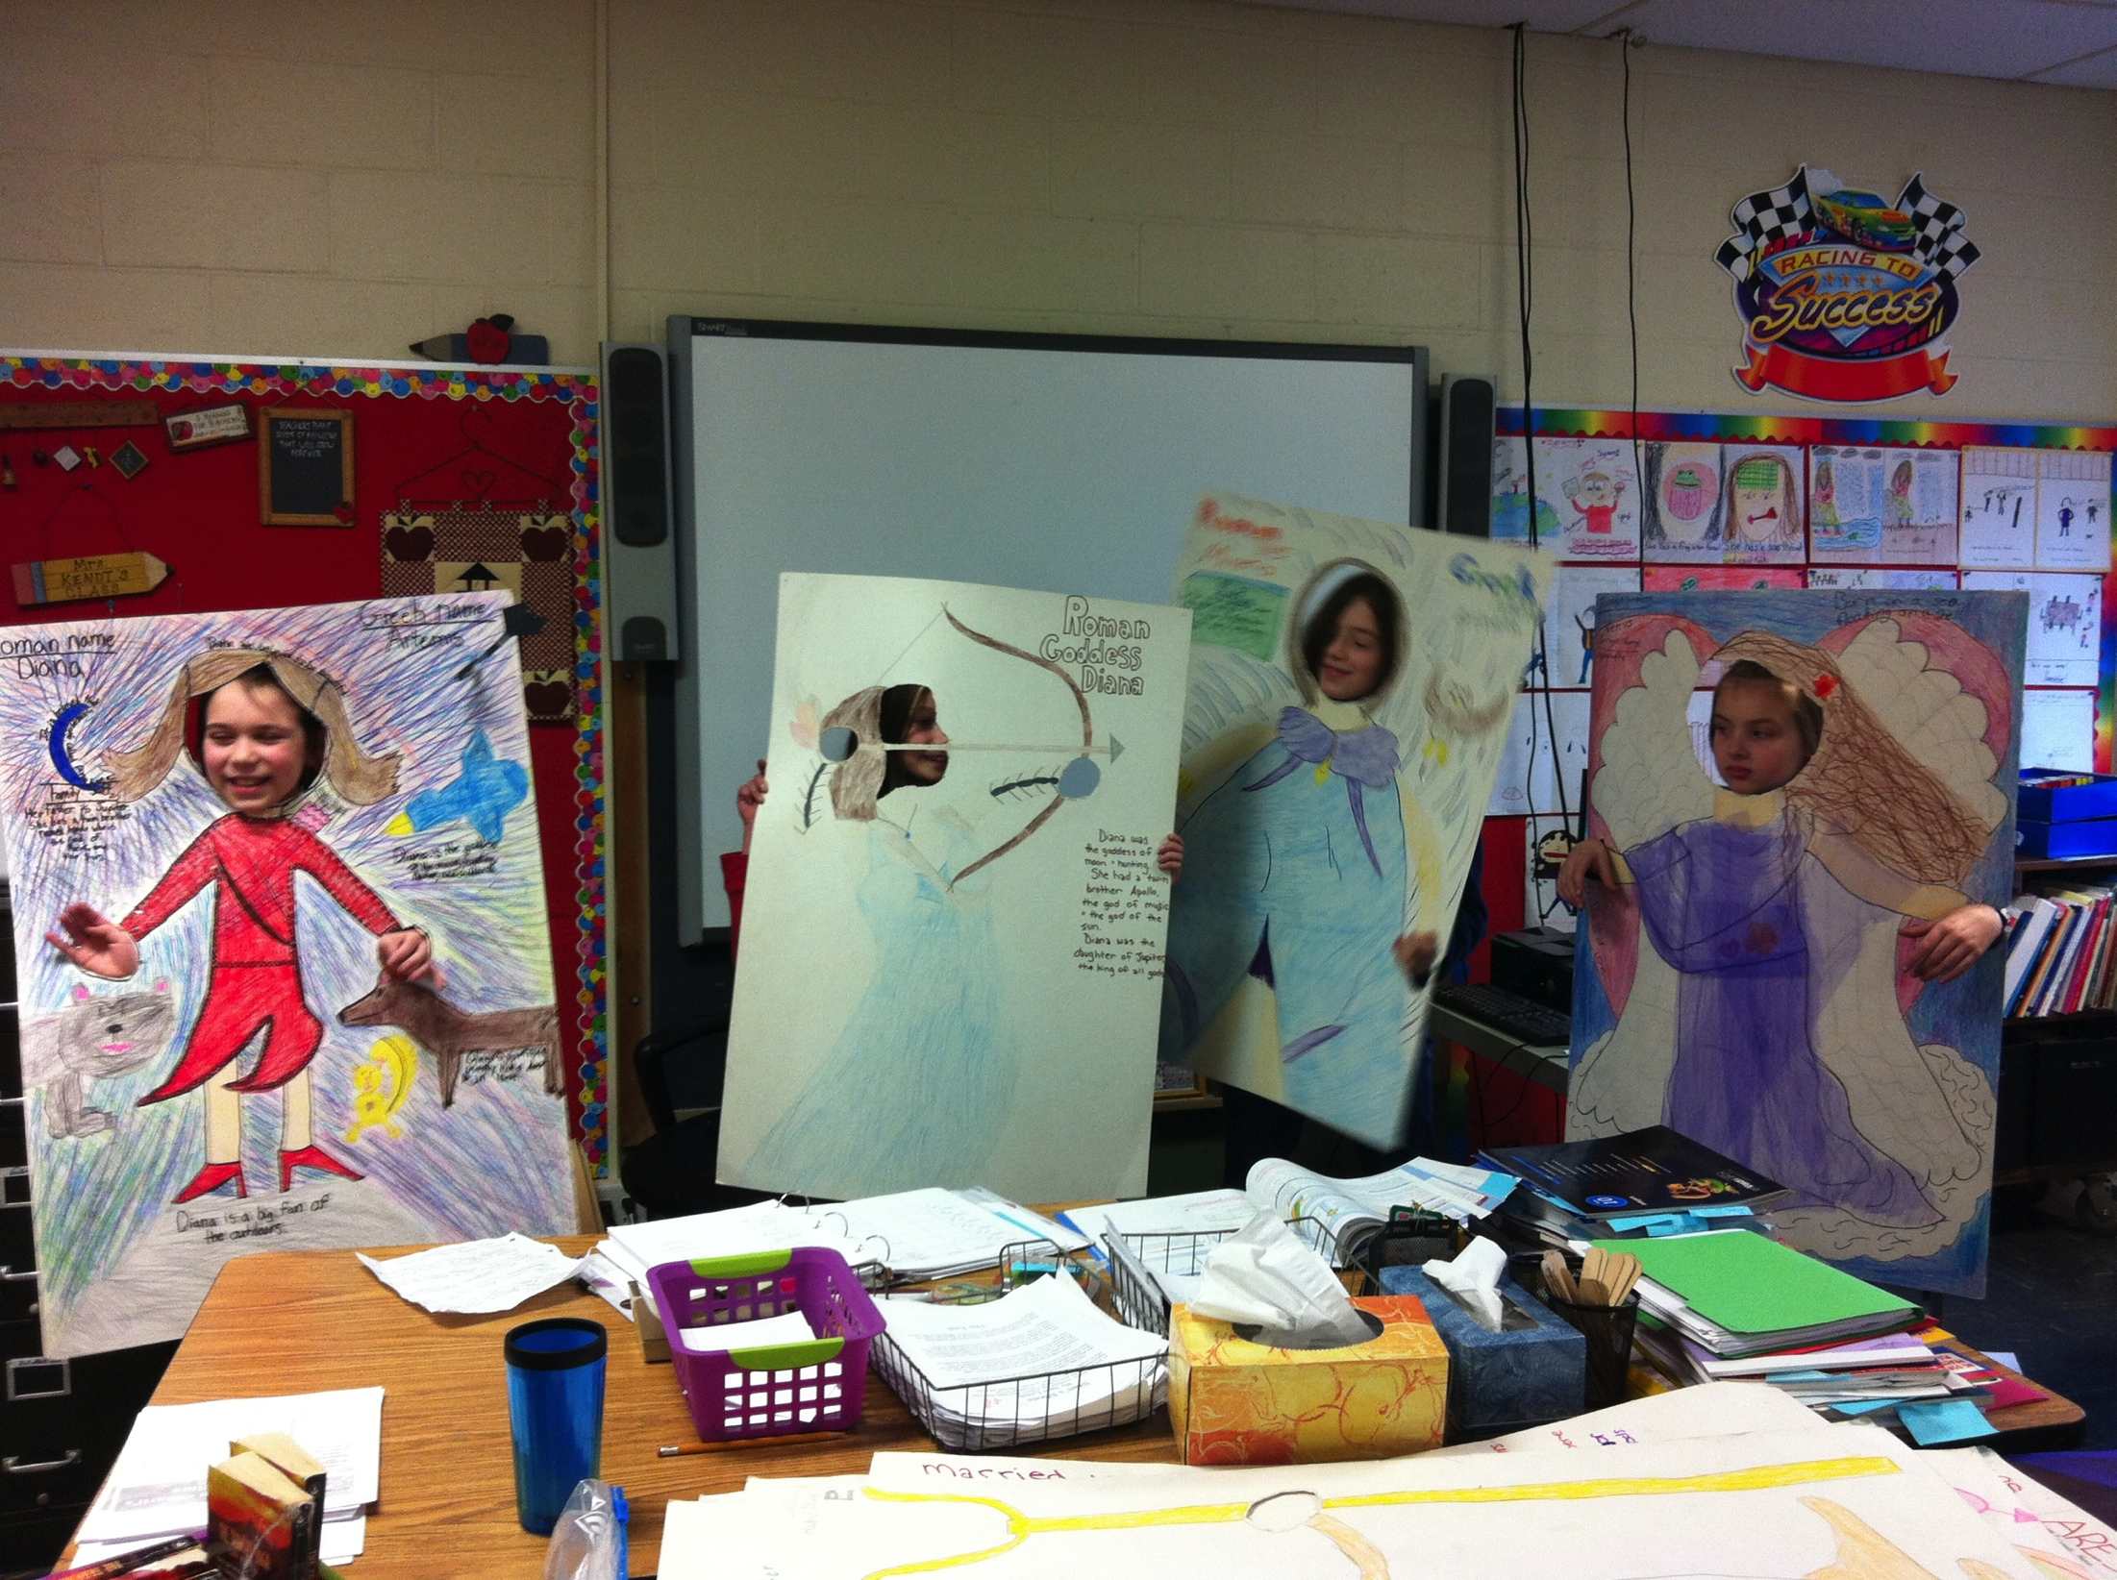
The Program
Compacts curriculum
Depth instead of breadth
Project work
Self-evaluation and goal setting
Use of rubrics to reduce ceiling effect
Curriculum is alternated
Math in small groups
Novels and literature circles

Slide 10
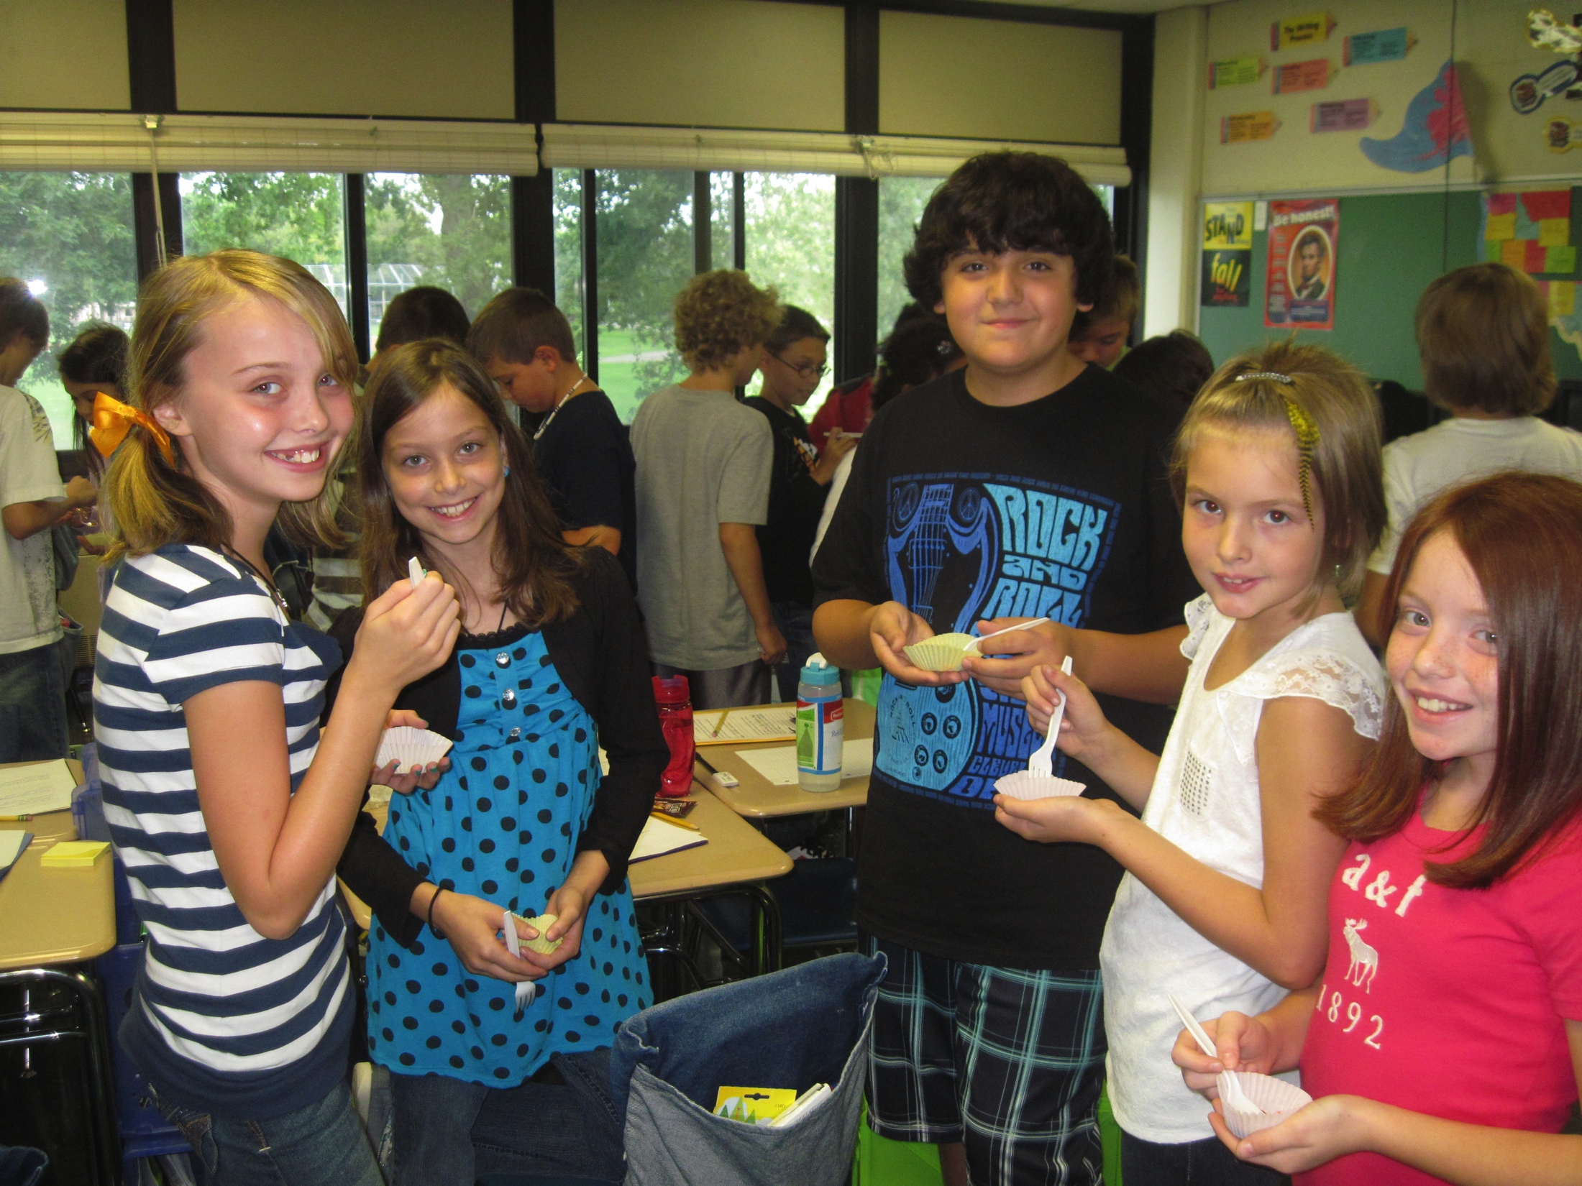
What to Expect
Missing the old school and friends
Either being overwhelmed with homework, or “not having enough.”
Transition in math grades
Feeling “stupid”
Struggling with listening and organization

Slide 11
What Eventually Happens
By October, the kids have adjusted and most report they love the classroom.
Strong friendships
Eventually the kids learn to ask questions and adjust to being “one of many.”
Feeling pride in more challenging work
Working more in depth

Slide 12
Commonly Asked Questions
Have longitudinal studies been done?
What do past students report?
What do past parents report?
What if we don’t like it, can we change our minds?
How will my child get to school?
What about specials and field trips?

