Slide 1
Moisture in the AIR

Slide 2
Humidity
The amount of water vapor actually present in the air is absolute humidity
Capacity – the amount of water vapor an air mass can hold
The comparison between the amount of moisture in the air to the air’s capacity is relative humidity

Slide 3
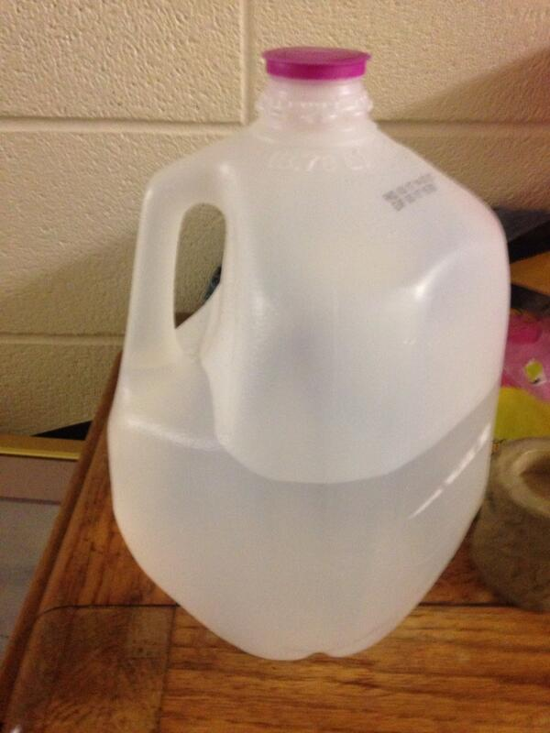
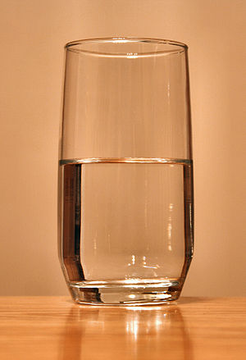

Slide 4
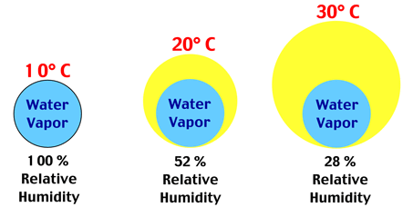
The capacity of air is directly related to the temperature

Slide 5
Relative humidity can be changed in two ways:
Change the amount of water vapor
Change the temperature
When air is filled to capacity it is Saturated

Slide 6
Dew point Temperature is the temp to which air needs to be cooled to reach saturation
As dew point temp and air temp come closer together relative humidity increases and precipitation probability increases

Slide 7
Psychrometer is used to find dew point and relative humidity

Slide 8
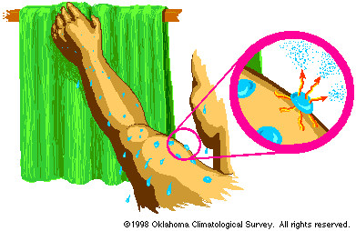
Evaporation is a cooling process

Slide 9
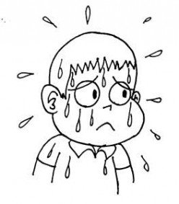
Why are humid days so uncomfortable?

Slide 10
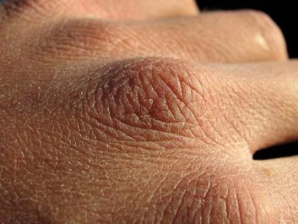
Why do your hands and lips dry out in the winter?

Slide 11
Why does the bathroom mirror get foggy during a hot shower?

Slide 12
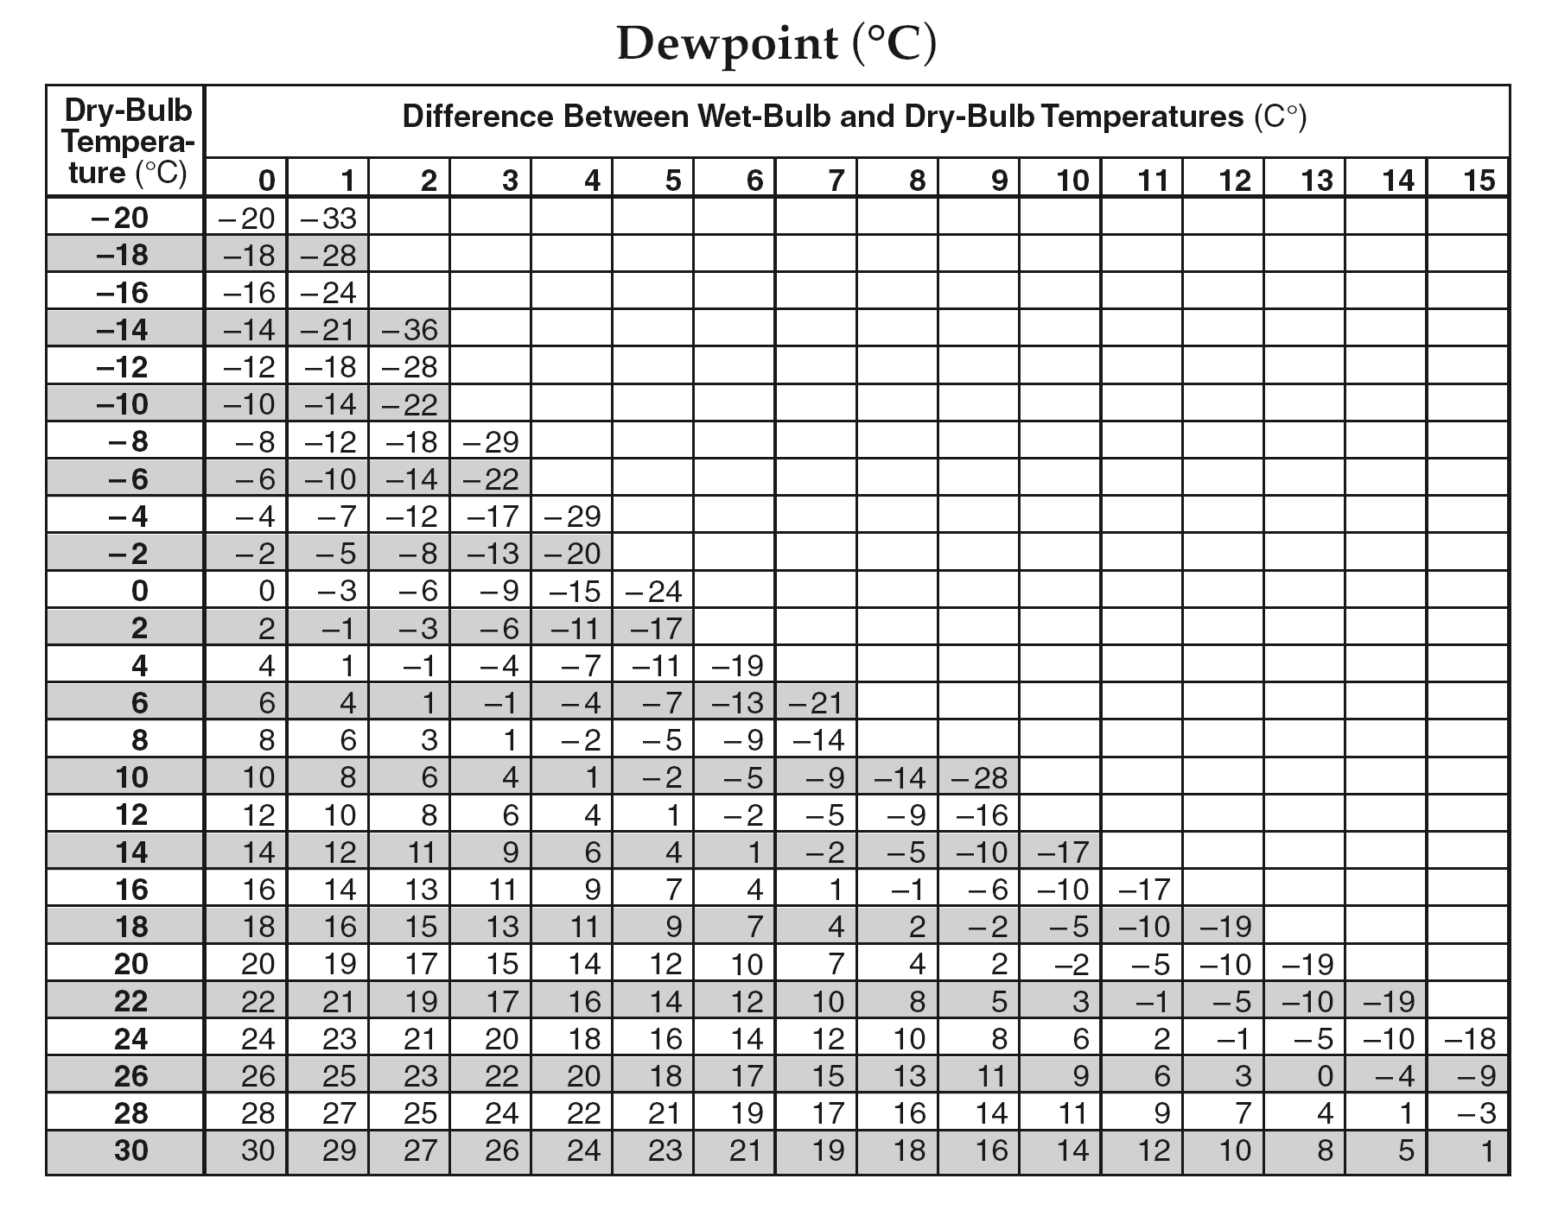

Slide 13
Determining DewPoint Temperature with Chart (ESRT 12)
Assume a dry-bulb temperature of 10ºC and a wet bulb temperature of 6ºC. The difference between these two readings is 4ºC. Follow these steps to find the dewpoint temperature
Locate the Dry-Bulb temperature reading at the left of the chart.
Locate the difference between the Wet-bulb and the dry-bulb temperature at the top of the chart.
Find the point where the horizontal line from the dry-bulb reading meets the vertical line from the difference between the wet and dry-bulb readings.

Slide 14
What about Relative Humidity?

Slide 15
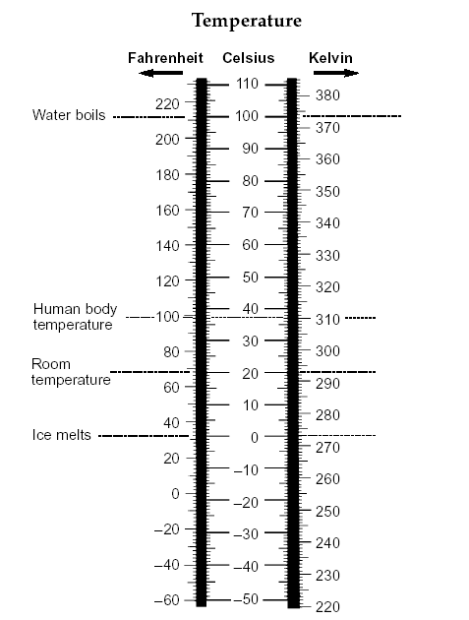

Slide 16
Temperature Conversion
Fill in the chart below using your Earth Science Reference Tables.
Fahrenheit (°F) | Celsius (°C) | Kelvin (K)
30
 | 30
 |  | 330
-1
272
86
303
135
57

Slide 17
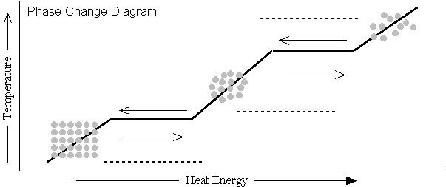
To change state energy must be either Absorbed or released
Latent Heat – hidden or stored energy
Gas
Condense
Evaporate
Freeze
Liquid
Melt
Solid

Slide 18
1. Melting
a. Solid changed to a liquid (Energy Absorbed)
b. Latent heat of melting - 334 j/g
2. Freezing
a. Liquid changed to a solid (Energy Released)
b. latent heat of fusion - 334 j/g

Slide 19
3. Evaporation
a. Liquid changed to a gas (Energy Absorbed)
b. Latent heat of vaporization - 2260 j/g
4. Condensation
a. Water vapor (gas) changed to a liquid (Energy Released)
b. latent heat of condensation - 2260 j/g

Slide 20
5. Sublimation
a. Solid changed directly to a gas
(ex: dry ice)
6. Deposition
a. Water vapor changed to a solid
(ex: freezer burn)

Slide 21
Properties of Water
Heat energy gained during melting . . . . . . . . 334 J/g
Heat energy released during freezing . . . . . . 334 J/g
Heat energy gained during vaporization . . . . 2260 J/g
Heat energy released during condensation . . 2260 J/g
Density at 3.98°C . . . . . . . . . . . . . . . . . . . 1.0 g/mL

Slide 22
Check the box which describes whether energy
is gained or lost for each process.
Process | Energy Gained | Energy Lost
Condensation
Evaporation
Melting
Solidification
Process | Joules Gained | Joules Lost
Condensation
Evaporation
Melting
Solidification
2260
2260
334
334

