Slide 1
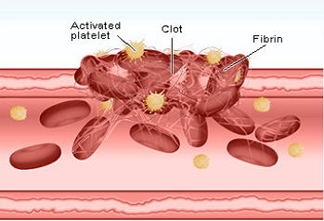
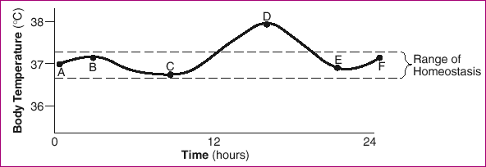
HOMEOSTASIS “homeo” = ___________ “stasis” = ____________
The components of the human __________, from cell organelles through
organ systems, _______________ to maintain a balanced ______________
internal environment called HOMEOSTASIS.
For example, when you ______ yourself (a deviation from
normal), the _____________ in the blood become sticky
and a _______ forms (a corrective action). You no longer
bleed and homeostasis is _______________.
DYNAMIC EQUILIBRIUM
Human body systems must _________ and
respond to changes. Conditions are
______________ (changing) and yet
homeostasis must be restored to keep the
body at __________________ (balance).
same
state
body
interact
healthy
cut
platelets
clot
restored
detect
dynamic
equilibrium

Slide 2
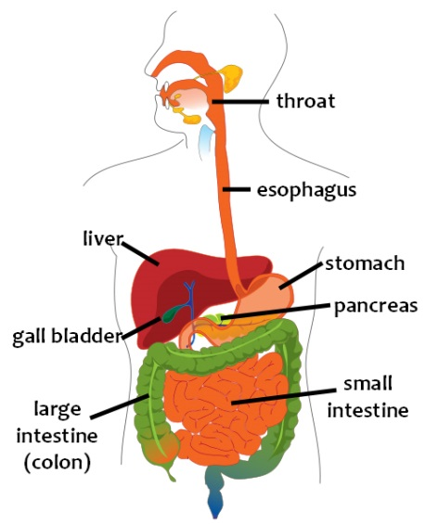
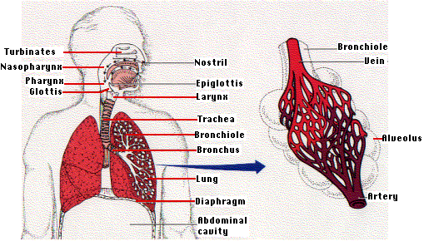
HUMAN BODY SYSTEMS
(1) DIGESTIVE SYSTEM
A. Breaks down _______ into molecules that are
________ enough to enter the _______
B. Nutrients are _____________ into the ________ in the
small intestine
C. Disorders include diarrhea, _________________, & ulcers
(2) RESPIRATORY SYSTEM
A. Exchange of ____________ and carbon dioxide between
the air and the ________
B. The _____________ muscle causes the lungs to inflate
C. Disorders include emphysema and _______________
food
small
cells
absorbed
blood
constipation
oxygen
blood
diaphragm
asthma

Slide 3
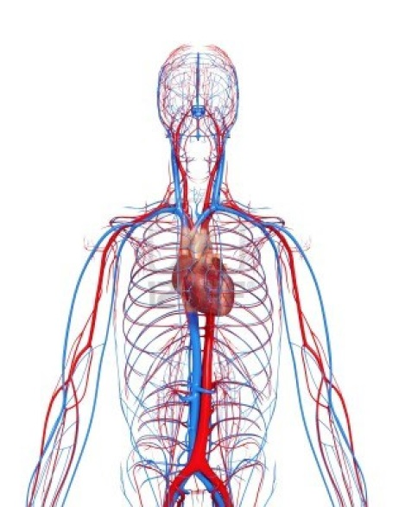
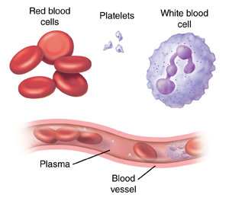
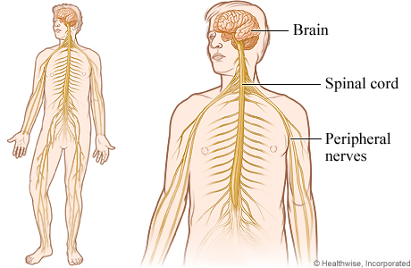
(3) CIRCULATORY SYSTEM
A. Transport system to take ____________ and
Carry oxygen Clot Fight disease nutrients to the _________, and to take
__________ like CO₂ away from the cells
B. You can feel a __________ in your ____________
as your heart contracts
C. Disorders include high blood _____________ and
heart attack
(4) NERVOUS SYSTEM
A. Coordination and ___________ of messages
between the __________ and the body
B. Composed of the brain, __________ cord, and
___________ to the body
C. Disorders include ____________ and meningitis
oxygen
cells
wastes
pulse
arteries
pressure
relay
brain
spinal
nerves
stroke

Slide 4
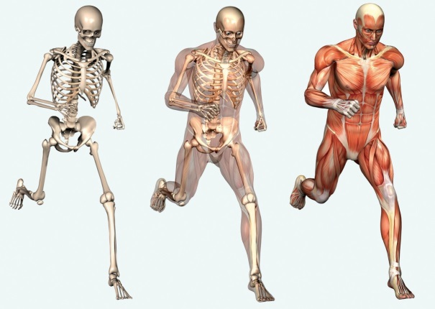
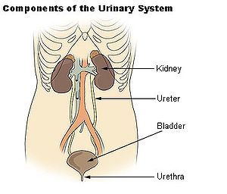
(5) LOCOMOTION
A. Allows for ______________ from place to place
B. Bones provide _______________ and attachment points for tendons and ________________
C. Disorders include arthritis and broken ________
(6) EXCRETION
A. Removal of ____________ made by cells
B. The ____________ filter the blood and make __________
C. Disorders include kidney stones and ____________
infections
movement
protection
ligaments
bones
wastes
kidneys
urine
bladder

Slide 5
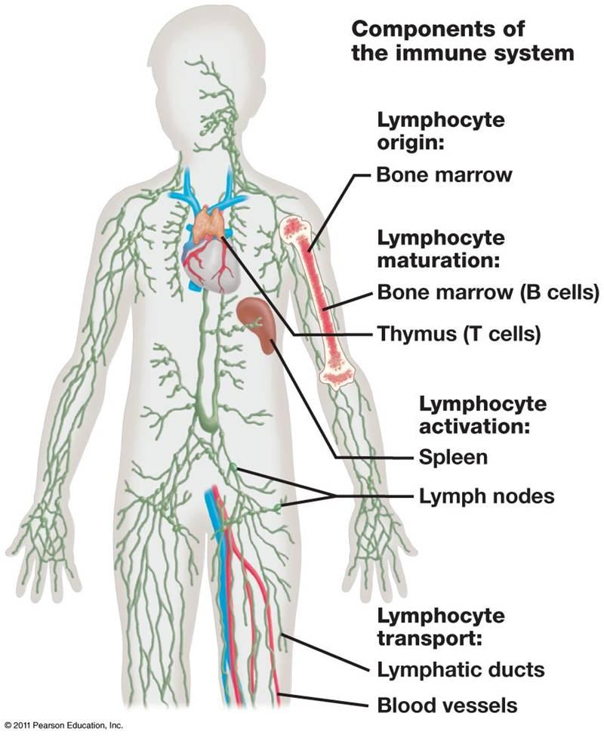
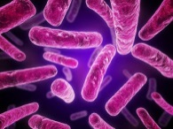
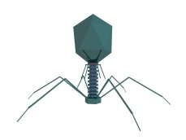
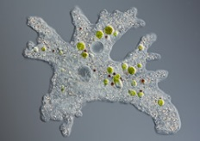
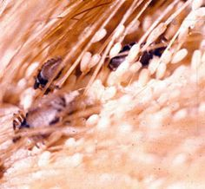
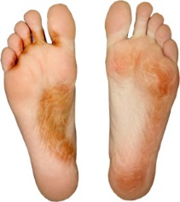
(7) IMMUNE SYSTEM
PROTECTS AGAINST ________________ (disease causing agents) and ____________ cells
5 TYPES OF PATHOGENS:
_____________* Ex. Strep Throat
_____________* Ex. _______
_____________* Ex. Ameba
_____________ Ex. _______
_____________ Ex. Athlete’s Foot
* ___________
(microscopic)
pathogens
cancer
bacteria
viruses
flu
protists
parasites
lice
fungus
microbes

Slide 6
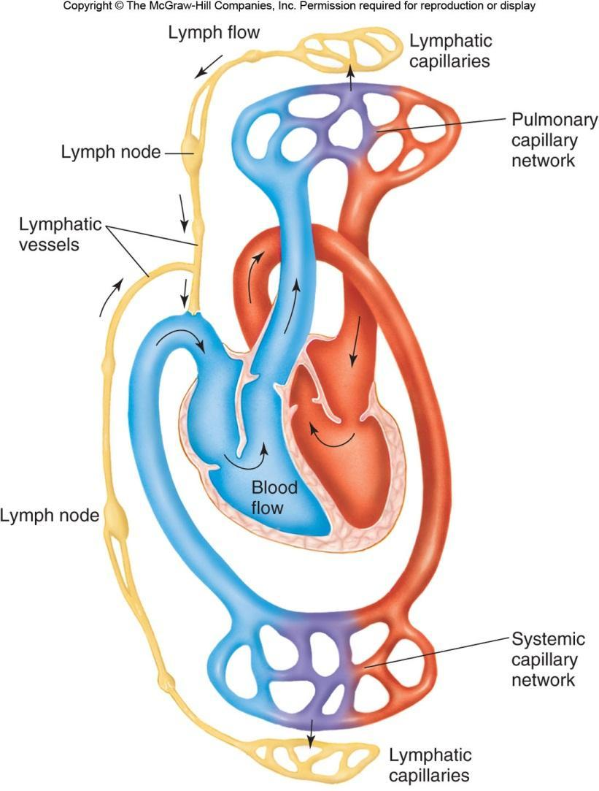
WHAT IS LYMPH?
Lymph is blood ___________ that
leaks out of blood vessels enters
_________ vessels.
As the lymph flows through a
lymph ________ white blood cells
destroy any _______________.
When you are _________ your
lymph nodes swell as the white
blood cells ____________ to kill
off the disease.
The cleaned lymph then re-enters
your circulatory ____________ just
above your heart.
plasma
lymph
vessel
pathogens
sick
multiply
system

Slide 7
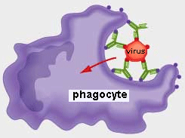
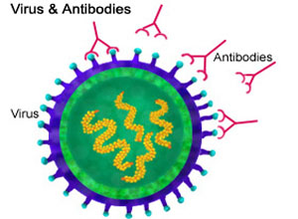
IMMUNE RESPONSE
In the immune response, the white blood cells (_______) multiply and fight ____________
Antigens are _____________ substances including pathogens, bee stings,
__________ and organ transplants.
4 STEPS:
(1) (2) (4)
An antigen enters Your lymphocytes (a type A phagocytic WBC engulfs and
the body. Ex. _____ of _____) recognize the ____________ the antigen, but
(Antigen = bad guy) antigen as __________ releases the ________________
and make antibodies to
trap it (Antibody = good guy)
(3)
TTh The antigen is now __________
and is harmless.
(Bad guy is in _____________)
WBC’s
antigens
foreign
venom
Flu
WBC
destroys
foreign
antibody
trapped
“handcuffs”

Slide 8
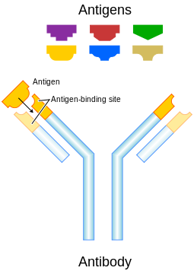
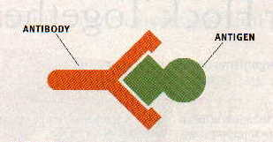
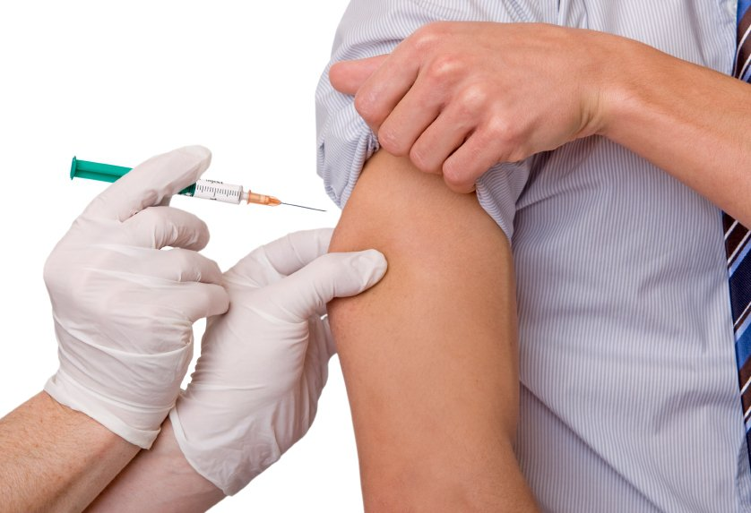
shape
Each ANTIBODY binds with one _____________ ANTIGEN based on its __________.
For ex. the chicken pox antibody only bonds with _______________ antigen.
This flu vaccine contains
weakened flu _________
VACCINATIONS - Vaccines contain _____________
or dead antigens to cause your body to build
up an army of ________________ in case
you get infected with the real disease.
specific
chicken pox
virus
weakened
antibodies

Slide 9
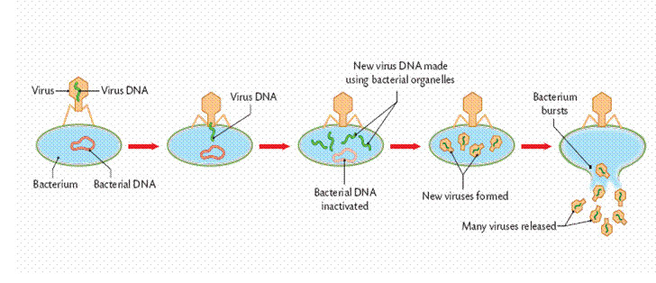
VIRUSES
Viruses are the cause of the common ________, measles, ________, and other diseases.
Although viruses come in a variety of shapes, all viruses are composed of ________
surrounded by a ____________ coat.
HOW A VIRUS REPRODUCES:
The virus attaches to the _______ cell
and pumps in its ________.
Then the host cell begins reading the
DNA and making _________ of the virus.
Eventually the cell bursts ________, releasing all the virus particles which go to _____________ other cells.
HIV Virus, which causes __________, damages the ____________________ and the
immune system, making the person __________ to fight off other pathogens.
Then other illnesses, such as the _______ can be deadly.
cold
AIDS
DNA
protein
host
DNA
copies
open
infect
AIDS
white blood cells
unable
flu

Slide 10
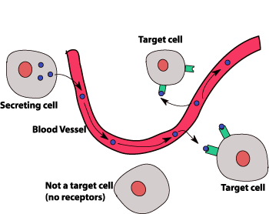
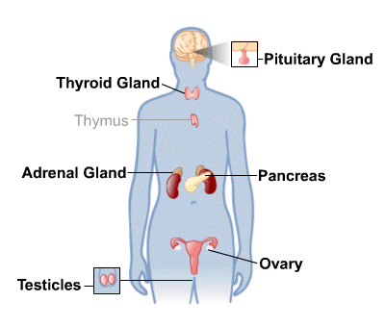
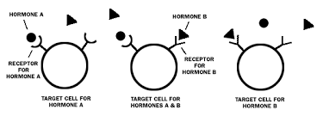
ENDOCRINE SYSTEM
A system of _________ that make and release ________________ (chemical messengers)
into the blood. The hormones then travel in the blood to ____________ cells. Each
hormone has a specific _________ that binds with the protein ________________ of
specific cells, telling the cell what to do.
Ex. Pituitary Gland – Makes ___________ hormone that tells the bones & muscles to ______
Ex. Adrenal Gland – Makes ______________ for the “Fight or ___________” response
Ex. Pancreas - Makes ____________ to tell the cells to let in glucose
glands
hormones
target
shape
receptor
growth
grow
adrenalin
flight
insulin

Slide 11
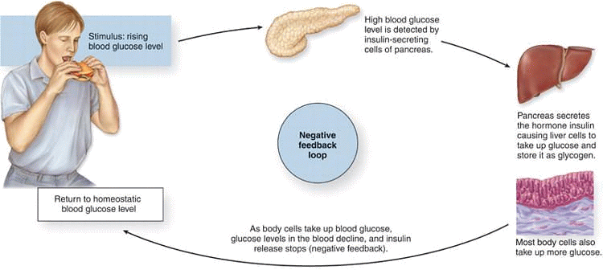
HUMANS & DISEASES - Homeostasis in humans is constantly threatened.
Failure to ______________ to changes can
result in ____________ or death
FEEDBACK (CONTROL) MECHANISMS attempt to maintain __________________ by responding to changes.
Ex. Blood Sugar & Insulin
respond
disease
homeostasis

Slide 12
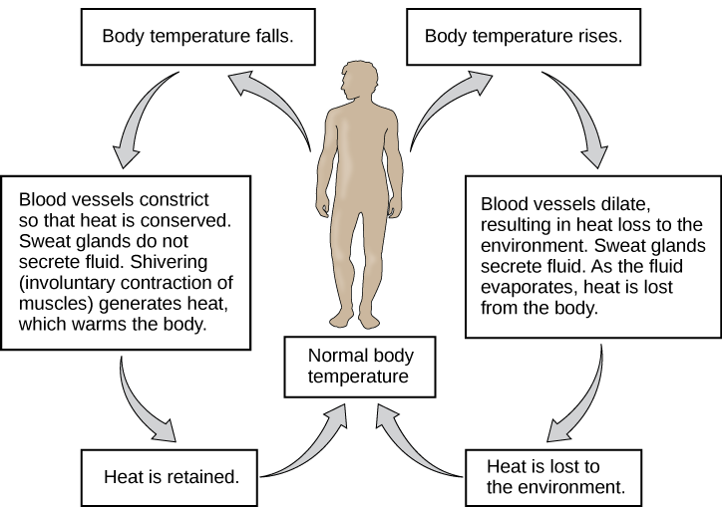
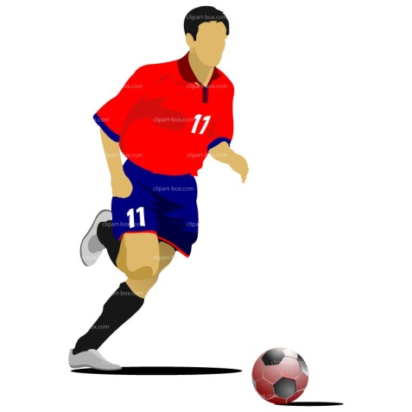
Ex. Body Temperature
Ex. Exercise
When you exercise your muscle cells need more
____________ so your heart ________ and
breathing rate ______________ to deliver more O₂
oxygen
rate
increase

Slide 13
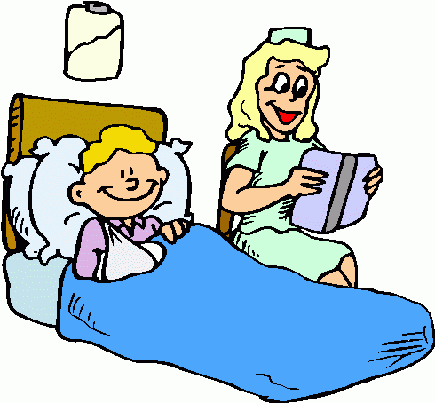
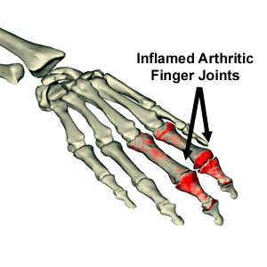
DISEASES & DISORDERS
Diseases and disorders have many _____________ including the following:
causes
Cause | Disease/Disorder
Inheritance | ___________________
__________________________ | Mental retardation in unborn babies
Poor nutrition | _________________ ____________
_________________________ | Kidney Failure, Heart Failure
Down syndrome
Alcohol
Obesity
Diabetes
Organ malfunction
immune
ALLERGIES – Allergies are when a person’s ____________ system responds to
usually _______________ substances such as pollen or peanuts
AUTOIMMUNE DISEASES – This is when the body ____________ its own cells.
Ex. Crohn’s disease, rheumatoid _______________
harmless
attacks
arthritis

