Slide 1
Chapter 7 PERIODIC TRENDS

Slide 2
Ionization energy (IE)
The amount of energy required to remove the most loosely bound electron, the valence electron, of an isolated gaseous atom to form a cation.
X_{(g)} X⁺ _{(g)} + e⁻
First ionization energy- Increases from left to right across a period; decreases going down a group.
2

Slide 3
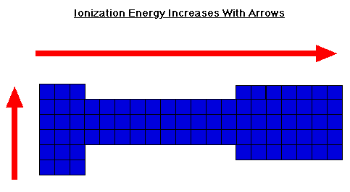

Slide 4
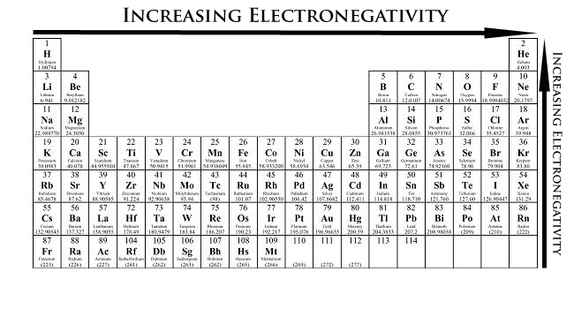
Electronegativity
A measure of the tendency of an atom to attract a bonding pair of electrons.
The Pauling scale is the most commonly used.
Fluorine (the most electronegative element) is assigned a value of 4.0, and values range down to cesium and francium which are the least electronegative at 0.7.

Slide 5
Electron Affinity
The energy change associated with the addition of an electron to a gaseous atom.
X(g) + e⁻ → X⁻(g)
These values tend to be exothermic (energy released). Adding an electron to an atom causes it to give off energy. So, the value for electron affinity will carry a negative sign.
5

Slide 6
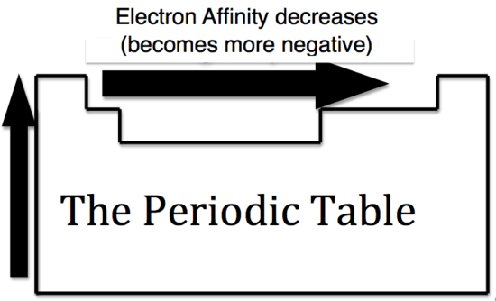
A more negative electron affinity corresponds to a greater attraction for an electron

Slide 7
Electron Affinity becomes more exothermic as you go from left to right across a row
The greater the attraction between an atom and an added electron, the more negative the atom’s electron affinity will be.

Slide 9
Atomic Radius
Decrease going from left to right across a period. This decrease can be explained in terms of the increasing positive nuclear in going from left to right. The valence electron are drawn closer to the nucleus, decreasing the size of the atom.
Increase going down a group, because of the increase in orbital sizes in successive principal quantum levels.
9

Slide 10
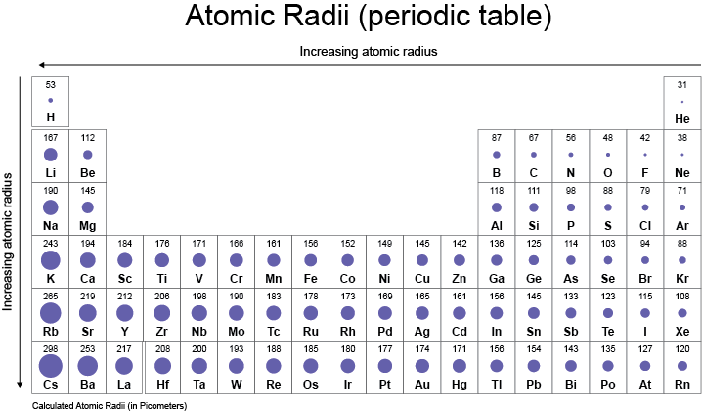
10

Slide 11
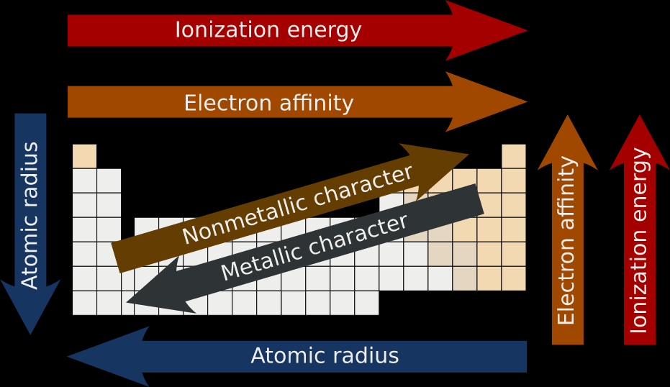

Slide 12
Electromagnetic Radiation
Significance
When atoms absorb energy , electrons jump to higher energy levels. When they drop back to lower energy levels , atoms give off energy in the form of electromagnetic radiation.
For a particular atom, the energy level changes of the electron are always the same, so atoms can be identified by their emission and absorption spectra.
Definition
Radiant energy that exhibits wavelength-like behavior and travels through space at the speed of light in a vacuum.
Examples
X-rays, Ultraviolet waves, microwaves, radio waves
12

Slide 13
Waves
Waves have 3 primary characteristics:
1. Wavelength (λ): distance between two consecutive peaks in a wave.
2. Frequency (ν): number of waves (cycles) per second that pass a given point in space.
3. Speed: speed of light is 2.9979 × 10⁸ m/s. We will use 3.00 x10⁸ m/s.
13

Slide 14
Wavelength and frequency is an inverse relationship
c = vλ
ν = frequency (s⁻¹)
λ = wavelength (m)
c = speed of light (m/s)
Wavelength is in nanometers (nm), angstroms (Å) & meters (m)
(1 nm = 10⁻⁹ m) (1 Å = 10⁻¹⁰ m).
The frequency value of s⁻¹ or 1/s is also called “hertz (Hz)” like MHz or KHz on the radio.
14

Slide 15
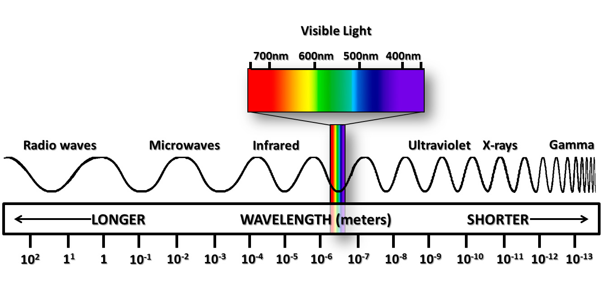

Slide 16
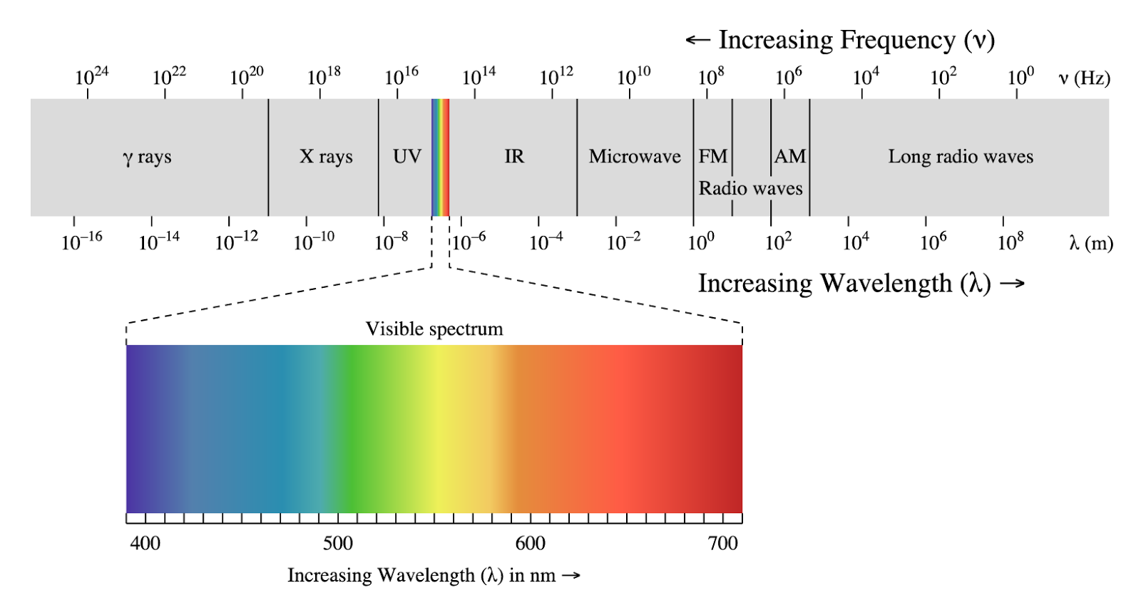
16

Slide 17
Sample Problem:
When green light is emitted from an oxygen atom it has a wavelength of 558 nm. What is the frequency?
17

Slide 18
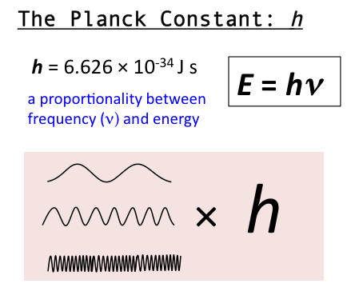
Energy and Electromagnetic Radiation
Max Planck determined that Energy can be gained or lost only in whole-number quantities.
His discovery made it clear that energy is quantized and can occur only in discrete units of size . Each of these small packets of energy is called a quantum.
A system can transfer energy only in whole quanta.

Slide 19
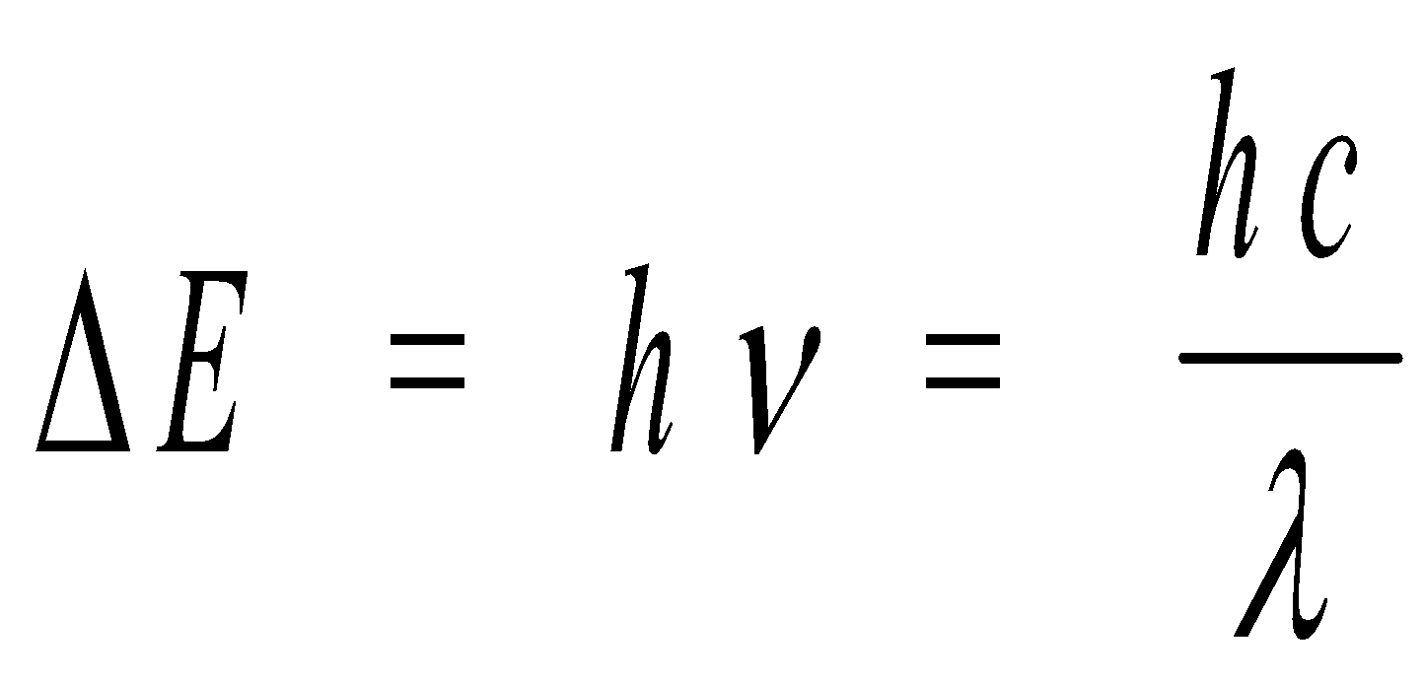
Planck’s Constant
ΔE = change in energy, in J
h = Planck’s constant, 6.626 × 10⁻³⁴ J s
ν = frequency, in s⁻¹
λ = wavelength, in m
19

Slide 20
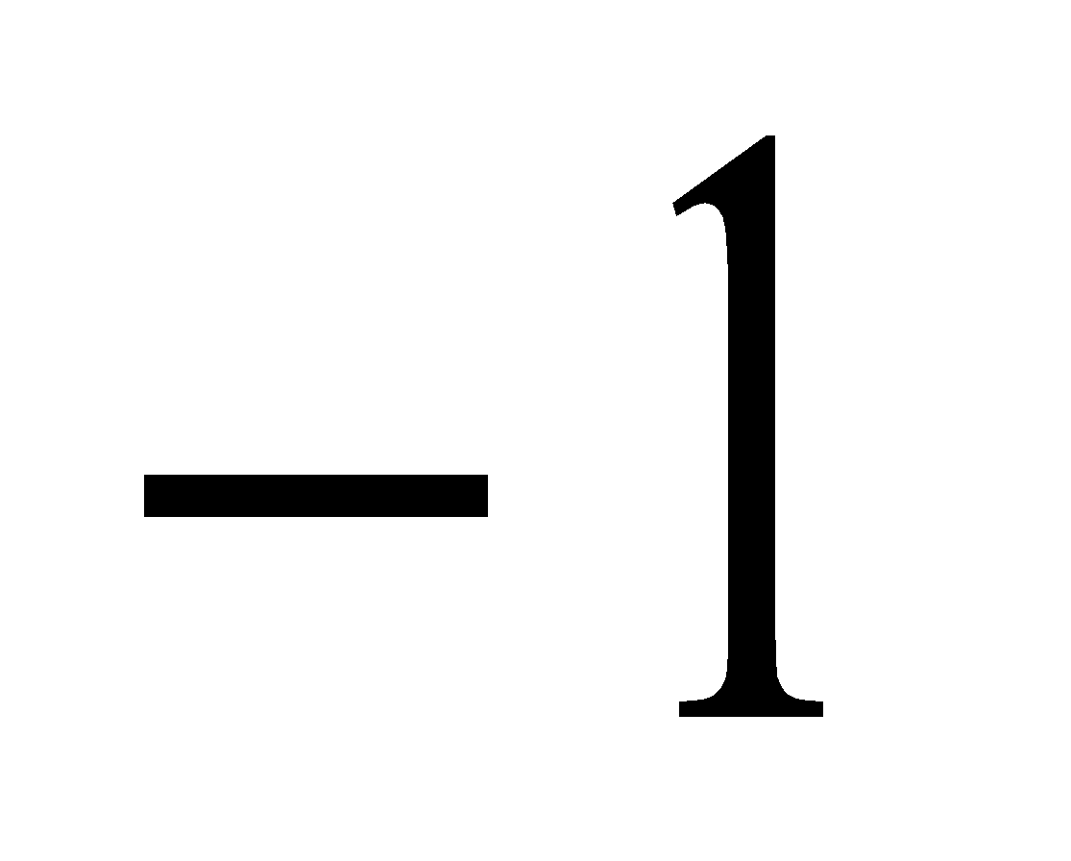
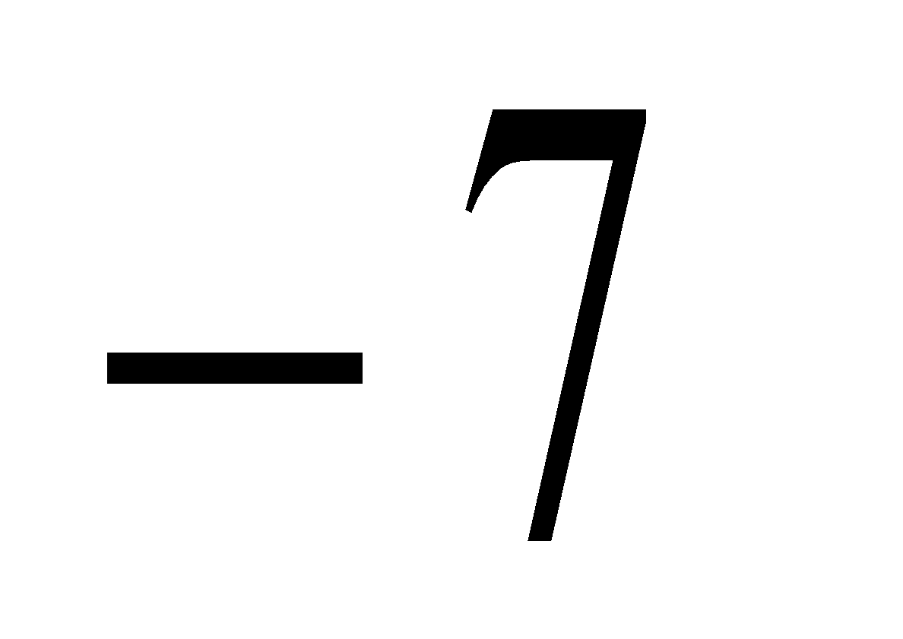
Example: The Blue color in fireworks is often achieved by heating copper (I) chloride (CuCl) to about 1200ºC. Then the compound emits blue light having a wavelength of 450 nm. What is the increment of energy (the quantum) that is emitted at 4.50 x 10² nm by CuCl?
The quantum of energy can be calculate from the equation
ΔE = hν
The frequency ν for this case can be calculated as follows:
So,
ΔE = hν = (6.626 x 10⁻³⁴J.s)(6.66 x 10¹⁴ s⁻¹)
= 4.41 x 10⁻¹⁹J
A sample of CuCl emitting light at 450 nm can only lose energy in increments of 4.41 x 10⁻¹⁹J, the size of the quantum in this case.
20

Slide 21
Niels Bohr - 1913
Observed spectral lines for hydrogen
Proposed an orbit theory of the electron around the atom.

Slide 22
Bohr Model

Slide 23
A Continuous Spectrum (a) and A Hydrogen Line Spectrum (b)
23

Slide 24
Electronic Transitions in the Bohr Model for the Hydrogen Atom
24

Slide 25
Summary of Bohr’s model
Electron in a hydrogen atom moves around the nucleus only in certain allowed circular orbits.
Bohr’s model gave hydrogen atom energy levels consistent with the hydrogen emission spectrum.
Ground state – lowest possible energy state (n = 1)
All others are excited states
Corrections to the Bohr Model
Bohr’s model is incorrect. This model only works for hydrogen.
Electrons move around the nucleus in circular orbits
Copyright © Cengage Learning. All rights reserved
25

Slide 26
Quantum Mechanical Model of the Atom
The quantum mechanical model is based on mathematics.
It is also based on quantum theory, which says matter also has properties associated with waves.
According to quantum theory, it’s impossible to know the exact position and momentum of an electron at the same time. This is known as the Uncertainty Principle.

Slide 27
Werner Heisenberg Uncertainty Principle
It implies that we cannot know the exact motion of the electron as it moves around the nucleus because it is impossible to know both momentum and position at the same time.
In terms of atomic structure, this means that electrons do not move in planetary fixed orbitals around the nucleus.
Electron movement is better described as a probability function of where it will be found in a certain area of space.(cloud)
27

Slide 29
Electron Configuration
It is a shorthand description of how electrons are arranged around the nucleus of an atom.
Electron configurations are important because they help us predict chemical behavior. We can predict whether two elements will react or not, and if they react, we can also predict what kind of reaction we are likely to have, as well as how strong the reaction will be.

Slide 30
The Aufbau Principle:
When building up the electron configuration of an atom, electrons are placed in orbitals, subshells, and shells in order of increasing energy
Pauli Exclusion Principle:
No atomic orbital can contain more than two electrons and they must be opposite spin!
Hund’s Rule:
When an electron is added to a subshell, it will always occupy an empty orbital if one is available They will only pair up if an empty orbital is not available.

Slide 31
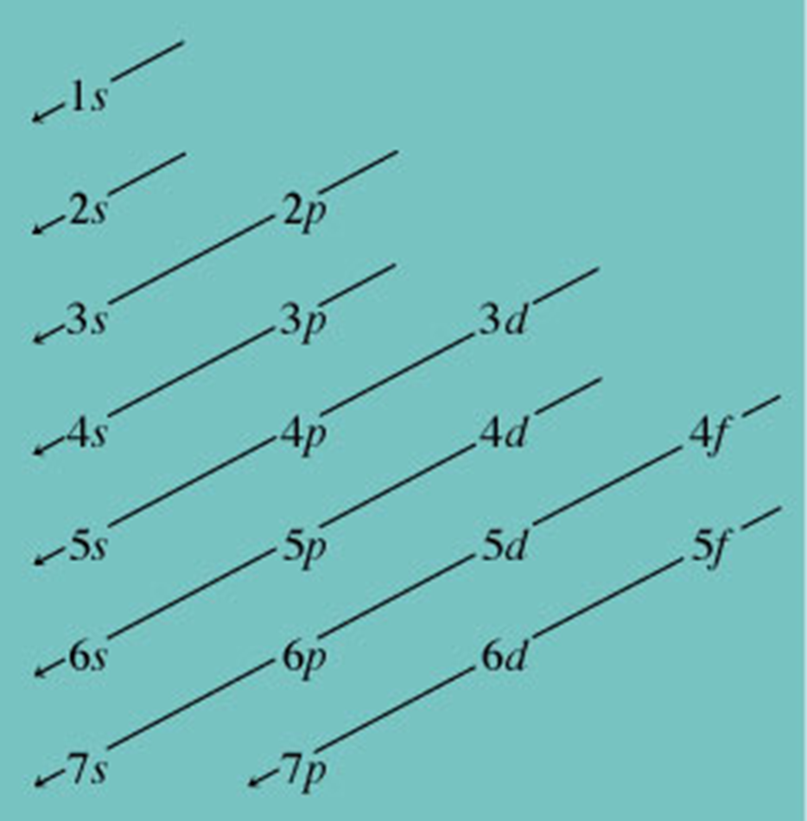
Orbital Box Diagram
It describes the subshell filling order, or the order can be determined by using the periodic table

Slide 32
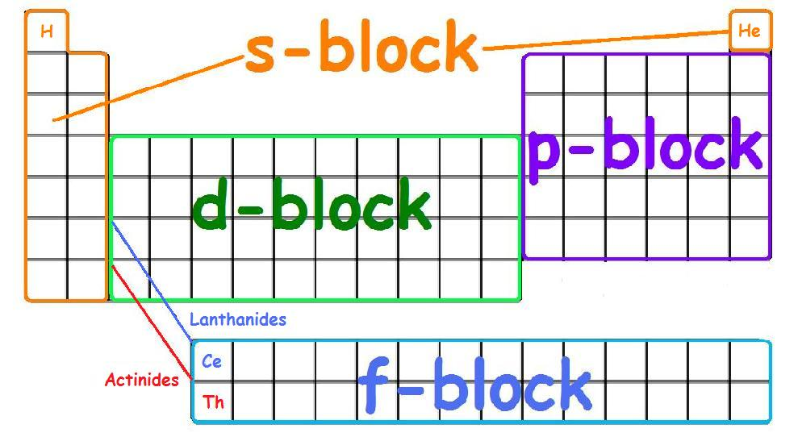

Slide 33
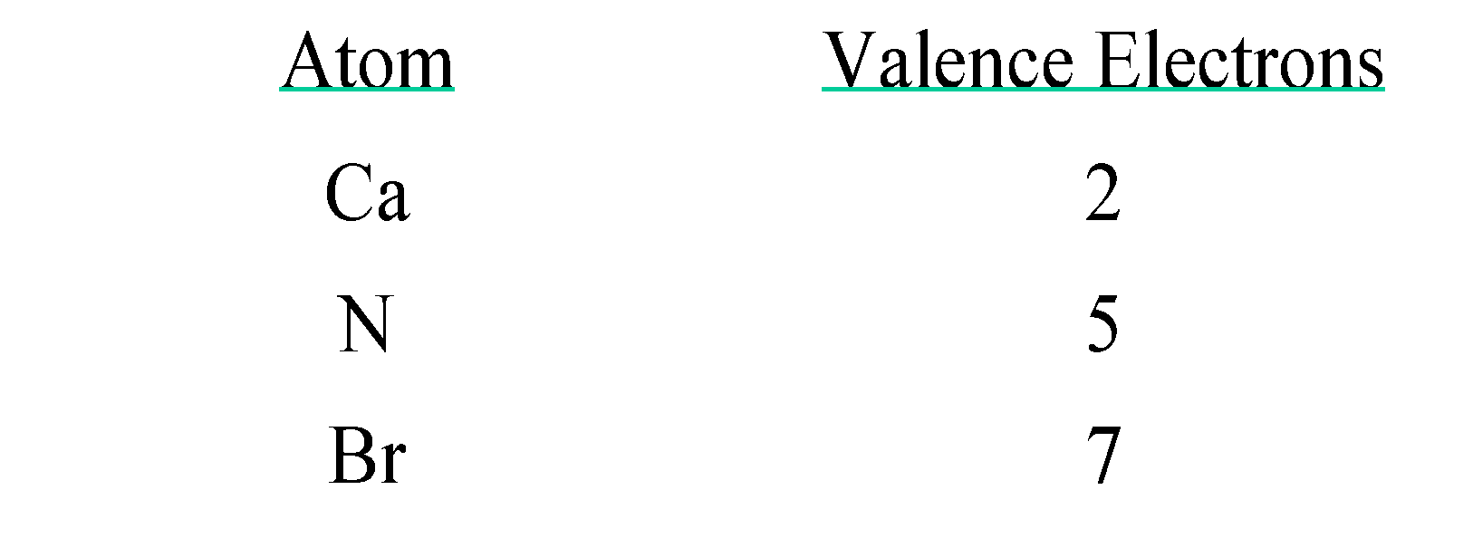
Valence Electrons
The electrons in the outermost principle quantum level of an atom.
Valence electron is the most important electrons to us because they are involved in bonding. Elements with the same valence electron configuration show similar chemical behavior. Inner electrons are called core electrons.
33

Slide 34
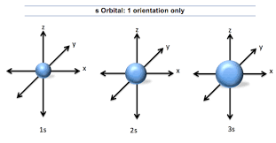
Orbital Shapes and Energies
Two types of representations for the hydrogen 1s, 2s and 3s orbitals are shown below. The s orbitals are spherical shape.
34

Slide 35
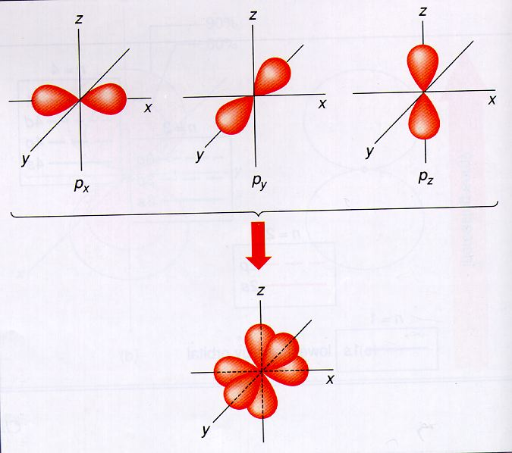
Representation of p orbitals
The p orbitals are not spherical like s orbital but have two loves separated by a node at the nucleus. The p orbitals are labeled according the axis of the xyz coordinate system.

Slide 36
Representation d orbitals
The d orbitals have two fundamentally different shapes. Most of them are the cloverleaf shape
The Boundary Surfaces of All of the 3d Orbitals
36

