Slide 1
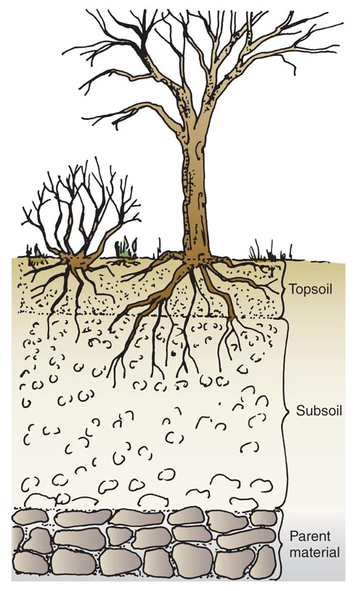
WHAT IS SOIL?
Soil is the ______ outer layer of the earth’s crust,
made up of weathered ____________, living
_____________, __________, _________, and ______.
_______
TOPSOIL is the _____________ soil layer. It is finely
weathered (has the ___________ particles in it) and
Is the richest in ___________ matter. Topsoil is the
_____________ layer and must be preserved and
____________. The _______ of plants flourish in the
topsoil and ______ on it for nutrients, water, and air.
ORGANIC MATTER is the remains of once living
_________ and _________ tissues. It ___________ the
mineral content and the water-holding __________ of
the soil. Naturally occurring organic matter is called
________ and includes ______________ leaves, twigs,
animal waste, and feathers. (__________ works like
humus to enrich the soil.)
thin
minerals
organisms
humus
water
air
humus
uppermost
smallest
organic
shallowest
protected
roots
rely
plant
animal
increases
capacity
humus
decomposing
Compost

Slide 2
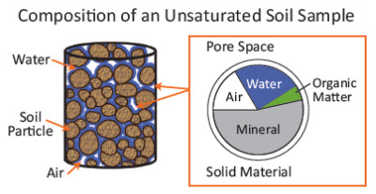
WHY SOILS DIFFER
Even if the parent material (the bedrock) is the ________, topsoil & subsoil can _________ due to:
- The amount of ___________ matter
- Climate
- _________________ (Slopes, valleys, hills)
- Weathered elements
- Soil _____________
SEDENTARY SOIL – Created from
___________ and sits in place
TRANSPORTED SOIL – Soil that was
created somewhere else and
________ to its current location
by wind, glaciers, _______ deposition
landslides, or mudslides
WATER & AIR – Water and air exist __________ the soil particles. As much as ____ % of the
volume of topsoil may be water and air. Water can exist in both _________ and _______ form.
same
differ
organic
Topography
movement
bedrock
moved
water
around
50
liquid
vapor

Slide 3
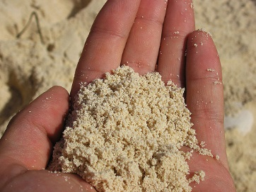
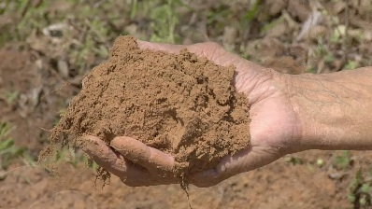
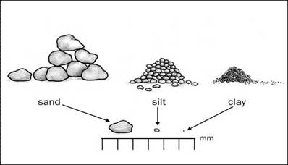
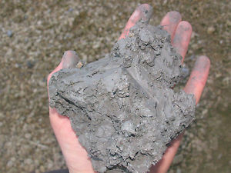
SOIL SEPARATES
COMPARISON OF SAND, SILT, & CLAY
As the parent rock _____________ it forms
particles of different ________. Based on SAND - Particles have assorted _______ & sizes
their _____________, these particles are - _________ between particles are large
classified into ________ called SOIL SEPARATES: - Water passes through sand __________
- Air is present in ___________ quantity
1. ___________ - 2.0mm or more in diameter - Low in ___________ nutrients
2. ________ - Ranges from very __________ (1.0 to 2.0 mm) SILT - Irregularly __________
to very _______ (0.05 mm - .1 mm) - Greater surface area than sand so holds more ________
3. ________ - 0.002 mm to 0.05 mm - Not as much space for _____
- Low in ____________ nutrients
4. ________ - Less than 0.002 mm
CLAY - Very _______ plate-like particles
- Greatest surface area so water is held
__________ and passes through slowly
- Air is in short _________
- _______ mineral content
- Adhesive quality when wet can create sticky hard to ______ fields
weathers
sizes
shapes
diameter
Spaces
groups
quickly
greatest
GRAVEL
mineral
SAND
coarse
shaped
fine
water
SILT
air
mineral
CLAY
small
tightly
supply
High
plow

Slide 4
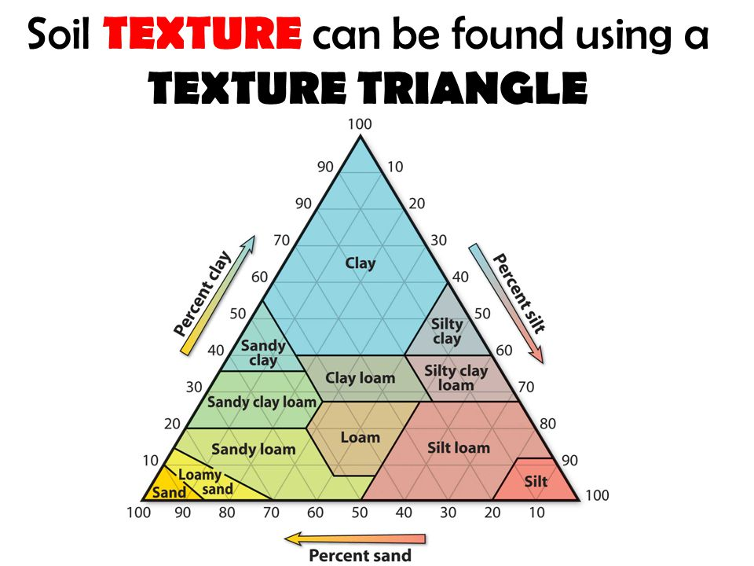
SOIL TEXTURE
The relative _______________ of sand, silt, and clay ________________ the soil texture
The best soil is
Loam is a soil that contains:
40% ______ 40% ______
20% ______
This is the _______ type of soil for horticultural use
because it has good ___________ and ___________
from the sand, yet it has enough silt and clay to
____________ water & minerals
proportions
determines
LOAM
sand
silt
clay
best
drainage
aeration
retain

Slide 5
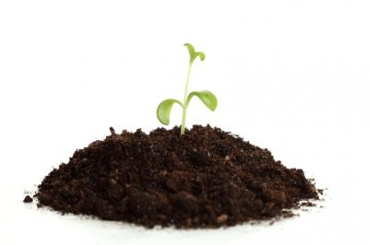
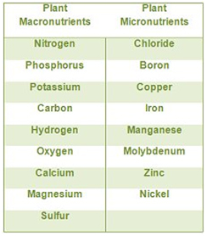
ESSENTIAL ELEMENTS
A rich loam soil will provide a balanced ___________ of the essential elements needed for
__________ and health of plants.
Some elements are required in ________ amounts (macronutrients)
and some only in _______ amounts (micronutrients), but all are
essential for the plant to grow and develop.
A catchy phrase to remember these 17 elements:
See Meg’s men mob Cousin Hopkins nice clean café
C Mg Mn Mo B Cu Zn H O P K N S Ni Cl Ca Fe
NUTRIENT DEFICIENCY – Plants may show deficiency ____________ for
several reasons:
- The element is _____ in the soil, or there is not _________ of it
- The element is in a _______ that the plant cannot use
- There may be an _____________ of nutrients in the soil
supply
growth
large
small
symptoms
not
enough
form
imbalance

Slide 6
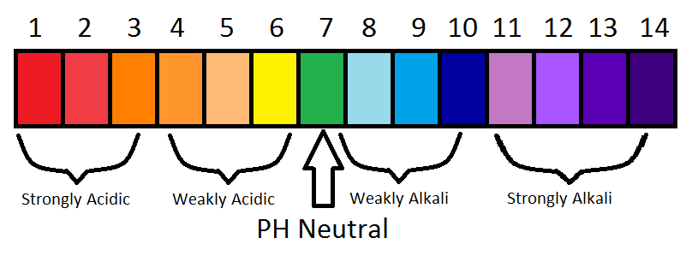
pH Scale
_________
_______ ______ _______ _______ _______
_____ _____ _____
( _______ )
_____________
fruits
battery
acid
acid
rain
normal
rain
soaps
drano
bases
pure water

Slide 7
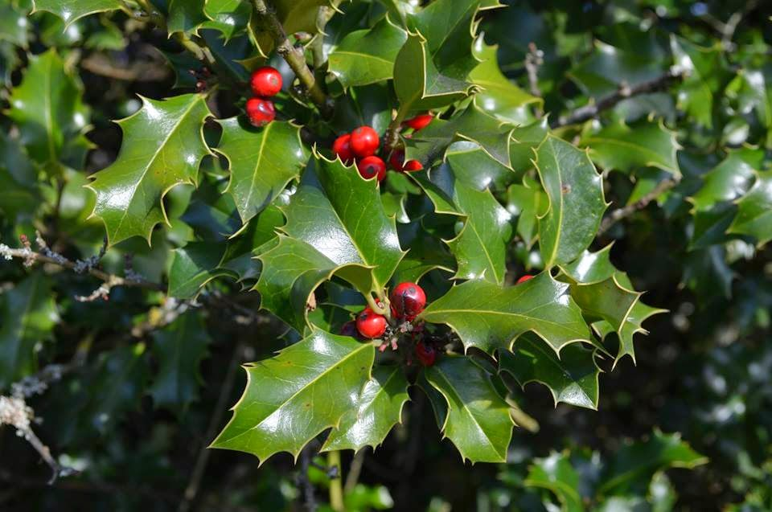
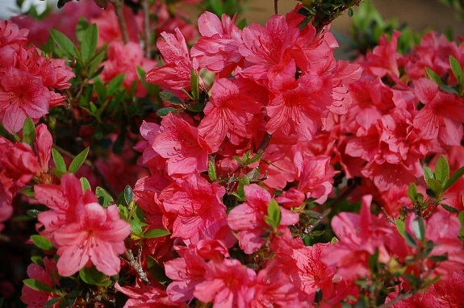
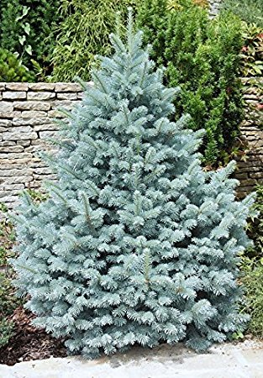
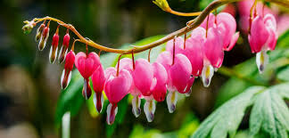
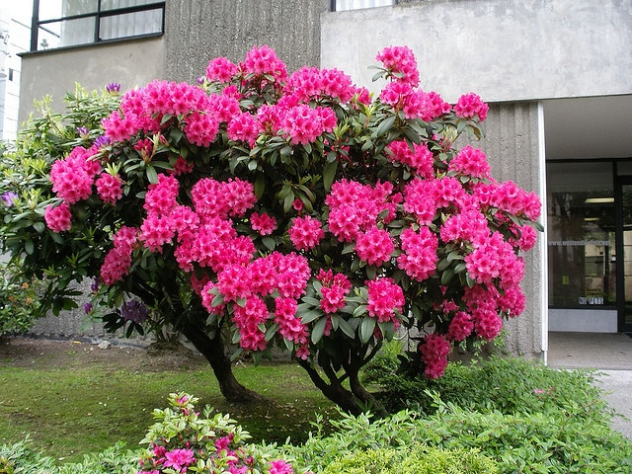
SOIL pH
Certain plants grow better in ____________ soil pH ranges
PLANTS THAT PREFER ACIDIC SOIL (“sour soil”)
_________________ ________________
____________________
____________________ ____________________
specific
Azaleas
Holly
Bleeding hearts
Blue spruce
Rhododendrons

Slide 8
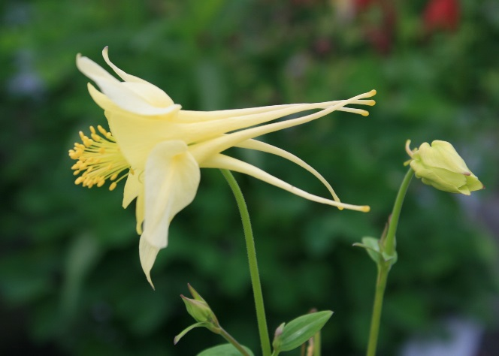
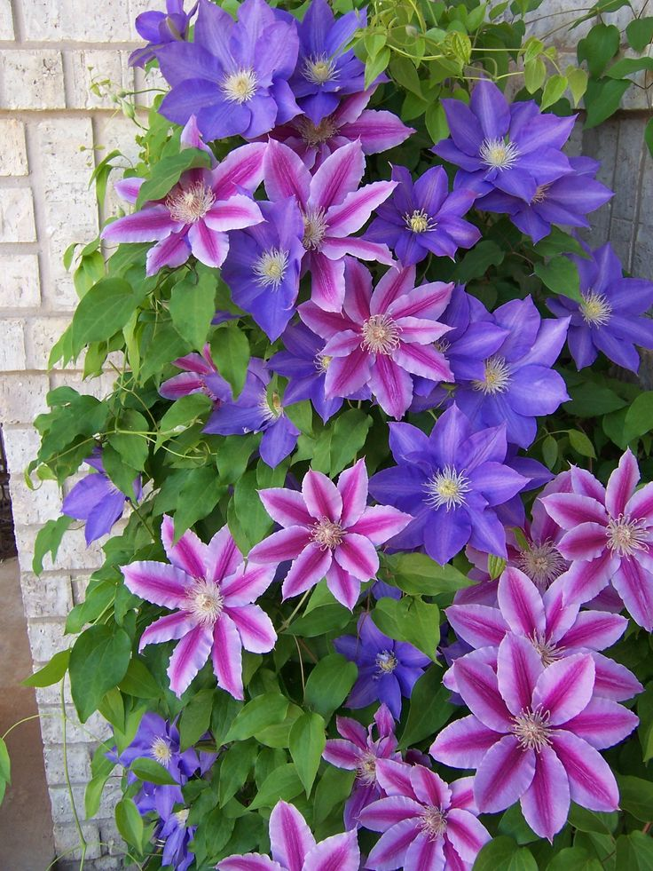
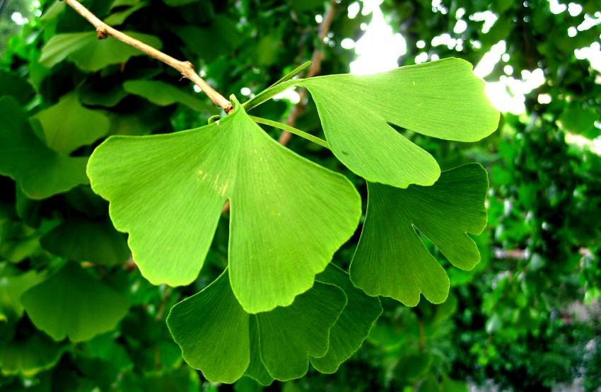
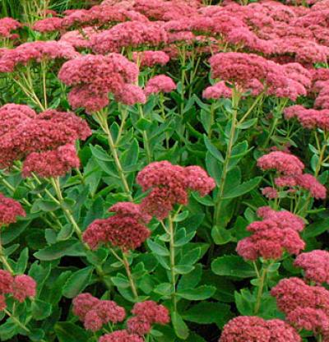
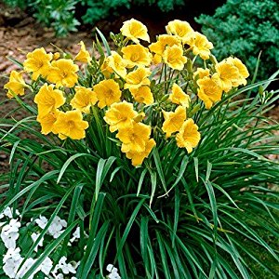
PLANTS THAT PREFER ALKALINE SOIL (“sweet soil”)
_________________
_______________
_______________________
__________________
_____________
Columbine
Clematis Vine
Ginkgo Biloba Tree
“Autumn Joy” Sedum
Daylilies

Slide 9
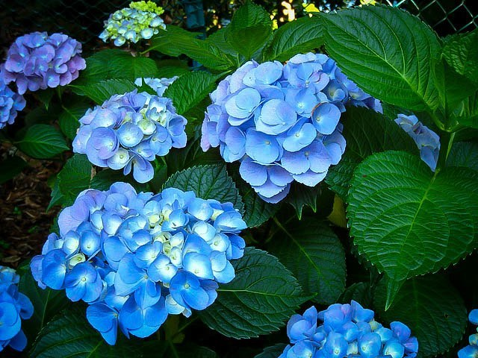
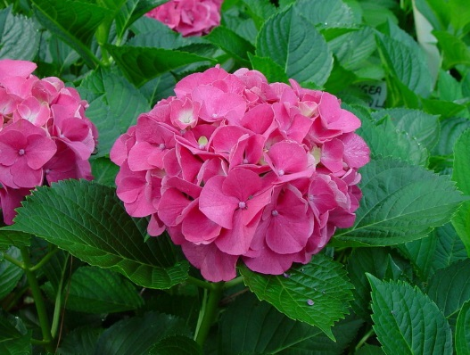
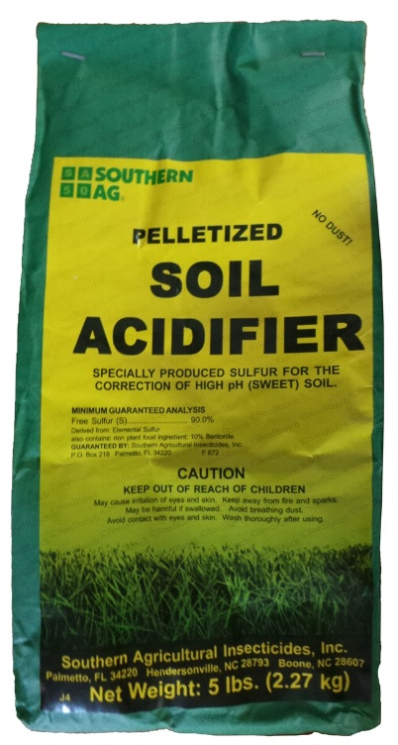
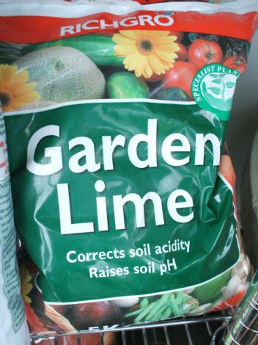
FUN FACT:
Hydrangeas grown in _________ soil will grow _______ flowers
and those grown in __________ soil will grow ______ flowers
Blue hydrangea Pink hydrangea
To shift the pH of your soil you can add:
_______________ like garden sulfur, aluminum sulfate, or
iron sulfate to ________ to pH
_______ like garden lime to ____________ the pH
acidic
blue
alkaline
pink
Acidifiers
lower
Base
increase

Slide 10
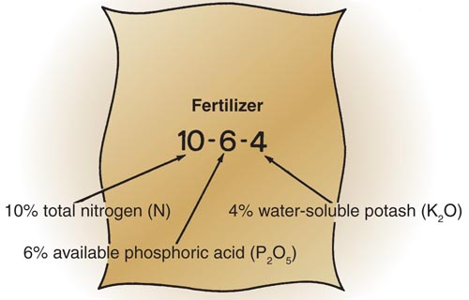
FERTILIZERS
Fertilizers are ____________ boosts _________ to the soil to enhance crop productivity.
The _____ macronutrients needed in ____________ quantity by the plant are: _______________ _____
A fertilizer that provides ______ three of these _______________ _____
elements is called a ____________ fertilizer
_______________ _____
On a fertilizer ______________ you will see three numbers
listed on the front in a _________ font size.
These numbers represent the __________ by _________ of
the three nutrients (Ex. 10% N 6% P 4% K)
The nutrients are in the form: N P₂O₅ (phosphoric acid)
K₂O (potash)
(so the __________ of P and K is actually ______ than the
analysis really says
nutrient
added
3
greatest
Nitrogen
N
all
Phosphorus
P
complete
Potassium
K
container
large
percent
weight
amount
less

Slide 11
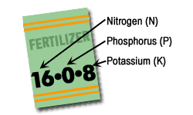
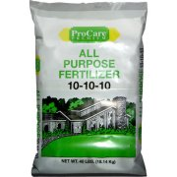
You do the Math!
1. If you have 100 lbs. of a 5-10-5 fertilizer, how many pounds of each do you have?
________ ________ ________
N P₂O₅ K₂O
Why don’t the 3 numbers add up to 100 pounds? Because the balance is ____________ and possibly _______ minerals
2. If you have 50 lbs. of a 20-5-20 fertilizer, how many pounds of each do you have?
_______ _______ ________
N P₂O₅ K₂O
5 lbs.
10 lbs.
5 lbs.
fillers
some
10 lbs.
2.5 lbs.
10 lbs.

Slide 12
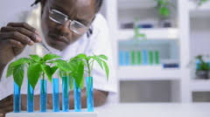
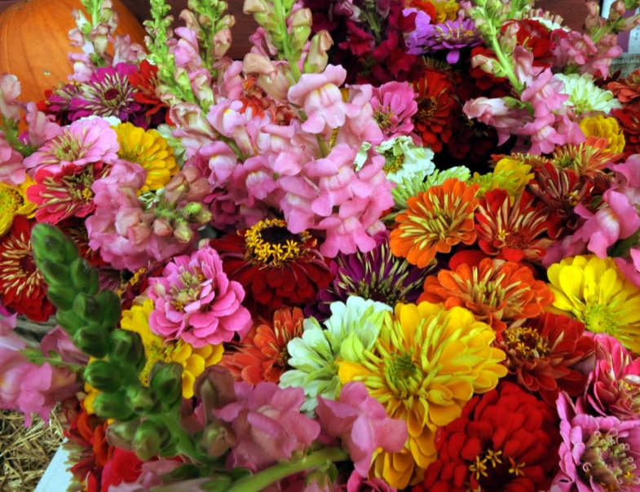
PROFESSIONS IN HORTICULTURE
Some of the benefits of a ___________ in horticulture are:
Wide __________ of careers
Work indoors or __________
Help ___________ the community
Relaxing & ______________ work
Jobs in horticulture can be classified as _____________ labor, ____________ labor, middle management,
owner/operator, educator, and ______________.
FLORICULTURE
The _________________ industry is involved
with the ______________, distribution, and
utilization of __________ products. Its businesses
range in _______ from small shops to international
companies.
career
variety
outdoors
beautify
enjoyable
unskilled
skilled
researcher
floriculture
production
floral
size

Slide 13
FLORICULTURE CAREERS
GROWERS Floriculture crops may be grown outdoors or in ____________ Growers can start as _____________ labor and ______ experience to become skilled labor Most growing operations are ___________ firms selling to __________ garden centers & florists | LANDSCAPE FLORICULTURE SPECIALIST Work for large _________ or property management companies using flowers to help _________ their properties The crew _________ will design the layout of flower beds, prepare __________, and _______ & supervise the crew members
FLOWER SHOPS Small businesses where the ________ is directly involved with the ______ and services offered Products offered include _________ plants, floral arrangements, and _____ flowers Requires _____________ & _______________ skills | TEACHER Teach students ____________ in horticulture and foster their careers Masters __________ are required Can teach at the ____________ or college level
FLORAL DESIGN The artistic craft of ____________ floral designs by __________ and assembling colors, _______, textures, and materials for ______ arrangements May design arrangements for __________, proms, funerals, ___________, and special events | RESEARCHER Researchers seek ways to ___________ crops and production methods Their research may include selectively __________ plants to develop _____ and better varieties. They also research ways to _________ pests
resorts
greenhouses
market
unskilled
gain
leader
wholesale
contracts
train
retail
owner
interested
goods
potted
degrees
cut
high school
salesmanship
interpersonal
creating
improve
selecting
shapes
floral
breeding
weddings
new
holidays
control

Slide 14
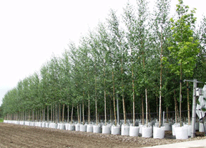
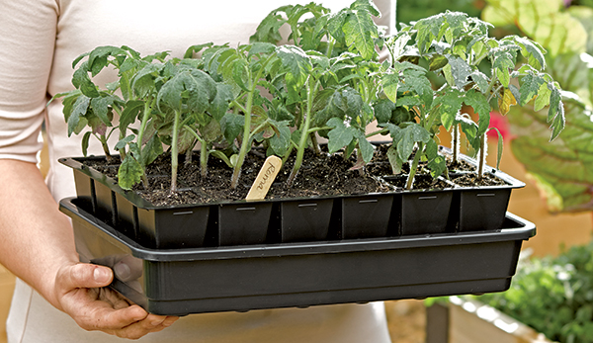
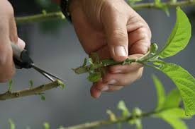
CAREERS IN THE NURSERY INDUSTRY
Nurseries deal largely with ________ plants
such as ________, shrubs, and vines.
DIFFERENT TYPES OF NURSERIES
(1) PROPAGATION NURSERIES
Initiate plant production using ________, cuttings,
or other types of vegetative _______________
Introduce new varieties and ___________ to the
nursery industry as a whole
Key _________ of ____________ stock
woody
trees
seeds
propagation
cultivars
sources
pest-free

Slide 15
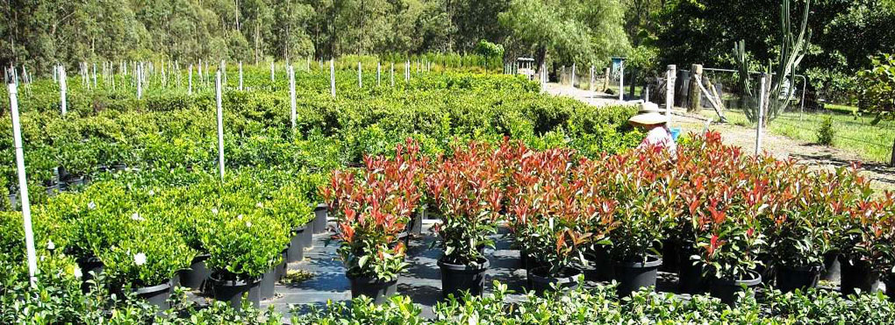
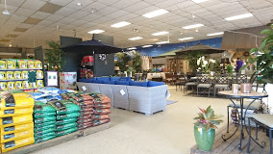
(2) WHOLESALE NURSERIES
Grow plants in a _______ that can be sold for
landscape installation
Plants may spend from ___ to 5 years here
To hold down production costs, they may
________ the number of varieties to those
requiring __________ growing requirements
(3) RETAIL NURSERIES & GARDEN CENTERS
Where the ____________ buys trees, shrubs, _____________, fertilizers,
grass seed and tools
Might also have _______ items, pet supplies, bird food, firewood, and
_____________ items
No real growing areas, instead plants are ____________ in sales yards
Workers in retail nurseries must have a thorough _______________ of plants
as well as good ______________ skills and ______ working with the public
size
1
limit
similar
homeowner
pesticides
gift
decorative
displayed
understanding
communication
enjoy

Slide 16
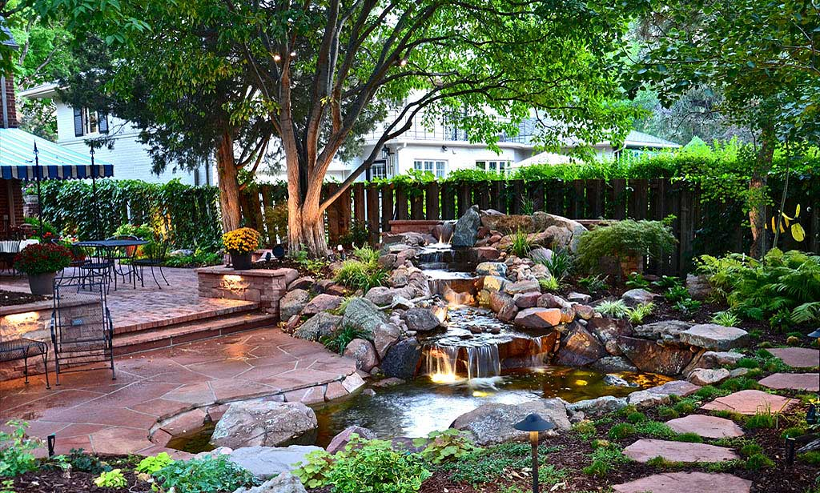
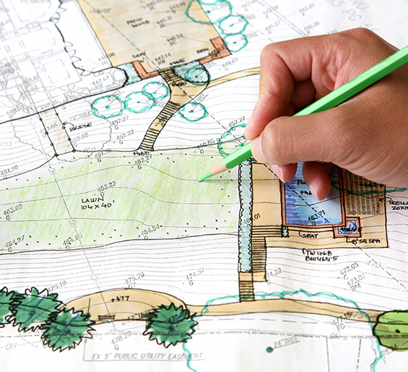
CAREERS IN LANDSCAPE
A landscaper ___________ and __________ the spaces
outside of buildings
(1) LANDSCAPE ARCHITECTS AND DESIGNERS
- Conceive ______ that become the landscape
- Identify client ______ and match them with
the ______________ and ___________ of the site
- Makes graphic _______and models to communicate
ideas
- In New York State, landscape _______________ must
have the correct _____________ and be
certified; _____________ do not have this
requirement
develops
controls
ideas
needs
opportunities
constraints
plans
architects
education
designers

Slide 17
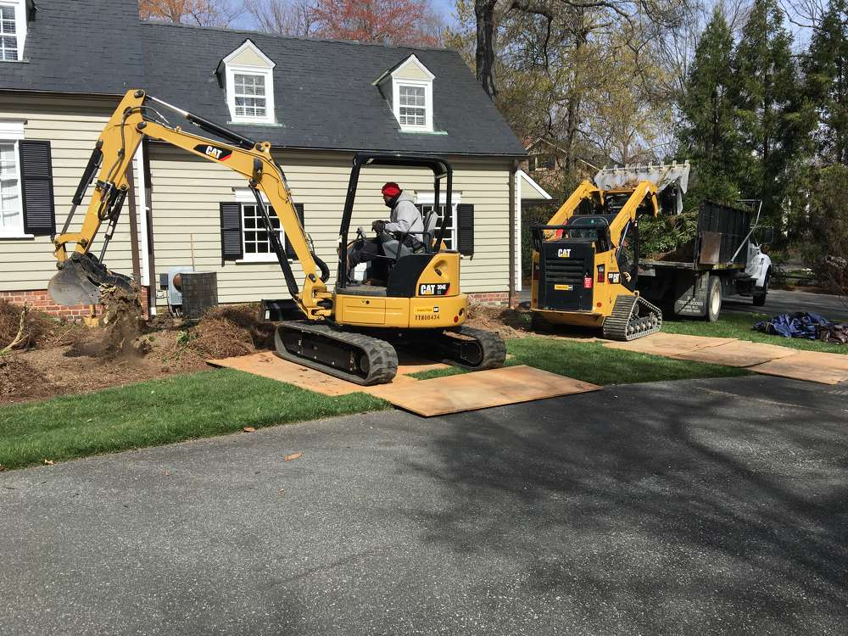
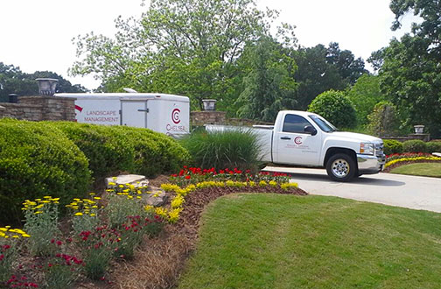
(2) LANDSCAPE CONTRACTORS (3) LANDSCAPE MAINTENANCE
- Construct and __________ landscapes that - Responsible for the ______ of landscapes ______
were designed by the architect they have been installed by the contractor
High ______ of equipment - Tasks such as _________, pruning, weeding,
fertilizing, and __________
- Investment cost is ______ than contractors
install
care
after
cost
mowing
repair
less

Slide 18
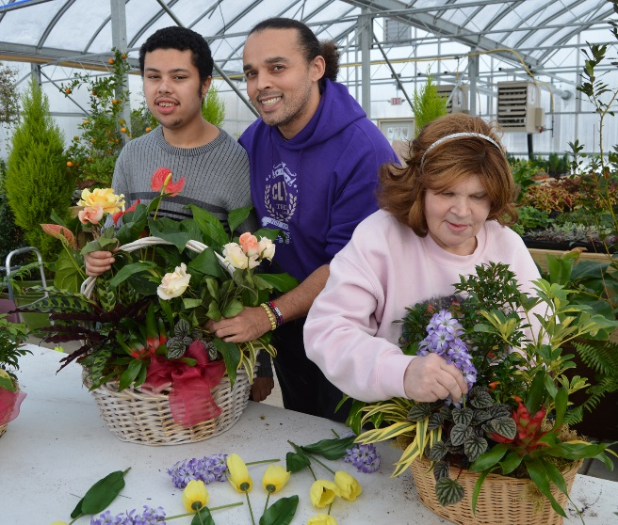
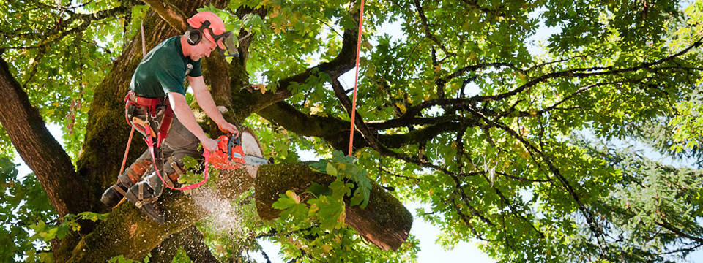
OTHER CAREERS
(1) HORTICULTURE THERAPISTS
- Work with the ___________, physically or mentally ______________,
or imprisoned
- For the elderly, many have ______________ of plants & gardening and
they ________ growing and nurturing living plants
- Disabled individuals can increase their ___________ dexterity and
self-confidence. Working with plants is mentally
_______________ and gives them usable ______ skills
(2) ARBORISTS
- Tree _________________ specialists
- Vigorous ___________ work that is
potentially dangerous
- Services include tree __________,
tree removal, fertilizing, and
______ treatment
elderly
disabled
knowledge
enjoy
manual
stimulating
work
maintenance
outdoor
pruning
pest

Slide 19
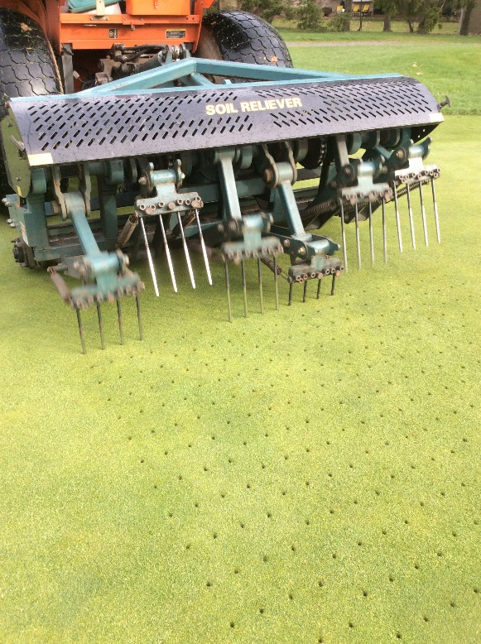
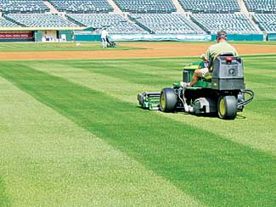
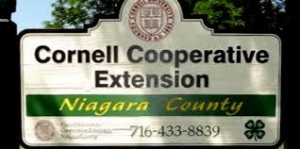
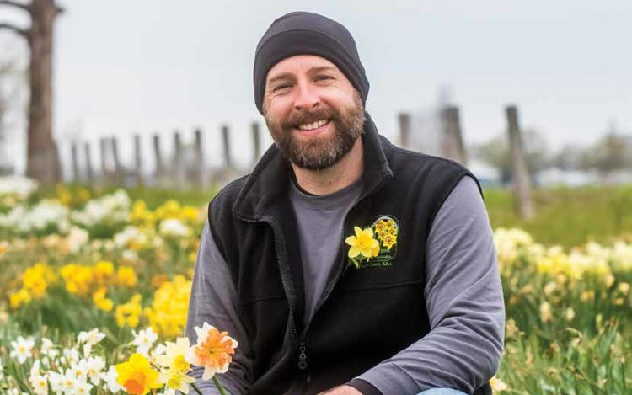
(3) TURF MANAGEMENT
- Install and maintain ______ courses, athletic fields,
parks, residences, and _____________ land
- Work involves __________, aerating, dethatching,
and fertilizing
(4) COOPERATIVE EXTENSION SPECIALIST
- Process the latest _______________ from universities and research firms
and turn it into a form that the industry and _____________ can use
- Affiliated with the state college of _______________
- Works with growers, homeowners and _______ groups
(5) COMMUNICATIONS SPECIALIST
- ________ and speak about horticulture for newspapers,
_____________, on-line, and live audiences - Career opportunities include _________, photographer,
illustrator, __________ designer, and public speaker
golf
commercial
mowing
information
consumer
agriculture
4-H
Write
magazines
writer
graphic

Slide 20
