Slide 1
Chapters 14 & 15
Acid and Base
Equilibrium

Slide 2
History of Acids and Bases
In the early days of chemistry chemists were organizing physical and chemical properties of substances. They discovered that many substances could be placed in two different property categories:
Substance A
Sour taste
Reacts with carbonates to make CO₂
Reacts with metals to produce H₂
Turns blue litmus pink
Reacts with B substances to make salt and water
Substance B
Bitter taste
Reacts with fats to make soaps
Do not react with metals
Turns red litmus blue
Reacts with A substances make salt and water

Slide 3
Arrhenius Theory
The Swedish chemist Svante Arrhenius
proposed the first definition of acids and bases.
(Substances A and B became known as
acids and bases)
“acids are substances that dissociate in water to produce H⁺ ions and bases are substances that dissociate in water to produce OH⁻ ions”
NaOH (aq) Na⁺ (aq) + OH⁻ (aq) Base
HCl (aq) H⁺ (aq) + Cl⁻ (aq) Acid

Slide 4
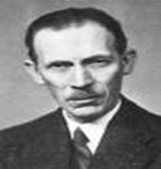
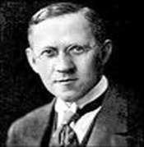
But what if the acid/base is not dissolved in water?
The Arrhenius definition for acids and bases only refers to compounds dissolved in water.
Does this mean that acids and bases cannot exist out of water?
Not quite, that’s where the Bronsted-Lowry definition comes in.
Bronsted
Lowry

Slide 5
Bronsted Lowry Theory
Johannes Brønsted and Thomas Lowry revised Arrhenius’s acid-base theory to include other solvents besides water.They defined acids and bases as follows:
An acid is a hydrogen containing species that
donates a proton.
A base is any substance that
accepts a proton”
HCl (aq) + H₂O (l) Cl⁻ (aq) + H₃O⁺ (aq)
In the above example,
what is the Brønsted acid?
what is the Brønsted base?

Slide 6
In reality, the reaction of HCl with H₂O is an equilibrium and occurs in both directions, although in this case the equilibrium lies far to the right.
HCl (aq) + H₂O (l) Cl ⁻ ( aq) + H₃O⁺ (aq)
For the reverse reaction Cl ⁻ behaves as a Brønsted base and H₃O⁺ behaves as a Brønsted acid. The Cl⁻ is called the conjugate base of HCl.
Brønsted acids and bases always exist as conjugate acid-base pairs. Their formulas differ by only one proton.

Slide 7
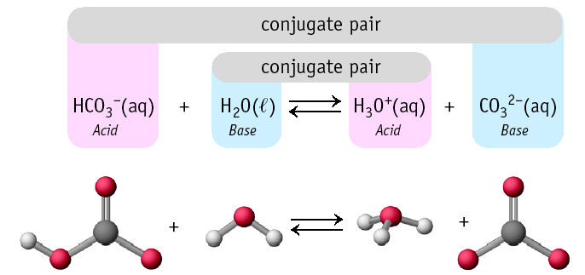
Conjugate Pairs

Slide 8
Give it a Try !
Label the acid, base, conjugate acid, and conjugate base in each reaction:
HCl + OH⁻ → Cl⁻ + H₂O
H₂O + H₂SO₄ → HSO₄⁻ + H₃O⁺

Slide 9
Strong acids ionize 100% and weak ones do not!
A single arrow is used to represent the ionization of strong acids. HCl _{(g)} H⁺ _{(aq)} + Cl ⁻ _{(aq)}
double arrows are used to represent ionization of weak acids because an equilibrium is created.
HF _{(g)} H⁺ _{(aq)} + F – _{(aq)}

Slide 10
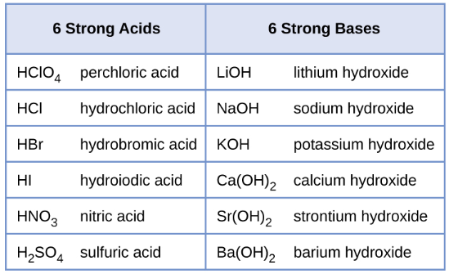
Common Strong Acids and Bases Easy, memorize them!

Slide 11
6 Common Strong Acids
These are the strong acids. What makes them 'strong' is that they completely dissociate into their ions when they are mixed with water. Any other acid is a weak acid!
As the strong acids become more concentrated, they may be unable to fully dissociate.
The rule of thumb is that a strong acid is 100% dissociated in solutions of 1.0 M or less.

Slide 12
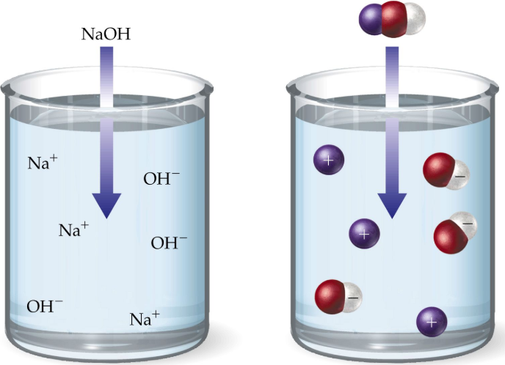
6 Common Strong Bases
Strong bases are bases which completely dissociate in water into the cation and OH⁻ (hydroxide ion).
The hydroxides of the Group I and Group II metals usually are considered to be strong bases.

Slide 13
Autoionization of Water
In pure water (no solute) water molecules behave as both an acid and base!!
It is called amphoteric meaning it will act as either an acid or a base depending on the situation.
H₂O (l) + H₂O (l) H₃O⁺ (aq) + OH⁻ (aq)
This is called the autoionizationof water. Although the equilibrium lies far to the left it is very important to take into consideration, especially for living systems.
For pure water [OH-] = [H+]

Slide 14
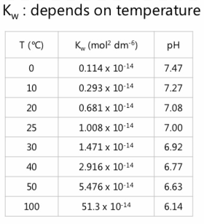
K_{w} is called ionization constant of water and is very small. As with all Kw values, it is temperature dependent.
K_{w} = 1.0 x 10 ^{-14 @} 25ºC
K_{w} = [H⁺][OH⁻]
K_{w} =(1 x 10⁻⁷ )(1 x10⁻⁷ )
, This only means that the neutral value for pH is getting lower, it does not mean that the solution is becoming more acidic as the temperature increase. it

Slide 15
We define an aqueous solution as being
neutral when the [H⁺] = [OH⁻]
acidic when [H⁺] > [OH⁻]
basic when [H⁺] < [OH⁻]
CHECK THIS OUT !
[H⁺] = 0.0000001 = 10⁻⁷
How can this be abbreviated further?
By just describing the power called the POWER OF H
pH = 7

Slide 16
A pH Number line
The pH scale is a way of expressing the strength of acids and bases.
[H⁺] =10⁻¹⁴
[OH ⁻] = 10⁰
[H⁺] < [OH ⁻]
basic
pH = 14
basic
[H⁺] =10⁻¹²
[OH ⁻] = 10⁻²
pH = 12
[H⁺] < [OH ⁻]
basic
[H⁺] = 10⁻⁷
[OH ⁻] = 10⁻⁷
[H⁺] = [OH ⁻]
neutral
pH = 7
acidic
[H⁺] = 10⁻²
[OH ⁻] = 10⁻¹²
[H⁺] > [OH ⁻]
acidic
pH = 2

Slide 17
pH Calculations
To calculate pH or pOH
pH = -log [H⁺], or pOH = -log [OH⁻]
pH + pOH = 14 for water solutions
Find the pH of these:
0.15 M solution of Hydrochloric acid
2) 3.00 X 10⁻7 M solution of Nitric acid

Slide 18
This is the calculator button
Calculations for
Molarity Concentrations:
M= 2nd log = 10 ^{–pH} M= 2nd log = 10 ^{–pOH}
The number of decimal places in the log answer is equal to the number of sig figs in the original Molar [ ]
Find the Molarity:
A solution has a pH of 8.5. What is the Molarity of hydrogen ions in the solution?

Slide 19
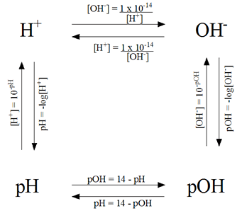
You only need one piece of information to be able to determine all the values associated with acids and base.

Slide 20
Acid and Base Equilibrium
Strong acids and strong bases completely dissociate in water. Therefore they DO NOT create an equilibrium system.
Weak acids and weak bases disassociate to a far lesser degree in an aqueous solution. They DO create an equilibrium system .
They have their own K_{c} constants.

Slide 21
They have their own Kc Constants
K is designated K_{a} ACID Dissociation constant
K gives the ratio of ions to molecules
Pure substances are not shown in the K_{a} constant
The greater the dissociation, the larger the K_{a} will be.

Slide 22
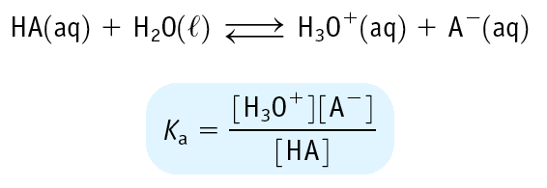
Equilibrium Constants for Weak Acids
Weak acid has K_{a} < 1
Leads to small [H₃O⁺] and a pH of 2 - 7

Slide 23
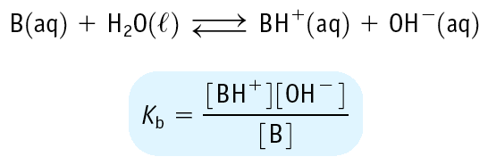
Equilibrium Constants for Weak Bases
Weak base has K_{b} < 1
Leads to small [OH⁻] and a pH of 12 - 7

Slide 24
% dissociation = [H⁺] X 100%
[HA]
In general, if the percent dissociation is less than or equal to 5%, then it is completely acceptable to ignore the X value in the ice table.
The justification for this is that K_{a} and K_{b} values are typically known only to an accuracy of ±5%.

Slide 25
EXERCISE!
Calculate the pH of a 0.50 M aqueous solution of the weak acid HF. Calculate the % dissociation
(K_{a} = 7.2 × 10^{–4})
Notes:
Major Species: HF, H₂O
Possibilities for primary reaction:
HF(aq) + H₂O  H₃O⁺(aq) + F⁻(aq)
H₂O + H₂O  H₃O⁺(aq) + OH⁻(aq)
The first reaction is the primary reaction because the K value is significantly larger. Thus, it is the primary source of H₃O⁺ (or H⁺).
Use an ICE table, K expression, and pH = –log[H⁺] to solve for pH.
pH = 1.72

Slide 26
Chapter 15
Neutralization Reactions
Buffers
Titration Curves

Slide 27
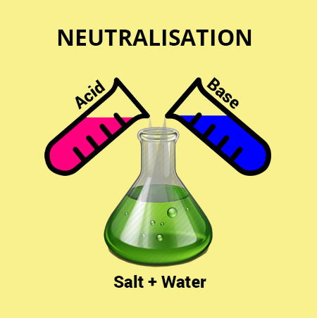
Neutralization Reactions
When an acid and a base mix, the acid will donate protons to the base in what is called a neutralization reaction.
There are four different ways that this can occur and it depends on the relative strengths of the acids and bases involved.

Slide 28
# 1) STRONG ACID + STRONG BASE
Both substances dissociate completely
The only important ions are the H+ and OH-, the rest are spectator ions.
Water and a salt will always be created.
HCl _{(aq)} + NaOH(aq) H₂O(l) + NaCl(salt)
H⁺ (aq) + OH⁻ (aq) H₂O(l) (net ionic)
The net ionic equation is identical for ALL strong acid/strong base reactions.
pH = 7 at 25⁰C, only if there were no excess ions in the solution. This assumes that all ions have been neutralized.

Slide 29
# 2) STRONG ACID + weak base
The strong acid dissociates completely and will donate a proton to the weak base.
The product will be the conjugate acid of the weak base.
HCl _{(aq)} + NaC₂H₃O₂ _{(aq)} HC₂H₃O_{2 (aq)} + Na+ + Cl⁻_{(aq)}
Net ionic equation involves the proton transfer from the strong acid to the weak base.
H⁺ _{(aq)} + C₂H₃O₂⁻ _{(aq)} HC₂H₃O_{2 (aq)} (Net Ionic)

Slide 30
#3) weak acid + STRONG BASE
The strong base, will accept protons from the weak acid
The products are the conjugate base of the weak acid and water.
HC₂H₃O₂ + NaOH H₂O + C₂H₃O₂⁻ + Na⁺
Net Ionic
HC₂H₃O₂ _{(aq)} + OH⁻ _{(aq)} H₂O _{(l)} + C₂H₃O₂⁻ _{(aq)}

Slide 31
# 4) weak acid + weak base
The solution contains both cations and anions and the pH is dependent on the relative numbers of each produced.
Less tendency to proceed to completion than neutralizations involving strong acids and strong bases.
HA (aq) + B (aq) BH⁺ (aq) + A⁻ (aq)

Slide 32
Summary of steps for determining the ph of Strong acid and bases neutralizations
Write out the equation
Determine the moles of each reactant
Create an ICE table and determine the limiting reactant and the excess reactant.
4. Determine the [H₃O⁺] of the excess reactant
5. Use the formula:
pH = -log[H₃O⁺] to determine pH

Slide 33
Sample problem :
Calculate the pH of a solution if you mix 200ml of 0.15 M Hydrobromic acid with 100 ml of .2M potassium hydroxide.

Slide 34
Oh No! How do I calculate the pH of a solution whenever weak bases or weak acids are involved?
The Henderson-Hasselbalch equation is widely used by many chemists, biologists and pharmacists to accomplish this.

Slide 35
Use the Henderson-Hasselbalch Equation
pK_{b} is found by taking the - log of K_{b}
BH⁺ is the conjugate acid of the corresponding weak base B
pK_{a} is found by taking the - log of K_{a}
A⁻ is the conjugate base of the corresponding weak acid HA

Slide 36
Summary of Steps for Weak Acid and Weak Base Neutralizations
Write out the equation
2. Determine the moles of each reactant
3.Create an ICE table and determine the limiting reactant
and the excess reactant.
4. Determine the [ ] of any excess reactants and the [ ] of any conjugate acid or conjugate base products.
5. Calculate either the pK_{a} or the pK_{b}
6. Use the appropriate HH Equation

Slide 37
The Henderson-Hasselbalch Equation
Find the pH of a mixture of :
100.0 ml of 0.30 NH₃ and 180.0 ml of 0.10 M HCl
K_{b} _{NH3} = 1.8 x 10 ⁻⁵

Slide 38
Buffers
What is it?
A buffer is a solution with a very stable pH
You can add acid or base to the buffer without greatly affecting the pH of the solution.
How do buffer solutions work?
A buffer solution contains compounds that can remove any hydrogen ions or hydroxide ions that you might add to it, otherwise the pH will change.
Simply put, a buffer is a solution of a weak acid or base and its salt [which is its conjugate]. Therefore, any titration involving a weak A/B is buffer problem.

Slide 39
AP TEST TIP!
If you are asked to construct a buffer of a specific pH and given a table of Ka’s, choose a Ka with an exponent close to the desired pH and use equal concentrations of the acid and base.
The above works because pH = pK_{a} at the ½ equivalence point, buffer region.

Slide 40
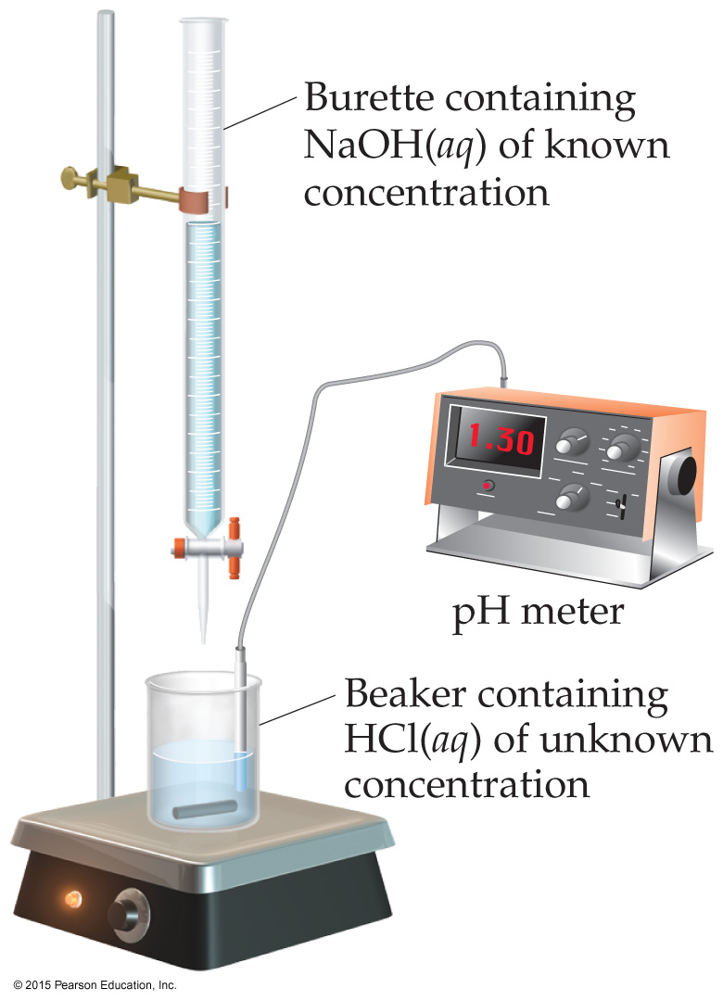
What is a Titration?
Titrant
In this technique, an acid (or base) solution of known concentration (titrant) is slowly added to a base (or acid) solution of unknown concentration(analyte).
A pH meter or indicators are used to determine when the solution has reached the EQ.
equivalence point(EQ): The point at which equivalent quantities of acid and base have been brought together.
Analyte

Slide 41
Comparison of Titration curves
This is the type you need to be most familiar with for the AP Exam

Slide 42
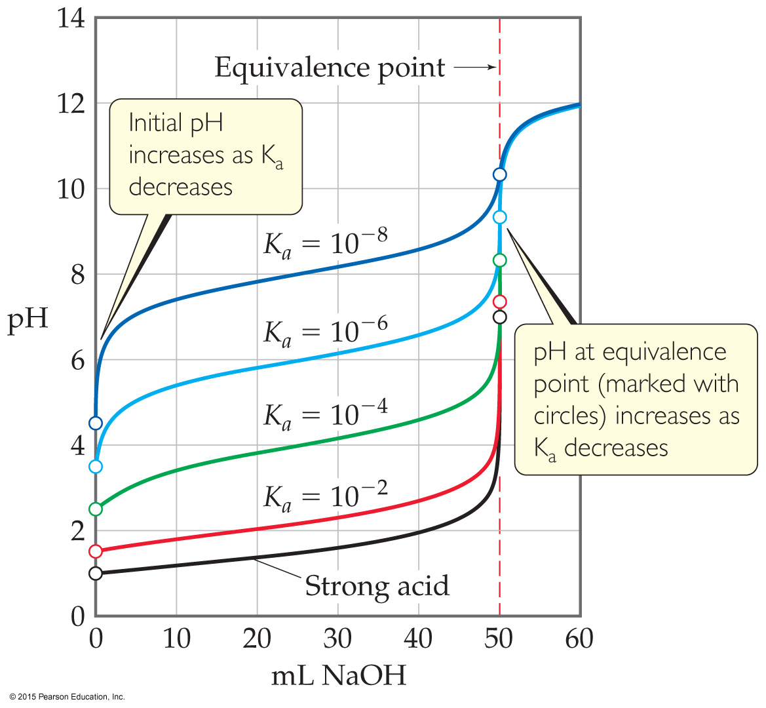
K_{a} and initial pH for weak acid and strong base titrations
The pH will be always be above 7 at the equivalence point
The initial pH will be usually be at 2 or above for the weak acids.

Slide 43
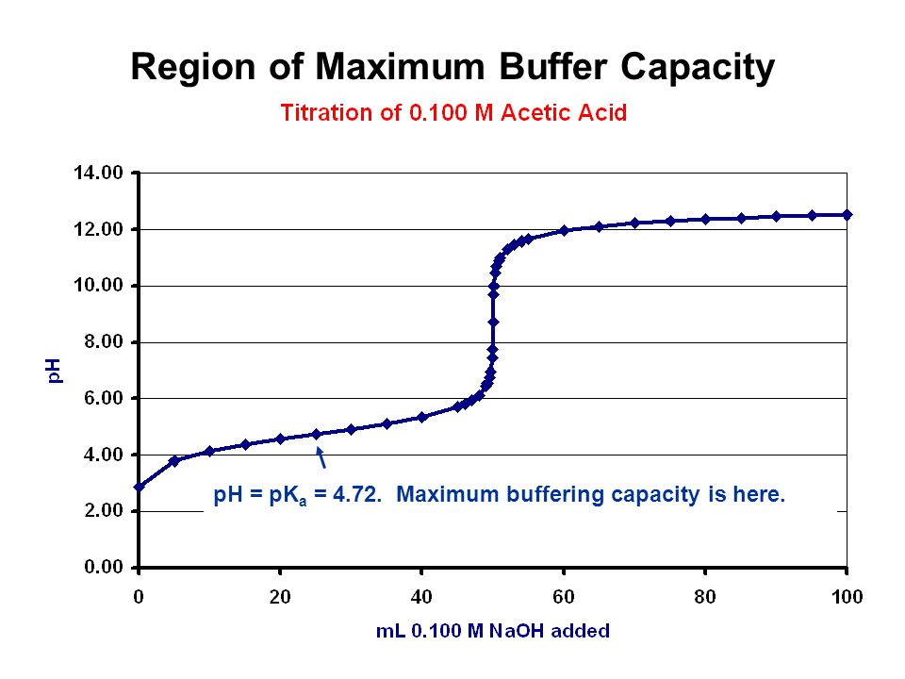
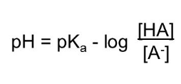
Weak Acid and Strong Base Titration
Equivalence point
Excess OH-
pH= 14 – (-logOH⁻)

Slide 44
Calculations forWEAK ACID/ STRONG BASE Titration Curve
The pH before the titration begins. Treat as usual, the acid or base in the flask determines the pH. If weak, use an ICE table.
The pH on the way to the equivalence point. You are in the “land of buffer” as soon as the first drop from the burette makes a splash and reacts to form the salt. Use your Henderson-Hasselbach
The pH at the midpoint of the titration (½ eq point): pH = pKa.
The pH at the equivalence point.—you are calculating the pH of the salt, all the acid or base is now neutralized [to salt + water!]
The pH beyond the equivalence point—it’s stoichiometry again with a limiting reactant. Calculate the molarity of the EXCESS and solve for either pH directly (excess H+ ) or pOH (excess OH− ) and subtract it from 14 to arrive at pH.

