Slide 1
Chemical Equilibrium
Chapter 13
Chemical Balance
Notes:
1
1
1
1

Slide 2
Equilibrium
Chemical Equilibrium, the state where the concentrations of all reactants and products remain constant with time.
Any chemical reaction carried out in a closed container will reach equilibrium.
A reaction that seems to favor the products and gives numbers close to the theoretical yield is said to go far to the right.
A reaction that seems to not happen at all and yields products far below the theoretical yield is said to lie far to the left.

Slide 3
The Concept of Equilibrium
As the reaction progresses
[A] decreases to a constant,
[B] increases from zero to a constant.
When [A] and [B] are constant, equilibrium is achieved.

Slide 4
The Equilibrium Expression
Write the equilibrium expression for the following reaction:

Slide 5
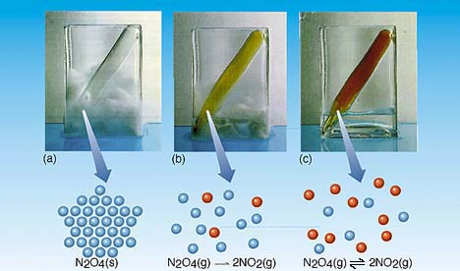
A.) As the N₂O₄ warms it begins to decompose
B.) When enough NO₂ is formed, it can react to form N₂O₄.
C.) At equilibrium, as much N₂O₄ reacts to form NO₂ as NO₂ reacts to
re-form N₂O₄.

Slide 6
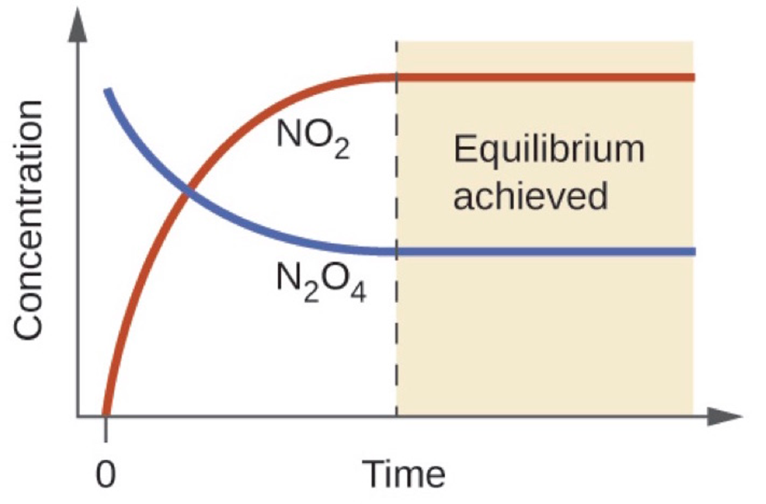

Slide 7
Le Châtelier’s Principle
If you disturb an equilibrium, it will shift to undo the disturbance.
“Shift Happens”
Three types of Equilibrium Stresses:
Changes in concentration of reactants or products.
Changes in temperature
Changes in pressure

Slide 8
1. Change in Reactant or Product Concentrations
Adding a reactant or product shifts the equilibrium away from the increase.
Removing a reactant or product shifts the equilibrium towards the decrease.
To make the greatest amount of product at equilibrium, we need to flood the reaction vessel with reactant and continuously remove product (Le Châtelier).

Slide 9
2. Effect of Temperature Changes
For an endothermic reaction:
Heat can be considered as a reactant and is placed on that side.
Adding heat would favor the forward reaction
Removing heat would favor the reverse reaction.
For an exothermic reaction
Heat can be considered as a product and is placed on that side.
Adding heat would favor the reverse reaction.
Removing heat would favor the forward reaction.

Slide 10
3. Effects of Volume and Pressure
The story is very different with Gases!
An increase in pressure favors the direction that has fewer moles of gas.
In a reaction with the same number of product and reactant moles of gas, adjusting pressure has no effect.

Slide 11
4. Effects of a catalyst
It speeds up the rate of reaction by providing an alternative pathway for reaction, lowers minimum activation energy and allows the reaction to proceed.
It increases frequency of effective collisions and hence speeds up rate of reaction.
It does not affect the equilibrium concentrations of the reactants or products and thus not the equilibrium constant value.
It just makes the equilibrium get achieved faster.

Slide 12
The Equilibrium Constant
Kc

Slide 13
The Equilibrium Constant
No matter the starting composition of reactants and products, the same ratio of concentrations is achieved at equilibrium.
For a general reaction:
aA _{(g)} + bB _{(g)} cC _{(g)} + dD _{(g)}
The value of K_{c} is the equilibrium constant and the information on the right side is considered the Equilibrium expression.

Slide 14
The Equilibrium Constant
K_{c} is based on the molarities of reactants and products at equilibrium.
We omit the units of the equilibrium constant.
The Equilibrium expression is products over reactants.
For the reverse reaction:
Equilibrium expression = reciprocal of the original expression. Kc = 1
K_{c}

Slide 15
Large Value for the Equilibrium Constant
Kc ˃( 10³)
Product favored over reactants.
Reaction proceeds almost to completion
Position of reaction is said to be to the right
Small Value for the Equilibrium Constant
Kc ˂( 10⁻³)
Reactants are favored over products.
Reaction hardly proceeds forward at all.
Position of reaction is said to be to the left.
10⁻³ ˂ Kc ˂ 10³ it means that good amounts of both reactants and products exist.

Slide 16
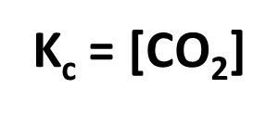
Heterogeneous Equilibria : means that reactants and products are present in more than one phase
Molar concentrations of solids and pure liquids are constant because you can’t find the concentration of something if it is not a liquid!
Ignore the concentrations of pure liquids and pure solids in equilibrium constant expressions.
The amount of CO₂ formed will not depend greatly on the amounts of CaO and CaCO₃ present.

Slide 17
For the reaction:
CO(g) + 2 H₂ (g) CH₃OH(g)
The equilibrium concentrations are:
[Co] = 2.58M
[H2] = 0.280 M
[Ch3OH] = 2.93 M
Calculate the K_{c} for this reaction.
Calculate the K_{c} for the reverse reaction

Slide 18
The Equilibrium Constant in Terms of Pressure
This equation is on the AP Reference table.
If K_{P} is the equilibrium constant for reactions involving gases, we can write:
K_{P} is based on partial pressures measured in atmospheres. Notice that [ ] are not used but rather
( ) to write the values of the partial pressures.

Slide 19
ΔGº can be used to determine k for a reaction
If we know the standard free energy change, ΔGº, for a chemical process at some temperature T, we can calculate the equilibrium constant for the process at that temperature using the relationship between Δ Gº and K.
∆G° = – RT ln K
This equation is found on the AP reference table under the Thermodynamics section.
K =equilibrium constant
∆G° =standard Gibb's free energy
R =constant (8.314 J/K•mol)
T =temperature.

Slide 20
Using ∆G° you can make inferences about K
∆G° is zero |  | Rxn is at equilibrium
∆G° is negative ( spontaneous) | K is large | Forward rxn is favored
∆G° is positive (non-spontaneous) | K is small | Reverse rxn is favored

Slide 21
Predicting the Direction of Reaction
We define Q, the reaction quotient, for a reaction at conditions NOT at equilibrium
as
where [A], [B], [P], and [Q] are molarities at any time.

Slide 22
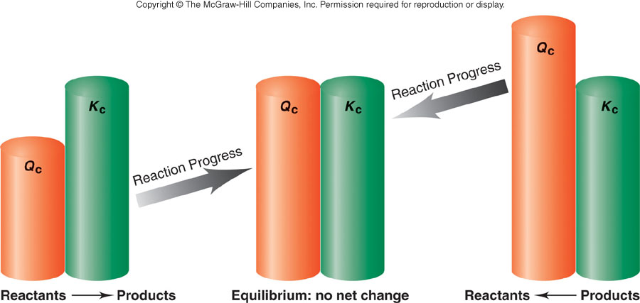
If Qc < K_{eq}, shift to
right (toward product)
If Qc > K_{eq}, shift to
left (toward reactant)

Slide 23
Predicting the Direction of Reaction
Reaction quotient Qc is the same as the equilibrium constant expression except that the concentrations are not necessarily equilibrium values.
If Q > K then the reverse reaction must occur to reach equilibrium (go left)
If Q < K then the forward reaction must occur to reach equilibrium (go right)

Slide 24
Calculating Equilibrium Constants from initial concentration
Steps to Solving Problems:
Write an equilibrium expression for the balanced reaction
Write an ICE box
I =initial concentration
C= Change in concentration
E = Equilibrium concentration
3. Fill in the given amounts and solve for x .
4. Check your results by substituting them into the equilibrium equation.

Slide 25
Practice Problem: Calculate the equilibrium concentrations of all three species
The reaction PCl_{5 (g)} PCl₃ _{(g)} + Cl_{2 (g)}
Kc = 85.0
Temperature is 760⁰ C
PCl₅ is 5.00 M

Slide 26
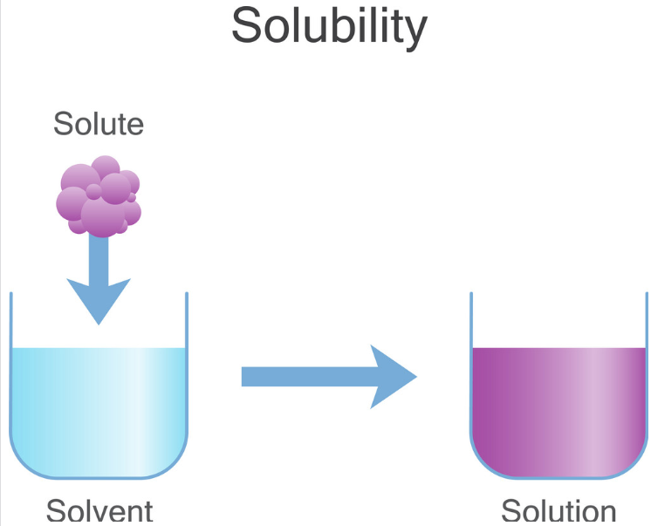
Solubility

Slide 27
Solubility Review:
It is the amount of a substance (solute) that will dissolve in a given amount of solvent.
Soluble if more than 1g of the solute dissolves in
100ml solvent.
Insoluble if less than 0.1g dissolves in 100ml solvent
Slightly soluble substances with solubility values between the above limits.

Slide 28
Main factors that control solubility of a solute.
(1) Temperature
(2) Nature of solute or solvent
(3) Pressure
(4) Common Ions
(5) pH in certain conditions

Slide 29
#1. EFFECT OF TEMPERATURE
It depends on the reaction process and what phases of matter are present
Guidelines:
Endothermic process: solubility increases with the increase in temperature
Exothermic process: solubility decrease with the increase in temperature.
Gases are more soluble in cold solvent than in hot solvent.

Slide 30
#2. NATURE OF SOLUTE AND SOLVENT
Solubility of a solute in a solvent completely depends on the nature of both solute and solvent.
A polar solute has a high solubility if dissolved in polar solvent.
A polar solute has low solubility or insoluble in a non-polar solvent.

Slide 31
#3. EFFECT OF PRESSURE
The effect of pressure is observed only in the case of gases.
An increase in pressure increases solubility of a gas in a liquid.
Example: carbon dioxide is filled in cold drink bottles (such as coca cola, Pepsi 7up etc.)under pressure.

Slide 32
#4.The Effect of a Common ion on Solubility
The solubility of salt is reduced in a solution that contains an ion in common with that salt.
Common ion: An ion that already exists in the solution that is the same as one that will be produced by the dissolving substance.
Common ion effect: A salt becomes less soluble in a solution that contains one of its ions.
LeChatelier explains that the equilibrium will shift to the the left to compensate for the extra ions.
The shift left favors the solid compound and solubility decreases.

Slide 33
#5 Solubility and pH
If the salt contains ions that can act as an acid or a base, the solubility will be affected by pH.
MgOH_{2(s)} ↔ Mg⁺² _{(aq)} + 2OH⁻ _{(aq)}
In basic solution, with a high pH, the concentration of OH- is high and the equilibrium will shift to the left, lowering the solubility.
In acidic solution, with a low pH, the concentration of H₃0⁺ is high, and the OH- will be neutralized by these H₃0⁺ , driving the shift to the right, and increasing solubility.

Slide 34
Ksp - Solubility product constant definition
Solubility product constant is an equilibrium constant for the equilibrium that exists between an ionic solid and its respective ions in a solution.
Its value indicates the degree to which a compound dissociates in water.
The higher the Ksp value, the more soluble the compound.
Like all K values , it is temperature dependent

Slide 36
Molar SolubilityProblem Determine the molar solubility given the Ksp
( How much PbI₂ will dissolve ?
Ksp = [Pb⁺²] [I⁻]² Ksp = 1.4 x 10 ⁻ ⁸
PbI_{2(s)} Pb^{+2 (aq)} + 2I^{- (aq)}

Slide 37
Q and Ksp
Q = Ksp solution is at equilibrium and all ion
[ ] will be constant.
Q › Ksp equilibrium will be established by reducing the ion [ ] and shifting to the left ( forming more solid) and a precipitate will form.
Q ‹ Ksp equilibrium will be established by increasing the ion [ ] and shifting to the right (forming more ions) no precipitate will form.

Slide 38
Will a Precipitation Occur?
If 1.00 mg of Na₂CrO₄ is added to 225 ml of 0.00015 M AgNO₃, will a precipitate form?
Molecular: Na₂CrO₄ + 2AgNO₃ → Ag₂CrO₄ +2 NaNO₃
Net ionic: Ag₂CrO₄ (s) → 2Ag⁺ + CrO₄²⁻
Step 1 :Determine the initial concentration of ions.
Ag⁺ = 1.5 x 10^{-4 M}
CrO₄²⁻ = 1.00 x 10⁻³ g / 115.99 = 8.621 x 10⁻⁶ mol .225 L .
= 3.83 x 10⁻⁵ M

Slide 39
Step 2 Compare (Q) for the initial concentrations to the solubility product constant
Initial (Q) concentration of ions:
Q-=(Ag⁺)² (CrO₄²⁻)
Q=(1.5 x 10⁻⁴)² (3.83 x 10⁻⁵ M)
Q= 8.61 x 10⁻¹³
Ag₂CrO₄ Ksp = 1.1 x 10⁻¹²
No precipitation will occur because the Q value is less than the Ksp.

