Slide 1
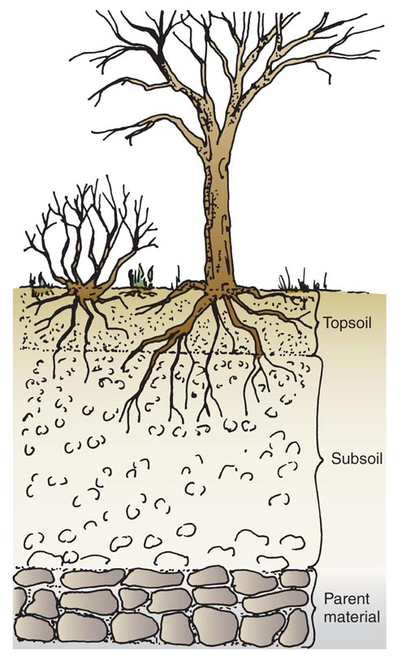
WHAT IS SOIL?
Soil is the ______ outer layer of the earth’s crust,
made up of weathered ____________, living
_____________, __________, _________, and ______.
_______
TOPSOIL is the _____________ soil layer. It is finely
weathered (has the ___________ particles in it) and
Is the richest in ___________ matter. Topsoil is the
_____________ layer and must be preserved and
____________. The _______ of plants flourish in the
topsoil and ______ on it for nutrients, water, and air.
ORGANIC MATTER is the remains of once living
_________ and _________ tissues. It ___________ the
mineral content and the water-holding __________ of
the soil. Naturally occurring organic matter is called
________ and includes ______________ leaves, twigs,
animal waste, and feathers. (__________ works like
humus to enrich the soil.)

Slide 2
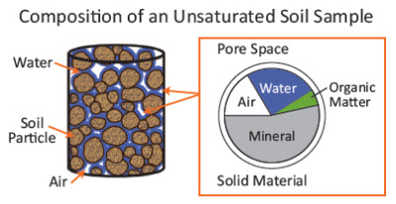
WHY SOILS DIFFER
Even if the parent material (the bedrock) is the ________, topsoil & subsoil can _________ due to:
- The amount of ___________ matter
- Climate
- _________________ (Slopes, valleys, hills)
- Weathered elements
- Soil _____________
SEDENTARY SOIL – Created from
___________ and sits in place
TRANSPORTED SOIL – Soil that was
created somewhere else and
________ to its current location
by wind, glaciers, _______ deposition
landslides, or mudslides
WATER & AIR – Water and air exist __________ the soil particles. As much as ____ % of the
volume of topsoil may be water and air. Water can exist in both _________ and _______ form.

Slide 3
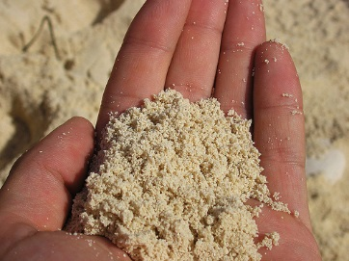
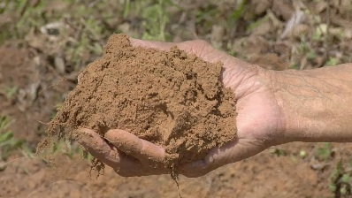
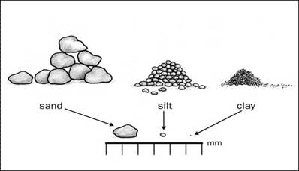
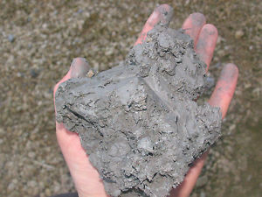
SOIL SEPARATES
COMPARISON OF SAND, SILT, & CLAY
As the parent rock _____________ it forms
particles of different ________. Based on SAND - Particles have assorted _______ & sizes
their _____________, these particles are - _________ between particles are large
classified into ________ called SOIL SEPARATES: - Water passes through sand __________
- Air is present in ___________ quantity
1. ___________ - 2.0mm or more in diameter - Low in ___________ nutrients
2. ________ - Ranges from very __________ (1.0 to 2.0 mm) SILT - Irregularly __________
to very _______ (0.05 mm - .1 mm) - Greater surface area than sand so holds more ________
3. ________ - 0.002 mm to 0.05 mm - Not as much space for _____
- Low in ____________ nutrients
4. ________ - Less than 0.002 mm
CLAY - Very _______ plate-like particles
- Greatest surface area so water is held
__________ and passes through slowly
- Air is in short _________
- _______ mineral content
- Adhesive quality when wet can create sticky hard to ______ fields

Slide 4
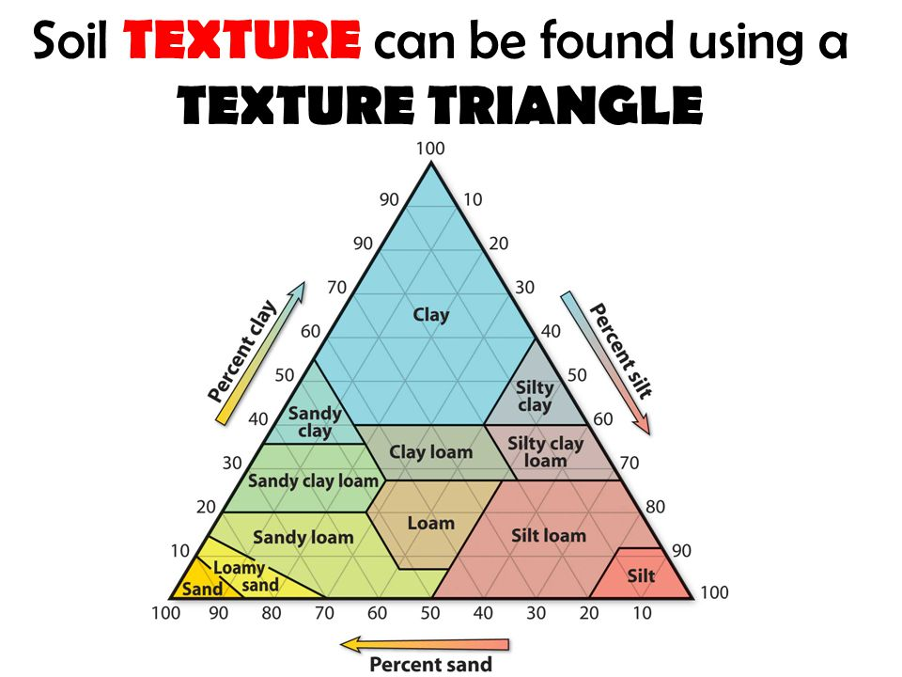
SOIL TEXTURE
The relative _______________ of sand, silt, and clay ________________ the soil texture
The best soil is
Loam is a soil that contains:
40% ______ 40% ______
20% ______
This is the _______ type of soil for horticultural use
because it has good ___________ and ___________
from the sand, yet it has enough silt and clay to
____________ water & minerals
LOAM

Slide 5
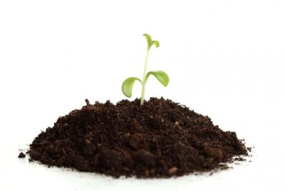
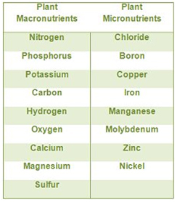
ESSENTIAL ELEMENTS
A rich loam soil will provide a balanced ___________ of the essential elements needed for
__________ and health of plants.
Some elements are required in ________ amounts (macronutrients)
and some only in _______ amounts (micronutrients), but all are
essential for the plant to grow and develop.
A catchy phrase to remember these 17 elements:
See Meg’s men mob Cousin Hopkins nice clean café
C Mg Mn Mo B Cu Zn H O P K N S Ni Cl Ca Fe
NUTRIENT DEFICIENCY – Plants may show deficiency ____________ for
several reasons:
- The element is _____ in the soil, or there is not _________ of it
- The element is in a _______ that the plant cannot use
- There may be an _____________ of nutrients in the soil

Slide 6
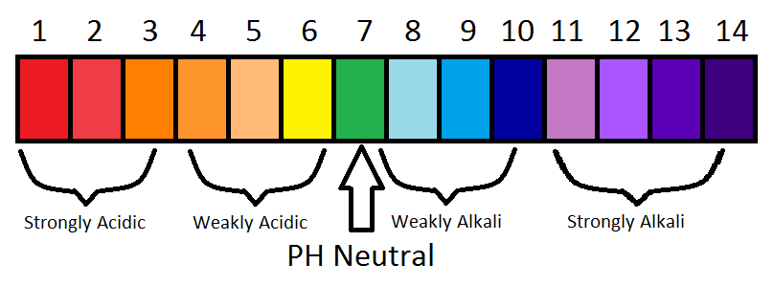
pH Scale
_________
_______ ______ _______ _______ _______
_____ _____ _____
( _______ )
_____________

Slide 7
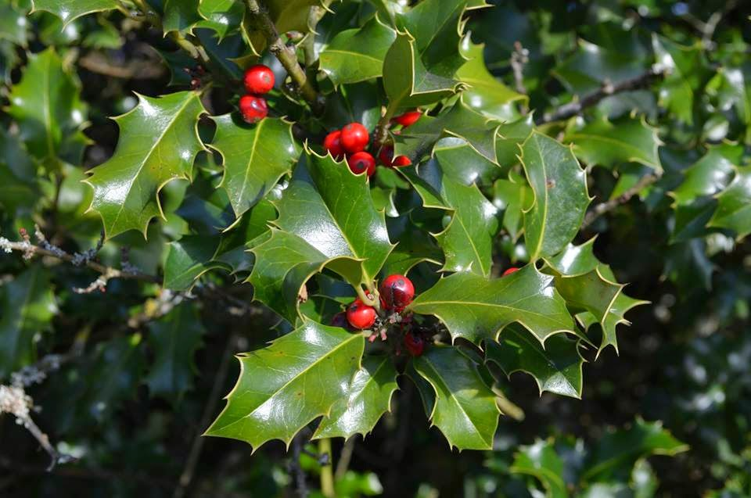
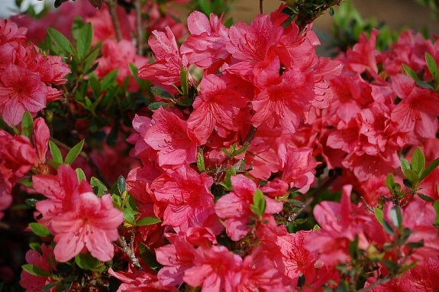
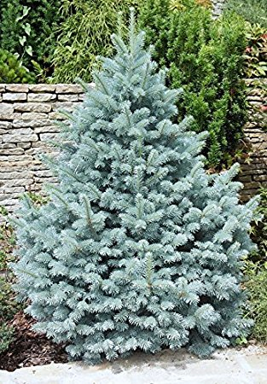
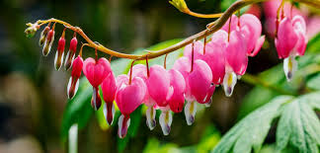
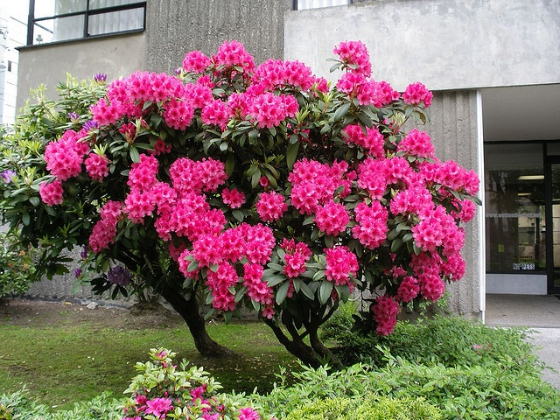
SOIL pH
Certain plants grow better in ____________ soil pH ranges
PLANTS THAT PREFER ACIDIC SOIL (“sour soil”)
_________________ ________________
____________________
____________________ ____________________

Slide 8
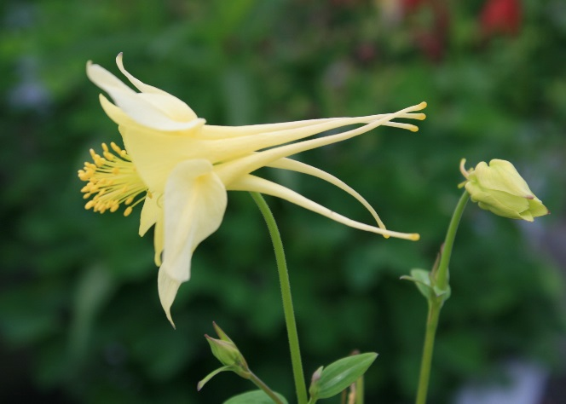
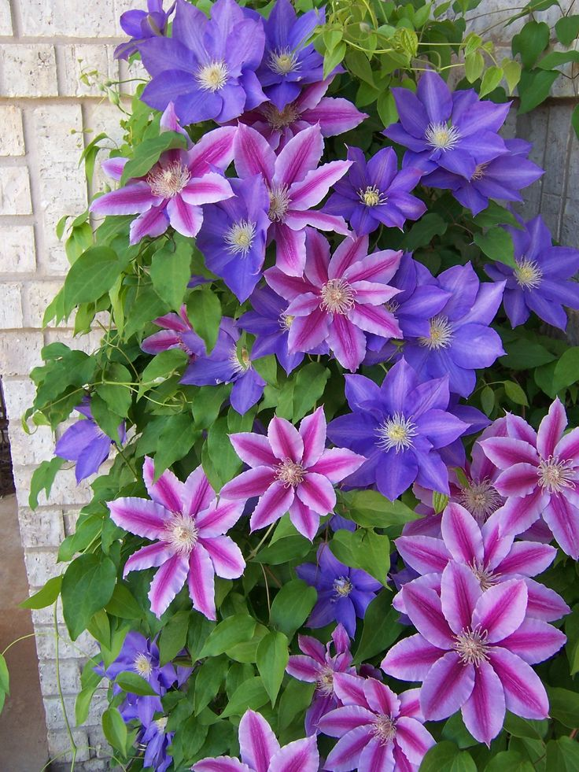
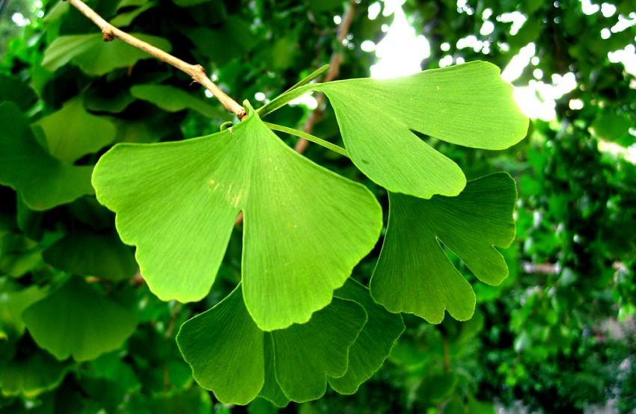
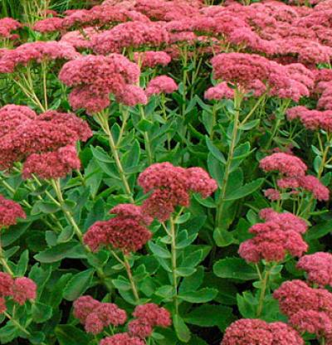
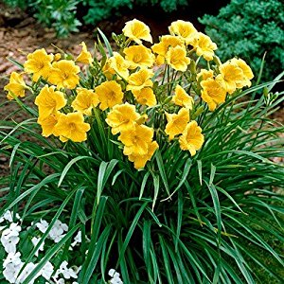
PLANTS THAT PREFER ALKALINE SOIL (“sweet soil”)
_________________
_______________
_______________________
__________________
_____________

Slide 9
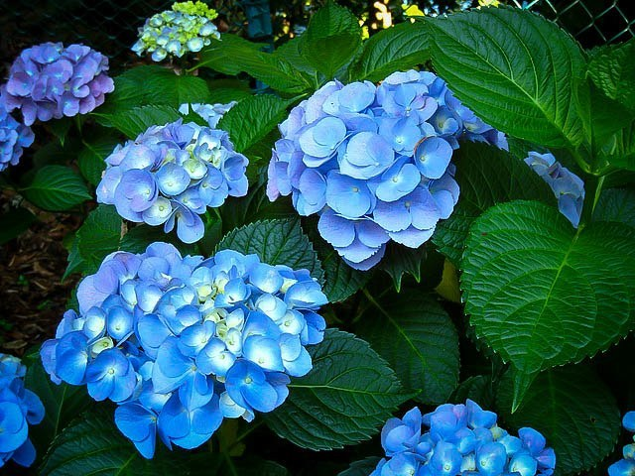
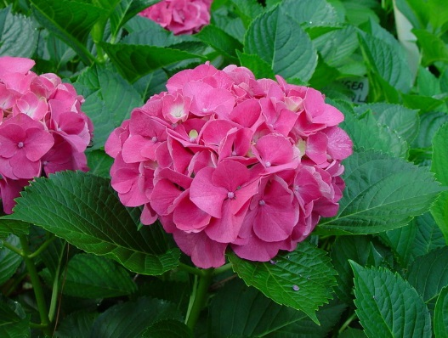
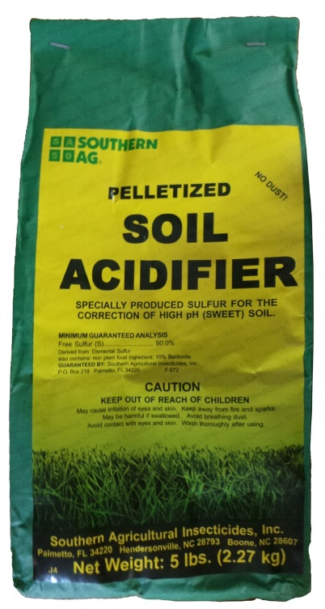
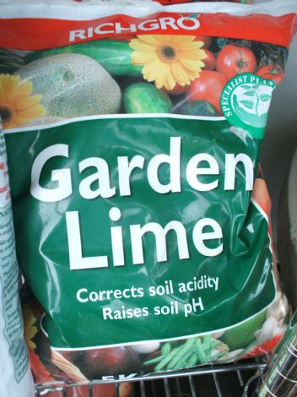
FUN FACT:
Hydrangeas grown in _________ soil will grow _______ flowers
and those grown in __________ soil will grow ______ flowers
Blue hydrangea Pink hydrangea
To shift the pH of your soil you can add:
_______________ like garden sulfur, aluminum sulfate, or
iron sulfate to ________ to pH
_______ like garden lime to ____________ the pH

Slide 10
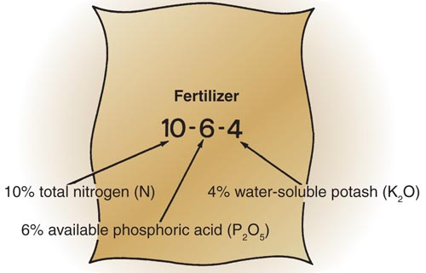
FERTILIZERS
Fertilizers are ____________ boosts _________ to the soil to enhance crop productivity.
The _____ macronutrients needed in ____________ quantity by the plant are: _______________ _____
A fertilizer that provides ______ three of these _______________ _____
elements is called a ____________ fertilizer
_______________ _____
On a fertilizer ______________ you will see three numbers
listed on the front in a _________ font size.
These numbers represent the __________ by _________ of
the three nutrients (Ex. 10% N 6% P 4% K)
The nutrients are in the form: N P₂O₅ (phosphoric acid)
K₂O (potash)
(so the __________ of P and K is actually ______ than the
analysis really says

Slide 11
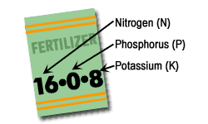
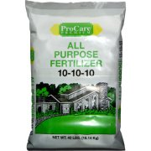
You do the Math!
1. If you have 100 lbs. of a 5-10-5 fertilizer, how many pounds of each do you have?
________ ________ ________
N P₂O₅ K₂O
Why don’t the 3 numbers add up to 100 pounds? Because the balance is ____________ and possibly _______ minerals
2. If you have 50 lbs. of a 20-5-20 fertilizer, how many pounds of each do you have?
_______ _______ ________
N P₂O₅ K₂O

Slide 12
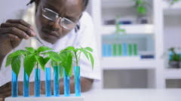
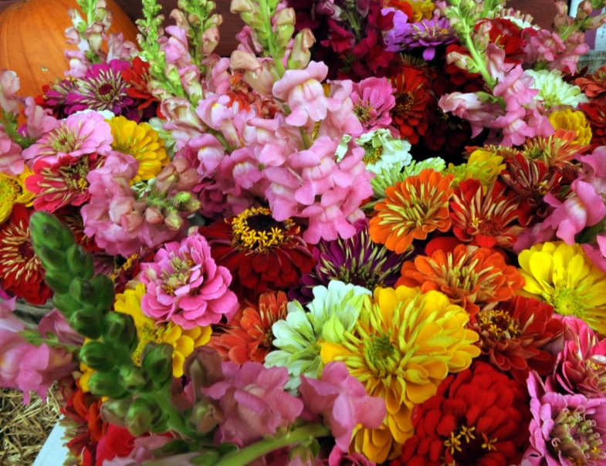
PROFESSIONS IN HORTICULTURE
Some of the benefits of a ___________ in horticulture are:
Wide __________ of careers
Work indoors or __________
Help ___________ the community
Relaxing & ______________ work
Jobs in horticulture can be classified as _____________ labor, ____________ labor, middle management,
owner/operator, educator, and ______________.
FLORICULTURE
The _________________ industry is involved
with the ______________, distribution, and
utilization of __________ products. Its businesses
range in _______ from small shops to international
companies.

Slide 13
FLORICULTURE CAREERS
GROWERS Floriculture crops may be grown outdoors or in ____________ Growers can start as _____________ labor and ______ experience to become skilled labor Most growing operations are ___________ firms selling to __________ garden centers & florists | LANDSCAPE FLORICULTURE SPECIALIST Work for large _________ or property management companies using flowers to help _________ their properties The crew _________ will design the layout of flower beds, prepare __________, and _______ & supervise the crew members
FLOWER SHOPS Small businesses where the ________ is directly involved with the ______ and services offered Products offered include _________ plants, floral arrangements, and _____ flowers Requires _____________ & _______________ skills | TEACHER Teach students ____________ in horticulture and foster their careers Masters __________ are required Can teach at the ____________ or college level
FLORAL DESIGN The artistic craft of ____________ floral designs by __________ and assembling colors, _______, textures, and materials for ______ arrangements May design arrangements for __________, proms, funerals, ___________, and special events | RESEARCHER Researchers seek ways to ___________ crops and production methods Their research may include selectively __________ plants to develop _____ and better varieties. They also research ways to _________ pests

Slide 14
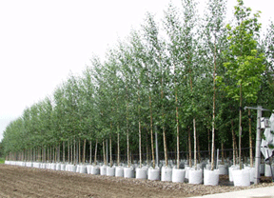
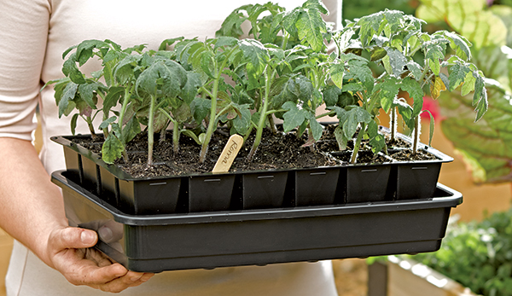
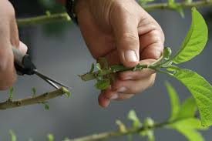
CAREERS IN THE NURSERY INDUSTRY
Nurseries deal largely with ________ plants
such as ________, shrubs, and vines.
DIFFERENT TYPES OF NURSERIES
(1) PROPAGATION NURSERIES
Initiate plant production using ________, cuttings,
or other types of vegetative _______________
Introduce new varieties and ___________ to the
nursery industry as a whole
Key _________ of ____________ stock

Slide 15
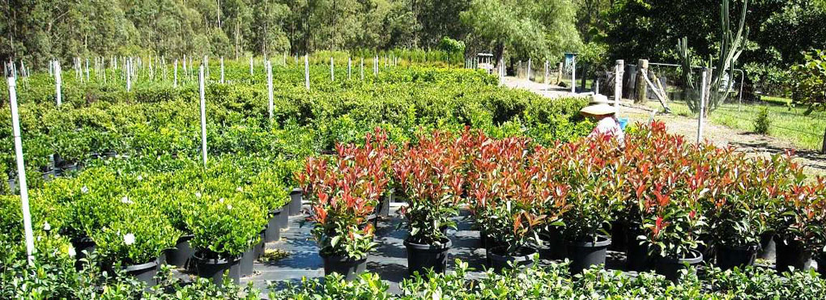
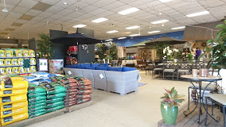
(2) WHOLESALE NURSERIES
Grow plants in a _______ that can be sold for
landscape installation
Plants may spend from ___ to 5 years here
To hold down production costs, they may
________ the number of varieties to those
requiring __________ growing requirements
(3) RETAIL NURSERIES & GARDEN CENTERS
Where the ____________ buys trees, shrubs, _____________, fertilizers,
grass seed and tools
Might also have _______ items, pet supplies, bird food, firewood, and
_____________ items
No real growing areas, instead plants are ____________ in sales yards
Workers in retail nurseries must have a thorough _______________ of plants
as well as good ______________ skills and ______ working with the public

Slide 16
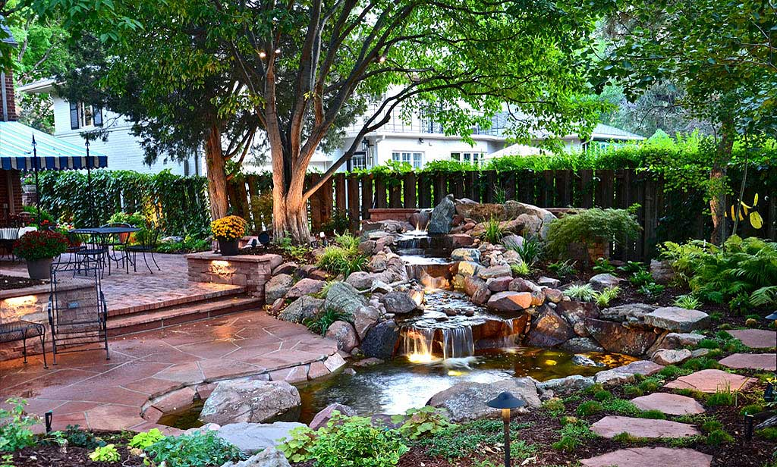
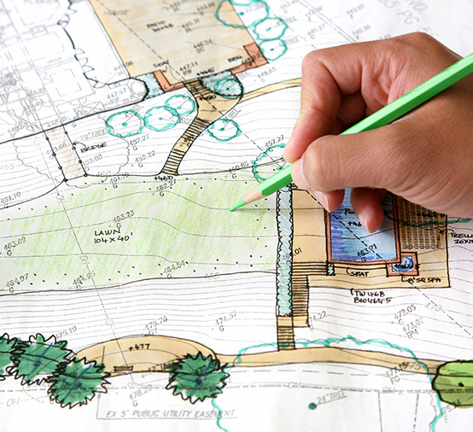
CAREERS IN LANDSCAPE
A landscaper ___________ and __________ the spaces
outside of buildings
(1) LANDSCAPE ARCHITECTS AND DESIGNERS
- Conceive ______ that become the landscape
- Identify client ______ and match them with
the ______________ and ___________ of the site
- Makes graphic _______and models to communicate
ideas
- In New York State, landscape _______________ must
have the correct _____________ and be
certified; _____________ do not have this
requirement

Slide 17
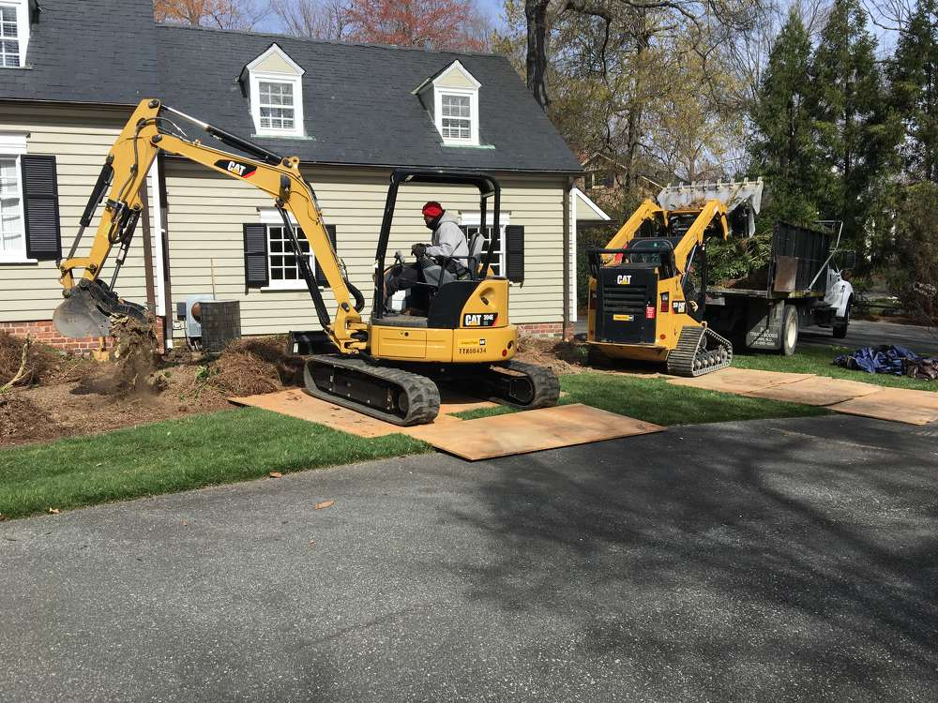
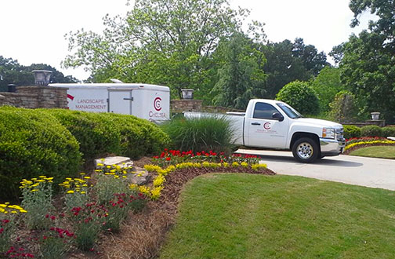
(2) LANDSCAPE CONTRACTORS (3) LANDSCAPE MAINTENANCE
- Construct and __________ landscapes that - Responsible for the ______ of landscapes ______
were designed by the architect they have been installed by the contractor
High ______ of equipment - Tasks such as _________, pruning, weeding,
fertilizing, and __________
- Investment cost is ______ than contractors

Slide 18
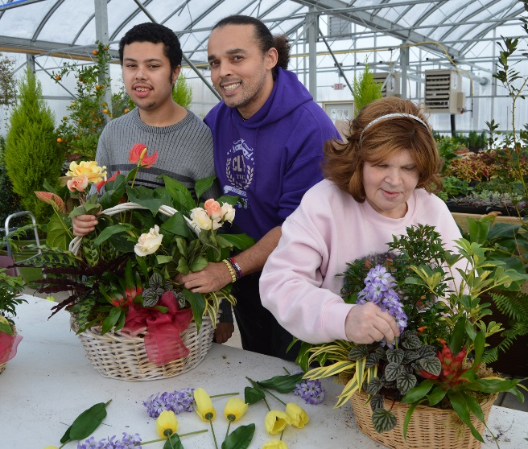
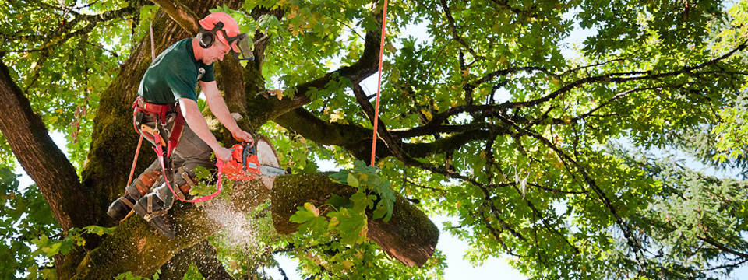
OTHER CAREERS
(1) HORTICULTURE THERAPISTS
- Work with the ___________, physically or mentally ______________,
or imprisoned
- For the elderly, many have ______________ of plants & gardening and
they ________ growing and nurturing living plants
- Disabled individuals can increase their ___________ dexterity and
self-confidence. Working with plants is mentally
_______________ and gives them usable ______ skills
(2) ARBORISTS
- Tree _________________ specialists
- Vigorous ___________ work that is
potentially dangerous
- Services include tree __________,
tree removal, fertilizing, and
______ treatment

Slide 19
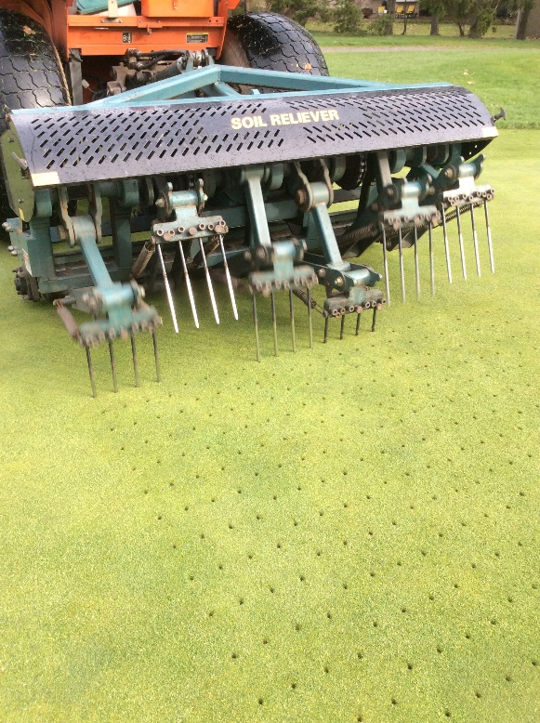
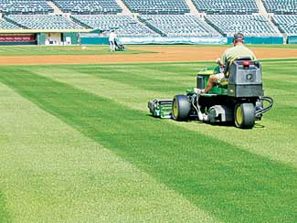
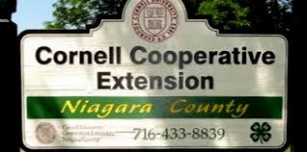
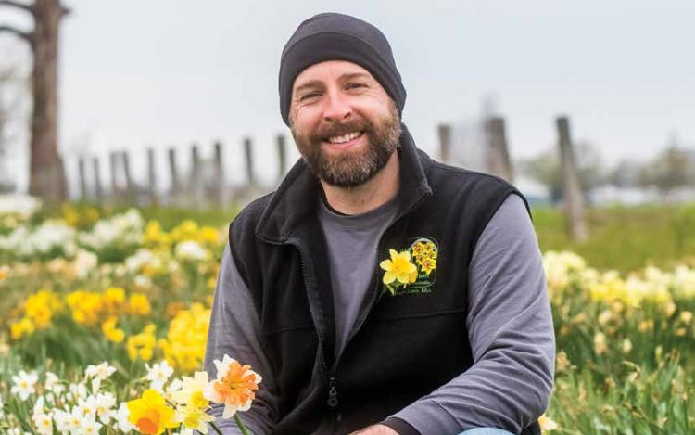
(3) TURF MANAGEMENT
- Install and maintain ______ courses, athletic fields,
parks, residences, and _____________ land
- Work involves __________, aerating, dethatching,
and fertilizing
(4) COOPERATIVE EXTENSION SPECIALIST
- Process the latest _______________ from universities and research firms
and turn it into a form that the industry and _____________ can use
- Affiliated with the state college of _______________
- Works with growers, homeowners and _______ groups
(5) COMMUNICATIONS SPECIALIST
- ________ and speak about horticulture for newspapers,
_____________, on-line, and live audiences - Career opportunities include _________, photographer,
illustrator, __________ designer, and public speaker

Slide 20
