Slide 1
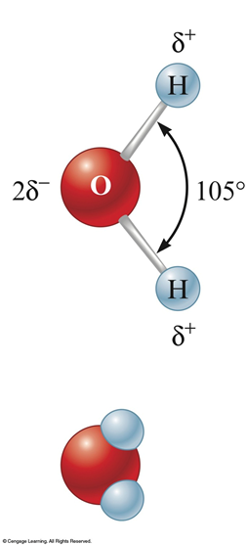
4.1 Water, the UNIVERSAL solvent
One of the most important substances on Earth.
Dissolves many different substances.
Polar molecule because of its unequal charge distribution.

Slide 2
Dissolution of a SOLID in a LIQUID
The ions from the ionic solid, stay in solution and conduct a current rather than re-forming a solid.
Polar nature of the water molecule allows for this to happen…
Positive ions associate with negative end of H₂O
Negative ions associate with positive end of H₂O

Slide 3
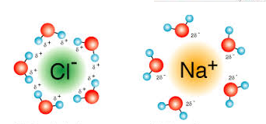
Dissolution of ionic solid in a liquid

Slide 4
Aqueous Solutions
Solute is the dissolved substance in a solution.
Sugar in soda drinks
Salt in salt water
Carbon dioxide in soda drinks
Solvent is the dissolving medium in a solution.
Water in salt water
Electrolyte is a substance that when dissolved in water produces a solution that can conduct electricity.

Slide 5
“Like Dissolves Like”
Nonpolar solutes dissolve best in
nonpolar solvents
Fats | Benzene
Steroids | Hexane
Waxes | Toluene
Polar and ionic solutes dissolve best in
polar solvents
Inorganic Salts | Water
Sugars | Acetic acid

Slide 7
Strong Electrolytes
Completely ionize when dissolved in water.
Soluble salts like NaCl
Strong acids like HCl, HNO₃ and H₂SO₄
Strong bases like NaOH, KOH

Slide 8
Weak Electrolytes
They produce few ions when dissolved in water
Weak acids like acetic acid HCH₃O₂
Only 1% dissociates into cations
Since it is a weak electrolyte it is called a weak acid
Weak Bases like Ammonia NH₃
Only 1% dissociates into anions
Since it is a weak electrolyte it is called a weak base

Slide 9
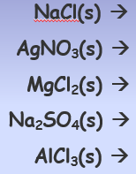
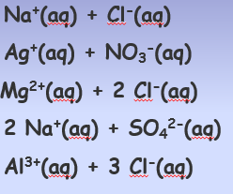
Practice with Dissociation of Ionic compounds

Slide 10
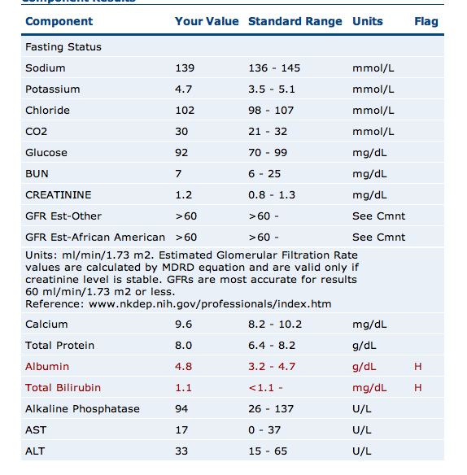
Concentration of Solutions

Slide 11
Calculating concentration
The concentration is important because it tells you the amounts of chemicals present in the solution
Molarity is a common way of expressing concentrations, and it is defined as moles of solute per volume of solution.
M = moles of solute
liters of solution

Slide 12
Finding Molarity practice problem
Calculate the molarity of a solution prepared by dissolving 11.5g of solid NaOH in enough H2O to make 1.50 L of solution
Want:
Have:
Need:
Fromula:

Slide 13
Finding ion concentration when Molarity is given
Give the concentration of each type of ion in 0.50M Co(NO₃)₂
Want:
Have:
Need:

Slide 14
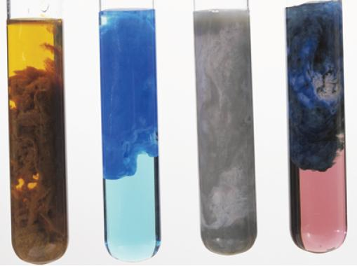
Precipitation Reactions
Pages 153-158

Slide 15
When two ionic solutions are mixed, an insoluble substance may form.
The solid separates from the solution and is known as a precipitate.
Determining if a reaction will form a precipitate requires memorization of some basic solubility rules.
Table 4.1 page 156

Slide 16
NAGSAG

Slide 17
Always Insoluble Solubility Rules
Students Happily Prefer Chemistry Class!
Sulfides (S) ⁻²...............Except: Groups 1 & 2
Hydroxides (OH) …………Except : Group 1 & Castrobear
Phosphates (PO₄) ⁻³
Carbonates (CO₃) ⁻² Except: Group1 & NH4⁺
Chromates (CrO₄) ⁻²

Slide 18
Double Replacement Reactions
The ions of two compounds exchange places in an aqueous solution to form two new compounds.
AX + BY → AY + BX
One of the compounds formed is usually a
precipitate (an insoluble solid), an insoluble gas that bubbles out of solution, or a molecular compound, usually water.

Slide 19
Double replacement forming a precipitate…
Lead(II) nitrate + potassium iodide → lead(II) iodide + potassium nitrate
Double replacement (ionic) equation
Pb(NO₃)₂(aq) + 2KI(aq) → PbI₂(s) + 2KNO₃(aq)
Complete ionic equation shows compounds as aqueous ions
Pb²⁺(aq) + 2 NO₃⁻(aq) + 2 K⁺(aq) +2 I⁻(aq) → PbI₂(s) + 2K⁺(aq) + 2 NO₃⁻(aq)
Net ionic equation eliminates the spectator ions
Pb²⁺(aq) + 2 I⁻(aq) → PbI₂(s)

Slide 20
Practice Problem
silver nitrate + potassium chloride silver chloride + potassium nitrate
Double Replacement reaction
AgNO_{3 (aq)} + KCL(aq) AgCl_{(s)} + KNO_{3 (aq)}
Complete ionic reaction
Ag⁺ + NO₃⁻ + K⁺ + CL⁻ Ag⁺ + Cl⁻ + K⁺ + NO₃
Net ionic Reaction
Ag⁺_{(aq)} + Cl- _{(aq)} AgCl(s)

Slide 21
Reactions of Acids and Bases
www.lab-initio.com

Slide 22
7 Strong Acids
These are the strong acids. What makes them 'strong' is that they completely dissociate into their ions (H⁺ and an anion) when they are mixed with water. Any other acid is a weak acid!
HCl - hydrochloric acid HNO₃ - nitric acid H₂SO₄ - sulfuric acid HBr - hydrobromic acid HI - hydroiodic acid (also known as hydriodic acid) HClO₄ - perchloric acid
HClO₃ - chloric acid As the strong acids become more concentrated, they may be unable to fully dissociate. The rule of thumb is that a strong acid is 100% dissociated in solutions of 1.0 M or less.

Slide 23
Acids React with Active Metals
Acids react with active metals from Group 1 and Group 2 to form salts and hydrogen gas.
Mg + 2HCl → MgCl₂ + H₂(g)
Zn + 2HCl → ZnCl₂ + H₂(g)
Mg + H₂SO₄ → MgSO₄ + H₂(g)
Acids DO NOT react with inactive metals like
Cu, Ag, Au

Slide 24
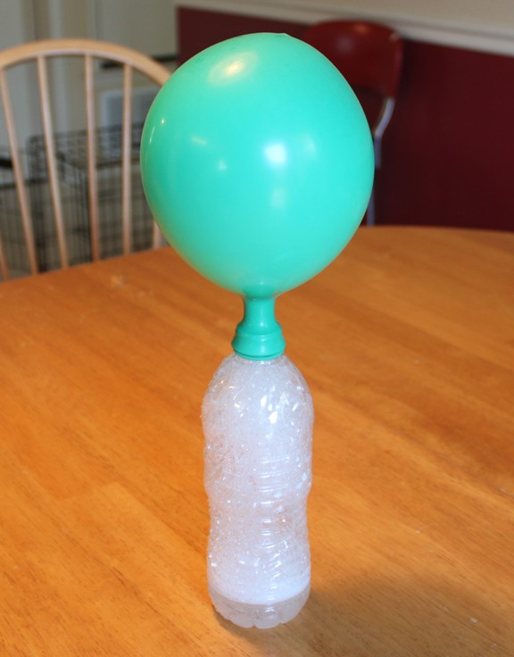
Acids React with Carbonates
2HC₂H₃O₂ + Na₂CO₃
Acetic acid Baking Soda
2 NaC₂H₃O₂ + H₂O + CO₂
Sodium Acetate

Slide 25
Effect of Acid Rain on Marble!
H₂CO₃ + CaCO₃ →CO₂ + H₂0
Carbonic Acid + Calcium Carbonate
George Washington:
BEFORE
George Washington:
AFTER

Slide 26
8 Strong Bases
Strong bases are bases which completely dissociate in water into the cation and OH⁻ (hydroxide ion). The hydroxides of the Group I and Group II metals usually are considered to be strong bases.
LiOH - lithium hydroxide
NaOH - sodium hydroxide
KOH - potassium hydroxide
RbOH - rubidium hydroxide
CsOH - cesium hydroxide
Ca(OH)₂ - calcium hydroxide
Sr (OH)₂ - strontium hydroxide
Ba(OH)₂ - barium hydroxide

Slide 27
Strong Acids Neutralize Strong Baes!
Neutralization reactions ALWAYS produce a
salt and water.
HCl + NaOH → NaCl + H₂O
H₂SO₄ + 2NaOH → Na₂SO₄ + 2H₂O
2HNO₃ + Mg(OH)₂ → Mg(NO₃)₂ + 2H₂O

Slide 28
Acid/Base Problems
Write the balanced molecular, ionic and net ionic equations
Strong Acids and strong Bases
Solutions of hydrochloric acid and sodium hydroxide are mixed.
2. Solutions of sulfuric acid and potassium hydroxide are mixed.

Slide 29
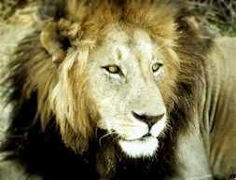
Oxidation-Reduction Reactions “Redox”
LEO SAYS GER

Slide 30
Electrons are transferred in REDOX reactions !
Lose Electrons = Oxidation
Sodium is oxidized
Gain Electrons = Reduction
Chlorine is reduced

Slide 31
Brief Review of Oxidation Numbers:
1. The sum of the oxidation numbers in
ANYTHING is equal to its charge
2. Hydrogen in compounds is ⁺1
3. Oxygen in compounds is ⁻2

Slide 32
Not All Reactions are Redox Reactions
Reactions in which there has been no change in oxidation number ARE NOT redox rxns.
Examples:

Slide 33
Trends in Oxidation and Reduction
Active metals:
Lose electrons easily
Are easily oxidized
Active nonmetals:
Gain electrons easily
Are easily reduced

