Slide 1
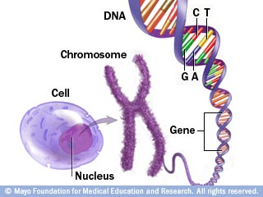
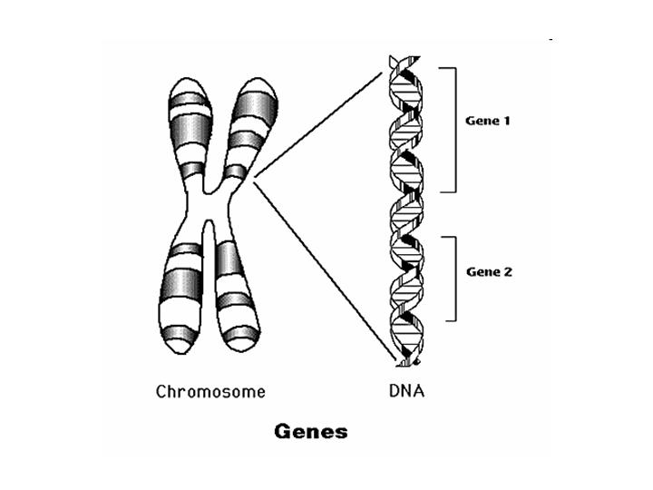
GENETICS - The study of how _________ are passed from parent to ____________
TRAIT = _________________ of an organism
Ex. ____________ ____________ ____________________
Human cells contain _____ chromosomes.
Along the length of the chromosome are
________ of genes. Each gene codes for
one trait (it is like a “_____________”)
___________
traits
offspring
characteristic
height
eye color
shape of nose
46
1000’s
recipe
DNA

Slide 2
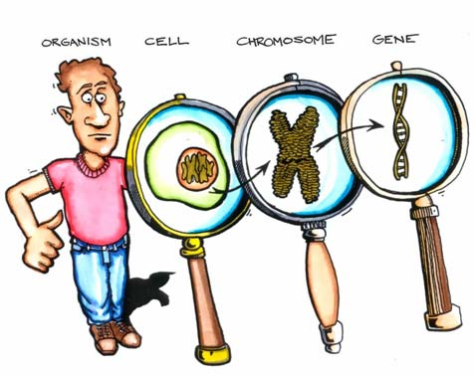
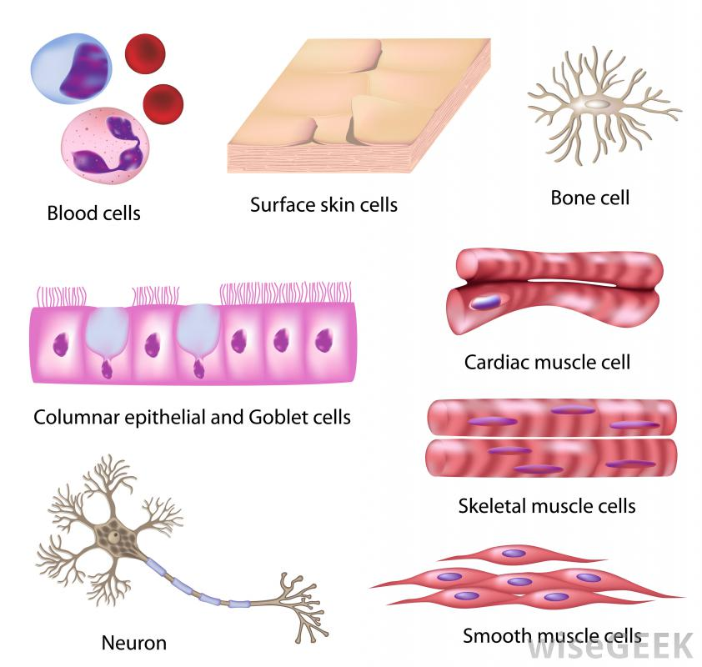
LARGE to SMALL: The _____________ contains 46 chromosomes.
Each chromosome is made of __________.
The genes are made of _______.
DNA For some traits, _______ than
one gene may work together
to _______________ a trait.
For example, _______ color
Body cells in an individual can be very
_______________ from one another because
different ___________ are switched on, even
though all cells contain the same _______.
nucleus
genes
DNA
more
determine
eye
different
genes
DNA

Slide 3
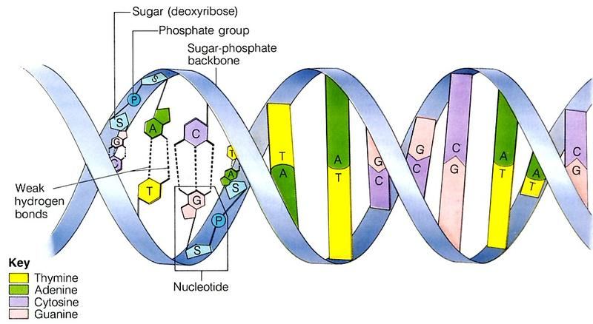
DNA
DNA is the abbreviation for _______________________________
DNA is the _____________ material that is _______________ (copied) and passed from parent to offspring. Each person has ____________ DNA
When DNA replicates
itself, the ________
bonds break.
There are 4 _________ (CGAT) that make up the “rungs” of the DNA “ladder.”
C always bonds with _____ A always bonds with _____
This is because the _________ of C fits with G, and the shape of A fits with T.
Deoxyribonucleic Acid
genetic
replicated
unique
weak
bases
G
T
shape

Slide 4
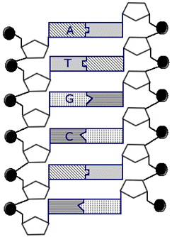
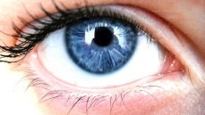
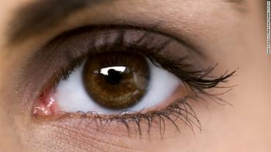
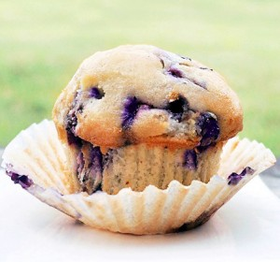
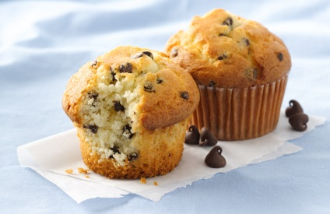
order
The ___________ of the bases determines the trait:
You Try! Ex. BLUE EYES BROWN EYES
Fill in the missing BASES C C
Label one SUGAR and one T T
PHOSPHATE G A
T T
A A
G G
Just like the list of ________________ in a
________ determines the food you create
ingredients
recipe

Slide 5
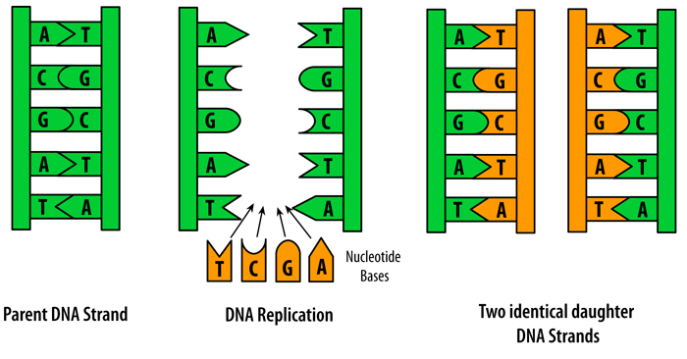
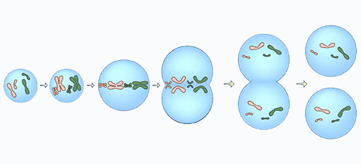
DNA REPLICATION - Chromosomes replicate (_______) themselves before
the cell ____________. Weak bonds ________
replication and the DNA “unzips.”
happens here
2 exact _________
of each chromosome
Each side of the DNA acts are created
as a _____________ for
Each daughter cell gets making more DNA
______ copy of each chromosome
copy
divides
break
copies
template
one

Slide 6
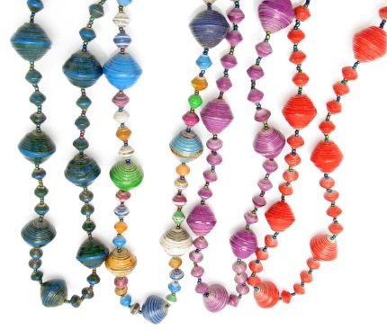
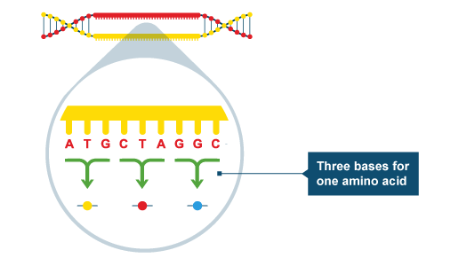
DNA to PROTEINS
1. DNA is the code for the synthesis of 1000’s of ____________ such as hair, muscle, &___________
2. Proteins are long, folded chains of __________________. There are _____ different amino acids
lined up in ________________ sequences.
It’s as though you had _____ different beads
and could make ________ of necklaces.
3. The _____________ of amino acids determines
the __________ and function of the protein.
Each _____ bases code for one of the 20
amino acids. The amino acids bond and
fold to make the ____________.
proteins
enzymes
amino acids
20
specific
20
1000’s
sequence
shape
3
protein

Slide 7
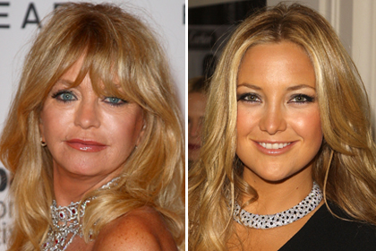
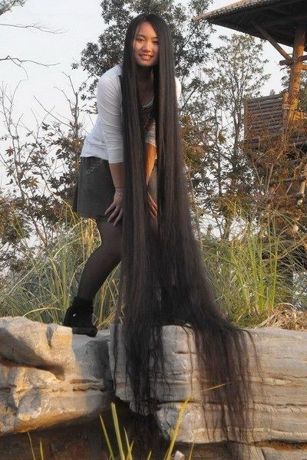
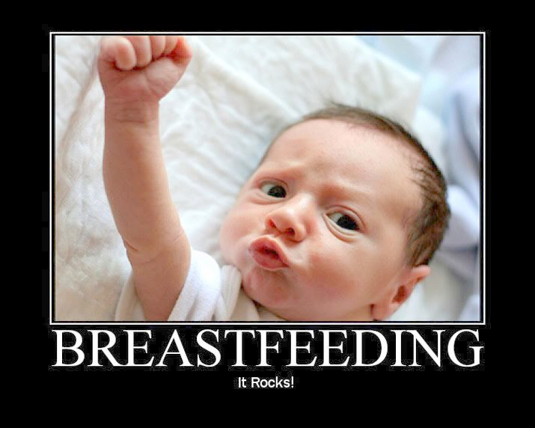
4. Offspring resemble their _____________
because they inherit genes that code
for similar _______________.
5. Each cell is regulated by hormones to _____________ which genes are
_______________ (“switched on”) and therefore which proteins are _______.
Ex. MAMMARY GLAND CELLS - The milk producing ________
is expressed when the baby breast feeds.
Ex. HAIR FOLLICLE CELLS –
The hair _________ gene is expressed.
parents
proteins
control
expressed
made
gene
growth

Slide 8
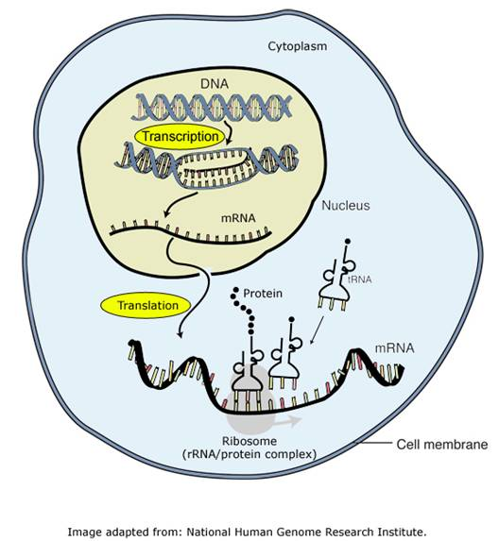
The Genetic Code and Protein Synthesis
1. The DNA code in the nucleus is converted
into ____________________ (mRNA).
2. The mRNA takes the code to the ____________
where a protein is made.
3. Each 3 bases sequence in the mRNA is a _______
for one of the amino acids.
4. The amino acids coded for are assembled into
a ______________
messenger RNA
ribosome
codon
protein

Slide 9
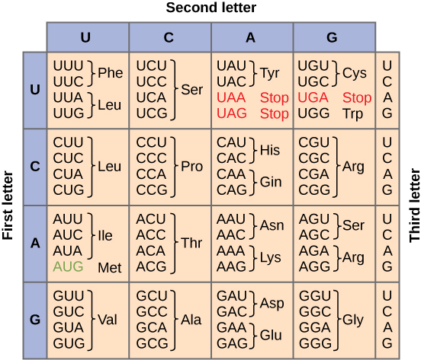
WHAT YOU NEED TO BE ABLE TO DO:
**NOTE – In mRNA, the
base Uracil (U) replaces
Thymine (T)
DNA Code: CAC GTG GAC AGA GGA CAC CTC
mRNA Code: ___ ___ ___ ___ ___ ___ ___
Amino Acid: ___ ___ ___ ___ ___ ___ ___
GUG
CAC
CUG
UCU
CCU
GUG
GAG
Val
His
Leu
Ser
Pro
Val
Glu

Slide 10
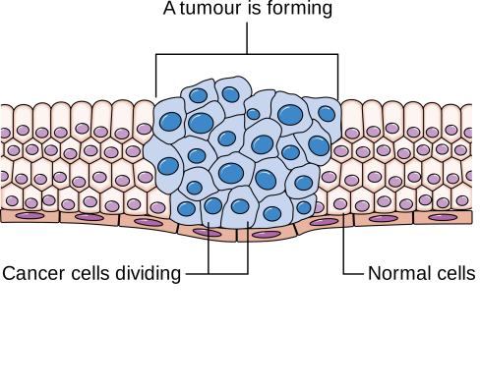
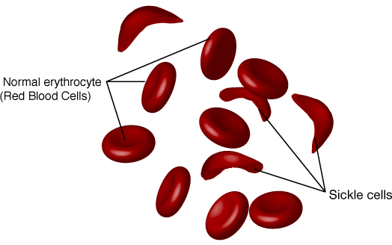
Mutations
Mutations are caused by alterations or ____________ in the DNA. Some causes of mutation
include the radiation from U-V Rays and ___________. Chemicals in the environment
like _____________ and cigarette smoke can also mutate DNA.
Altered genes may be passed on to every _________ that develops from it, but only
mutations in the egg or sperm will get passed on to the _____________.
EXAMPLES OF MUTATIONS:
1. CANCER – Uncontrolled cell division of abnormal cells
2. SICKLE CELL ANEMIA – This is a “Substitution” mutation where the normal base sequence GAA mutates to GTA coding for the _______ amino acid. This causes red blood cells to be sickle, or ____________ shaped rather than
round. These sickled RBC’s don’t carry oxygen well and can get stuck together forming _________.
changes
x-rays
asbestos
cell
offspring
wrong
crescent
clots

Slide 11
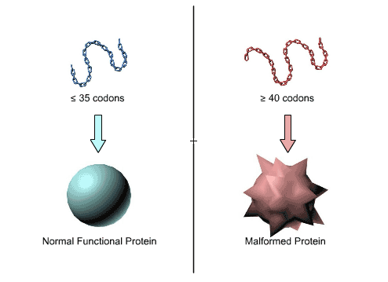
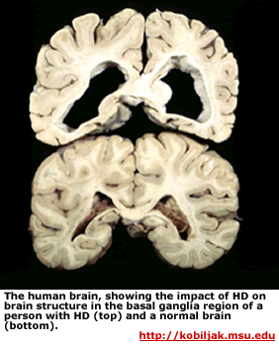
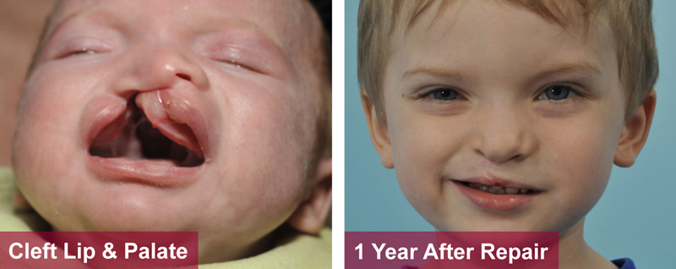
many
3. HUNTINGTON’S DISEASE – This is an “Insertion” mutation in which too ______ base sequences are _____________ into the DNA. This causes nerve cells to die in the _________.
4. “DELETION” mutations are when a ___________ of DNA is lost or deleted. Some
disorders ___________ by deletion are cleft palate and heart defects.
inserted
brain
section
caused

Slide 12
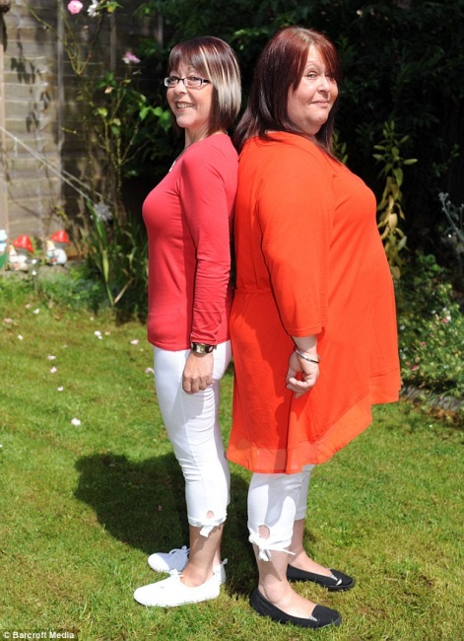
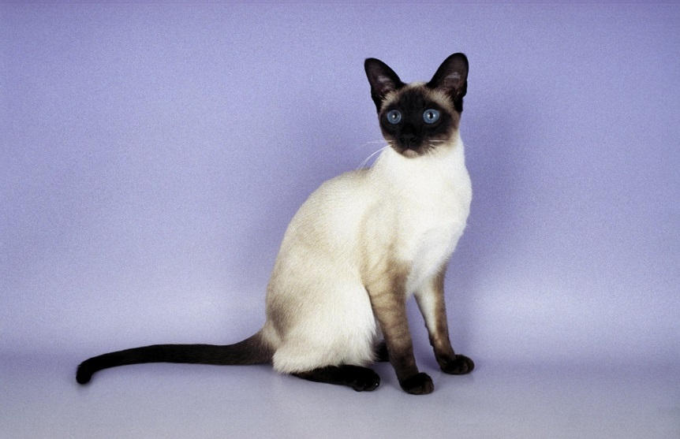
Interaction of Heredity & Environment
Traits are inherited but their _________________ can be modified, or changed, by
interactions with the environment.
Examples:
(1) IDENTICAL TWINS – The same genes
can be expressed differently due to choices
in ________, exercise, or exposure to toxins.
(2) TEMPERATURE & FUR COLOR – Siamese cats
grow dark fur in _______ areas of their bodies
like the nose, ears, and _______, and _________
fur in the warm areas like the chest.
expression
diet
cold
tail
light

Slide 13
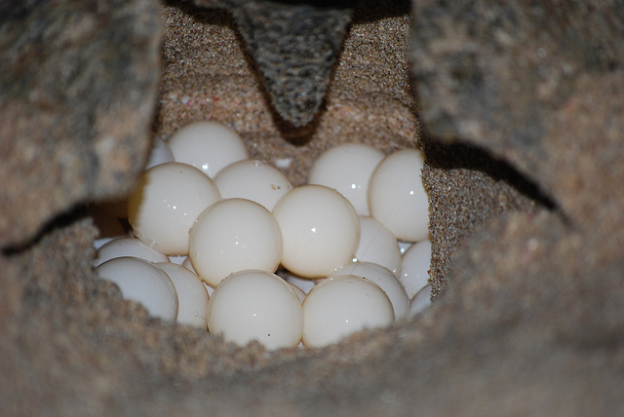
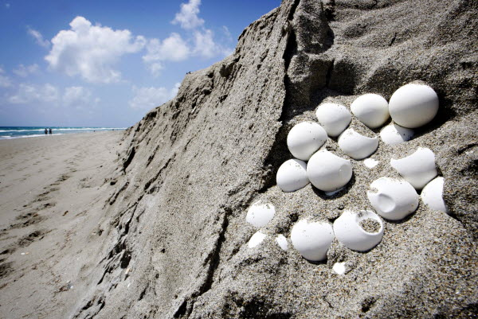
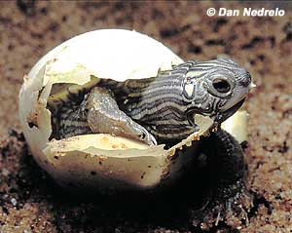
temperature
3. TURTLE EGGS – The gender of the turtle is determined by _________________.
If the eggs are buried in a ________ nest, they will develop into ________. But if the nest is hot, the turtles will become ____________.
cool
males
females

Slide 14
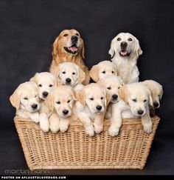
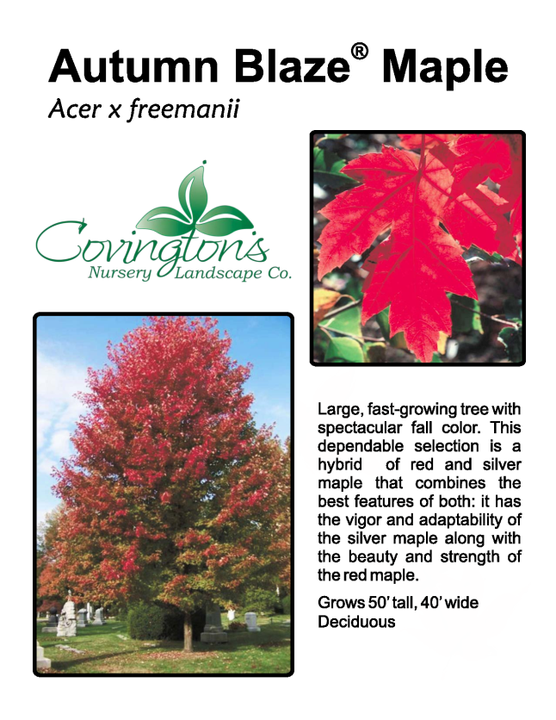
SELECTIVE BREEDING
For 1000’s of years, new ______________ of cultivated plants and domestic ____________
have resulted from selective breeding for particular __________. In other words,
humans have _______________ who will mate with whom.
EX. (1) DOG BREEDS – Pure bred dogs are (2) AUTUMN BLAZE MAPLE TREE maintained by mating closely Cross- __________________
_____________ dogs. of red maple & silver maple
varieties
animals
traits
selected
pollination
related

Slide 15
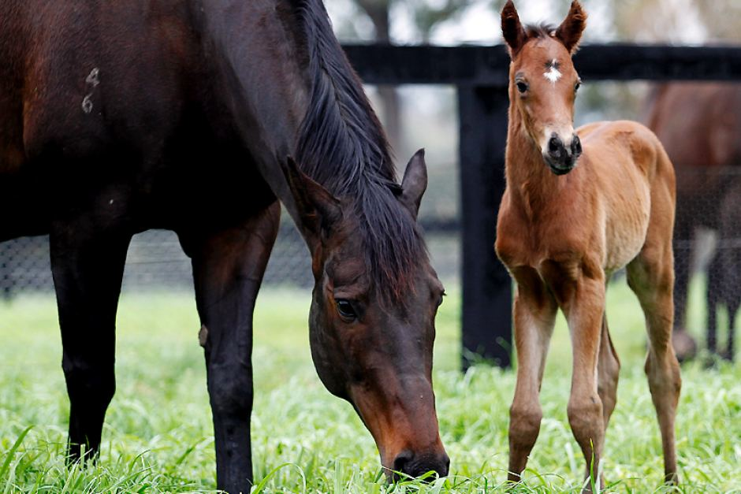
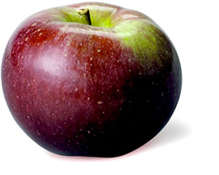
(3) McCOUN APPLES (4) RACE HORSES
Cross-pollination (hybrid) of Breeders will mate the ___________
McIntosh & Jersey Black and strongest stallions & mares in
____________ hopes of getting a winner
fastest
apples

Slide 16
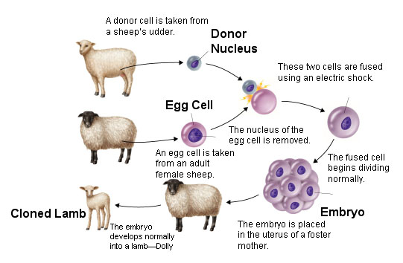
GENETIC ENGINEERING – The science of transferring ___________ from one
organism to another to bring about desired __________
and _____________ products.
CLONING – Cloning is useful for making _________ copies of the best animals.
genes
traits
protein
exact

Slide 17
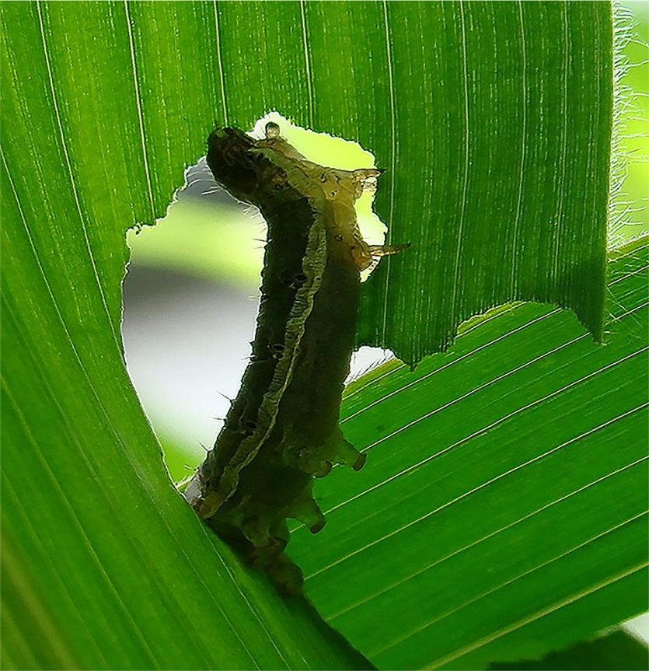
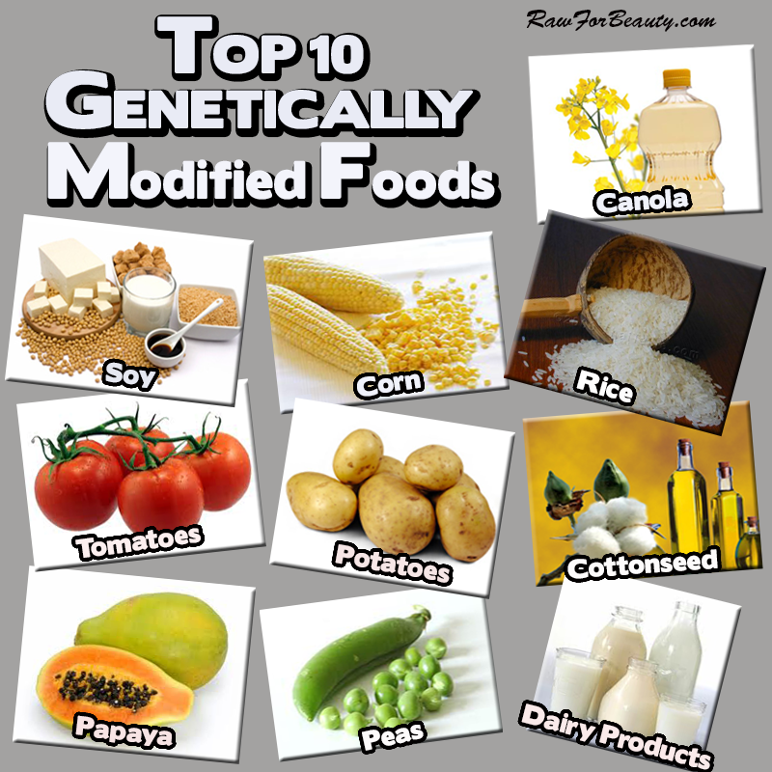
protein
2. PESTICIDAL CROPS - A gene that codes for a ____________ that is toxic
to insects is inserted into crops like corn. When the
insects ______ the crops, they ______ from the toxins.
eat
die

Slide 18
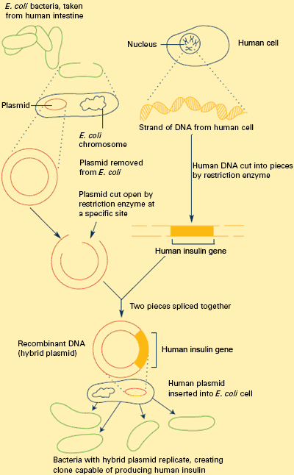
3. RECOMBINANT DNA
Human genes that code for
needed ___________ such
as insulin are inserted into
bacteria. ____________ are
used to cut segments of DNA.
The bacteria now start
reading the _______ and
making the protein in
________ quantities.
Each time the bacteria
reproduces, the gene gets
passed on to the ________
cells and they start making
more insulin.
proteins
enzymes
gene
huge
new

Slide 19
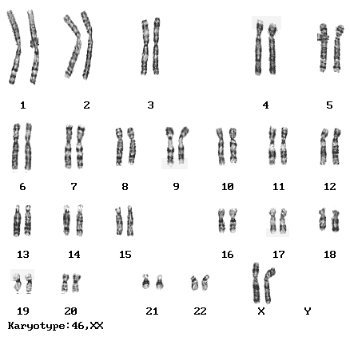
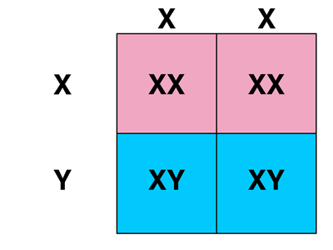
Sex Determination in Humans
The sex chromosomes in a human ________________ the sex of the baby.
WHAT IS THE PROBABILITY OF
HAVING A BOY OR A GIRL?
______ %
Mom’s Eggs
50%
Girls
Dad’s
XX = ___________ Sperm
50%
XY = ___________ _____ Boys
chromosomes
determine
50
female
male
sex

