Slide 1
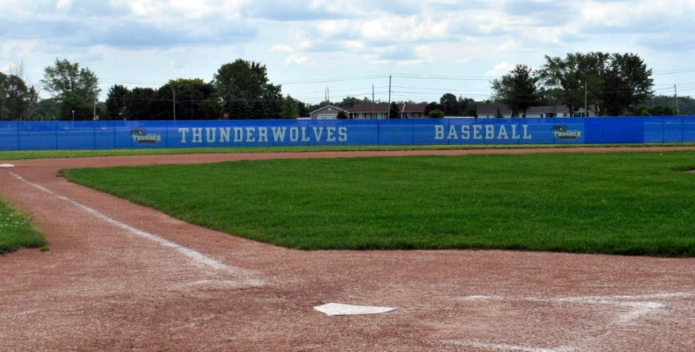
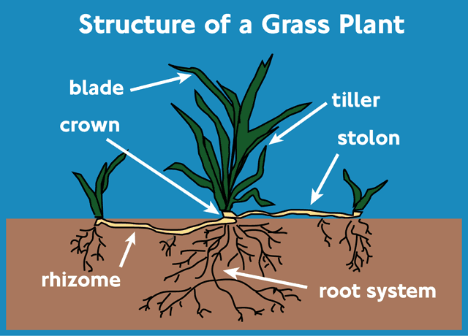
Intro to Turf Management
Turfgrasses are the __________ outdoor growing surface for:
Residential ___________
___________ and school campuses
Commercial ______________ (malls & office buildings)
________________ use in government buildings, airports, & highway ____________
Recreational use in _______ courses, parks, and athletic __________
Turfgrasses are ______________ whose apical meristems are at the
_________ near the soil. This low and ______________ location
of the growing point permits turfgrasses to be _________ and
walked on repeatedly. Turf species __________ in the amount
of ____________ they can handle – some will accept _________
use and will _________________ quickly, while others will show
__________________, slow growth, and even ________ spots.
Most turfgrasses are ________________ but there are some
__________ species used to quickly fill in bare spots. Turfgrass can
reproduce by ________ or by vegetative _________________.
ideal
lawns
College
landscapes
Municipal
dividers
golf
fields
monocots
crown
protected
mown
differ
traffic
heavy
recuperate
discoloration
bare
perennials
annual
seed
propagation

Slide 2
TURFGRASS BASICS
SEED SIZE ______ textured grasses = __________ seed = more seed per ________ = ______ expensive _________ textured grasses = __________ seed = less seed per _________ = ______ expensive | TEXTURE, COLOR & DENSITY TEXTURE – The ________ of the leaf blade determining fine, medium, or coarse texture. Typically, ______ texture is preferred COLOR – Varies from pastel to ______ green to bluish DENSITY – The # of aerial leaf ________ that a plant will produce
SOIL AND CLIMATE Turf species prefer a _____ of 6.5 to 7.0, well-___________, moist, and well-___________ soil Certain __________ are adapted for specific climatic _______________ such as humidity, _________, drought, or cold | TEMPERATURE COOL-SEASON GRASSES – Grow best in daytime temperatures of ________ ºF WARM-SEASON GRASSES – Grow best in daytime temperatures of ________ ºF
Fine
smaller
width
pound
more
fine
Coarse
larger
dark
pound
less
shoots
pH
aerated
drained
60-70
species
conditions
shade
80-95

Slide 3
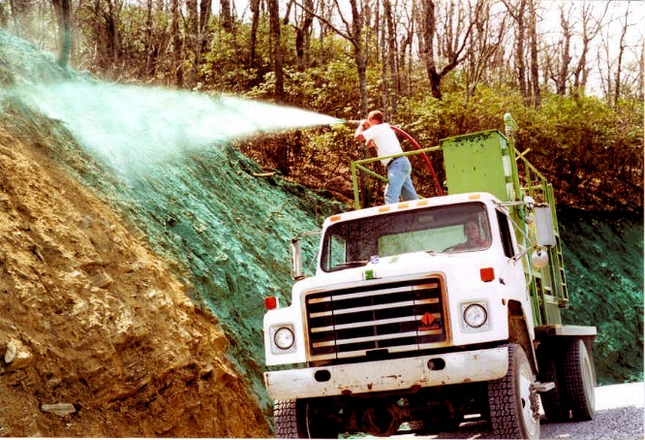
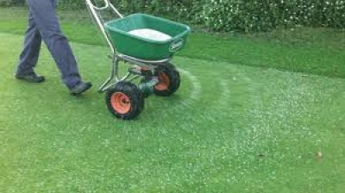
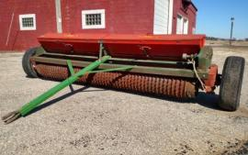
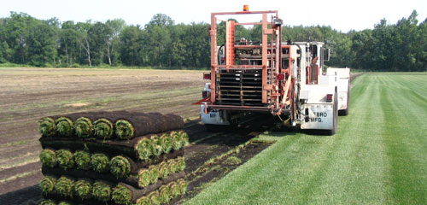
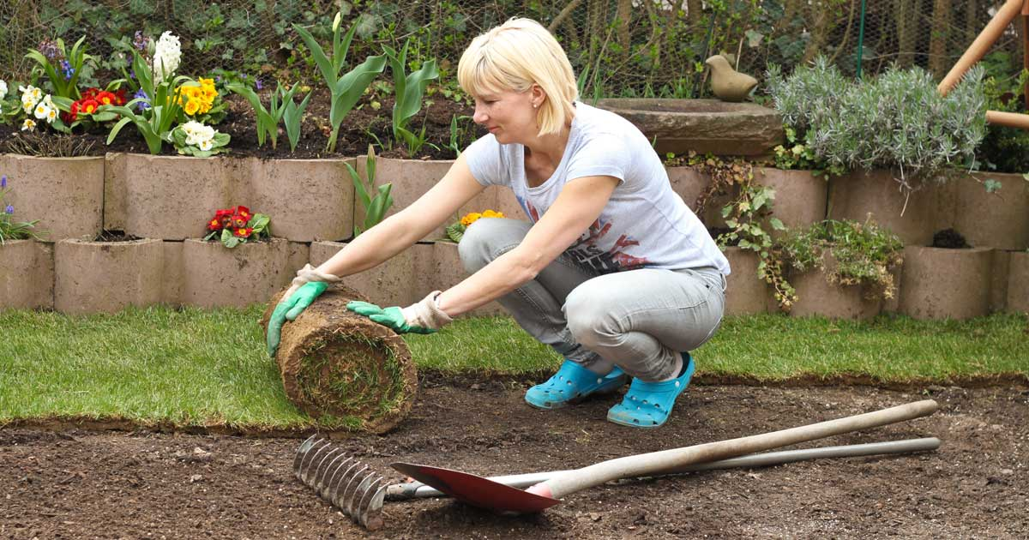
INSTALLING TURF (1) SEEDING
This is the most ____________ method of installing turf and the _________ expensive. Spreading seed can be done
by hand, with a spreader, a cultipacker ____________ , or by a hydroseeder.
SEEDER
SPREADER HYDROSEEDER
(2) SODDING
Sod is grown grass with the ________ attached. It is grown and ______ from one area then __________ to another.
Sodding gives ________ results but is _______________ and labor intensive.
SOD FARM
INSTALLING SOD
common
least
seeder
soil
cut
applied
fast
expensive

Slide 4
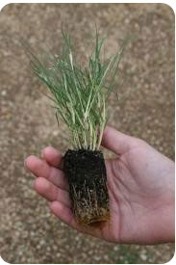
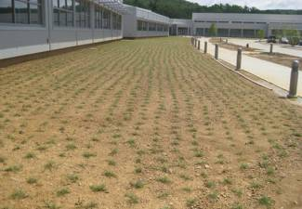
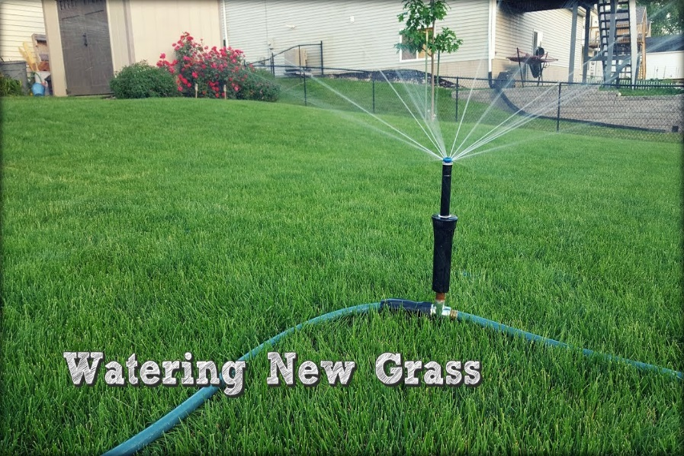
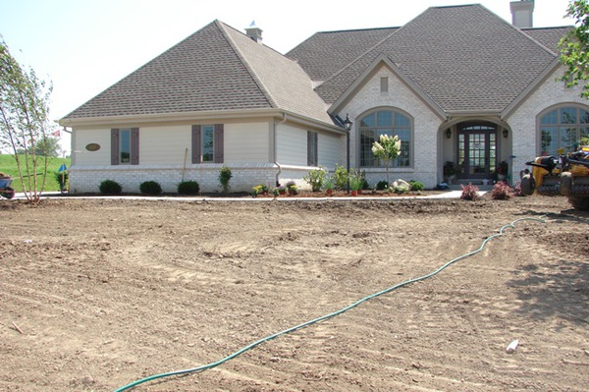
(3) PLUGGING
This is a _____________ more common in the ____________
states for ________________ grasses that are not good seed
producers. Plugs are _________ sections of sod. This is a
time-consuming way to __________ a lawn.
PLUG
NEWLY PLUGGED
ALL NEW LAWNS NEED:
Plenty of __________
Fertilizer
___________ - Lawns should be
designed with a slight ______
(6-12” decline per 100 feet)
to allow for ___________ of water
___________ - This is easily ___________
by adding organic matter to the soil
Removal of existing ______ and ________ GRADING
technique
southern
warm-season
small
install
water
Grading
slope
movement
Drainage
provided
rocks
weeds

Slide 5
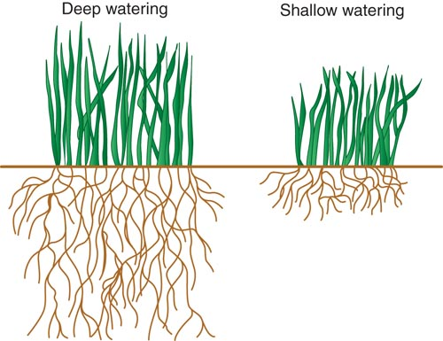
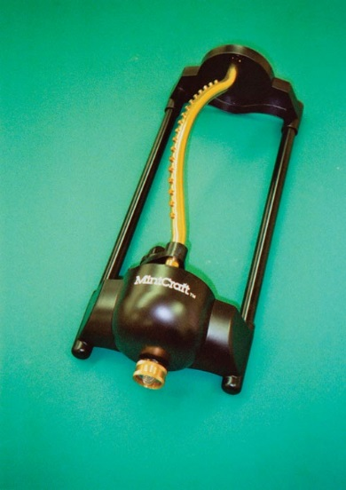
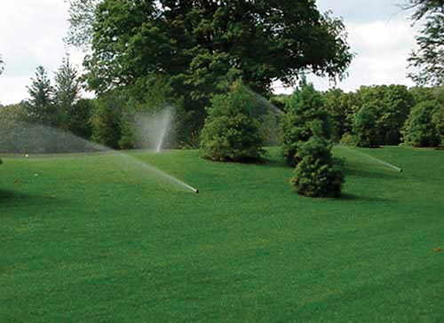
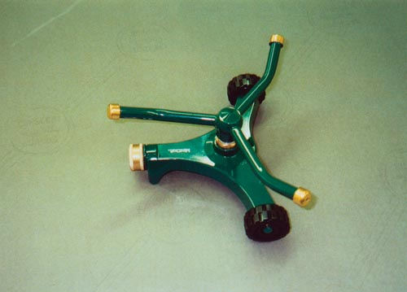
CARING FOR TURF
WATERING (Irrigation)
At first water ___________ and ________________
Once roots develop, water ___________ and infrequently
to ________________ deep root growth
When newly installed, turf should ______ be allowed to
dry out for at least one _________ or until the grass blades
are ___ inches long
Turf should be watered early in the ___________ to reduce
the amount of ________ the plant is wet
Automatic irrigation
irrigation
system
Revolving
sprinkler
Oscillating
sprinkler
lightly
frequently
deeply
encourage
not
month
2
morning
time

Slide 6
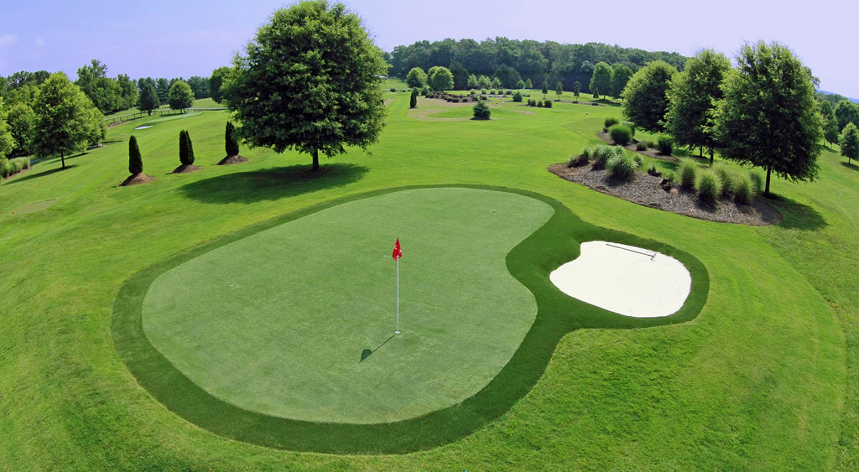
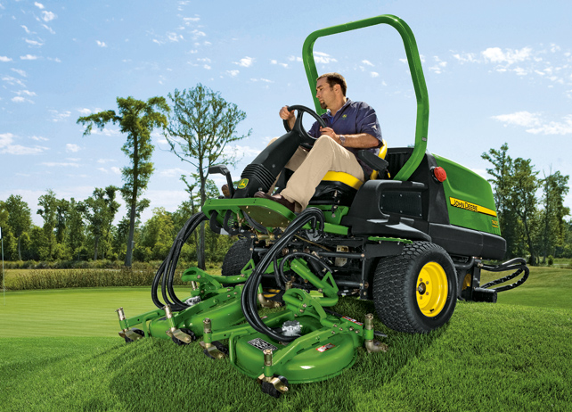
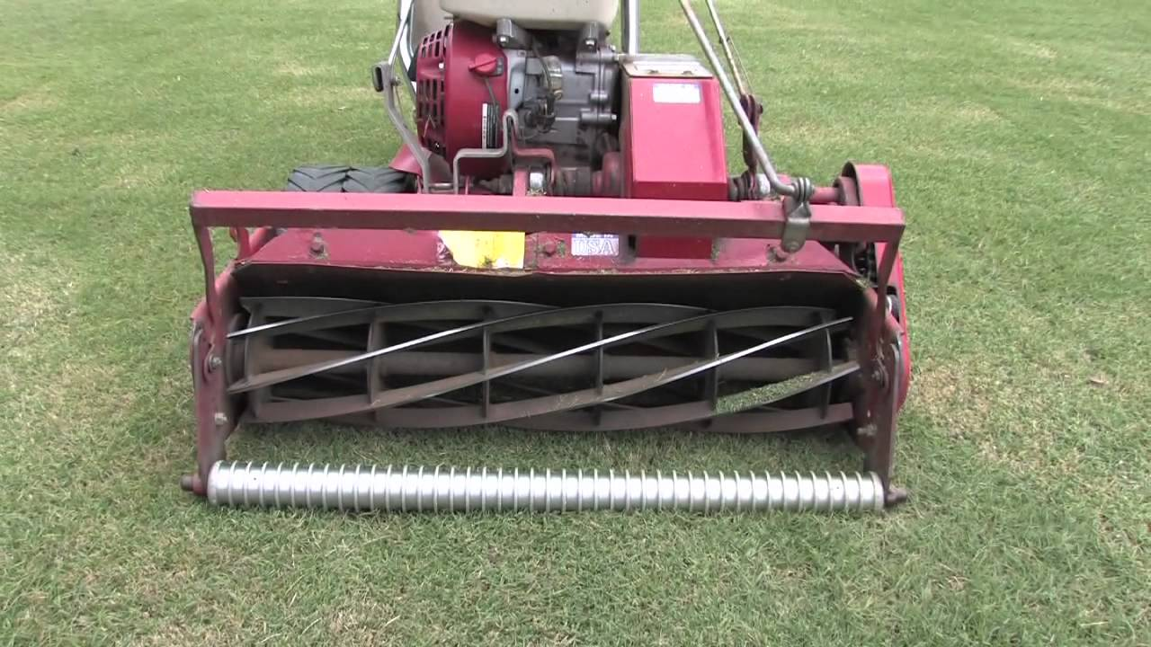
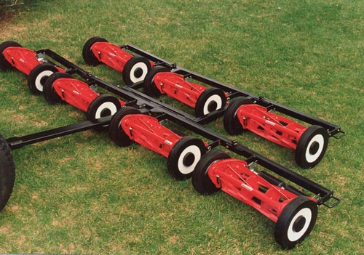
(2) MOWING
________ mow should be when new grass is _____ inches tall. Cut it back
to 1.5 inches. Collect ____________ only on this first mow as they
return ____________ to the soil
Future mowing _______________ and height depends on the __________
and desired look
Mowing is always ______________ to turf but ______________ growth
Most turf is mowed to 2-3 inches in ___________. Mowing too short can
lead to ________ invasion and reduces _______ growth and vigor
To endure ___________ conditions, increase the ___________ of the cut
and mow during ________ hours when not wilted
Keep mower _________ sharp and properly adjusted
Reel mower
First
3
clippings
nitrogen
frequency
species
stressful
encourages
height
weed
root
drought
height
cool
blades
Rotary mower

Slide 7
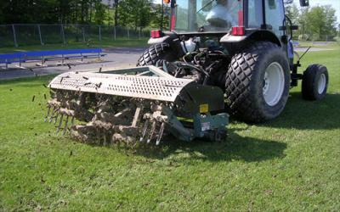
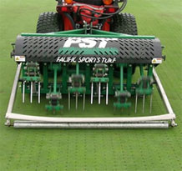
(3) AERATION
Aeration of a lawn is the _______________ of ______ to promote plant growth. Where traffic is _________ or the
________ content is high, the soil may become ________________. Aeration helps _____________ compaction.
HOLLOW TINE (Core Aeration) SOLID TINE
- Removes ________ and is the best relief from compaction - Punches holes ___________ removing a plug
- Can be messy and _________ intensive - _____ as disruptive to turf surface
- Can be _____________ to turf surface - Does not relieve compaction as _____ as hollow tine
addition
air
heavy
clay
compacted
alleviate
plugs
without
labor
Not
disruptive
well

Slide 8
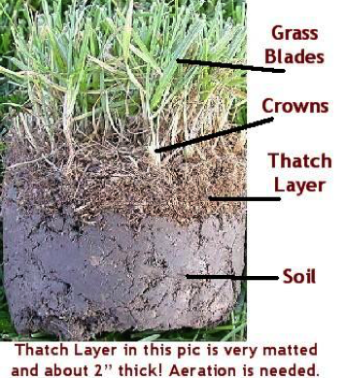
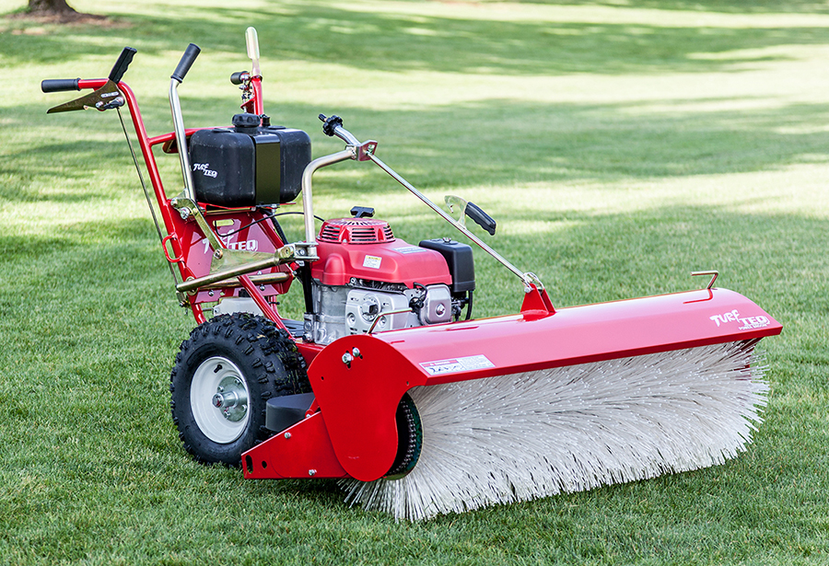
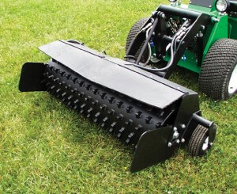
(4) DETHATCHING
Dethatching is the mechanical _________________ of a _________ of dead
organic matter called __________. A thin layer of thatch reduces compaction,
moderates soil _______________, and reduces water ________. But thatch
that is too _________ can keep _________ and nutrients from ___________
down to grass roots, and can encourage ______________ and insects.
If thatch is _____ than ½ inch thick it should be __________. Power raking
and core aeration are the _______ ways to reduce thatch.
Power sweeper
Power rake
removal
layer
thatch
temperature
loss
thick
water
seeping
disease
more
reduced
best

Slide 9
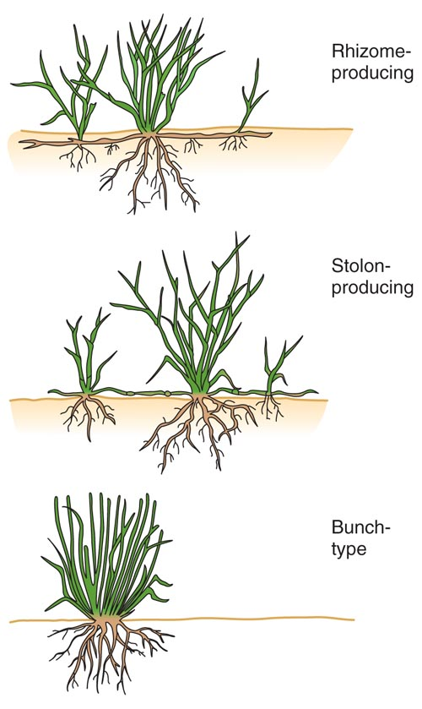
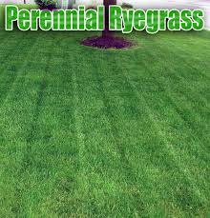
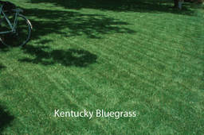
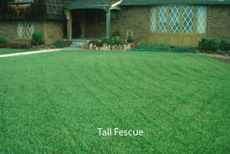
TYPES OF TURFGRASS
Turfgrass ____________ depends on many factors including the type of __________ on the turf (i.e. lawn, _____ course,
athletic field) and the _______________ and climatic conditions.
DESIRABLE TRAITS OF TURF:
Wear _______________
_________ recovery
Density
Traction
Pest/disease _____________
Attractive _______________
selection
activity
golf
temperature
tolerance
Rapid
resistance
appearance

Slide 10
COMPARISON OF TURFGRASSES
TRAITS | Perennial Ryegrass | Kentucky Bluegrass | Tall Fescue
Wear Tolerance (Toughness) | Fair to Good | Fair | _______________
Recuperative Ability (How quickly it can grow back) | ________ | Fair | Poor
Leaf Texture | Medium | __________________ | Medium to Coarse
Color of Blades | ________________ | Medium to Dark | Light to Medium
Shade Tolerance | Fair | Poor | _______
Cold Tolerance | Poor to Fair | ______________________ | Poor
Growth Habit | ________________ | Rhizomatous | Bunch Type
Seeding Rate (lb./1000 ft²⁾ | 7-9 | ______ | 7-9
Excellent
Poor
Fine to Medium
Light to Dark
Good
Good to Excellent
Bunch type
2-4
cool-season
two
Kentucky Bluegrass is the most commonly used ________________ turf. Mixtures of _____ or more grass species are
also common in our _____________ to increase wear tolerance and to ___________ disease issues. Blends of two or
more _____________ of the same species are used to maintain ________________ in appearance while reducing
devastation by ________, disease, and climate issues.
climate
reduce
cultivars
uniformity
wear

Slide 11
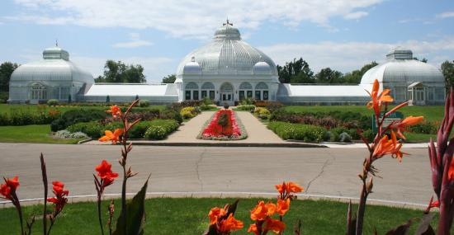
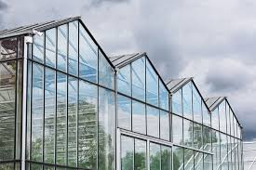
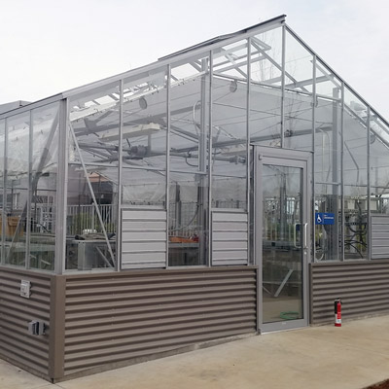
GREENHOUSE PURPOSES
1. To provide a ________________ growing environment
for high value crops
2. To _______ plants to be grown in areas where the
environmental conditions are not ___________ for
_____________ survival
Erie County Botanical Gardens 3. To extend the growing _____________ for plants at times
when they would normally go _____________
TYPES OF GREENHOUSES: (1) A-FRAME - This has the best environmental _____________ but is the
________ expensive to build and heat. A-frames also allow
the maximum amount of _________.
RIDGE AND FURROW
A type of a-frame
that is a bit less expensive Stand Alone due to lack of interior A-Frame
walls, but is weak under
heavy snow
controlled
allow
suitable
outdoor
season
dormant
control
most
light

Slide 12
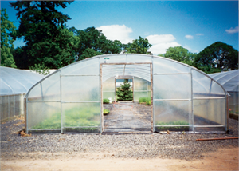
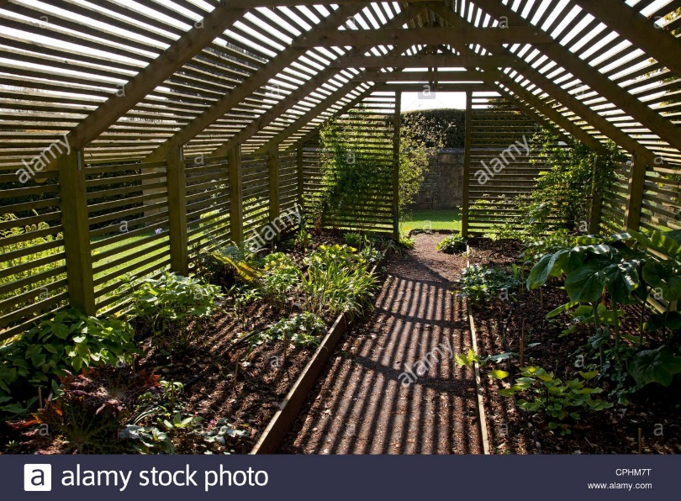
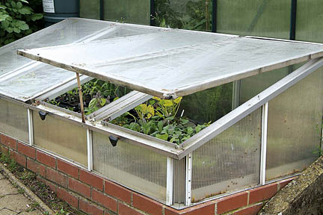
(2) QUONSET/HOOP - This greenhouse is ______ expensive Quonset/Hoop
to build and is _____________. It’s main function is to extend
the growing season by ____________ plants from the early spring
and late fall _________
Wood Lath
Shade House
(3) SHADE HOUSE - This is a frame with either _______ lath or
shade _________ on top and provides a shaded area
for heat-sensitive plants. It also serves as a cool __________
area for plants awaiting _________ or shipment
(4) COLD FRAME – A growing space for _______________, Cold Frame
seed starting, and plant hardening off. It uses only
___________ for warmth
less
unheated
protecting
chill
wood
cloth
holding
sale
propagation
sunlight

Slide 13
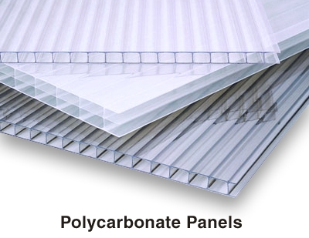
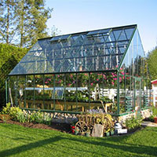
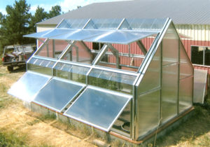
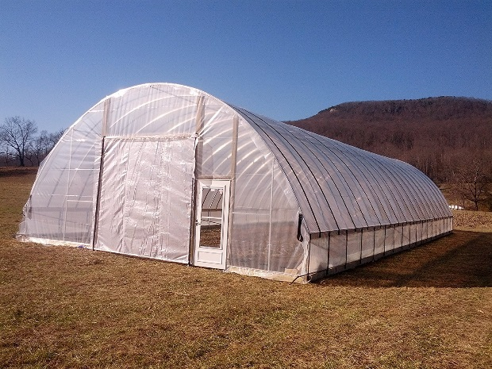
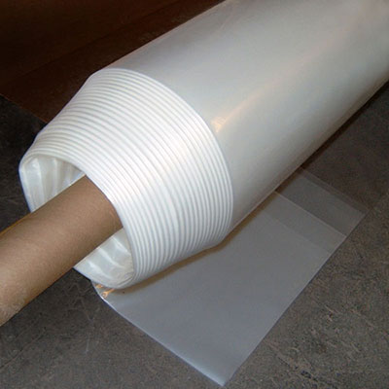
COVERING MATERIALS FOR GREENHOUSES
The material used to cover (glaze) the greenhouse is either ___________ or _____________. The choice of material will
___________ plant growth because materials __________ in the amount of _________ they let into the greenhouse,
and the amount of _______ retained or lost. Sometimes shade ___________ is added on the inside of the
greenhouse to ________ the transmission of light.
GLASS PLASTIC
__________ lasting 1. Available in both rolls of ______ plastic
Most __________ transmitted or _________ panels
_____ maintenance 2. ______ expensive initially
3. Broken down by ____ light
4. Needs to be ___________ more often
POLYETHYLENE (Vinyl)
glass
plastic
affect
differ
light
heat
fabric
lower
Longest
soft
sunlight
rigid
Low
Less
UV
replaced

Slide 14
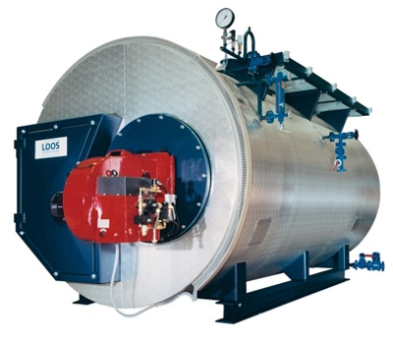
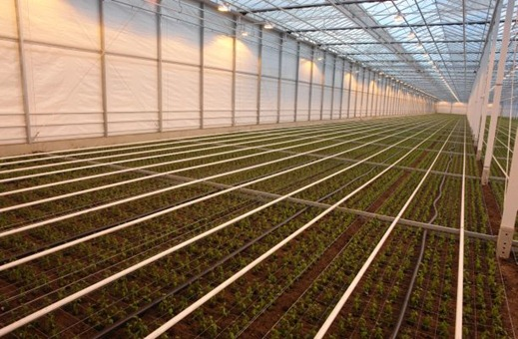
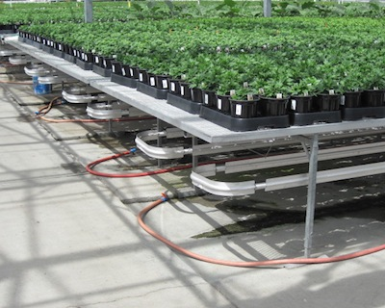
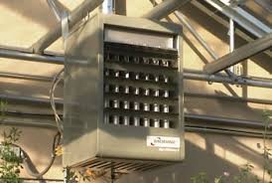
HEATING AND COOLING
While greenhouses quickly _______ up from the sun’s energy, they also rapidly _______ heat at
night due to no _________________ and must be ___________________ with a heat source.
HEATING SYSTEMS Boiler for steam or water
STEAM ________________ to 2. HOT WATER - Easier to 3. UNIT HEATERS – Use
install and maintain, hard to ____________ even natural _____ or propane,
__________ even temperatures, temperatures and less _____ is heated and blown
but heats up ____________ and _____________ than into the greenhouse, but
available for soil ________________ steam heating ______ distribution is uneven
heat
lose
insulation
supplemented
Expensive
maintain
gas
control
Air
quickly
dangerous
pasteurizing
heat
Steam runs through the pipes
Hot water runs through the pipes
Unit heater blows hot air

Slide 15
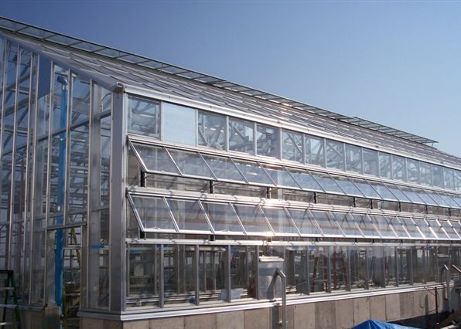
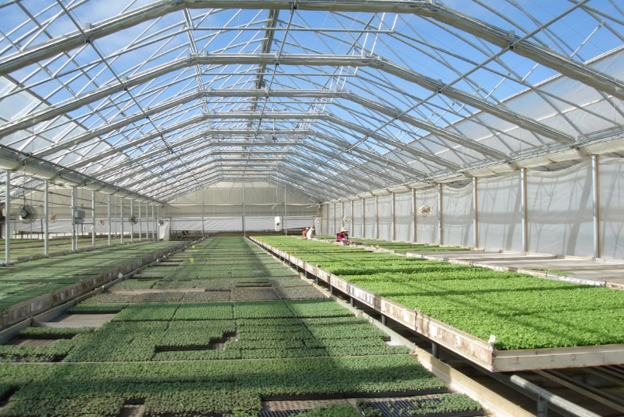
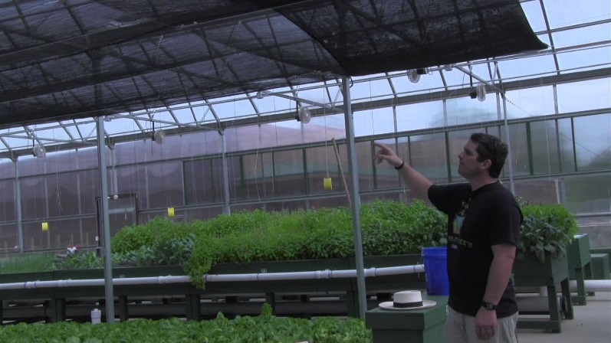
VENTILATION AND COOLING
The ______ distribution of air throughout a greenhouse is _______________ for consistent temperatures and for
uniform plant ___________.
Air movement ______________ diseases like powdery
____________ that thrive under ____________ air conditions.
Ventilation systems include:
1. Roof and ______ ventilation
2. ___________ fans
3. Retractable _______
Shading can also help ________ the greenhouse.
A compound can be sprayed on the __________
of the glass or cloth _________ can be used inside.
These sun screens have the _____________ of
being used only when needed.
even
essential
growth
minimizes
mildew
stagnant
side
Exhaust
Side ventilation
roofs
cool
Retractable roof
outside
shades
advantage
Shade cloth

Slide 16
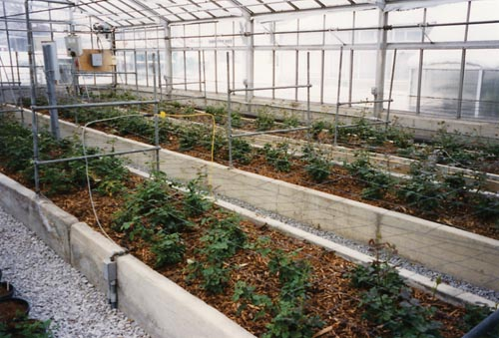
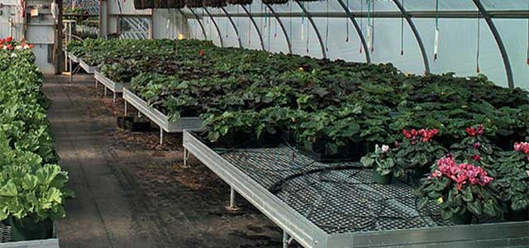
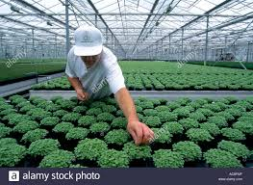
GREENHOUSE BENCHES
Benches provide the growing _______ for greenhouse plants and can be ___________ up or at _________ level. The bench can __________ the crop or just ____________ potted plants.
Ground level
Raised benches
Regardless of the _________ or _________________ of the benches,
they all must:
1. ________ quickly
2. Maximize ___________ reaching the crop
3. Be a ________ that allows workers to _______
into the center
Worker reaching
area
raised
ground
contain
support
style
arrangement
Drain
sunlight
width
reach

Slide 17
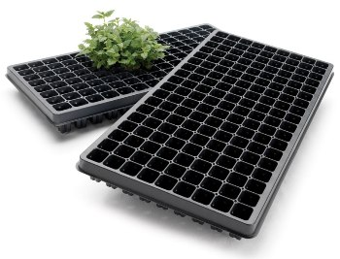
CONTAINER TYPES
There are various containers for ___________ and selling ___________ plants including:
1. ____________
Used to start seedlings
for later transplant
2. ___________ in a flat
3. ________________ 4. ___________________
5. __________
______________
growing
potted
Plug Tray
6 Pack
Plastic Pots
Hanging Baskets
Patio
Containers

Slide 18
NURSERY PRODUCTION
Propagation nurseries deal largely with _________ plants such as _________ and shrubs
FIELD NURSERIES CONTAINER NURSERIES
Crops are grown in the ________ - Plants grown in _______ for 1-4 years
Usually trees & shrubs that take 1-10 _______ to - Need a _________ area, good ________ supply,
harvest and access to __________________
Need _______, well-drained soil, reliable _______ - May need to _______________ into larger pots
supply, and access to _________________ - Predicted that the nursery _____________ is
- ______________ to weather condition, deer & rodents headed more toward _____________ production
woody
trees
soil
pots
years
level
water
transportation
rich
water
transplant
transportation
industry
Vulnerable
container

Slide 19
CROP SELECTION - The __________ of plants for nursery production
is determined by market _____________. What species will ______?
_____ wants to buy them? What _______ and _______________ are
desired? Plants headed for ___________ centers and other retail sites
are often ___________ in size than those going to ______________
contractors.
Typically, nurseries will ________________ in the production of _____
type of market rather than trying to _______ them all. This helps
_____________ propagation methods, nutrient and water ________,
pest ___________ requirements, ________ requirements, spacing,
and harvest methods. Only the tools and _______________ required
for the crops being produced need to be ______________.
choice
demand
sell
Who
sizes
quantities
garden
smaller
landscape
specialize
one
serve
simplify
needs
control
light
equipment
purchased
Nursery
specializing in
poinsettias
Nursery in Springville growing Birch trees

Slide 20
FIELD PRUNING NURSERY STOCK
The objective of field __________ is to ___________ and direct branching, and to create a __________ plant as quickly
as possible.
Trees need to be pruned to shape a straight ________ with
_________ bark, and strong _________ with good angles.
Evergreen trees must have their candles (_____ growth) pinched off
in the _________ to promote fullness
ROOT PRUNING - Blades cut around the __________
of the root system to remove ___________ roots and
encourage new root growth near
the center. This produces a
__________ root ball with a __________
chance of surviving ___________,
handling, and _____________
pruning
promote
fuller
trunk
smooth
limbs
new
spring
outside
lateral
compact
candles
harvesting
transport

Slide 21
HARVESTING FIELD CROPS - Most species of trees are harvested in the ______, overwintered,
and sold in the _________.
BALLED-AND-BURLAPPED (B&B) BARE ROOT
The root ball is ______ up and wrapped in The soil is shaken _____ and the plants are
burlap. The soil ball should be ________ kept __________ in a cooler. These plants are
and contain enough roots for survival, but more _____________ with larger root __________
not be unnecessarily _________. than B&B. However, bare root trees must be
planted ________ dormancy before buds grow.
fall
spring
dug
off
round
dormant
lightweight
systems
heavy
during

Slide 22
INTRODUCTION TO LANDSCAPING
Landscaping is _______________ and controlling the __________ outside of buildings. A landscape designer must
determine client ________ such as:
Composition of __________
Planned _____ of site
Attitude toward _______________
Attitude toward __________
___________
Preferences for _________ & colors
The typical American _________________ landscape has 3 different _____ areas:
1. _________________ - Between the house and the __________. This is the area used to
approach the house and should ___________ traffic to the _________ entrance.
The public area should also provide an _____________ setting (“curb appeal”).
2. ______________________ - Usually at the _______ of the house. This is where the
________ and pool are found, friends are entertained, _____________ are held,
and the family members _________.
3. ________________ - Contains trash cans, ____________ areas and clotheslines. It is
usually ___________ from view.
developing
spaces
needs
family
use
maintenance
privacy
Budget
plants
residential
use
Public area
street
direct
front
attractive
Family Living Area
rear
patio
barbecues
relax
Service Area
storage
screened

Slide 23
SITE ANALYSIS
Before beginning a landscape _____________, the designer will do an ____________ assessment called a
_______ analysis that includes:
- _____________ of the lot
- Topography (______________ variations)
- _____________ (rock formations)
- Hydrography (_______ drainage patterns)
- Existing ________________
- Existing ____________
- Location of __________ lines above & below ground
- ____________ importance of the site
- Wind ____________
project
initial
site
Dimensions
elevation
Geology
water
vegetation
buildings
utility
Historical
direction

Slide 24
walls
ceilings
floors
OUTDOOR ROOM CONCEPT - Interior rooms are defined by their ________, ____________, and _________.
Likewise, outdoor spaces can be considered ___________ rooms.
outdoor
COMPONENT | FUNCTION | MATERIALS
WALLS | Define the ________ & shape Direct _________ __________ privacy Provide ___________ | Shrubs, trees, stone or brick _______, fences, water, walls of _____________
FLOORS | Define the ______ of the room Absorb the __________ of traffic | Turf, hard ________, soft pavings, flowers
CEILINGS | Define the ________ limits Provide _________ Provide ___________ | Trees, canopies and _________, vines, pergolas
limits
walls
traffic
Provide
buildings
security
base
pavings
Plants define the walls & trees form the ceiling
impact
upper
shade
awnings
privacy
An outdoor room

Slide 25
WALLS (ENCLOSURES) FLOORS (SURFACING) CEILINGS
Should be _________ like a Need to be able to absorb Should define the ________
security fence or retaining wall the __________ of traffic limits of the outdoor room and
and provide __________ offer shade and privacy
strong
upper
impact
privacy
HARD PAVINGS – Brick,
concrete, slate, wood deck
SOFT PAVINGS – Mulch,
wood chips
Retaining Wall
Shade trees
Turf
Pergola
Privacy Trees

Slide 26
SELECTING PLANTS
When selecting plants, ____________ designers look at:
______________ (ability to survive the ___________)
Mature _______ (height and width)
__________ color and fragrance
Foliage ________
Foliage silhouette (________)
____________ or evergreen
Presence or absence of __________
Ability to ___________ wildlife
______ preferences (pH, soil texture)
Susceptibility to ________
___________ or pruning
_______
landscape
The regions are defined by a 10-degree Fahrenheit difference in the average annual minimum temperature. The higher the numbers, the warmer the temperatures for gardening in those areas.
It is standard practice for seed dealers and nurseries to label their products according to their USDA Plant Hardiness Zones -- that is, the planting zones in which you are most likely to be successful at growing those particular plants. As such, these "zone" designations serve as guides.
Hardiness
winter
size
Flower
color
HARDINESS ZONES
shape
Deciduous
thorns
attract
Soil
pests
Frequency
Cost

Slide 27
Deciduous vs.
Evergreen
A mix of
tree types
shapes &
colors
Tree Silhouettes

Slide 28
ENRICHMENT MATERIALS
After the outdoor room has been _______________, enrichment materials can be _________ to make it more usable
and _____________. These include _________ features, rocks, __________ plants, animals, ______________.
wind chimes, furniture, and sound & lighting systems.
constructed
added
personal
water
potted
sculptures
Wind chime
Statue
Water feature with rocks
Potted plants

Slide 29
quality
matches
STANDARDS FOR ENRICHMENT ITEMS: (1) Make sure the ____________ of the item __________ the quality
of the overall landscape
(2) Do _____ use enrichment items to ____________
not
excess
A few nice enrichment items
These are too much!

