Slide 1
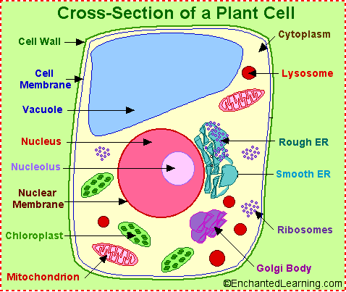
TOP 15 BIOLOGY TERMS
# 15 _____________________ Small parts of a cell that carry out specific functions (ex. Nucleus)
# 14 _______________________________________ A structure in the cell membrane that receives chemical messages based on their shapes
# 13 ______________________________ An orderly series of steps in which an ecosystem recovers from a natural disaster
# 12 _____________________ A fighter molecule made by white blood cells in response to
an invasion by an antigen
# 11 _____________________ The fertilized egg formed by the fusion of the egg & sperm
# 10 _____________________ A catalyst made of protein that speeds up chemical reactions
# 9 _____________________ The process by which a cell clones itself resulting in 2 identical
daughter cells
Organelles
Protein Receptor Molecule
Ecological Succession
Antibody
Zygote
Enzyme
Mitosis

Slide 2
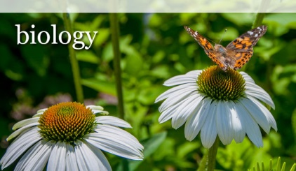
Biodiversity
# 8 ____________________ The variety of life on earth
# 7 ____________________ The sugar made by plants during photosynthesis, and used during
cellular respiration
Glucose
Insulin
# 6 ___________________ A hormone released by the pancreas to lower blood sugar after a meal. Diabetics sometimes need to inject this.
# 5 ____________________ An “other feeder” or consumer that eats other organisms.
# 4 ____________________ Movement of molecules, other than water, from high concentration
to low concentration without any energy
# 3______________________________ The factor you are testing in an experiment. It is labeled on the X-axis
# 2 ______________________________ This is why, according to evolution, organisms have
similar traits. “They came from the same… “
# 1 ____________________ Maintenance of a constant, healthy internal environment
Heterotroph
Diffusion
Independent Variable
Common Ancestor
Homeostasis

Slide 3
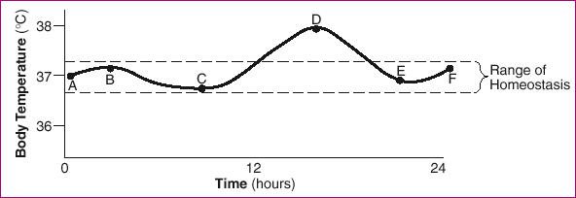
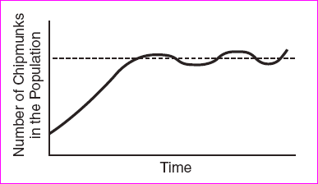
3 KEY GRAPHS
(1) ___________________________ - Conditions
in the human body ___________, yet
_________________ must be restored.
For example, if you get too _____, you respond by _____________, if you get too
cold, you respond by ________________.
(2) ___________________________
The ______________ number of organisms
an environment can support. Carrying
capacity is _____________ by space, food,
water, disease, and ________________.
DYNAMIC EQUILIBRIUM
change
homeostasis
hot
sweating
shivering
CARRYING CAPACITY
maximum
limited
predators

Slide 4
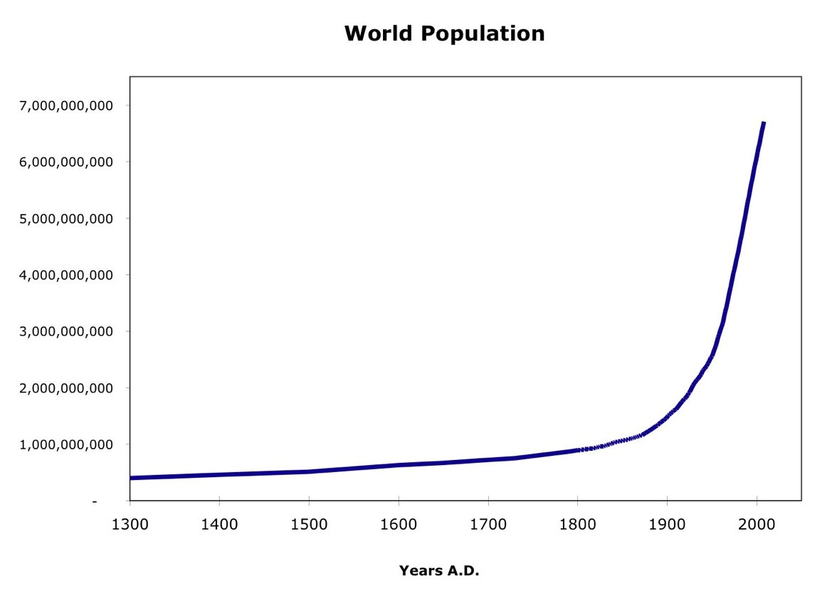
HUMAN POPULATION GROWTH
(3) _________________________________ - The human population has grown at a very rapid rate since the _______________ Revolution due to advances in ________________ and technology.
Industrial
medicine

Slide 5
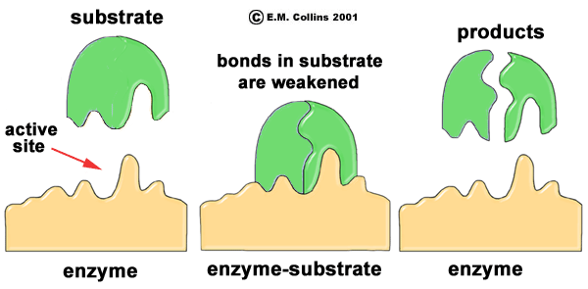
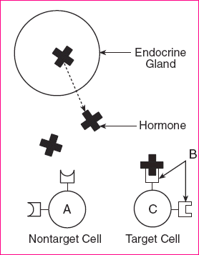
WHEN SHAPES FIT
1. ___________________________
or “Lock & Key Model”
Enzymes bond with their substrates at
the _________ site, then ________ up
chemical reactions. Enzymes are also
called _____________ _____________.
Each enzyme fits specifically with _____
substrate.
2. ________________ are chemical
messengers that bond with
protein _____________ molecules
in the cell membrane, telling the
cell what to do. Ex. The hormone
______________ tells the cell to
let in glucose. Each hormone fits
specifically with ______ receptor.
Enzyme-Substrate Complex
active
speed
protein catalysts
one
Hormones
receptor
insulin
one

Slide 6
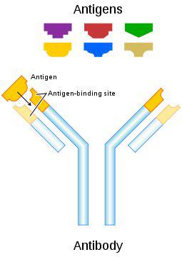
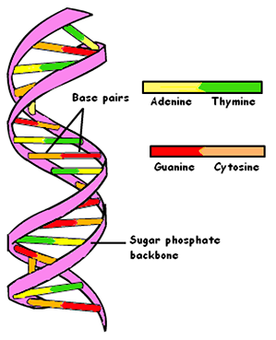
Antibodies
3. ____________________
Each antibody fits with one specific ____________,
or foreign invader, making it harmless until a phagocytic WBC _____________ it.
Our bodies make the antibodies (________ guys) to
bind with the antigens (_______ guys). Some
antigens include bacteria & viruses.
4. ________________________________ (DNA)
DNA is the ___________ material that codes for traits.
Cytosine always bonds with ______________
Adenine always bonds with ______________
antigen
destroys
good
bad
Deoxyribonucleic Acid
genetic
Guanine
Thymine

Slide 7
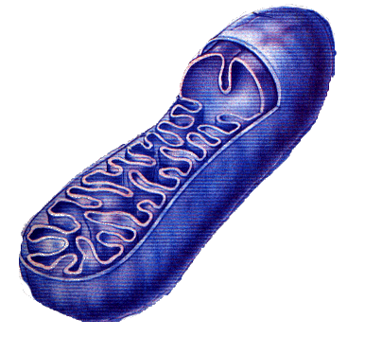
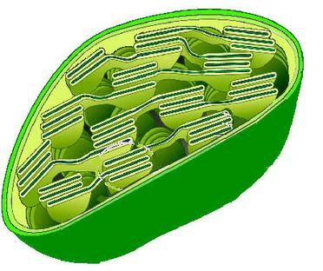
2 CHEMICAL REACTIONS: (Animal cells do only cellular respiration, while plant cells do _______ photosynthesis & cellular respiration)
CELLULAR RESPIRATION - Happens in the ________________________
WORDS: ___________ + ___________ → ___________ + ___________ + ___________
SYMBOLS: __________ + ___________ → ___________ + ____________ + __________
PHOTOSYNTHESIS – Happens in the _______________________
WORDS: ___________ + ____________ → __________ + ___________ + ____________
SYMBOLS ___________ + ___________ → __________ + ___________ + ____________
both
Mitochondria
carbon
dioxide
glucose
oxygen
ATP energy
water
C₆H₁₂O₆
O₂
ATP energy
CO₂
H₂O
Chloroplast
carbon
dioxide
water
glucose
oxygen
water
CO₂
H₂O
C₆H₁₂O₆
O₂
H₂O

Slide 8
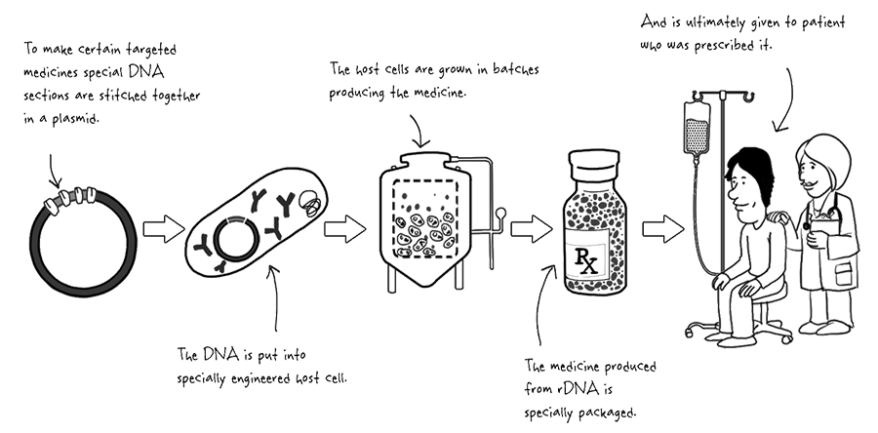
RECOMBINANT DNA
(Genetic Engineering)
Human _________ that code for needed proteins like _____________ are inserted into
bacteria. The bacteria then produce the human protein in huge ________________.
genes
insulin
quantity

