Slide 1
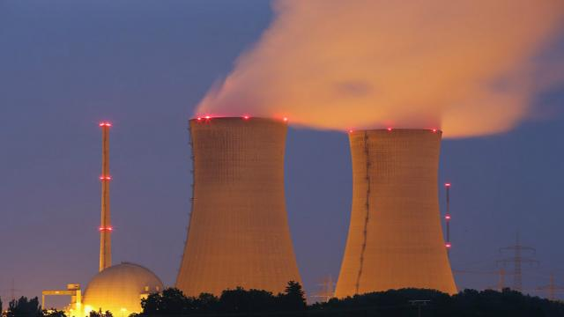
Nuclear Power
Nuclear Fusion and Fision

Slide 2
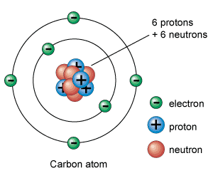
Atomic Structure
The nucleus of an atom contains all of its positively-charged protons and non-charged neutrons.
Negatively-charged electrons orbit the nucleus

Slide 3
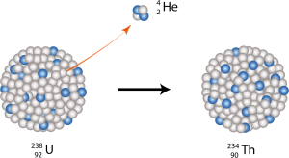
Uranium Isotopes
Isotopes - same element, different numbers of neutrons.
Radiation – isotopes break apart to become stable

Slide 4
Nuclear Fission
Weapons rely on fission – splitting a nucleus in two with a fast moving neutron
Releases large amounts of energy (and neutrons)
Newly released neutrons trigger chain reaction

Slide 5
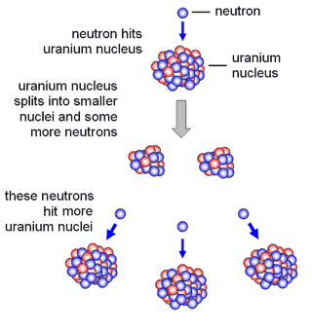
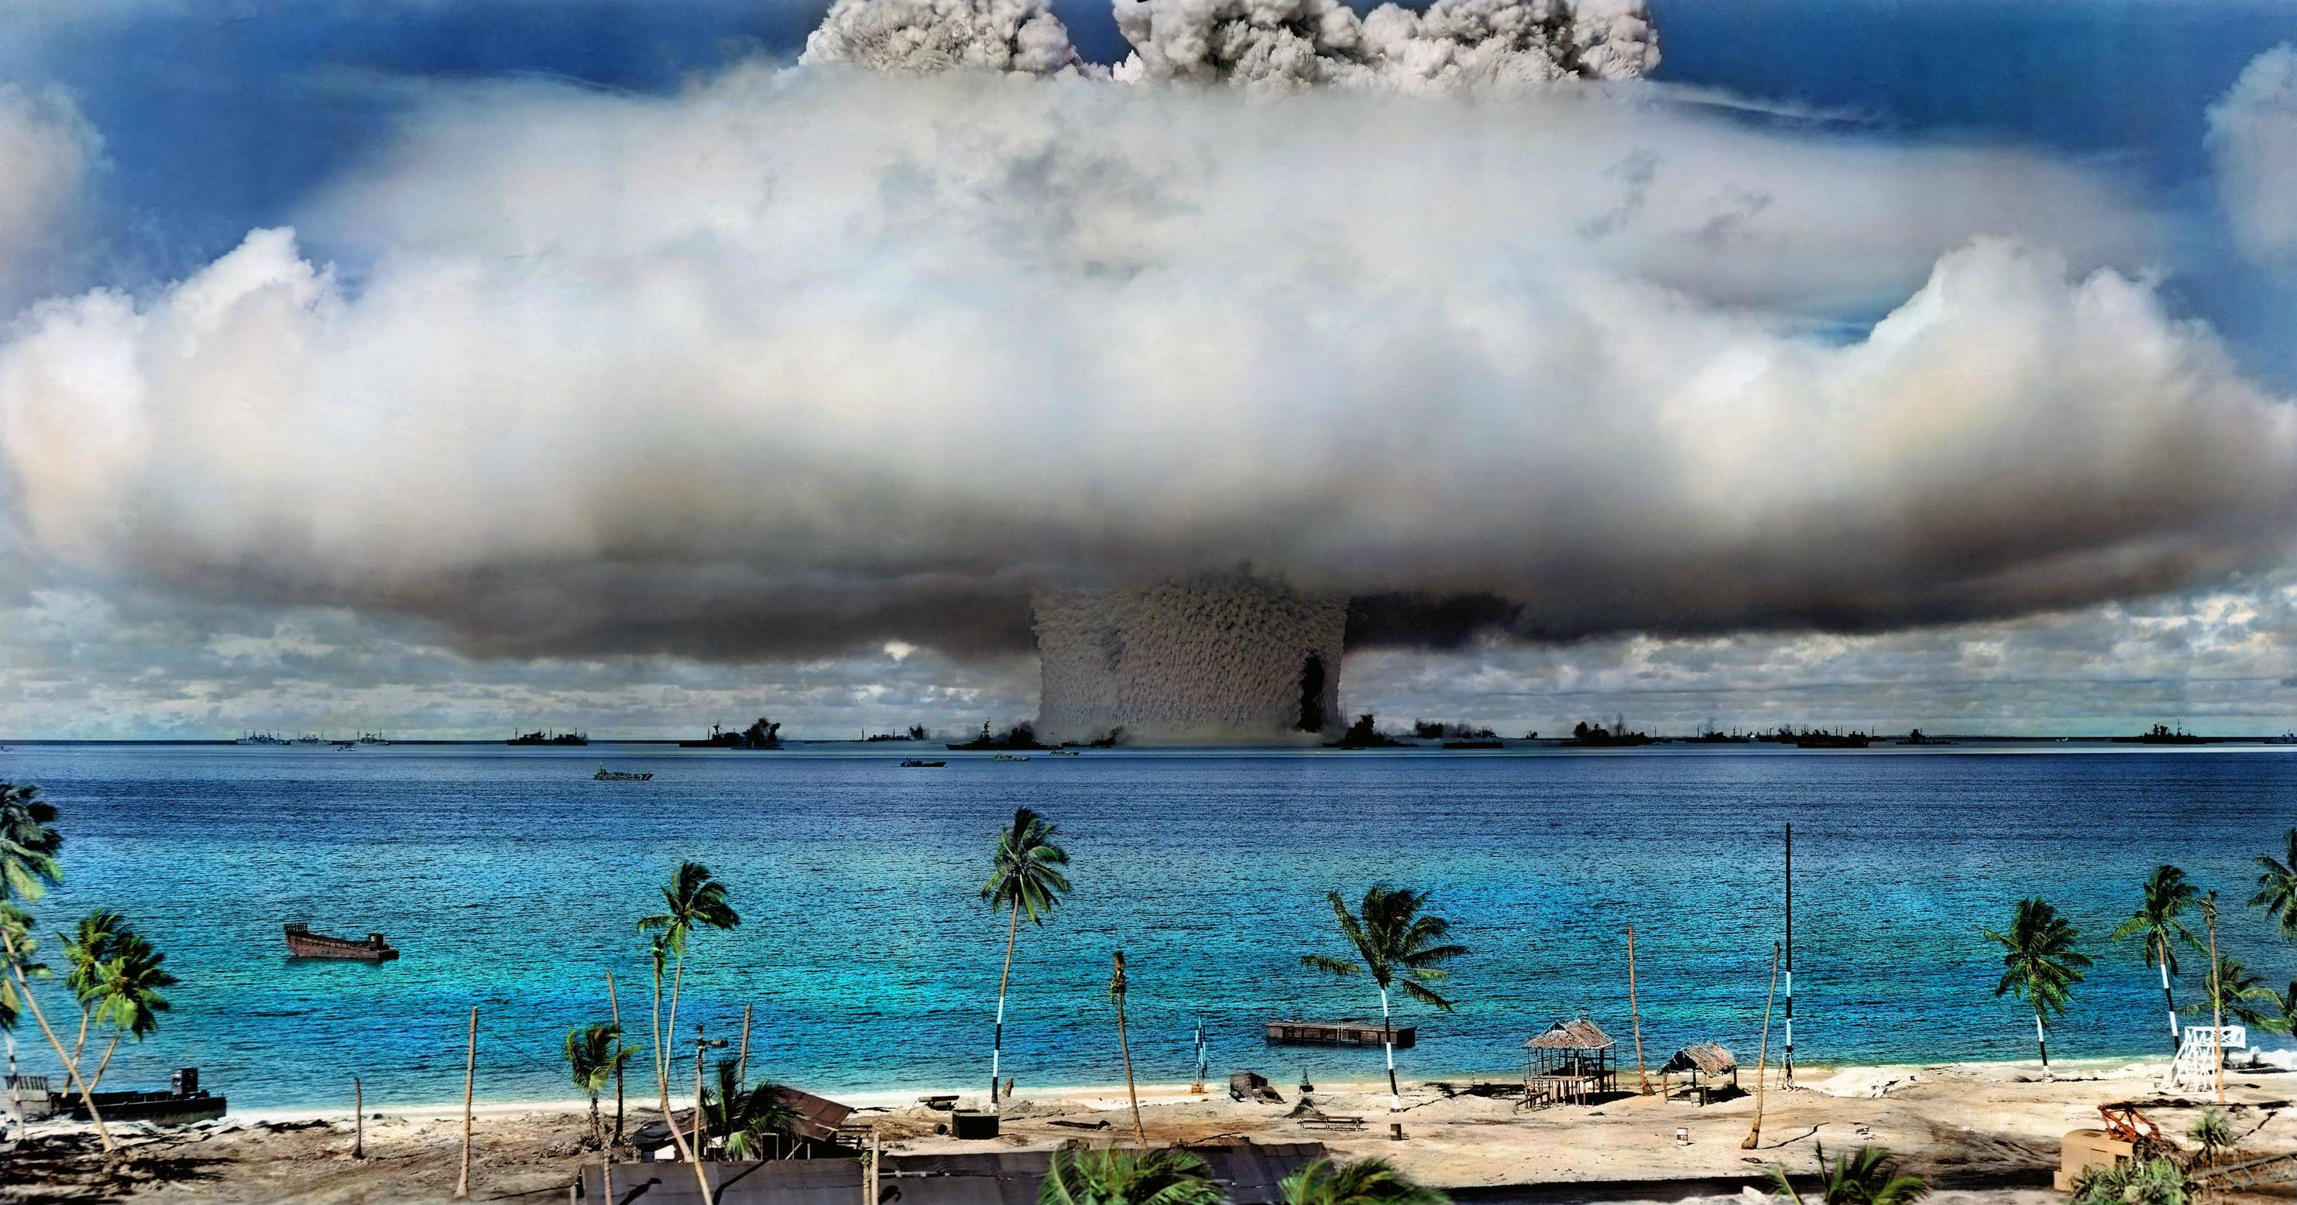

Slide 6
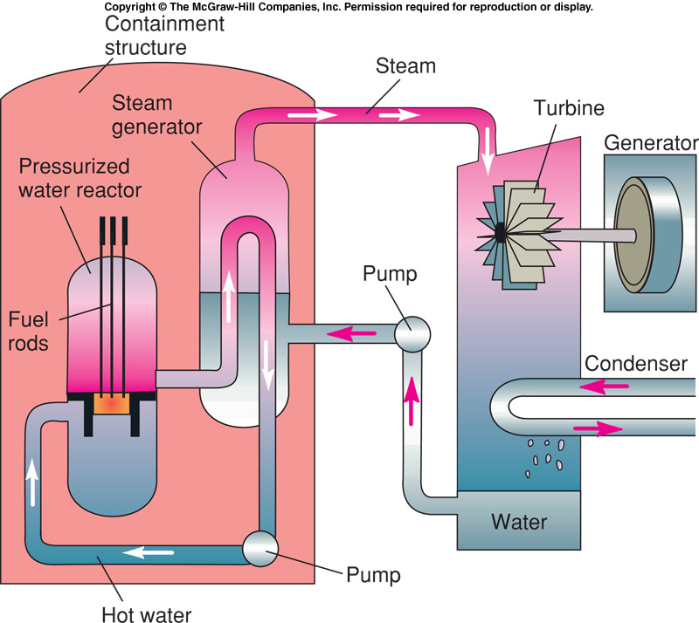
Water is boiled, the steam is passed through a turbine, which spins a generator.

Slide 7
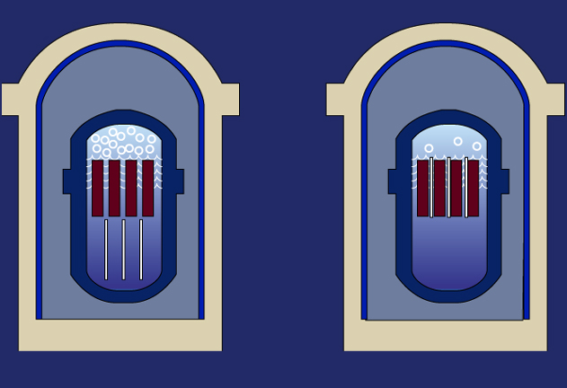
Control rods block reactions between fuel rods in the reactor
Withdraw control rods, reaction increases
Insert control rods, reaction decreases

Slide 8
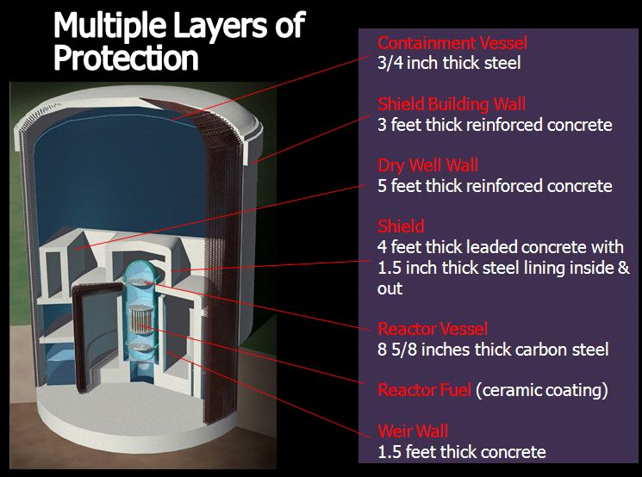

Slide 9
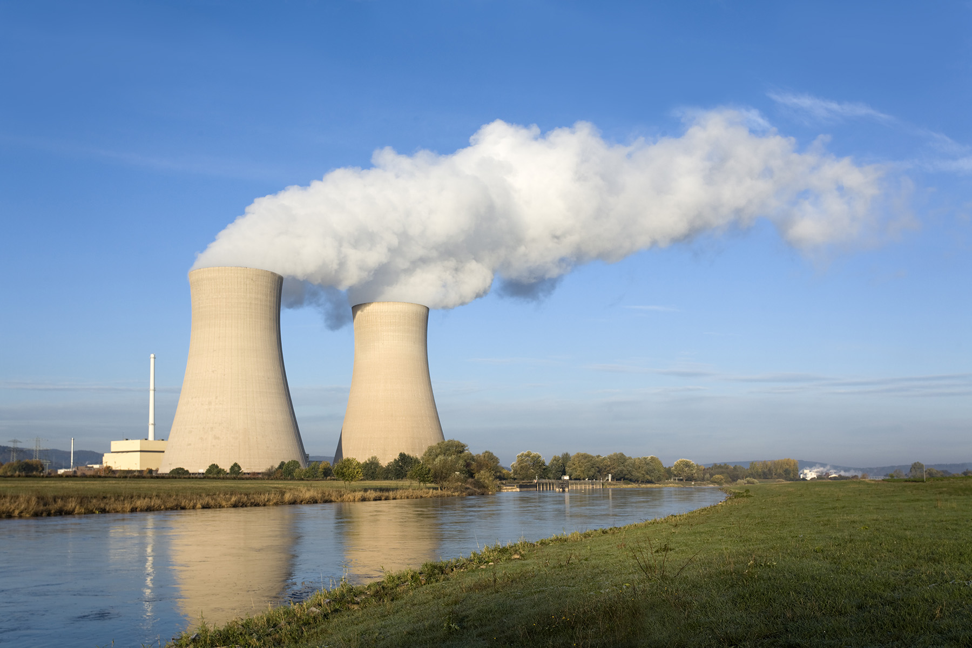
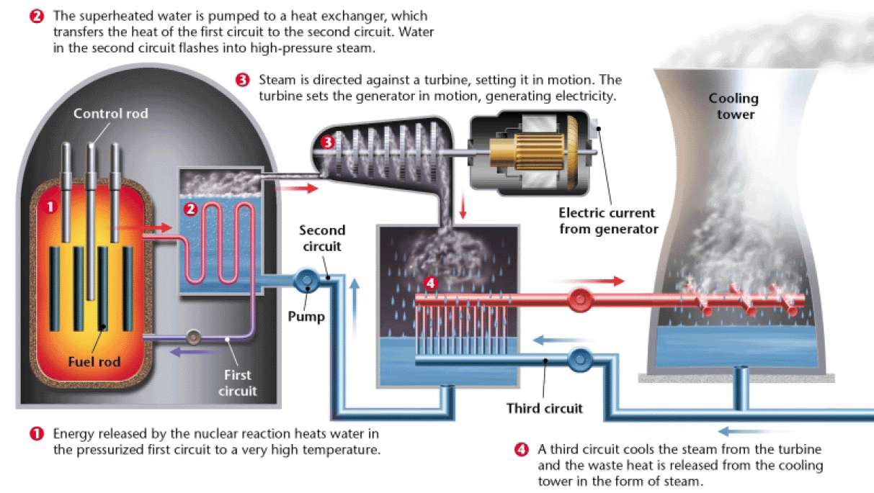
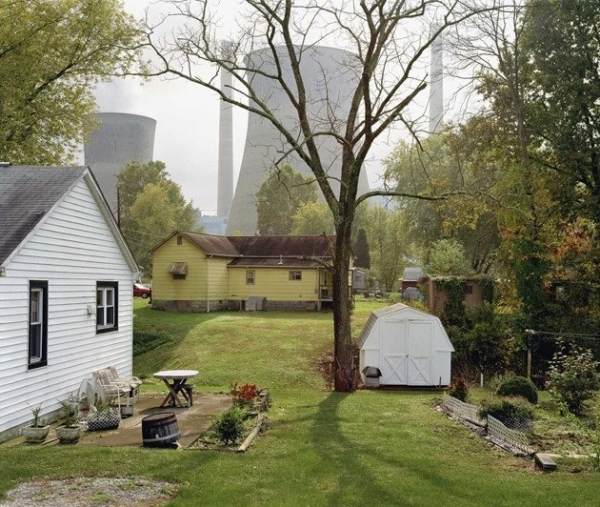

Slide 10
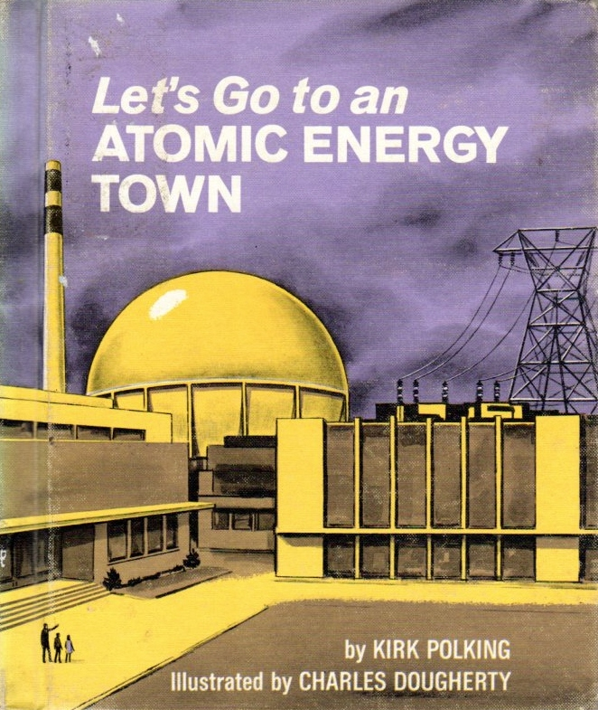
Public attitude was very pro-nuclear in the 60’s and 70’s
Power for the future of America

Slide 11
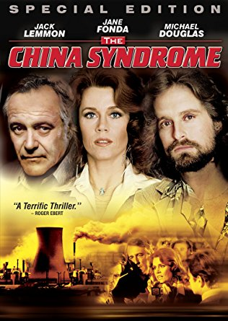
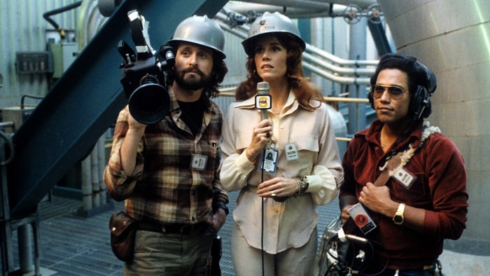
The China Syndrome - 1979

Slide 12
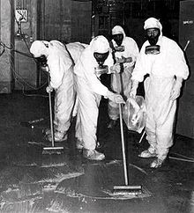
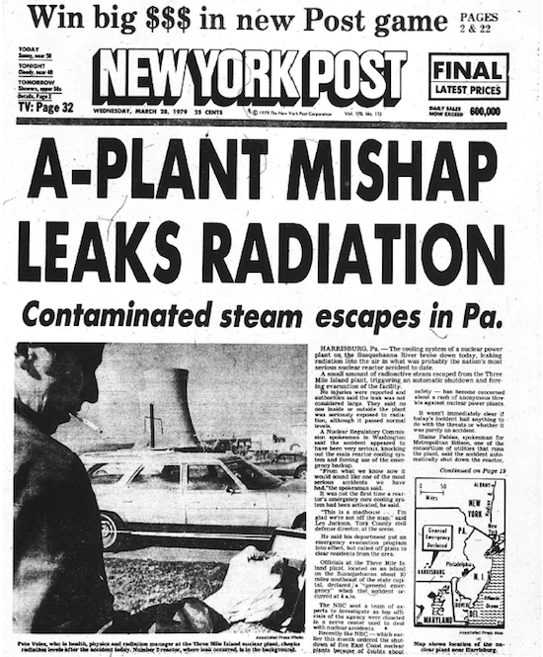
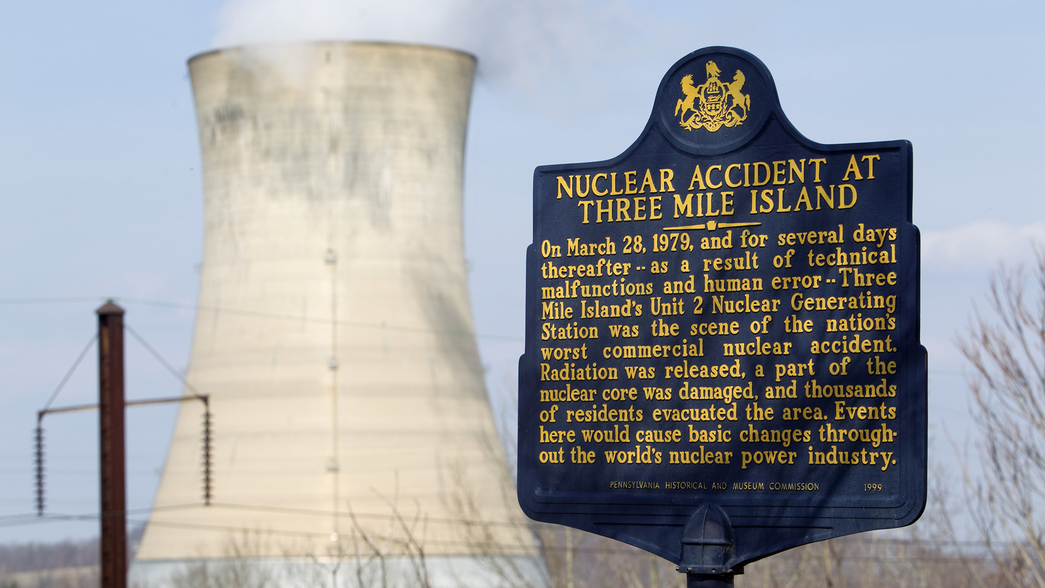
Three Mile Meltdown- 1979

Slide 13
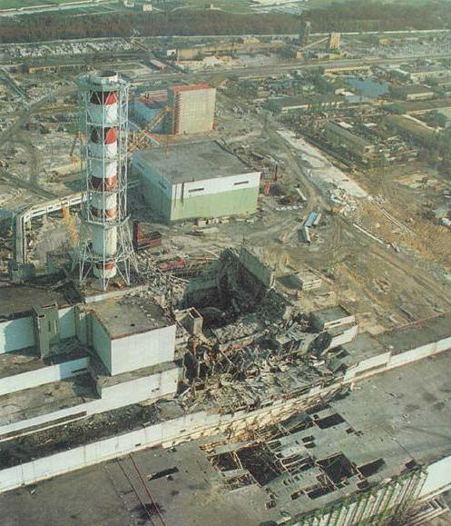
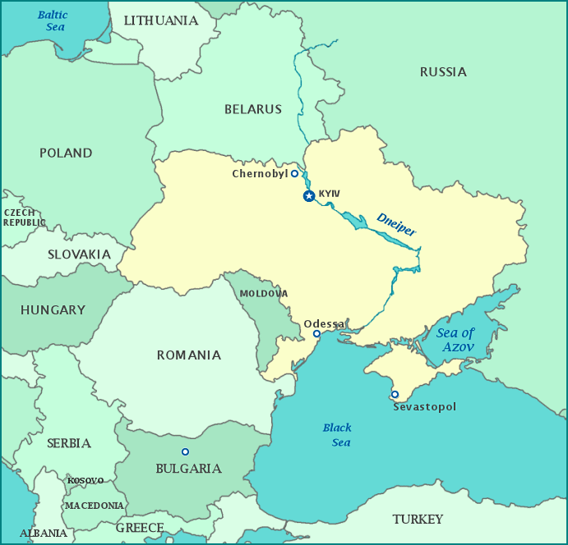
Chernobyl - 1986

Slide 14
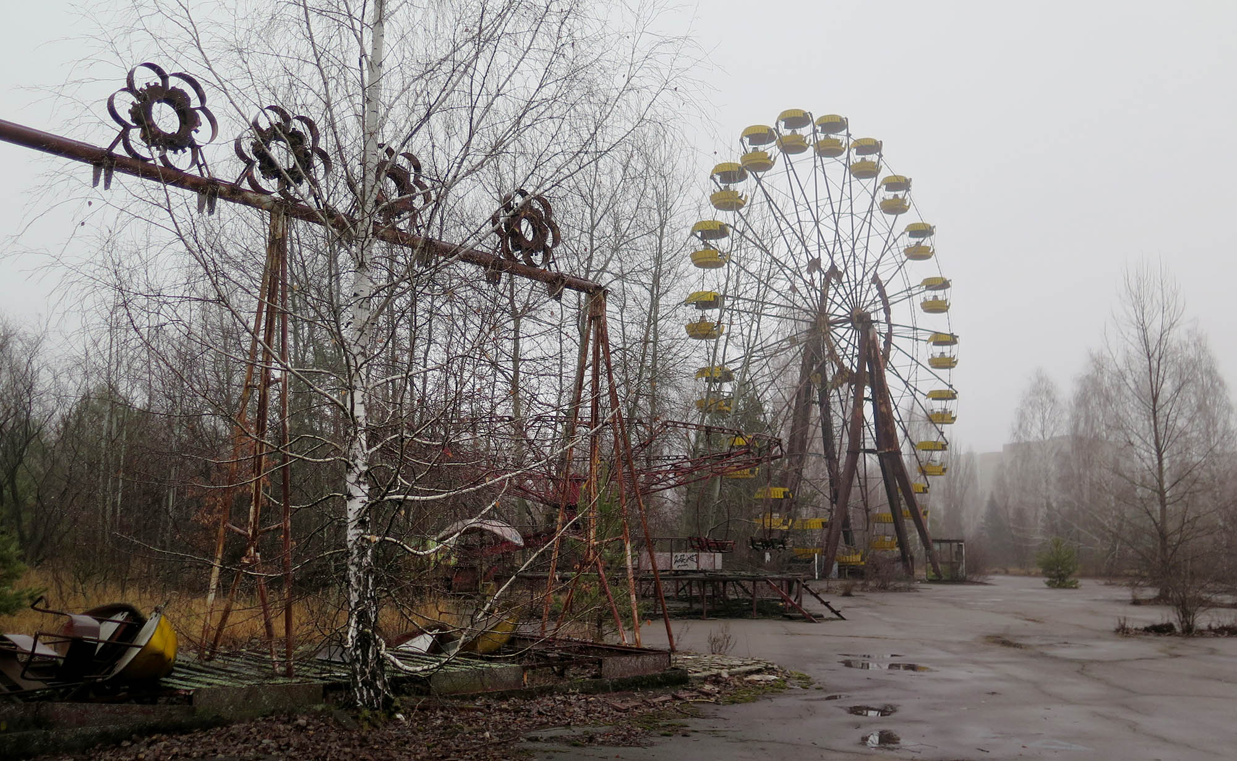
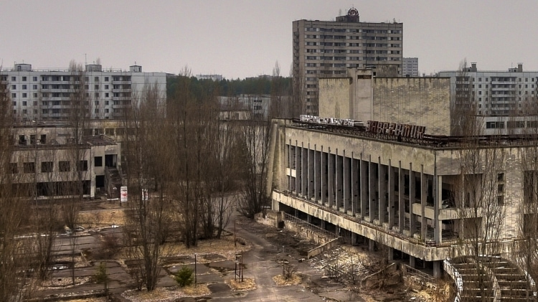

Slide 15
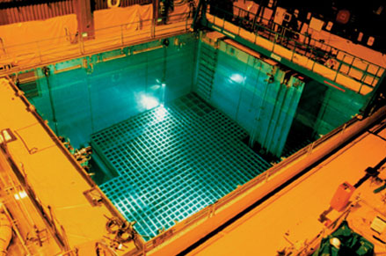
Radioactive Waste Management
low-level waste (clothing)
high-level waste (spent-fuel)
Spent rods need to cool in pools of water

Slide 16
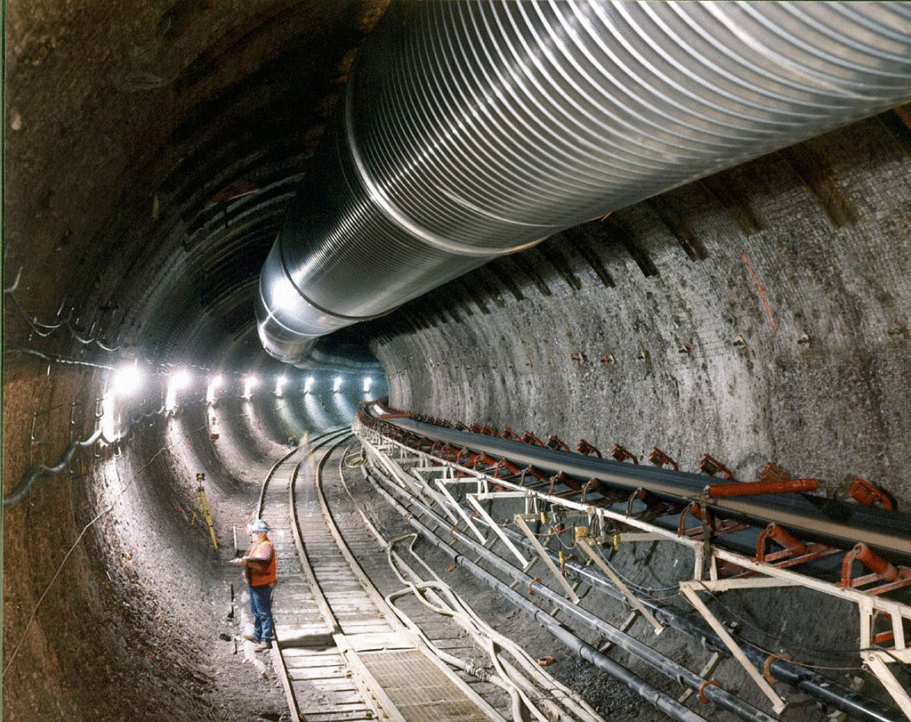
Yucca Mountain, Nevada
Low moisture.
Geologically stable.
Far away from major population centers.

Slide 17
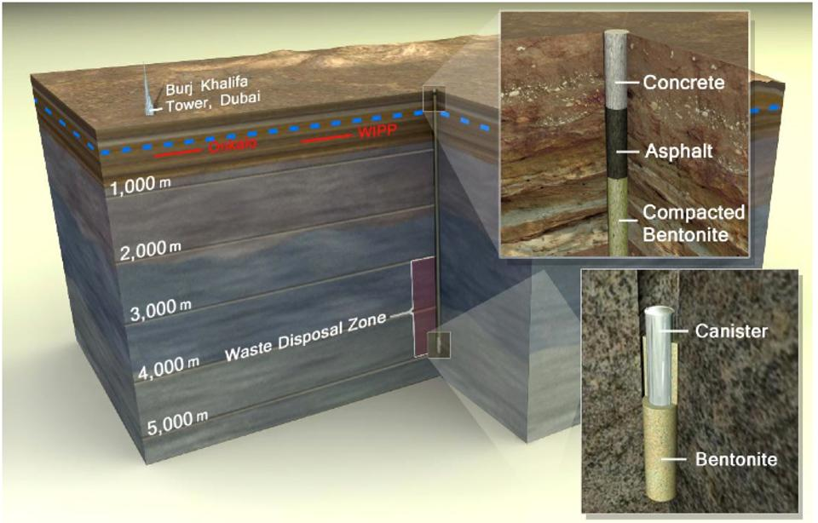

Slide 18
