Slide 1
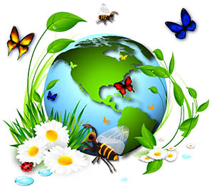
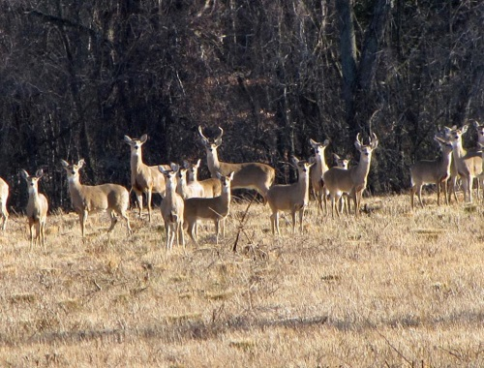
life
variety
BIODIVERSITY ( “Bio” = __________ “Diversity” = ______________
In healthy ecosystems, there are a variety of ________________
and a variety of _________ (niches). This biodiversity helps to
maintain ______________ in the ecosystem. The different niches
allow for various species to ______________.
Ex. In a forest, maple trees grow _______ and do well in full _____
while _________ trees are shade-tolerant and do well in the
shade of the maples.
Ex. If there were no predators like __________, the
prey population of ________ would overpopulate.
The organisms in a healthy ecosystem _____________ with each other and are
____________________ (need) each other. For example, grass grows and is eaten
by _____________ who in turn are eaten by ___________. When the foxes die,
bacteria and fungi ______________ their bodies back into soil in which the _______ grows.
organisms
roles
stability
co-exist
tall
sun
hemlock
wolves
deer
interact
interdependent
rabbits
foxes
decompose
grass

Slide 2
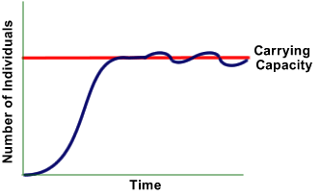
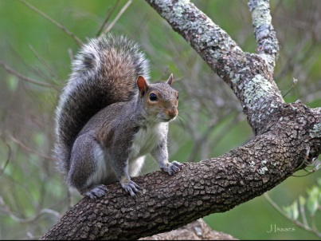
CARRYING CAPACITY
The maximum _____________ of organisms an environment can support.
Organisms could produce _____________ populations except resources
are ______________ (limited). Some “limiting ____________” include:
____________ ____________
____________ ____________
QUESTION: How many squirrels live in your backyard? Why not 500 squirrels?
ANSWER: Because the squirrels are limited by _________ and __________.
They have reached their _______________________ at 2 or 3 squirrels.
number
unlimited
finite
factors
temperature
water
food
space
food
space
carrying capacity

Slide 3
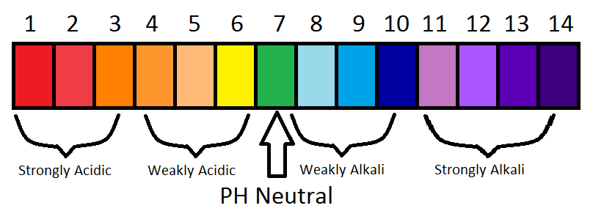
pH Scale
_________
_______ ______ _______ _______ _______
_____ _____ _____
( _______ )
_____________
fruits
battery
acid
acid
rain
normal
rain
soaps
drano
Bases
Pure water

Slide 4
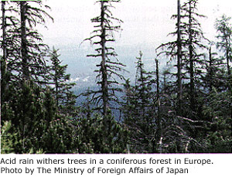
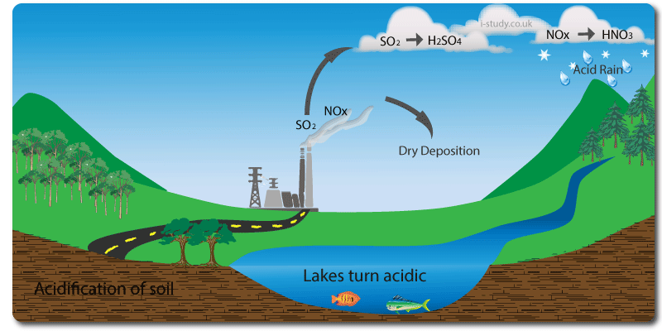
coal
oil
What is ACID RAIN? Factories burn ________ and _______ (fossil fuels) to make ________________. During this process a waste gas called ___________________ or ______ is released.
The SO₂ mixed with water vapor (H₂0) and makes
sulfuric acid (H₂SO₄). This strongly acidic rain then comes down and kills plant ________ and _________, and lowers the ______ of lakes killing off fish.
electricity
sulfur dioxide
SO₂
leaves
roots
pH

Slide 5
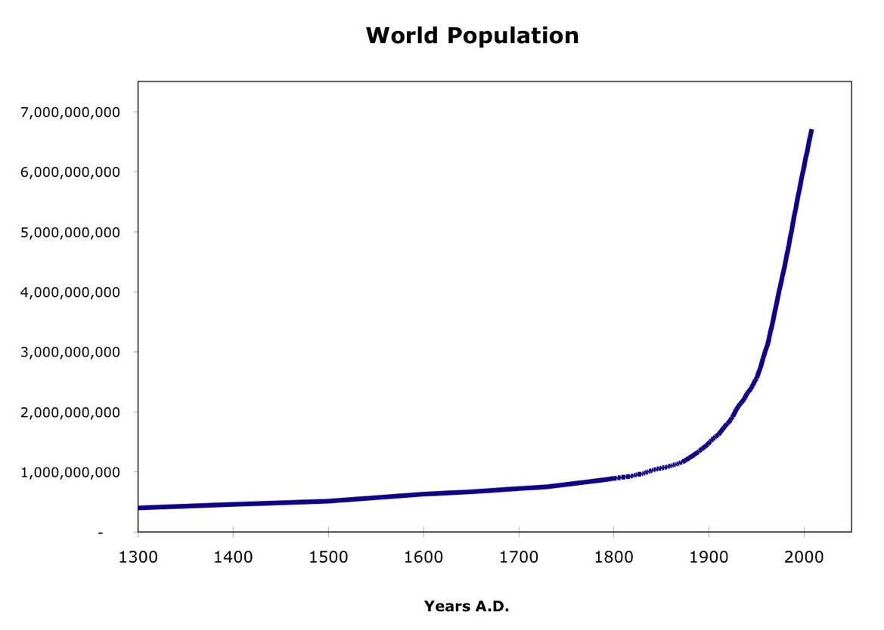
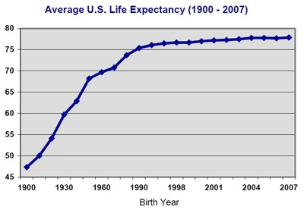
HUMAN POPULATION GROWTH
The human population has risen at
a very _________ rate. This is due in
part to advances in ______________
bringing a drop in the death rate from
disease.
However, the earth has limited ___________.
As the ___________ of humans increases,
so does the consumption of resources such as
________, water, __________, and space.
We are causing detrimental (_____________)
changes to our planet, threatening our global
_____________.
Average
Humans are working to __________ some of Life (years)
these problems through the use of technology
and careful _____________ making. We must
evaluate the ______________ in our ecological
decisions. For example, we gain ________ for
our houses by knocking down forests, but the
coyotes lose their ___________.
rapid
medicine
resources
number
food
energy
harmful
stability
solve
decision
trade-offs
space
habitat

Slide 6
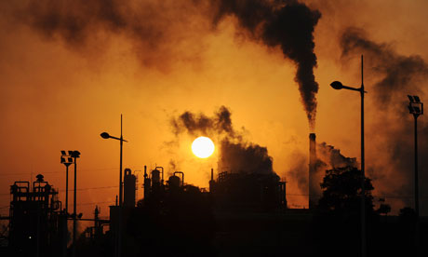
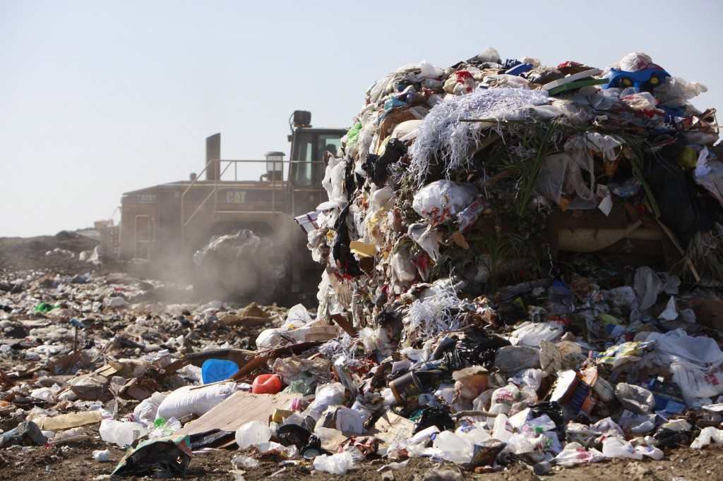
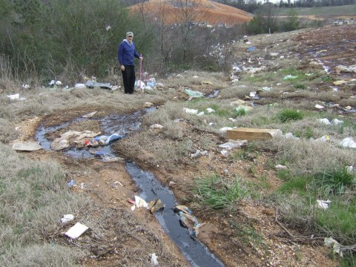
NEGATIVE IMPACTS OF HUMANS
POLLUTION - Air has been _______________ by automobiles
and factories. Soil and _________ have also
been polluted by ___________. With the
increasing number of humans, there is also
an ____________ consumption of goods and
products creating a huge quantity of ___________.
Air, water and soil are all polluted by vapors and
___________ from landfills.
polluted
water
people
increased
garbage
run-off

Slide 7
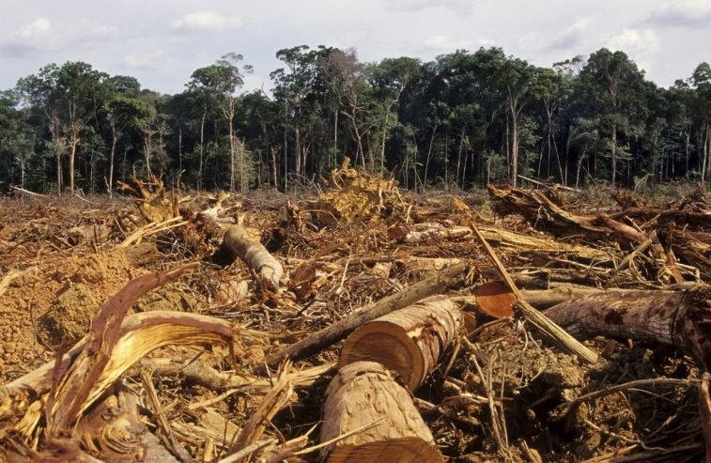
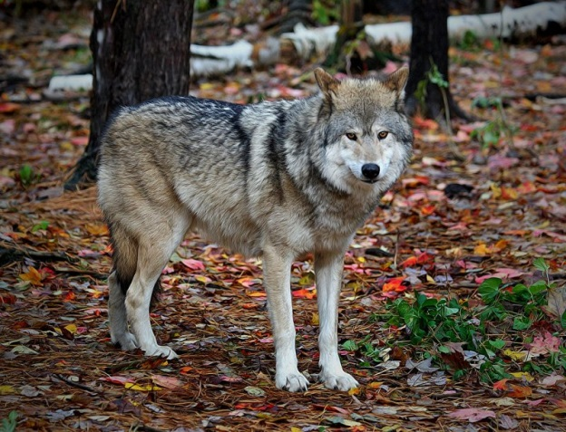
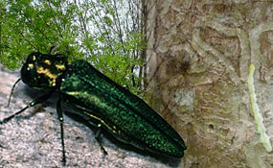
(2) HABITAT DESTRUCTION
Ecosystems are being ______________
by humans to make _______ for their
houses and buildings. When forests are
cut down this is called _________________.
(3) OVERHUNTING - Humans have trapped
and __________ some animals to the
point of extinction. For example, the
Easter Timber Wolf can no longer be
found in ___________________.
(4) INVASIVE (IMPORTED) SPECIES
People bring in a plant or animal that is not _________ to
an environment and it disrupts the natural ___________.
For example, the Emerald Ash Borer was brought over from
China in _________. It has been killing off _____ trees in
the United States.
destroyed
room
deforestation
hunted
New York State
native
ecosystem
lumber
ash

Slide 8
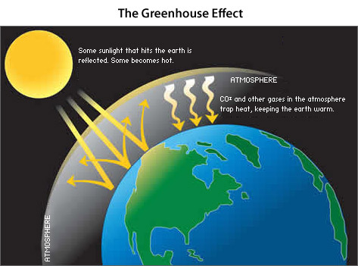
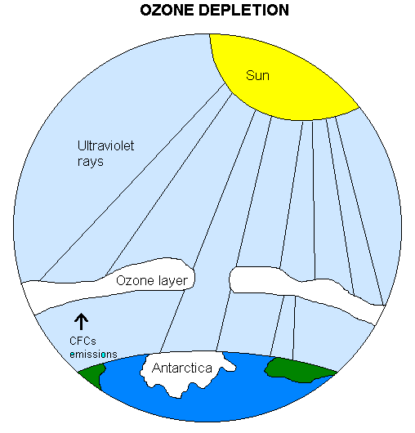
(5)Global Warming
Carbon dioxide ( _____ ) in the atmosphere is helpful
in keeping the planet ___________. It prevents heat
from ________________ back out into space. This is
called the “ ___________________________. “
But the amount of CO₂ has been _________________
due to human activities such as the burning of gasoline
in our __________. Many people are concerned that
the CO₂ “_____________ “ is getting too thick and our
planet is getting too hot. This could cause ____________
of the polar ice caps and flooding, and loss of habitat for
________________ .
(6) OZONE DEPLETION
A protective ____________ called the ozone shield surrounds the
earth and prevents harmful ultraviolet ( _____ ) rays from
reaching the earth. Chlorofluorocarbons, or CFC’s, found in
_________________________ and aerosol cans have depleted
the amount of ozone. The UV rays that reach the earth from
the sun can mutate skin cells and cause skin ______________.
CO₂
warm
escaping
Greenhouse Effect
increasing
cars
blanket
melting
polar bears
shield
UV
air conditioners
cancer

Slide 9
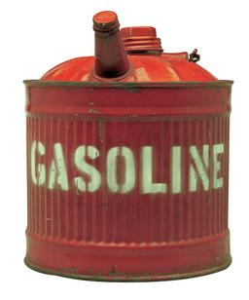
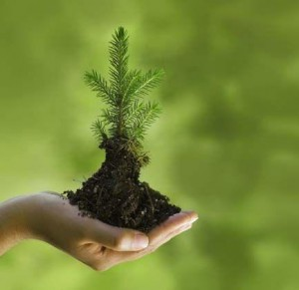
POSITIVE EFFECTS OF HUMANS
CONSERVATION OF RESOURCES - Efforts are being made to conserve ___________, water, and other natural ________________. Some strategies include:
- RECYCLING
- _______________ ENERGY such as solar (sun),
hydroelectric, and wind energy
- COMPOSTING
- REDUCING CONSUMPTION by using _______
RESOURCES MAY BE ________________ OR _____________________
Renewable resources can Nonrenewable resources
be ____________ in a cannot be replaced.
lifetime. Ex. Planting new Ex. Fossil _______ such as
_________ when others coal, oil, and natural gas
are cut down for lumber.
energy
resources
Alternative
less
Renewable
Nonrenewable
replaced
fuels
trees

Slide 10
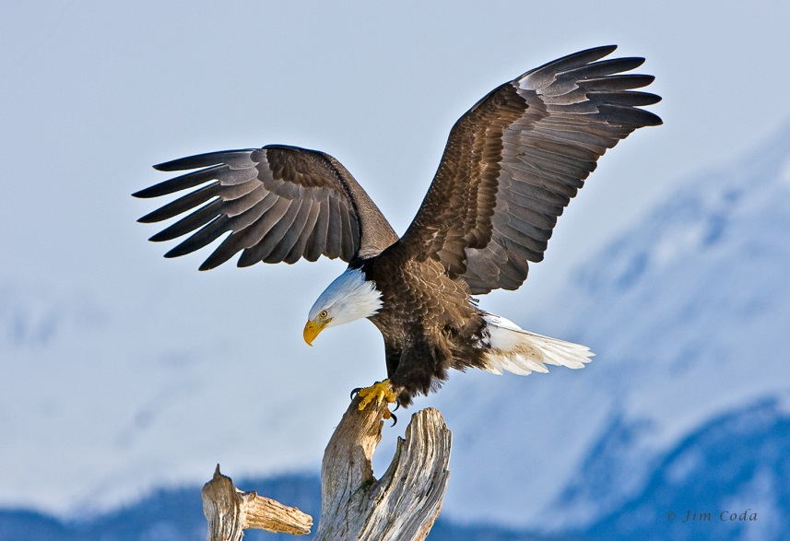
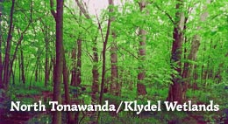
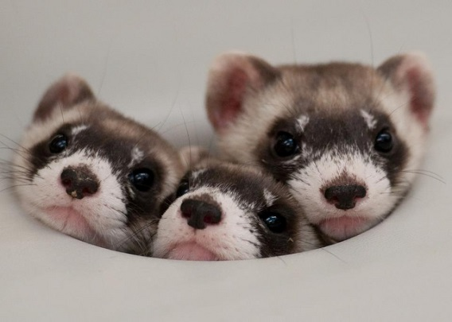
(2) SPECIES PRESERVATION - Laws regarding hunting and pollution
are helping to _________ plants and animals.
Also wildlife preserves are created to provide
______________ to native species.
Because of preservation efforts, some plants
animals that were once in ____________ of
extinction are making a comeback. For example,
_________________ and american bison are
now increasing in numbers.
Another strategy to preserve species is
____________ breeding programs in which
young are bred in captivity then are released
into the ________. This is a strategy being used
with wolves and black-footed ____________.
protect
territory
danger
bald eagles
captive
wild
ferrets

